Slide 1

#CountMeIn:
Engaging Your Community
in the 2020 Census
Lindsay Marsh
Community Action Partnership

Slide 2
Agenda
Census Basics Recap
Changes Due to COVID
  Challenges
  In the News
Plans for the next 3 months
  Census
  Civic Engagement
Questions
Notes:
This presentation has a number of objectives.
Provide an overview of the Census, what it is, why its important, and what to expect.
Additionally, we will lay out information about all of the current Census Outreach efforts, from the Census Bureau to the Census Campaign, and the Partnership’s efforts.
We will discuss what steps can be taken now at the local level to start engaging your communities around the census
Most importantly we aim to form a dialogue where we can hear your most pressing questions about the Census, and answer when we can, and also hear from you about practices in your community that are already taking place or have taken place in the past to Get out The Count, which we hope to amplify across the network

Slide 3
Census Basics Recap
Notes:
Census is constitutionally mandated

Slide 4
Census Basics
Every ten years since 1790
Constitutionally Mandated
  Article 1, Section 2*
  We count *everyone* who lives here on 4/1
10 Demographic Questions
Results used to allocate Federal funding and political power
Safe, Easy and Important
*Language adjusted to reflect Amendment XIV, Article II to US Constitution, July 9, 1868
Notes:
This presentation has a number of objectives.
Provide an overview of the Census, what it is, why its important, and what to expect.
Additionally, we will lay out information about all of the current Census Outreach efforts, from the Census Bureau to the Census Campaign, and the Partnership’s efforts.
We will discuss what steps can be taken now at the local level to start engaging your communities around the census
Most importantly we aim to form a dialogue where we can hear your most pressing questions about the Census, and answer when we can, and also hear from you about practices in your community that are already taking place or have taken place in the past to Get out The Count, which we hope to amplify across the network

Slide 5
COVID Changes
Notes:
Census is constitutionally mandated

Slide 6
Timelines
January 21, 2020 – Alaska Kickoff
Self Response Period
  Planned to push Mid-March to May and end in July
    Mailed invitations, forms.
  Now through Halloween
Non-Response Follow Up
  Planned May through July
    Enumerators door to door
  Now Starting early August through Halloween
Data Delivery
  Apportionment 12/31, now 4/30
  Redistricting 4/30, now 7/31
Notes:
All households will receive a letter asking to complete the census online, areas less likely to respond online will also receive a paper questionnaire. 6 attempts for in person follow up: 3 in person, 3 proxy
After 6 attempts, secondary sources will be used

Slide 7
Challenges
Offices shuttered
Census Hiring
Public Trust Eroding
Time Elapsing
Political Turmoil
COVID fear
Notes:
The Census if the biggest non-war governmental field operation. It requires a huge investment in both dollars and man power. It can be a generator of temporary local jobs in your community, and the results have a major impact on funding to your community for a decade.

Slide 8
Current Affairs: Census in the News
Citizenship Question
  Settled by the Supreme Court in 2019
Trump’s Memorandum
  Unconstitutional
Senate funding request
Census Bureau’s Extension Request

Slide 9
3 Month Plan
Notes:
Census is constitutionally mandated

Slide 10
Two Census Campaigns
#CensusSummer
  Toolkit
  Colorful graphics, pushing people to self-respond
  Supplemented with Coalition campaigns
  Transitioning to talk about NRFU
Fall campaign after Labor Day through Halloween
  Toolkit with graphics, calendar, sample text

Slide 11
Civic Engagement
The Census
  Be counted, bring funding and political representation to your community
Voter Registration & Mobilization
  Encouraging customers that their voice matters, they count, and helping them register and vote
Redistricting
  Census counts are used to allocate political representation; sometimes lines drawn disenfranchise
Advocacy
  Making sure elected officials know who we are, what we do

Slide 12
Prohibited Activities
Things your Agency CANNOT do:
✘ Selectively encourage people to register to vote
✘ Promote any one candidate over another
✘ Tell voters which party to register under or who to vote for
✘ Plan partisan activities with a candidate, campaign, or political party
✘ Give money or volunteer time to a candidate
✘ Allow a candidate to hand out campaign/platform materials
✘ Use CSBG funds or staff for voter registration activities
✘ Use Head Start funds/staff during work hours for voter registration
✘ Conduct CSBG-funded programs or provide CSBG-funded services in manner that could result in identification of such programs or services with voter registration and other prohibited activities
Sources: https://www.caplaw.org/resources/articlesbytopic/Lobbying/CAPLAW_VoterRegistrationDosandDonts_2016.pdf, https://www.advocacyandcommunication.org/wp-content/themes/acs/docs/resources/eadvocacy/ACS_Voter_Registration_Guide3.pdf

Slide 13
Encouraged Activities
Things your Agency CAN do:
✔ Encourage people to participate and register to vote
✔ Encourage people to vote on Election Day, Early or via Mail
✔ Provide voters with election info (ID reqs, locations/hours, mail ballots)
✔ Encourage voters to research candidates & ballot issues before voting
✔ Refer customers to nonpartisan groups/govt offices to register to vote
✔ Allow a nonpartisan org to register voters at Head Start facilities during work hours
Sources: https://www.caplaw.org/resources/articlesbytopic/Lobbying/CAPLAW_VoterRegistrationDosandDonts_2016.pdf, https://www.advocacyandcommunication.org/wp-content/themes/acs/docs/resources/eadvocacy/ACS_Voter_Registration_Guide3.pdf

Slide 14
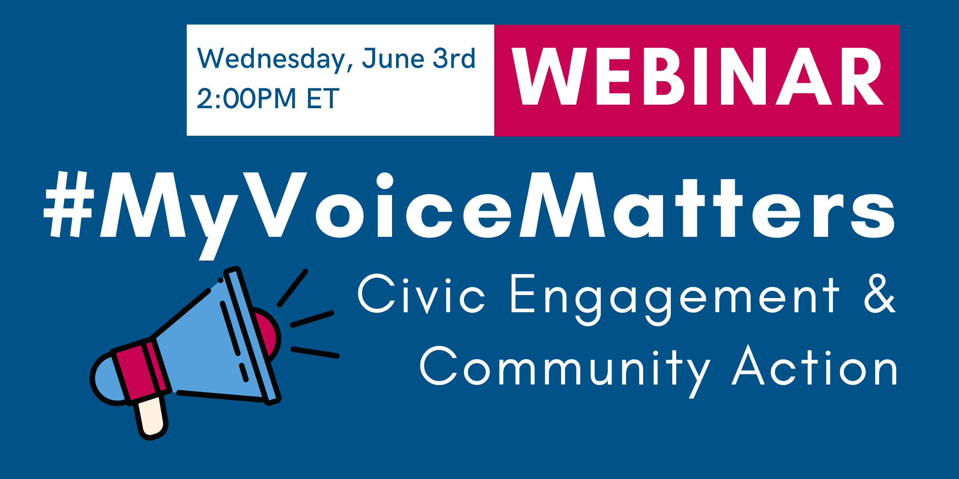
Webinar Series
Schedule
Advocating for your Community: Effective Strategies for Public Policy Engagement
August 13th | Register
Census & Redistricting
September 24th | Register
The Right to Vote: A Short History & Issues for 2020
October 22nd | Register

Slide 15
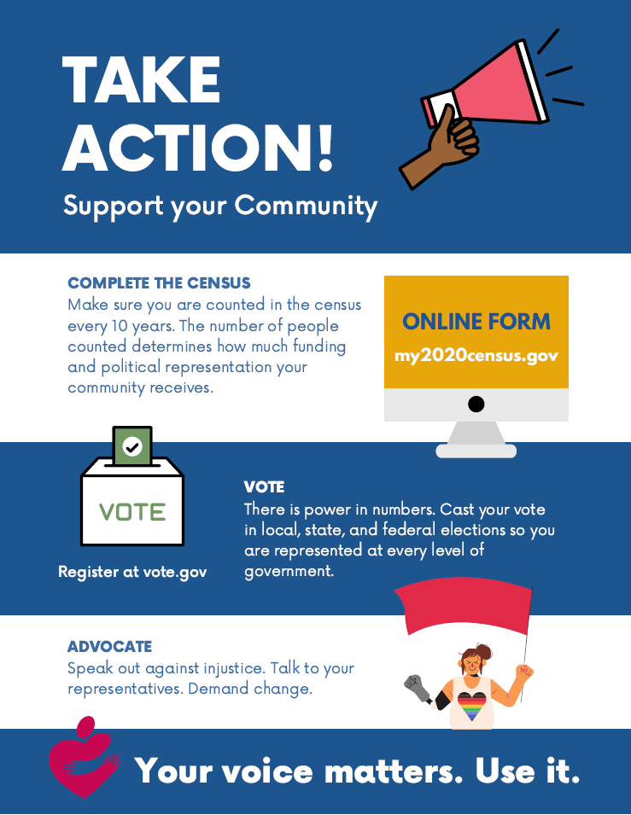
Voter Registration Next Steps
Identify non-CSBG programs that can participate
Engage your staff:
  How they can help: Dos and Don’ts
  To Register & Vote, too!
Download/Order materials to hand out:
  Civic Engagement 3-Step Fact Sheet
  Voting Rights Palm Cards
  Community Action Vote Buttons
Download
Sources: https://www.caplaw.org/resources/articlesbytopic/Lobbying/CAPLAW_VoterRegistrationDosandDonts_2016.pdf, https://www.advocacyandcommunication.org/wp-content/themes/acs/docs/resources/eadvocacy/ACS_Voter_Registration_Guide3.pdf

Slide 16

Engage With Social Media
Follow us on Twitter and Instagram: @CAPartnership
Sign-up for our Census newsletter for resources and trainings, and Census news
Join our Facebook group to engage with CAA staff across the network
Sign up for our CACivicEngagement google group for more detailed information
Notes:
Need content – Jim has this as TBD. Could remove for earliest sessions.

Slide 17
Resources
Find handouts, flyers, posters, fact sheets and more on our website: www.CommunityActionPartnership.com/Census-2020
Find the latest news, tips and tricks to helping get people counted on our blog: https://CommunityActionPartnership.com/census-blog/
Find our Census Count 2020 Coalition Partners’ toolkits, fact sheets and more: https://CensusCounts.org/Resources/

Slide 18

Community Action Team
Census Staff
Lindsay Marsh, LMarsh@CommunityActionPartnership.com
Lauren Martin, LMartin@CommunityActionPartnership.com
Public Policy Staff
Ryan Gelman, RGelman@CommunityActionPartnership.com
Center for Community Futures
Subject Matter Experts
Jim Masters, JMasters@cencomfut.com
Allen Stansbury, Allen@Stansbury.net

Slide 19

Questions?

