Slide 1

#MyVoiceMatters:
Civic Engagement & Community Action
Ryan Gelman
Senior Associate for
Public Policy & Advocacy
Lindsay Marsh
Senior Associate
Special Projects: Census Engagement

Slide 2
Agenda
Introduction
Civic Engagement
  Voting Rights
  Voter Registration & Education
  Advocating for your Community
  Census & Redistricting
Next Steps, Resources, & Questions
Notes:
This presentation has a number of objectives.
Provide an overview of the Census, what it is, why its important, and what to expect.
Additionally, we will lay out information about all of the current Census Outreach efforts, from the Census Bureau to the Census Campaign, and the Partnership’s efforts.
We will discuss what steps can be taken now at the local level to start engaging your communities around the census
Most importantly we aim to form a dialogue where we can hear your most pressing questions about the Census, and answer when we can, and also hear from you about practices in your community that are already taking place or have taken place in the past to Get out The Count, which we hope to amplify across the network

Slide 3

Civic Engagement is Community Action
Community Action has Advocacy and Civic Engagement built into our mission.
  Economic Opportunity Act of 1964
  Office of Economic Opportunity Instructions
  Community Services Block Grant Act
Notes:
The Economic Opportunity Act of 1964 states that the basic purpose of community action is to stimulate a better focusing of all available … resources on the goal of enabling low-income individuals and families to secure opportunities necessary to transition out of poverty.
Office of Economic Opportunity Instructions state that a CAA’s “primarily catalytic mission to make the entire community more responsive to the needs and interests of the poor by mobilizing resources and bringing about greater institutional sensitivity.” – it specifically references “improvements and changes” in a community’s attitudes and practices towards the poor”
CSBG – “greater use of innovative and effective community-based approaches to attacking the causes and effects of poverty”

Slide 4

The Right to Vote
A Brief History & Issues for 2020
Webinar
October 22 | Register

Slide 5
Constitutional Provisions
Article 1
Voter Qualifications
Federal Elections
Protective Amendments based on:
Equal Protection (14th)
Race (15th)
Sex (19th)
Taxes owed (24th)
Age (26th)
Association & Speech (1st)

Slide 6
Legislative Actions
& Interpretations
Federal
Voting Rights Act of 1965
National Voter Registration Act of 1993
States
Literacy Tests
Help America Vote Act of 2002
Poll Taxes
Gerrymandering
Voter ID Laws

Slide 7


Current Issues
H.R. 1
Voter ID Laws
Early Voting
Vote-By-Mail/Absentee Ballots
  “No Excuse”
  Third Party Collection
  Signature Matching
  Deadlines
Student Voting/Residency Requirements
Felony Convictions
Voter Purge Practices
Polling Places, Voting Machines, & Election Staff

Slide 8
Voter Registration
& Education
Webinar
July 16 | Register
Notes:
Census is constitutionally mandated

Slide 9

Why Elections Matter
Elected officials listen to the people they represent
  Voting influences what happens in your community
All politics are local!
If you want change, use your vote as your voice
The communities we serve deserve to have their voice heard
Notes:
All Americans 18 or older should exercise their voice through using their vote.
It's about electing people to *represent* you – if you don't make your preferences known, how can you expect government to work for you?
Many people think that their vote doesn't matter, but it does. If 1000 people in your area feel that way and don't vote, that's 1000 more votes that could sway the outcome of an election.

Slide 10
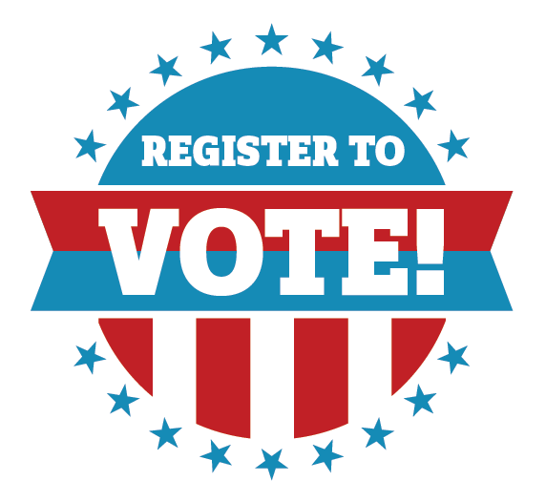
Voter Registration & Education
Voting activates are restricted by the COATES Act for the network, but that doesn't mean we can't encourage civic action.
CAPLAW and the Coalition on Human Needs will walk us through how entities that are both C-3 and CSBG funded can legally act to encourage voter participation.

Slide 11
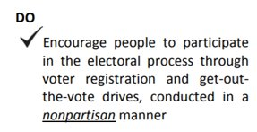
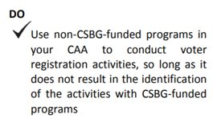
How Voter Education Works
Non-partisan
Non-CSBG funded programs
Uniform and Equal Education
Promote civic actions, not candidates
Discussion Points:
  Register, Check or Update Registration
    17+
    www.vote.gov
    www.rockthevote.org
  COVID impact
    Vote by mail
    Absentee Ballots

Slide 12
Advocating for Your Community
Effective Strategies for
Public Policy Engagement
Webinar
August 13 | Register

Slide 13
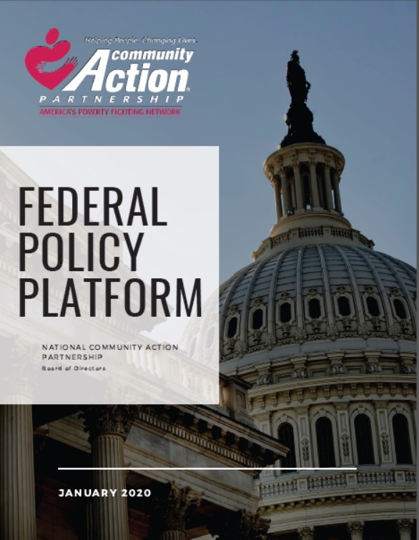
Policy Platform Areas
Community Services Block Grant (CSBG) Funding & Reauthorization
Creating an Economy that Works for All with Sufficient Income for Family Well-Being
Providing Equitable Access to Clean, Affordable Energy & Infrastructure
Expanding Safe & Affordable Housing
Ensuring High Quality Education & Workforce Readiness Regardless of Circumstance
Promoting Universal Health & Well-Being
Establishing Structural Equity in the Criminal Justice System
Protecting Immigrant Community Members
Encouraging Civic Engagement that Allows Every Voice to be Heard
Strengthening Community Resilience

Slide 14
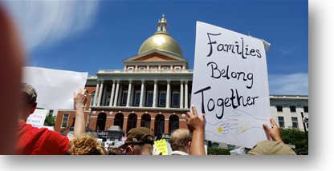
Why Advocacy?
  Charged with addressing the causes and conditions of poverty
  Be a voice for vulnerable populations in communities and states
  Raise awareness and create change

Slide 15
Advocacy vs. Lobbying
EDUCATION
LOBBYING
General
Issues
Programs
Specific
Legislation
Appropriations
Administrative Actions
Executive Orders

Slide 16

Building an Advocacy Strategy
Identify injustices/inequities
Identify the solutions, decisionmakers, and processes
Importance of coalition building
Advocacy in Action
Incorporating advocacy into your organization's initiatives

Slide 17
The Census & Redistricting
Webinar
September 24 | Register
Notes:
Census is constitutionally mandated

Slide 18
The 2020 Census
Constitutionally Mandated
Counts ALL people living in the US on April 1, 2020
COVID has extended this process
10 for 10
Crucially Important –
Federal funding
Political representation
Voting rights and civil rights legislation enforcement
Business and government planning
10 demographic questions, fewer than 10 mins to answer
Notes:
These questions are simple demographics - name, age, race, gender
The Census does NOT ask for Social Security Numbers
The Census will NOT ask about citizenship
There are other Census surveys that ask more, like the American Community Survey. This is different.
Common Questions You May Encounter:
Why don’t we count each person at the hospitals as babies?
Why don’t the schools just count kids?
What about the Citizenship question?
Can our customers get in trouble for filling out the Census form?
How do we count homeless populations?

Slide 19
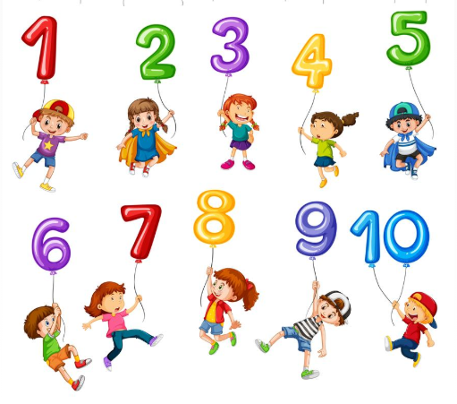
Why Being Counted
Helps Community Action
Many of the federal programs Community Action Agencies offer are funded through formulas that rely on census numbers
  Inaccurate counts could mean ~$2,000 PER PERSON PER YEAR FOR 10 YEARS lost in funding!
CNAs use census numbers
Communities are given a say in policies and government based on the official count
Notes:
These questions are simple demographics - name, age, race, gender
The Census does NOT ask for Social Security Numbers
The Census will NOT ask about citizenship
There are other Census surveys that ask more, like the American Community Survey. This is different.
Common Questions You May Encounter:
Why don’t we count each person at the hospitals as babies?
Why don’t the schools just count kids?
What about the Citizenship question?
Can our customers get in trouble for filling out the Census form?
How do we count homeless populations?

Slide 20

Redistricting: 2021
Census counts are used to:
  Assign seats in Congress to each state
  The more people are counted, the more seats are awarded
The Census Timeline has changed
  Apportionment counts 4/30/21
  Redistricting counts 7/31/21
Redistricting is state by state
  2021: NJ, VA, CA
  In some states, constituents can have a say!
Notes:
These questions are simple demographics - name, age, race, gender
The Census does NOT ask for Social Security Numbers
The Census will NOT ask about citizenship
There are other Census surveys that ask more, like the American Community Survey. This is different.
Common Questions You May Encounter:
Why don’t we count each person at the hospitals as babies?
Why don’t the schools just count kids?
What about the Citizenship question?
Can our customers get in trouble for filling out the Census form?
How do we count homeless populations?

Slide 21
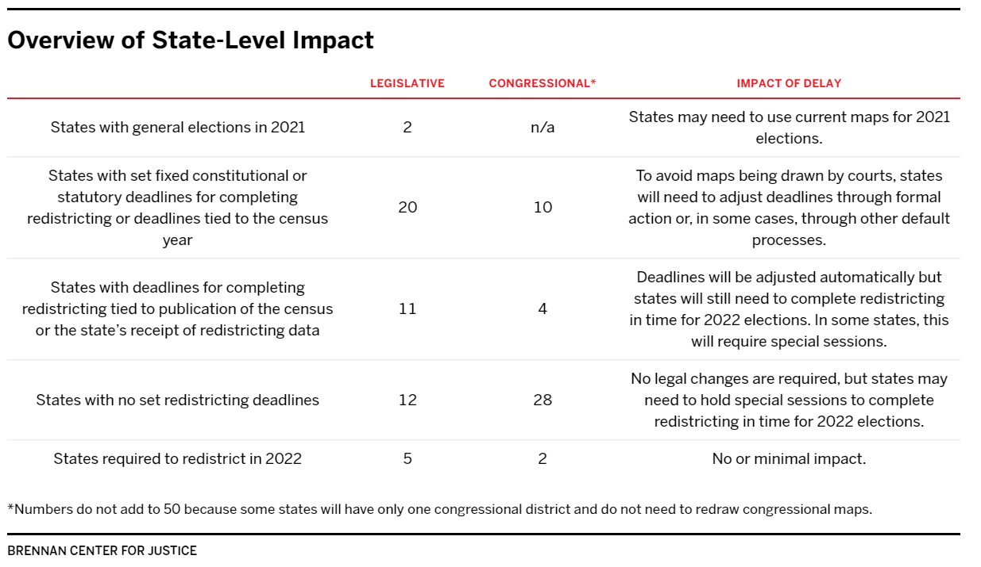
Redistricting: 2021
https://www.brennancenter.org/our-work/research-reports/how-changes-2020-census-timeline-will-impact-redistricting
Notes:
These questions are simple demographics - name, age, race, gender
The Census does NOT ask for Social Security Numbers
The Census will NOT ask about citizenship
There are other Census surveys that ask more, like the American Community Survey. This is different.
Common Questions You May Encounter:
Why don’t we count each person at the hospitals as babies?
Why don’t the schools just count kids?
What about the Citizenship question?
Can our customers get in trouble for filling out the Census form?
How do we count homeless populations?

Slide 22
The Agency Ask for Census
Know the Census basics from Moodle, our Webinars, or our videos
Get access to educational materials like posters, button templates, one pager fact sheets
Get out the Count!
What You Can Do
Our goal is to make it easy for agencies to talk about the Census along with other work
Here are some ideas:
Drop a postcard into children’s backpacks to take home​
Have transportation drivers pass out a Rural Census Postcard​
Run a Census PSA Video on the lobby CCTV​
Have a copy of Census FAQs at each employee’s desk​
Let children do a Census coloring page and take it home​
Put up a Census Poster in the lobby​
Have employees wear a Census button​
Make a social media post​
Place Census Basics Handouts at the front desk​
Have a phone or computer available for customers to take the Census while they wait​

Slide 23
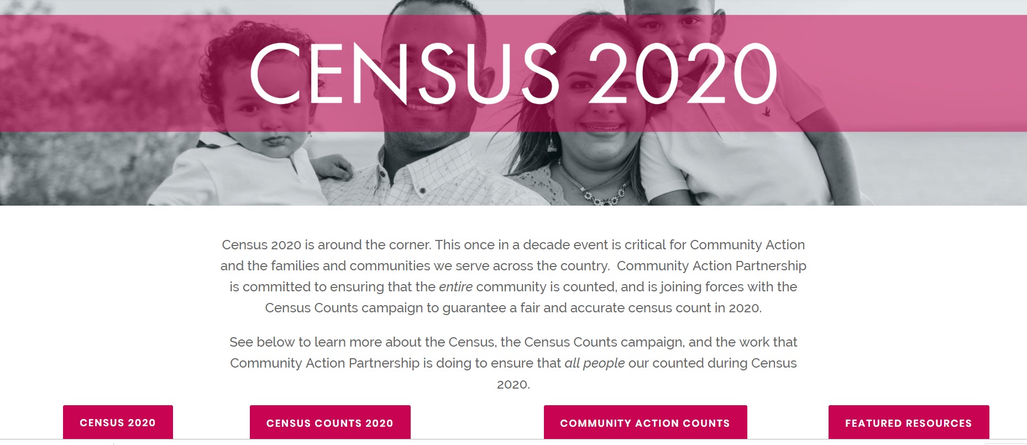
Community Action Counts
www.CommunityActionPartnership.com/Census-2020

Slide 24
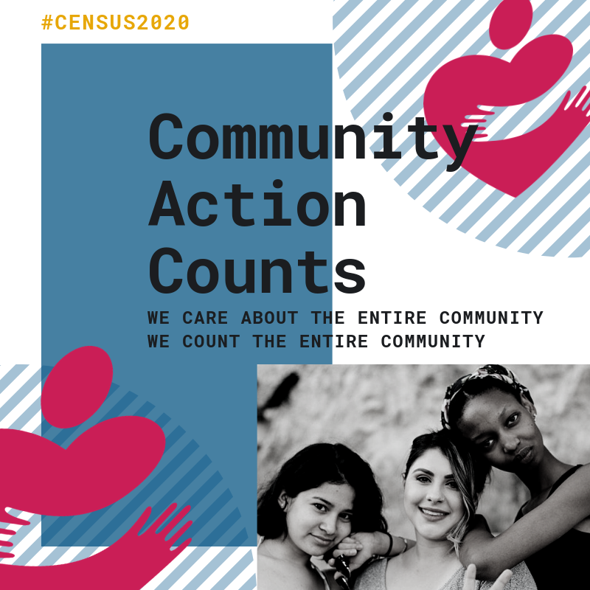
Engage With Social Media
Follow us on Twitter and Instagram: @CAPartnership
Sign-up for our Civics newsletter for resources and trainings, and news
Join our Facebook group to engage with CAA staff across the network
Notes:
Need content – Jim has this as TBD. Could remove for earliest sessions.

Slide 25
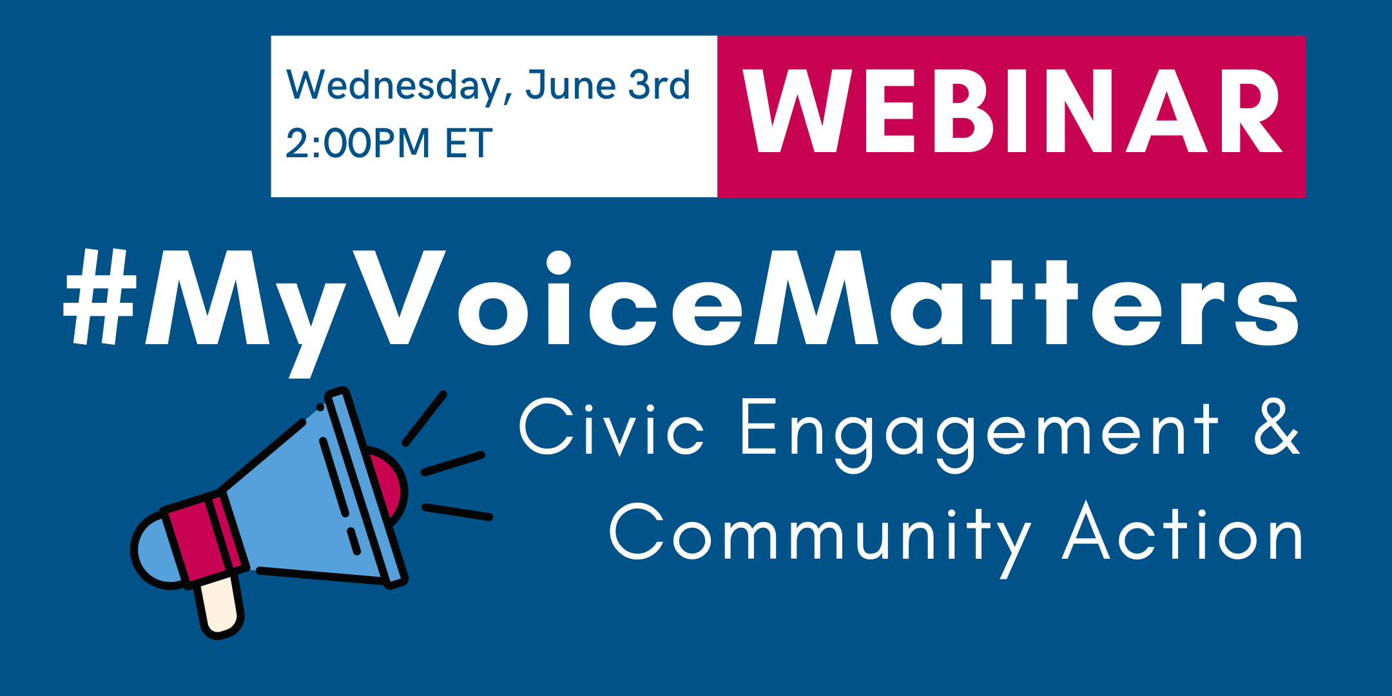
Webinar Series
Schedule
Voter Registration & Community Action - with CAPLAW & Coalition on Human Needs
July 16th | Register
Advocating for your Community: Effective Strategies for Public Policy Engagement
August 13th | Register
Census & Redistricting
September 24th | Register
The Right to Vote: A Short History & Issues for 2020
October 22nd | Register

Slide 26
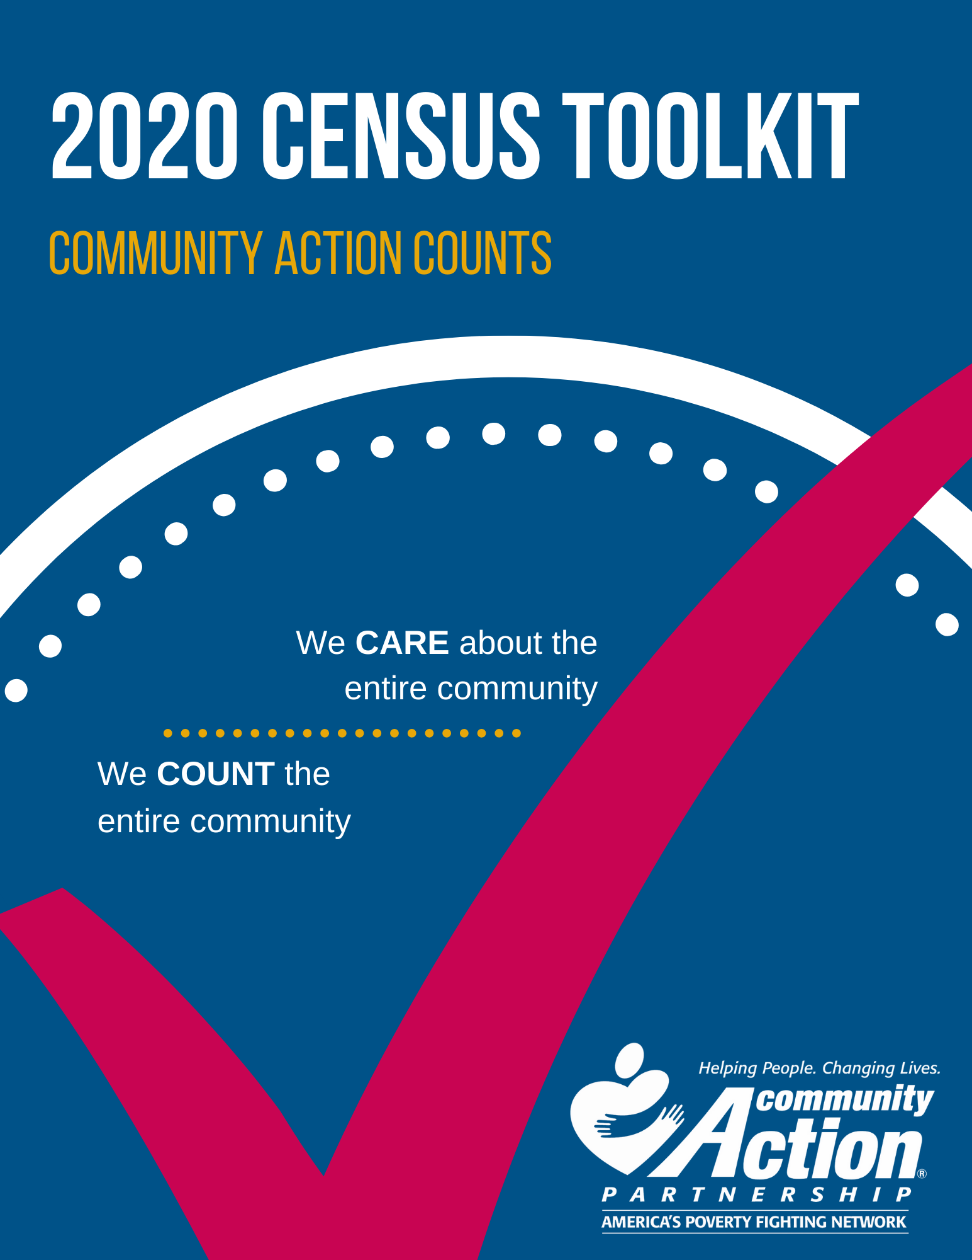

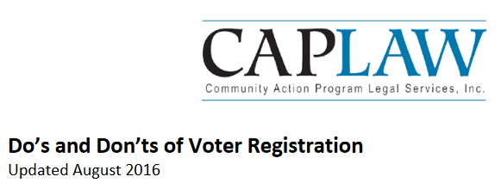



Civic Engagement Resources
Partnership Census Resources Handouts, Flyers, Posters, Fact Sheets
Partnership Census Blog
Census Count 2020 Coalition Partners’ toolkits, fact sheets, and more!
Do's and Don'ts of Voter Registration - CAPLAW Guidance
Updated Guidance on Voter Registration Activities OCS IM #81
Other Organizations doing civic engagement work
  National Conference of State Legislatures
  Brennan Center for Justice
  League of Women Voters

Slide 27

Community Action Team
Census Staff
Lindsay Marsh, LMarsh@CommunityActionPartnership.com
Lauren Martin, LMartin@CommunityActionPartnership.com
Public Policy Staff
Ryan Gelman, RGelman@CommunityActionPartnership.com
Center for Community Futures
Subject Matter Experts
Jim Masters, JMasters@cencomfut.com
Allen Stansbury, Allen@Stansbury.net

Slide 28

Questions?

