Slide 1

Conducting a Community Assessment During the COVID-19 Pandemic
Webinar Wednesday
May 20, 2020

Slide 2

Agenda
Welcome!
The Value of Assessment during Crisis
Partnership Tools for Conducting a CNA
CARES – University of Missouri Extension
  Data Collection, Analysis, & Prioritization
  COVID-19 Data Tools
Modifications to CNA in light of COVID-19
  Gathering qualitative data when social distancing/working remotely
Q&A

Slide 3
Value of Assessment During COVID-19
Documenting History
Determining the baseline and needs created by COVID-19
  Therefore, demonstrating the role of Community Action to respond
Identifying conditions that contribute to the community’s ability to respond to crisis
  Therefore, leading to future improvement

Slide 4
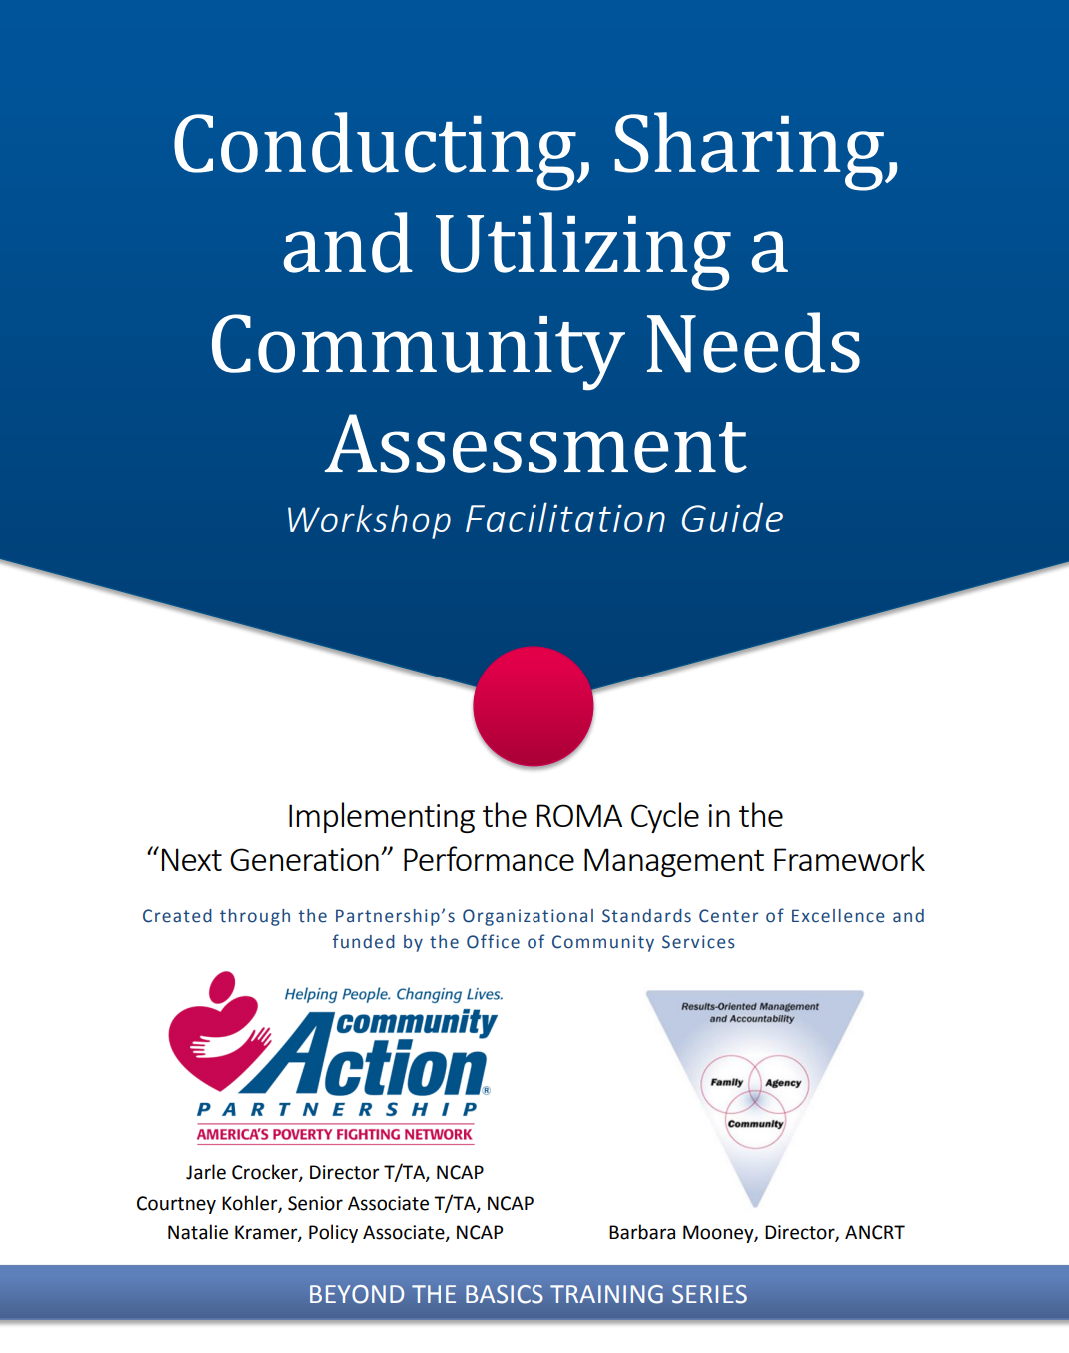
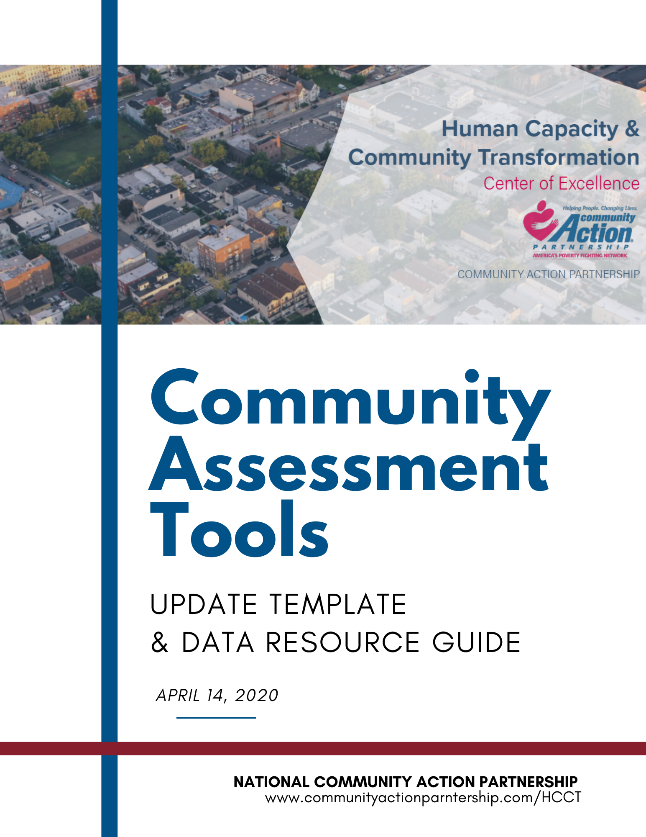
Tools for Conducting a CNA
https://communityactionpartnership.com/publication_toolkit/roma-next-gen-beyond-the-basics/
https://communityactionpartnership.com/publication_toolkit/covid-19-community-assessment-update-template-data-resource-guide/

Slide 5

Conducting a Community Assessment During the
COVID-19 Pandemic
Jamie Kleinsorge, MS
Senior Project Coordinator
Center for Applied Research and Engagement Systems (CARES)
University of Missouri Extension

Slide 6
Data collection, analysis, and prioritization during a pandemic
Effects on data collection methods
(i.e. – surveys, focus groups)
Effects on responses and response rates
(i.e. – fear, uncertainty)
Effects on data analysis
(i.e. – pre, post, and during)
Effects on prioritization
(i.e. – “old” issues vs. “new” issues, funding)
“Crises are, by definition, unexpected, non-routine occurrences that create conditions with the potential to render traditional research procedures difficult.”

Slide 7
Effects on data collection methods and responses
Most data collection is being done remotely.
Digital literacy must be a core consideration for online data collection.
Data collection instruments should be mobile friendly – this means testing surveys or focus group tech on various devices (iPhone, Android, tablets), keeping them short, and quantitative, if possible.
Consider reviewing privacy and recording policies to ensure they comply and reflect new technology.
Participants will respond differently (even if you tell them to think about conditions prior to COVID19).

Slide 8
Effects on data collection methods and responses
Response rates may be lower, but that doesn’t complete invalidate your data:
  Include safe, public WiFi locations in the survey request.
  Notation
  Weighting
  Geographic distribution
Note significant ”re-open” dates and milestones throughout your data collection processes.
  Pre-pandemic, quarantine period, post COVID – these may vary state by state, county by county
  Also note dates like when schools closed, when businesses were allowed to re-open, notable restrictions like those on milk and meat at grocery stores, etc.

Slide 9
Effects on data analysis and prioritization
Results from post-COVID data collection must recognize that fear and uncertainty may cause shifts in response.
  Financial stability
  Food security
  Childcare arrangements and affordability
  Safety
Free & Reduced Lunch
Domestic Violence
Health Insurance
Food Bank Usage
Crime
Medicaid
Belonging & Connectedness
Housing Stability
Notes:
Asking questions about what services they accessed during COVID and summer – you may see a dramatic decrease in the number of people saying “Free Lunch” program.

Slide 10
Effects on data analysis and prioritization
Look for patterns over time
  Issues that gain traction/disappear/shift in focus around *March 15, 2020/the start of the pandemic* and carry through until *mid-May?*
  Aggregate and group your data based on notable milestones and look for themes within and across the data.
Note what issues shift the most.
Note what issues are persistent across all phases (pre, during, post).
Pre-COVID client surveys should be weighted lower than results from broader community surveys.
Notes:
Asking questions about what services they accessed during COVID and summer – you may see a dramatic decrease in the number of people saying “Free Lunch” program.

Slide 11
Prioritization based on COVID-19 vulnerabilities
Seniors Age 65+
Uninsured
Population Density
Which of these vulnerabilities is most
significant in your region? → → →
COVID-19 Vulnerability Footprint→ → →

Slide 12
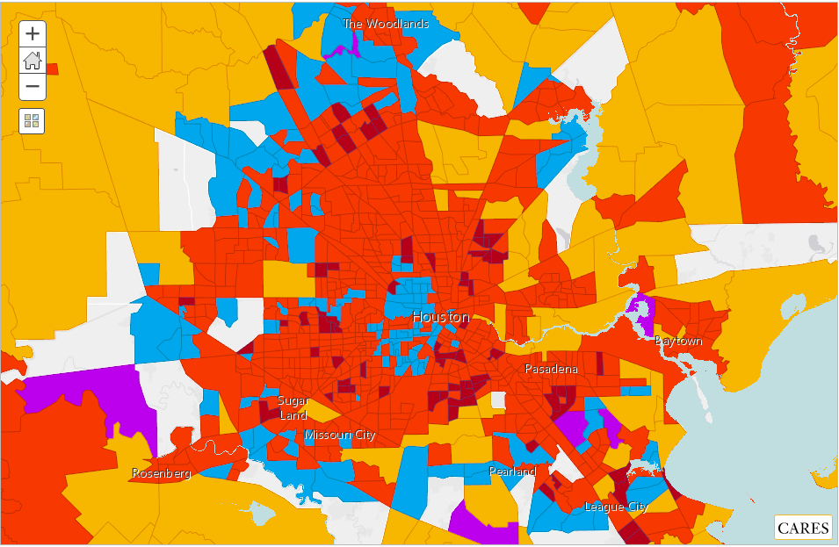
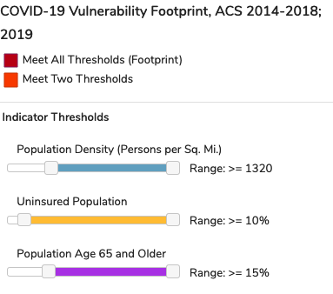
COVID-19 Vulnerability Footprint

Slide 13
Questions?
kleinsorgej@missouri.edu

Slide 14
Community Assessment Modifications
Internally: Review your process
Build in extra time
Identify staff capacities
Incorporate virtual meeting and communication techniques
Notify the agency staff and the community of changes

Slide 15
Community Assessment Modifications
Externally: Engaging the community differently
Utilizing surveys more effectively
  New or different questions
  Expanding online or distance-accessible techniques
Virtual meetings
Phone interviews
Polling

Slide 16
Lessons in Engaging the Community Virtually
Adapted from Center for Health Care Strategies
Ensure familiarity with online platforms
Provide strong facilitation
Recognize the desire for sharing
Add personal gestures to make a difference
Resonate with timely connections
Recognize the pros and cons of connecting virtually
Center for Health Care Strategies: https://www.chcs.org/when-covid-19-gives-you-lemons-pivoting-to-virtual-community-engagement/?ct=t%28CPP+Virtual+Engagement+05%2F19%2F20%29
Notes:
One-on-one coaching before engagement sessions can help reduce technical barriers to engagement.
Strong facilitation to ensure voices are heard
participants appreciated the opportunity to convene and discuss their experiences – could be a stress reliever
Acknowledging and compensating community members for their time and expertise remains important even in a virtual setting.
quickly pivoted to also discuss COVID-19’s impact on this population. Being responsive to the pandemic helped the WPC-LA team build a foundation for meaningful and trusted consumer engagement beyond the current crisis.
Hosting virtual gatherings is less costly than in-person meetings, and planning can be flexible. Technology allows for people who are geographically distant to participate in virtual convenings, but it is important to remember who has access to such tools and offers ways to be as inclusive as possible. Nowadays, cell phones are ubiquitous, but internet access is more limited, so making accommodations to ensure that everyone can participate is important.
Creates an opportunity for innovation and developing strategies that prioritize safety and comfort when engaging with consumers during this time.

Slide 17
What have you done differently or considered for your assessment process during COVID-19?
Chat with us!

Slide 18

Questions/Comments
Type in the Chat!

Slide 19


Join the Partnership for
Next Week’s Webinar Wednesday
May 27, 2020
Lessons in Trauma Informed Care
https://communityactionpartnership.com/events/category/webinars/

Slide 20

Contact Information
Aaron Wicks, PhD, CCAP, NCRT
VP of Organizational Capacity Building
awicks@communityactionpartnership.com
Courtney Kohler, MPA, CCAP, NCRT
Senior Associate, T/TA
ckohler@communityactionpartnership.com
Lauren Martin, MSW
Program Associate, T/TA
lmartin@communityactionpartnership.com

