Slide 1

#CountMeIn:
Engaging Your Community
in the 2020 Census
Jim Masters
Center for Community Futures
Lindsay Marsh
Community Action Partnership

Slide 2
Agenda
What is the Census & Why does it matter?
Get out the Count - what is being done?
Get out the Count - what can you do?
  Messaging that works with different populations
  COVID 19
Next Steps and Questions
Notes:
This presentation has a number of objectives.
Provide an overview of the Census, what it is, why its important, and what to expect.
Additionally, we will lay out information about all of the current Census Outreach efforts, from the Census Bureau to the Census Campaign, and the Partnership’s efforts.
We will discuss what steps can be taken now at the local level to start engaging your communities around the census
Most importantly we aim to form a dialogue where we can hear your most pressing questions about the Census, and answer when we can, and also hear from you about practices in your community that are already taking place or have taken place in the past to Get out The Count, which we hope to amplify across the network

Slide 3
What is the Census?
Notes:
Census is constitutionally mandated

Slide 4
“Representatives and direct Taxes shall be apportioned among the several States which may be included within this Union, according to their respective numbers, counting the whole number of persons in each State.
The actual enumeration shall be made…within every subsequent term of ten years, in such manner as they shall by law direct”
  US Constitution, Article 1, Section 2*
*Language adjusted to reflect Amendment XIV, Article II to US Constitution, July 9, 1868
Notes:
The census is rooted in the constitutional principle of representative democracy, where population is the basis for shared political power
The census aims to count the entire population of the country where they live, this includes all people regardless of age or citizenship status.
A count of the population every 10 years is mandated by the Constitution, and it is required by law to respond.
Governed by Title 13 of the US Code of Federal Regulations (CFR): Title 13 provides the following protections to individuals and businesses:
Private information is never published. It is against the law to disclose or publish any private information that identifies an individual or business such, including names, addresses (including GPS coordinates), Social Security Numbers, and telephone numbers.
The Census Bureau collects information to produce statistics. Personal information cannot be used against respondents by any government agency or court.
Census Bureau employees are sworn to protect confidentiality. People sworn to uphold Title 13 are legally required to maintain the confidentiality of your data. Every person with access to your data is sworn for life to protect your information and understands that the penalties for violating this law are applicable for a lifetime.
Violating the law is a serious federal crime. Anyone who violates this law will face severe penalties, including a federal prison sentence of up to five years, a fine of up to $250,000, or both.

Slide 5
The 2020 Census Questions
Age – in years, month, day and year of birth for each household member
Hispanic Origin – is this person Hispanic; if yes, which country of origin
Race – mark one or more boxes and print origins
Relationship – How is this person related to Person 1
Sex – gender: male or female
Tenure (owner/renter) – Is this house, apartment, or mobile home
Operational Questions:
  How many people lived here on April 1, 2020?
  Were additional people staying here on April 1?
  Telephone number, name of person filling out the census.
Notes:
These questions are simple demographics - name, age, race, gender
The Census does NOT ask for Social Security Numbers
The Census will NOT ask about citizenship
There are other Census surveys that ask more, like the American Community Survey. This is different.
Common Questions You May Encounter:
Why don’t we count each person at the hospitals as babies?
Why don’t the schools just count kids?
What about the Citizenship question?
Can our customers get in trouble for filling out the Census form?
How do we count homeless populations?

Slide 6
What the Census Won’t Ask For:
Social Security Numbers
Bank or Credit Card Information
Citizenship Status
Anything Political
Donations
Household Income
Notes:
These questions are simple demographics - name, age, race, gender
The Census does NOT ask for Social Security Numbers
The Census will NOT ask about citizenship
There are other Census surveys that ask more, like the American Community Survey. This is different.
Common Questions You May Encounter:
Why don’t we count each person at the hospitals as babies?
Why don’t the schools just count kids?
What about the Citizenship question?
Can our customers get in trouble for filling out the Census form?
How do we count homeless populations?

Slide 7
Census Data is Used To…
Apportion representation among states – Congressional Members
Draw congressional and state legislative districts, school districts, and voting precincts
Distribute federal dollars to states
Inform government planning decisions at the federal, tribal, state and local level
Inform organizational decisions (e.g., where to locate, size of market, etc.) of businesses and non-profits
Enforce voting rights and civil rights legislation
Notes:
This slide is straightforward but when touching on the bullets of Distribution of Funds, Informing Gov. Planning, and Informing Org. Decisions, this is a good opportunity to connect to functions of Community Action.

Slide 8
Counting The Population – Key Dates
March 12-20: Invitations sent to respond online
March 16-April 3: Reminder letters and postcards sent
April 1: Census Day
April 8-16: Reminder letters sent with paper questionnaire
April 20-27: Final postcard sent before in person follow up
May 28- August 14: Non-Response follow up visit
August 14, 2020: Last day to respond to the Census!
Click here for all COVID 19 Census Bureau Timeline Adjustments

Slide 9
2020 Census
Counting The Population - Strategy
95% of households will receive their census invitation by mail
5% of households will receive their census invitation when a census taker drops it off
Less than 1% of households will be counted in person by a census taker, instead of being invited to respond on their own
An estimated 40% of households will require in person follow up
Notes:
All households will receive a letter asking to complete the census online, areas less likely to respond online will also receive a paper questionnaire. 6 attempts for in person follow up: 3 in person, 3 proxy
After 6 attempts, secondary sources will be used

Slide 10
How will we get our forms?
It’s helpful for people to know how they will receive their Census invitation, so they know how to watch for it:
  The CUNY map shows which areas will get invitations in the mail to go online vs. print copies first vs. having them dropped in rural areas.
  These maps also show why populations might be hard to count and help developing messaging.
  If someone doesn’t get an invitation, they can and should still fill out the form. Direct them to call the tollfree numbers or go online to complete their Census.
Notes:
All households will receive a letter asking to complete the census online, areas less likely to respond online will also receive a paper questionnaire. 6 attempts for in person follow up: 3 in person, 3 proxy
After 6 attempts, secondary sources will be used

Slide 11
2020 Census Economics
The Census hires 100,000s of people a cycle, and will spend over $15 BILLION* to complete the count
The average cost for counting a household has gone up dramatically due to a changing political climate, increase in immigration, the rise of technology and a variety of other factors:
1970: $16. 2020: $107
Every person counted is equal to ~$2,000 in funding to your community a year – each year, for ten years!
*-census/https://www.gao.gov/highrisk/2020_decennial_census/why_did_study#t=1, https://www.census.gov/fieldjobs
Notes:
The Census if the biggest non-war governmental field operation. It requires a huge investment in both dollars and man power. It can be a generator of temporary local jobs in your community, and the results have a major impact on funding to your community for a decade.

Slide 12
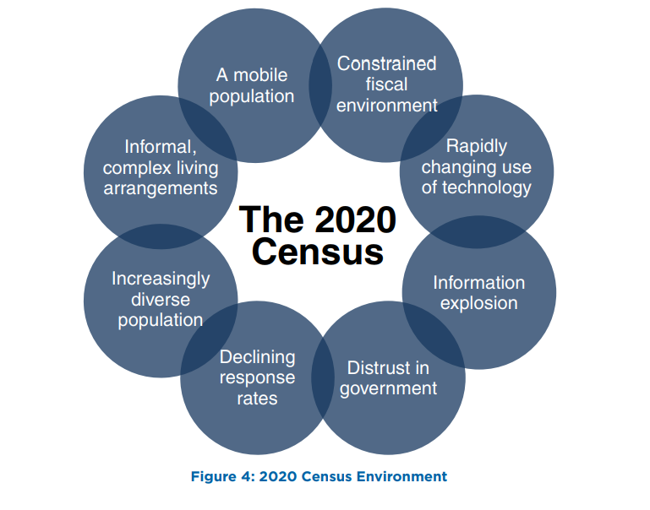
The 2020 Census- The Environment
Notes:
This slide is important. This slide’s purpose is to pivot from talking about how the Census Data is valuable to Community Action, to why making sure everyone is counted should be a concern for Community Action. The slide shows why this year in particular there are various factors that will make it difficult to ensure a complete count. And because we have already demonstrated why the Census is valuable to Community Action, this should be a big concern for Community Action, and is why we need agencies to do what they can to make sure people are counted. Below is an explanation of each circle:
• Constrained fiscal environment: Budget deficits place significant pressure on funding available for the research, testing, design, and development work required for successful innovation.
• Rapidly changing use of technology: Stakeholders expect the decennial census to use technology innovation, yet the rapid pace of change makes it challenging to plan for and adequately test the use of these technologies before they become obsolete.
• Information explosion: Rapid changes in information technology (IT) create stakeholder expectations for how the Census Bureau interacts with the public to collect data and disseminate data products.
• Distrust in government: The public’s concerns about information security and privacy, the confidentiality of information given to the government, and how government programs use the information they collect continue to grow. This impacts response rates and could make it more difficult for government agencies to collect important demographic survey information.
• Declining response rates: Response rates for Census Bureau surveys, and for surveys and censuses in general, have declined as citizens are overloaded with requests for information
and become increasingly concerned about sharing information.
• Increasingly diverse population: The demographic and cultural make-up of the United States continues to increase in complexity, including a growing number of households and individuals of Limited English Proficiency
• Informal, complex living arrangements: Households are becoming more diverse and dynamic, making it a challenge to associate an identified person with a single location. For example, blended families may include children
who have two primary residences.
• A mobile population: The United States continues to be a highly mobile nation as about 14.3 % of the population moves in a given year

Slide 13
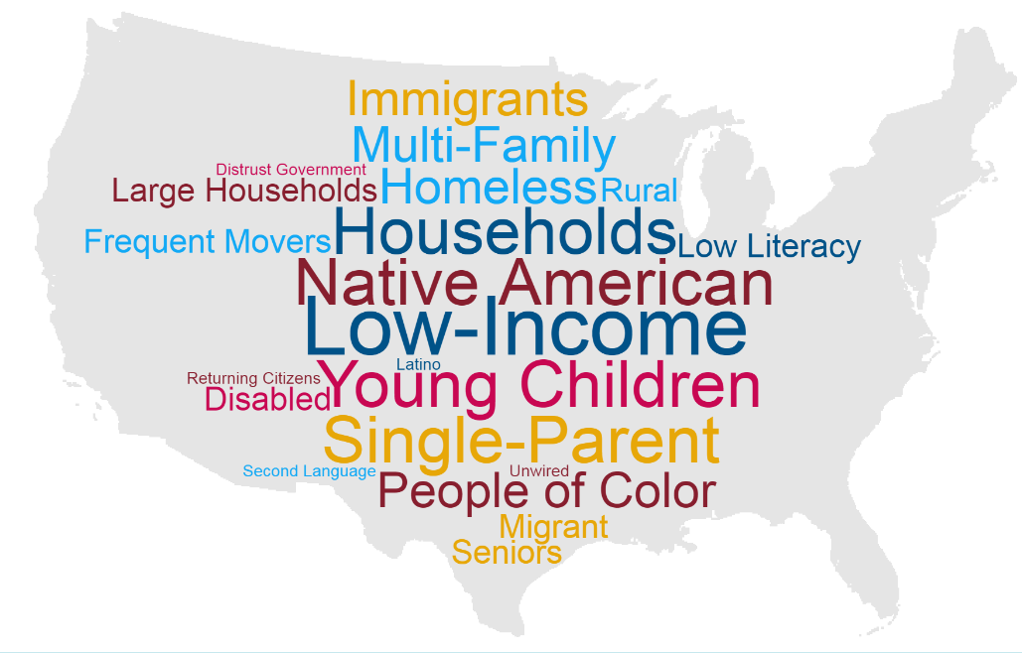
The Hard-To-Count Are:
Notes:
This means the hard to count population includes a variety of categories including:
Young children under the age of five.
Racial and ethnic minorities.
Non-English speakers.
Low income people.
People experiencing homelessness.
Undocumented immigrants.
People who distrust the government.
LGBTQ persons.
People with mental or physical disabilities.
People who do not live in traditional housing.
People who are members of disadvantaged or marginalized communities –with the most to lose – are at greatest risk of being uncounted. These are also the groups that are most likely to be served by Community Action

Slide 14
Economics and HTC: Follow Up
You can help the Census hire those 500,000!
Hiring people from communities that are Hard to Count means:
  Jobs for people: good hourly wages + mileage, flexible PT/FT
  And that people are working for the Census, sound, look and act like others in their community; builds trust.
  Jobs & Pay Rates are on the Census website
  2020 Census jobs online on the 2020 Census website
Notes:
The Census if the biggest non-war governmental field operation. It requires a huge investment in both dollars and man power. It can be a generator of temporary local jobs in your community, and the results have a major impact on funding to your community for a decade.

Slide 15
Why Does the Census Matter to Community Action?
Notes:
Census is constitutionally mandated

Slide 16
Why Community Action?
Populations that are the hardest to count or are the least likely to fill out the census happen to walk through our doors every day.
This is why we are involved; we are trusted messengers who can raise the issue of the Census with our customers and explain why it’s safe, easy, and important.
The populations we serve are often the most undercounted, which means our communities lose their fair share of dollars and representation

Slide 17
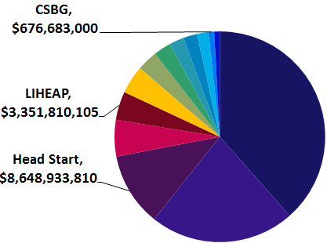
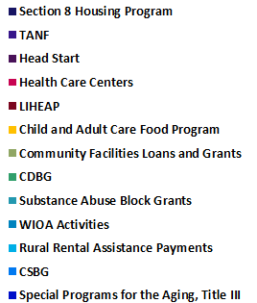
Census Data Drives Dollars
In 2016, 15 federal programs most used by CAAs relied on Census data to distribute $77 billion or 9% of $864 billion total federal program spending
Notes:
This slide is self explanatory, but important to note that the programs depicted here are not alll the programs that are impacted by the Census, just the ones that are most commonly utilized by Community Action. Worth noting out that the Weatherization program is one that is not included in this data

Slide 18
Get Out The Count –
What Is Being Done?
Notes:
Census is constitutionally mandated

Slide 19
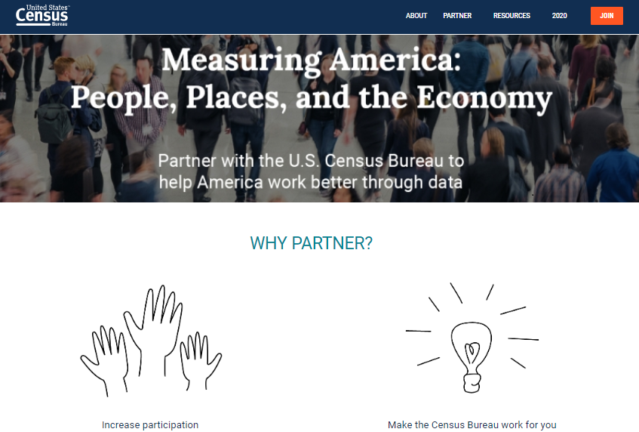
US Census Bureau: Partner Efforts
Notes:
The Census Bureau is investing a large amount of their own resources to ensure thaat everyone is counted. On their website you can join this effort and stay informed about all of the resources they offer by becoming a partner to the US Census.

Slide 20
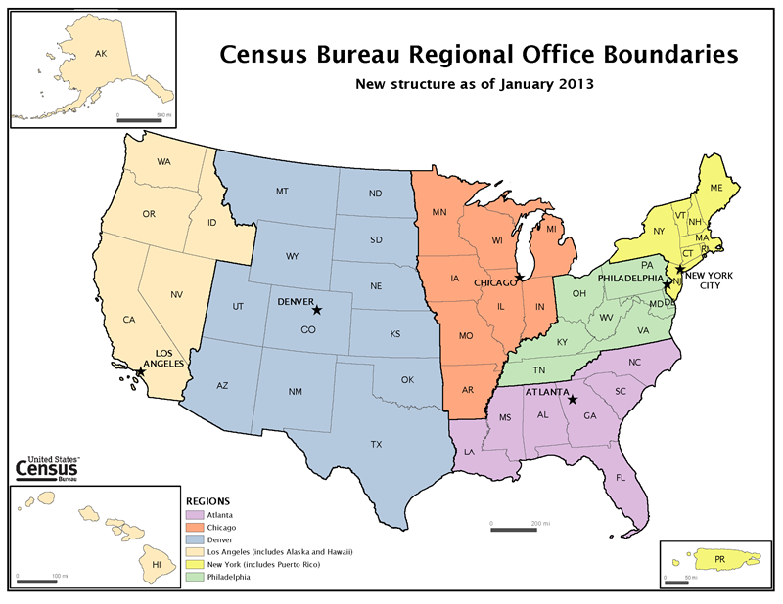
US Census Bureau: Partner Efforts
Your Regional Office
Notes:
The Census Bureau is investing a large amount of their own resources to ensure that everyone is counted. On their website you can join this effort and stay informed about all of the resources they offer by becoming a partner to the US Census.

Slide 21
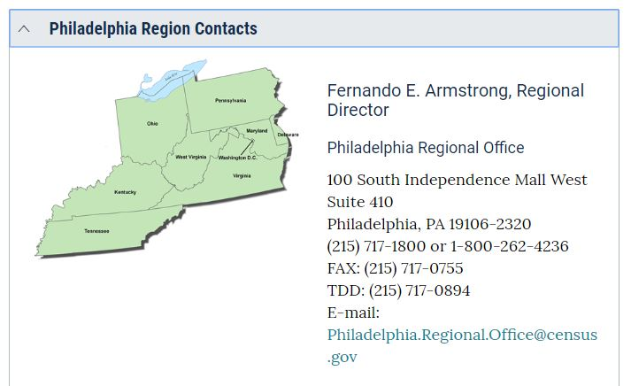
US Census Bureau: Partner Efforts
Your Regional Office
Notes:
The Census Bureau is investing a large amount of their own resources to ensure that everyone is counted. On their website you can join this effort and stay informed about all of the resources they offer by becoming a partner to the US Census.

Slide 22
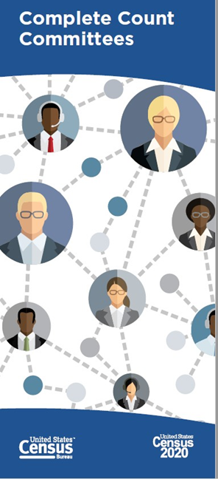
Complete Count Committees (CCCs):
Utilize local knowledge and resources to promote the Census through locally based outreach efforts
Provide a vehicle for coordinating efforts between tribal, state, and local governments; communities; and the Census Bureau
Help the Census Bureau get a complete count through partnerships with local governments and community organizations
Find existing Complete Count Committees on the Census website
Notes:
The Complete Count Committees (CCC) program is one of the main Get Out the Count efforts run by the Census Bureau. It is key to creating awareness in communities all across the country.
CCCs utilize local knowledge, influence, and resources to educate communities and promote the census through locally
based, targeted outreach efforts.
CCCs provide a vehicle for coordinating and nurturing cooperative efforts between tribal, state, and local governments; communities; and the Census Bureau.
CCCs help the Census Bureau get a complete count in 2020 through partnerships with local governments and community organizations.

Slide 23
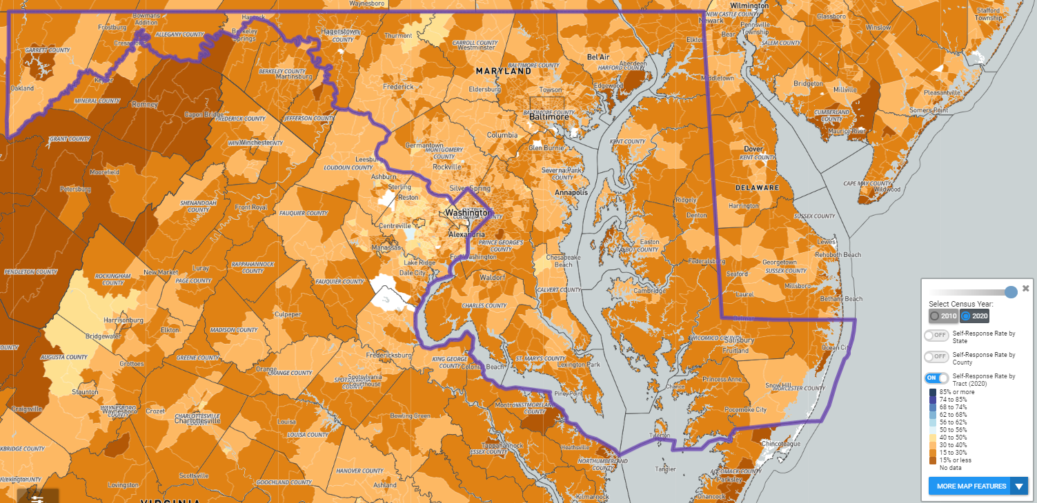
Finding The Hard To Count
www.CensusHardToCountMaps2020.us

Slide 24
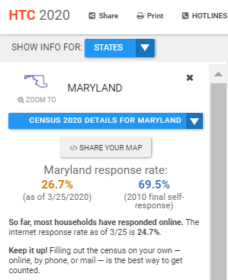
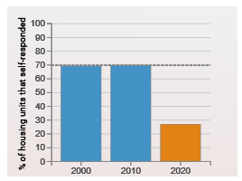
Maryland’s Response as of 3/26
www.CensusHardToCountMaps2020.us

Slide 25
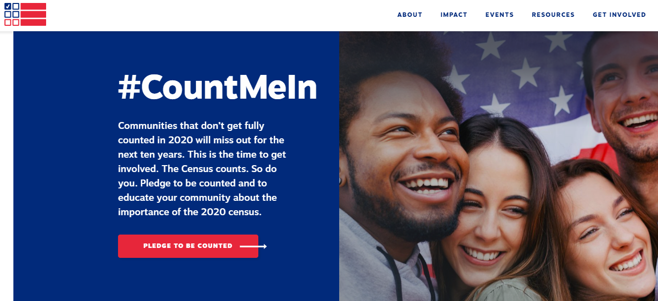

Census Counts 2020
Visit www.CensusCounts.org to find resources from our partners. Then take the pledge to be counted & educate your community about the Census!
Notes:
April 1st of this year (one year out from Census Day) the Census Counts Campaign held a Census Day of Action. This was the largest effort of the campaign to date. Among the many activities of that day, the campaign officially launched their website: censuscounts.org, where thousands of people across the country had the ability to pledge to be counted and work towards a fair and accurate census. You can still visit and take the pledge and censuscounts.org, this will sign you up for important campaign updates and tie to a community of thousands already working on census outreach efforts. Additionally, the website is valuable resources to learn more about the various national partners involved in the Census Counts campaign as well as a continually updated list of resources to help with your outreach efforts.

Slide 26






















Census Counts 2020
Notes:
The Census Counts Campaign is a national collaborative effort funded by some of the nations largest foundations and funding organizations. These funders have come together to make a very large scale investment to help complement the census bureau’s outreach efforts to gauntness that the 2020 census is fair and accurate. The Census Counts campaign is lead by the Leadership Conference Education Fund alongside a growing number of national hub organizations that represent various hard to count groups (partnership for america’s young children, color of change, naleo) or networks of important stakeholders (state voices, ready nation, faith in public life)

Slide 27
Engage with Partners
The Census Partnership Specialists are trained to help non-profits like our agencies engage customers with the Census
  They can come train your agencies; they also have pamphlets, fliers, and Census branded giveaways
Our Census Counts 2020 coalition members – there are other entities doing census work in your area.
  The lists of state leads and hubs to work with is HERE

Slide 28
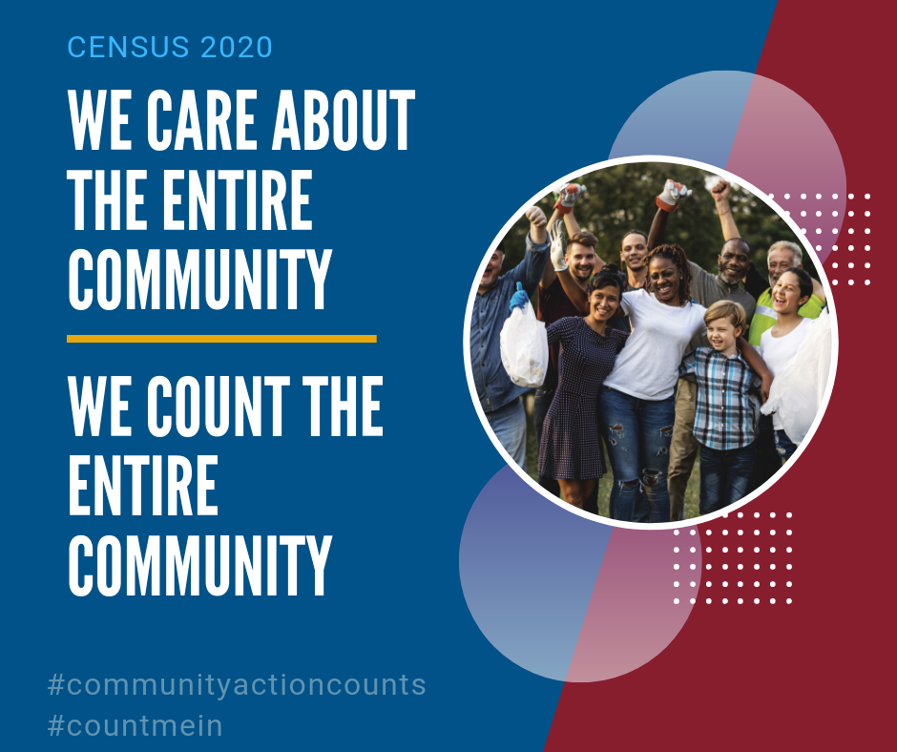
Community Action Counts -
What the Partnership is Doing:
Educate & increase awareness
Mobilize the network to act
Curate and generate resources specific to Community Action
Equip agencies to conduct effective local outreach efforts
10 member working group
Notes:
Increasing Awareness and Capacity across the Community Action Network
Conducting in-person trainings on Census information, tools and curriculum at state, regional and national conferences
Holding regular national webinars about the value of a complete Census to Community Action, and showcasing tools to help CAA staff support our customers’ Census participation
Using the network of working group members and CAA field expertise to learn and promote Census best practices for Community Action

Slide 29
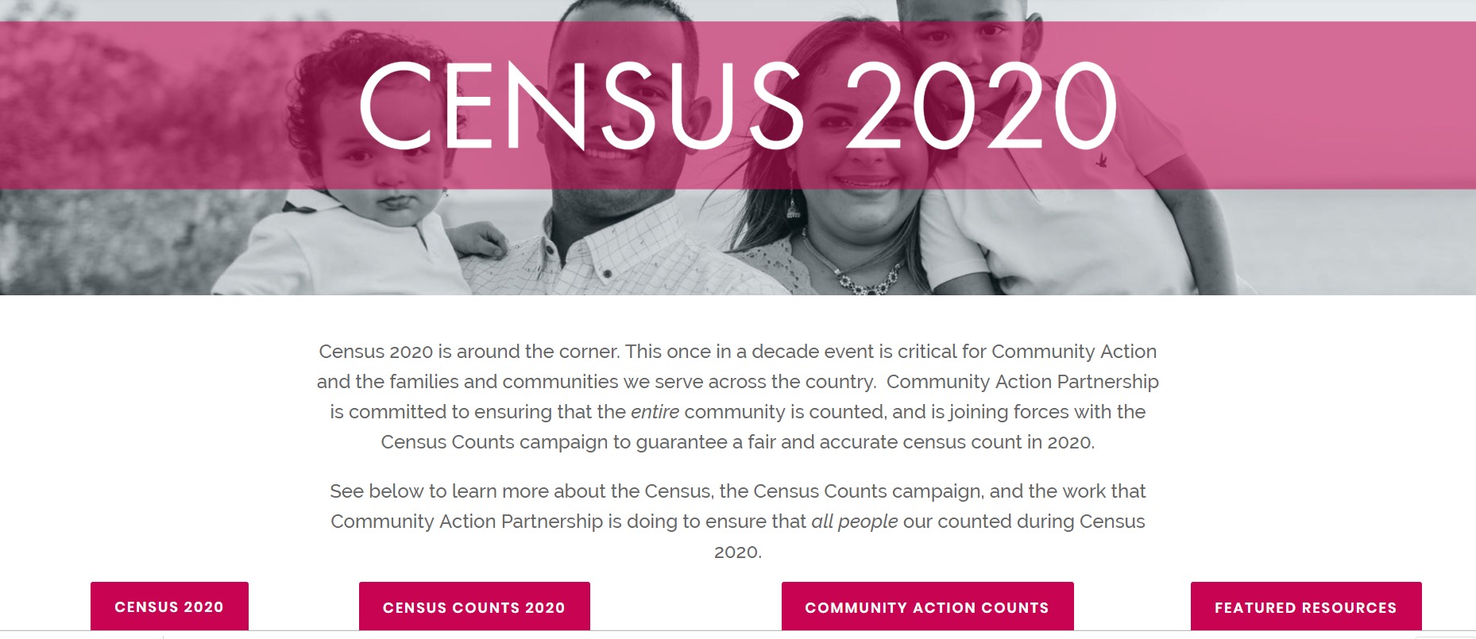
Community Action Counts
www.CommunityActionPartnership.com/Census-2020

Slide 30
Community Action
Complete Count Committee (CACCC)
Each Agency, Association, & State Office Should Nominate 1 Person To Be The Point Person For Their Office, And:
  Participate In Trainings And Webinars
  Help Organize Census Activities For Their Agency
  Be A Contact For Nationwide Partner Agencies
  Attend Census Academy And Be Certified On The Census
We Want 100% Network Participation!
If we care about the entire Community, then we have to help count the entire Community!
Notes:
Rework language

Slide 31


Census Academy
On-demand courses, videos & resources
Peer Engagement & Virtual Networking
Virtual space for Learning Community Groups
Free & Accessible for the Network!
Census track
Approx. 2 hours Get Census Certified!
Moodle is an online learning platform that provided trainers and learners with a single robust, secure, and integrated system to create personalized learning environments. https://moodle.communityactionpartnership.com

Slide 32
The Agency Ask
Our goal is to make it easy for agencies to talk about the Census as they do their other work
Knowing the Census basics from Moodle, one of our Webinars, and/or our videos is a good starting point.
Materials like posters, button templates, one pager fact sheets are all available.
Need a flyer or postcard that isn’t available?
Ask the National Partnership to create it!

Slide 33
Get Out The Count
What Can You Do?
Notes:
Census is constitutionally mandated

Slide 34
Talking to the Hard To Count
The Right Messaging is Key
Incorporate Census into existing contact with customers
  7 touches, marketing principles
Empower staff – As service providers, we are trusted messengers

Slide 35
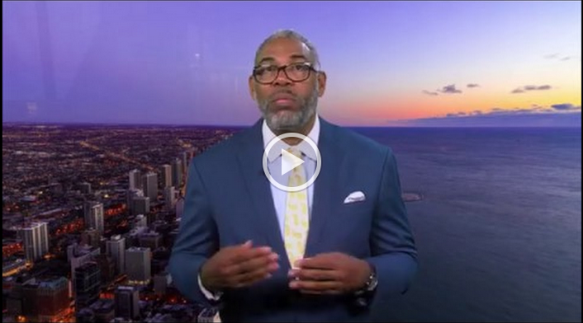
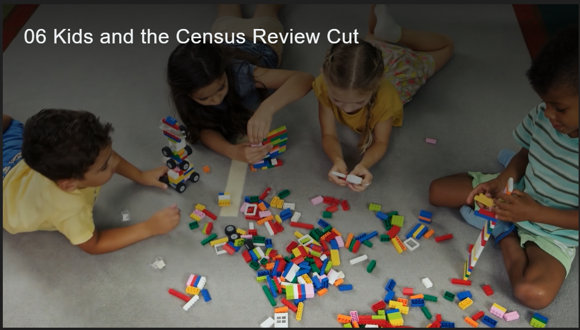
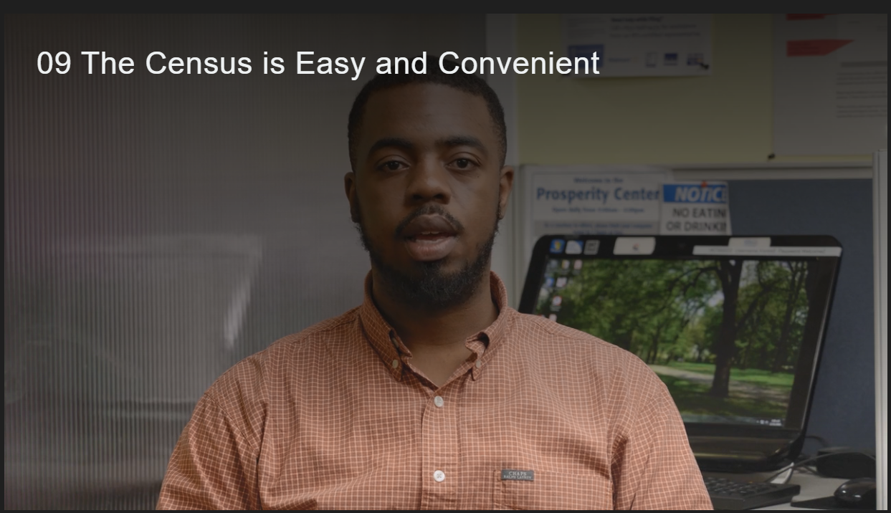
Training Tools: Videos
We have a ~7 min video highlighting how to talk to our customers about Census concerns. We also have 10 shorter videos (with two translated into Spanish) that highlight how easy it is to integrate Census into everyday work. Watch them on our website and share it with your agency!
Notes:
Insert video still and link when ready

Slide 36
Specific Messaging
The Census Counts 2020 coalition has done focus group/survey research to determine the best messaging for persuading families and households to count their children, and for persuading African Americans, Native Americans, Asian Americans and Hispanic/Latinx to complete their forms.
What messages work best across groups:
Resources that your community needs depend on counting everyone
  Funding for schools, childcare, housing, transportation, the services they receive from you, their trusted provider
  Helps your community get their fair share of resources
Only Census data can be used for funding decisions in funding formulas
Effect lasts for a decadehas been researched and presented by the Count All Kids Campaign
Full research is available online.

Slide 37
Why Kids Are Undercounted
Parents don’t understand how data is used
  Assume any funding decisions using the data are political
Think government already has the data
Have privacy concerns
Think they are too busy
Fear (too many people in home, immigrant status)
Complex Households (which account for 80% of children that are missed)
What messages work:
Resources that your community needs depend on counting everyone
  Funding for schools, childcare, housing, transportation
Only Census data can be used for funding decisions in funding formulas
Effect lasts for a decade, which is most of their childhoodis information has been researched and presented by the Count All Kids Campaign

Slide 38
Top Messages on Kids
Counting children means more funding for schools 82%
Helps government plan for the future and determines the level of funding from federal government for program services children use including schools, child care, housing, transportation 82%
Census happens once every 10 years, so if we don’t count a two-year old, your community will lose funding for education, child care, and other services they will need for 10 years, which is most of their childhood. 81%
This information has been researched and presented by the
Count All Kids Campaign

Slide 39
How African American
Communities Are Undercounted
Black adults, especially those age 35 and older, have a generally positive impression of the Census and recognize the importance of participating.
Black Millennials are an important target audience for any campaign to encourage participation in the 2020 Census.
  They are the least likely to recognize its importance and to say they will participate.
This information has been researched and presented by Color of Change.

Slide 40
Messaging for African American Communities
Messages that demonstrate the impact that the Census can have on communities are most convincing.
  “Funding specific government programs” is an important element of messaging, as is mentioning the impact on funding Medicaid and food stamps.
The greatest potential to convert is by clearly demonstrating the impact that the Census has on communities.
Many Black adults are not aware of how Census data are used and how those applications impact their communities.
Messages that focus on the impact that the Census has on communities through funding of important government programs are particularly compelling.
  Being specific about the impact that the Census has on ensuring that communities get their fair share, both in federal dollars and for specific programs, serves as a very compelling reason to participate in the Census.
This information has been researched and presented by Color of Change.

Slide 41
Top Messages for African Americans
Completing the census will make a difference to your community! ~$20k per person in funding over 10 yrs
The government has other ways to obtain this information, but if you don’t fill out the Census form, it doesn’t count.
There are only 10 basic demographic questions – this is less intrusive than, say, a LIHEAP or TANF form.
“Ensuring funding for programs in my community” is the most persuasive message across generations.
This information has been researched and presented by Color of Change.

Slide 42
Why Hispanic/Latinx American
Communities Are Undercounted
Hesitation, fear, and cynicism arose among focus group participants when they saw a version of the actual questionnaire
  The Citizenship question, which will NOT be on the Census, is still spreading fear among Hispanic populations
There was lack of confidence that the data provided would be kept confidential.
Most survey respondents (75%) would prefer to fill the form out on paper, not online or in person (nearly 40% said completing the form online was not convenient and 64% said a Census worker coming to their home was not convenient)
This information has been researched and presented by NALEO

Slide 43
Messaging for Latinx/Hispanic Communities
Any message is better than none: all four messages tested - Convenient, Safe, Required; Civic/Community Duty; Funding; Resistance/Defend Community - performed better than the control group which received no message
Messages about Census participation being “Convenient, Safe and Required” showed the most positive response in the survey
  “Participating in the Census is safe and really easy, just a few clicks online. The Census protects your personal data and keeps your identity anonymous. By federal law, your response is required, and your information cannot be given out or shared.”
Messages about the role of Census data in providing funding for local schools and community programs were the most effective in the focus groups
“The government relies on the Census population count to determine funding for state and local services, including education, police, fire, and health care. Our community schools, hospitals, and first responders are depending on us to do our part and participate in the Census”
Immigrants were especially responsive to the convenience, safety, and required message with 75% saying they would definitely participate in response to the message.
This information has been researched and presented by NALEO

Slide 44
Messaging for Latinx/Hispanic Communities Continued
Women were most responsive to the civic and community duty message with 57% saying they would definitely participate in response to the message
Latinos under age 40 were most responsive to the message about resistance, with 53% saying they would definitely participate in response to the message
Consistent with previous NALEO voter engagement research, “Family Members” were the most trusted messengers
Our previous voter engagement research also suggested that women in the household, in particular, were effective messengers
Nurses, doctors, health providers and Latino community organizations were also highly trusted as messengers
People who speak for “the children” or “the schools” – such as teachers -- were especially trusted and convincing (our previous research on voter engagement had comparable findings)
Elected officials were among the least trusted as a reliable source for Information
This information has been researched and presented by NALEO.

Slide 45
Top Messages for Latinx/Hispanic Communities
Any message is better than none: trusted messengers mentioning the Census at all moved people towards participating.
The Census is safe, easy, and important
There is NO citizenship question.
The Census Bureau keeps all information confidential –
  They are prohibited by law from sharing any personal details. They only report in aggregate.
  Census Bureau employees can be fined $250k and/or jailed for up to 5 years if they share private information. (This is under Title XIII)
  The actual forms filled out are kept private for 72 years, until 2092, long after they can hurt anyone.
Filling out the Census means our community gets their faire share of funding for local schools and community programs
This information has been researched and presented by NALEO.

Slide 46
Why Asian American Communities Are Undercounted
A majority of AAPIs have not heard anything about the upcoming census, and only 2/3 say they would be likely to participate.
AAPIs strongly prefer the paper form and online options to the phone or in-person options, with those concerned about the citizenship question more likely to use the paper option.
Our messaging should highlight that the Census helps your community get its fair share of resources and government services, that it is key to equality, and that completing the census will help your family.
This information has been researched and presented by
Asian-Americans Advancing Justice

Slide 47
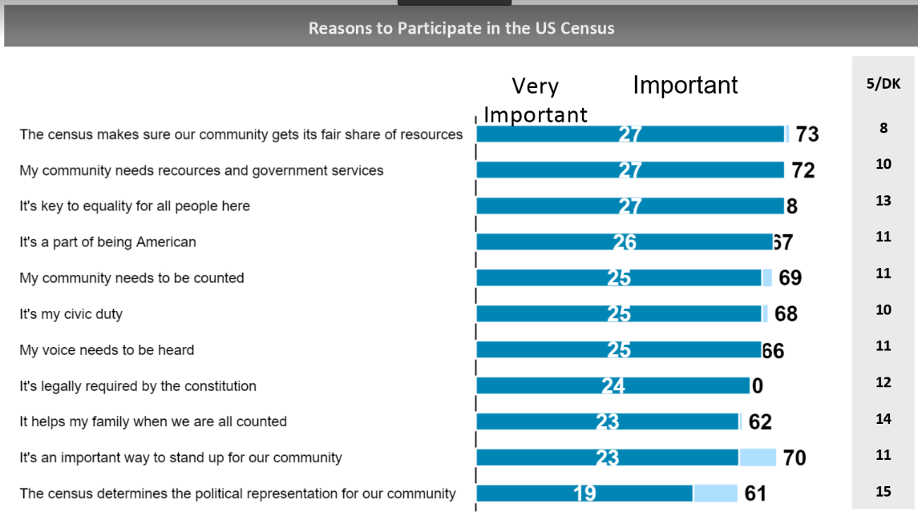
Reasons for Asian Americans to Participate
This information has been researched and presented by
Asian-Americans Advancing Justice

Slide 48
Top Messaging for Asian American Communities
Two of the top three reasons for participating in the census include making sure that our communities get resources.
Census Data is critical to our children’s future and the next generation. It helps us get the health care, transportation, schools, affordable housing, and higher education that our children need to get a good start and be successful (79% found this totally convincing.)
The Census makes sure our community gets its fair share of resources
My community needs resources and government services
It’s key to equality for all people here
This information has been researched and presented by
Asian-Americans Advancing Justice

Slide 49
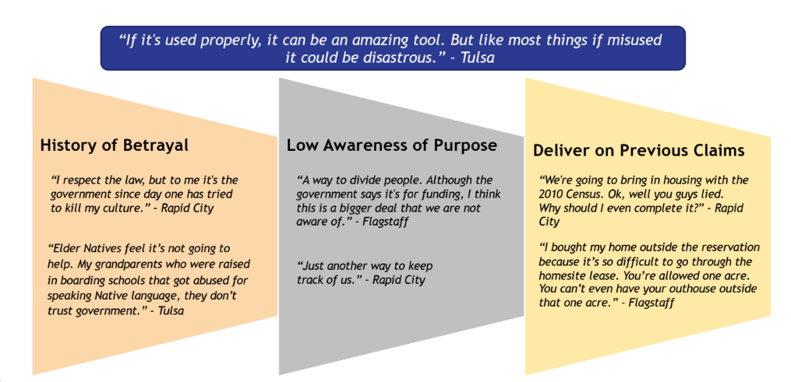
Why Native American Communities Are Undercounted
Suspicion of anything related to the U.S. government is a natural consequence of historically poor treatment of American Indians. Whether or not to participate in the census, and accept related messaging at face value, is not always an easy decision. Most Native people want more details as well as to be able to see a direct benefit to their community before participating.
Among all American Indian and Alaska Native groups, concerns of privacy proved to be the most widely cited barrier for filling out the census form. In multiple cases, participants attributed their lack of previous or potential future participation to privacy concerns—whether it was not feeling comfortable divulging personal information to an unknown enumerator or sending private information through a form.
This information has been researched and presented by
National Congress of American Indians

Slide 50
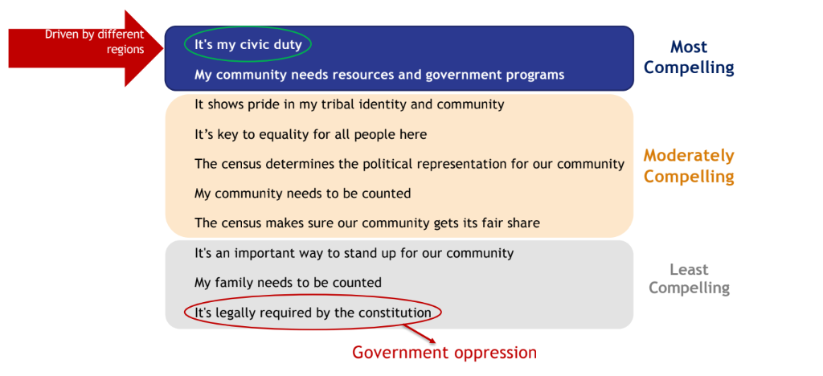
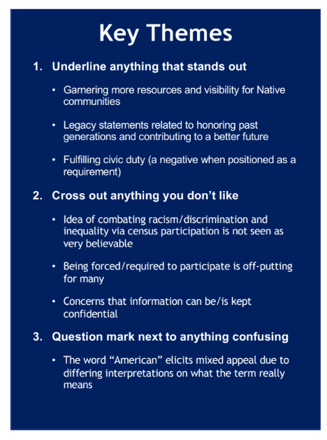
Messaging for Native American Communities
“Census is critical. By participating, we speak for the generations of native people before us and for those yet to come. Census data can help determine our native communities' needs for schools, housing, health care facilities and roads.”
“We want to make sure that the American Indian and Alaska Native community, which is growing every day, is not invisible. Filling out the census will ensure our community is counted, heard, and visible.”
This information has been researched and presented by
National Congress of American Indians

Slide 51
Top Messaging for Native American Communities
Filling out the Census is critical to fund our community programs -- school, housing, health care facility and road funding all rely on having an accurate count.
Completing the Census helps our Native communities be seen.
  Filling out the census will ensure our community is counted, heard, and visible.
The Census is safe, easy and important. All information collected is confidential –
  They are prohibited by law from sharing any personal details. They only report in aggregate.
  Census Bureau employees can be fined $250k and/or jailed for up to 5 years if they share private information. (This is called Title XIII)
  The actual forms filled out are kept private for 72 years, until 2092, long after they can hurt anyone.
Participating in the Census is my Civic duty
This information has been researched and presented by
National Congress of American Indians

Slide 52
COVID 19 aka Coronavirus
We know a lot of people are concerned about the spread of this novel corona virus. The Census has plans to continue the count, even during a pandemic.
This is an opportunity to bring up the Census to customers and encourage them to go online (www.my2020census.gov) or call the phone lines to fill out their Census form early and completely.
This will reduce the number of people who will need Census Bureau employee follow up at their doors.
The best way to handle fears about COVID 19 and the Census is to encourage people to do the form online, over the phones, or if they must wait, on the paper forms when they are sent out in late April.
Self Response is KEY

Slide 53
Common Questions & Answers
Do I participate if I am not a citizen?
  Yes, the US Constitution says that the Census should count every person, whether citizen or not.
    Federal money and creation of districts are both based on total size of population, not just citizens.
    There are a number of safeguards in place to protect the privacy of data shared, including citizenship status.
Notes:
Discuss additional videos/tools/resources “These are some examples”
CONFIDENTIALITY! Title 13 provides the following protections to individuals and businesses:
Private information is never published. It is against the law to disclose or publish any private information that identifies an individual or business such, including names, addresses (including GPS coordinates), Social Security Numbers, and telephone numbers.
The Census Bureau collects information to produce statistics. Personal information cannot be used against respondents by any government agency or court.
Census Bureau employees are sworn to protect confidentiality. People sworn to uphold Title 13 are legally required to maintain the confidentiality of your data. Every person with access to your data is sworn for life to protect your information and understands that the penalties for violating this law are applicable for a lifetime.
Violating the law is a serious federal crime. Anyone who violates this law will face severe penalties, including a federal prison sentence of up to five years, a fine of up to $250,000, or both.

Slide 54
Common Questions & Answers
Do they come to my house?
  If you do not complete the Census form by the end of April, a Census staff member will visit your home to conduct the Census in person. They will not enter your home.
    You will get a letter in the mail, with instructions on how and when to complete the Census in March.
    Completing the Decennial Census before the end of April does not mean a Census employee won’t come to your home for verification or other Census surveys, although it does make it less likely.
Notes:
Discuss additional videos/tools/resources “These are some examples”

Slide 55
Common Concerns and Answers
Is it safe for me to provide my information?
  Yes.
    Yes. Under the law, Census data can only be used for statistical purposes.
    Personal Census information cannot be disclosed for 72 years (including names, addresses, and telephone numbers, and citizenship status).
    Census Bureau staff who have access to personal information are sworn for life to protect confidentiality.
Notes:
The Census is Private and Confidential
Federal Law Protects Your Information. The U.S. Census Bureau is bound by Title 13 of the United States Code. This law not only provides authority for the work of the Census Bureau, but also provides strong protection for the information it collects from individuals and businesses. As a result, the Census Bureau has one of the strongest confidentiality guarantees in the federal government.
It is against the law for any Census Bureau employee to disclose or publish any Census or survey information that identifies an individual or business. This is true even for inter-agency communication: the FBI and other government entities do not have the legal right to access this information. In fact, when these protections have been challenged, Title 13's confidentiality guarantee has been upheld.

Slide 56
Common Concerns and Answers
Can I help someone fill out their Census form?
  Yes.
    As a CAA staff member, you CAN help a customer get online and pull up the proper form. You can sit with a customer and read the form over with them prior to their completing it.
    You CANNOT fill out the form for them. There are privacy concerns that prohibit you from doing so.
    You CAN help them call the Census hotline and fill out the form over the phone, or you can arrange for a Census Bureau staff member to help them in person.
Notes:
Discuss additional videos/tools/resources “These are some examples”

Slide 57
Common Concerns and Answers
What if a customer has accessibility issues?
  The Census has several ways forms can be returned
    The Census Bureau has dedicated staff members to assist people who have language or disability barriers.
    Census forms can be filled out online, on paper, or over the phone.
    Your local Census Partnership Specialist or Complete Count Committee will have more resources to help you guide customers.
Notes:
Discuss additional videos/tools/resources “These are some examples”

Slide 58
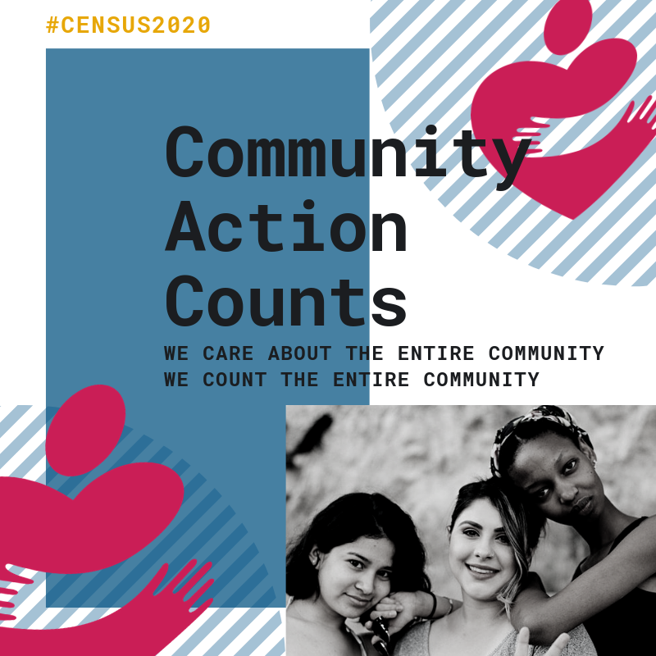
Engage With Social Media
Follow us on Twitter and Instagram: @CAPartnership
Sign-up for our Census newsletter for resources and trainings, and Census news
Join our Facebook group to engage with CAA staff across the network
Notes:
Need content – Jim has this as TBD. Could remove for earliest sessions.

Slide 59
Action Steps
Make sure your agency has nominated someone to the CACCC!
Reach out to Partnership Specialists to Connect with the Census Bureau
Join or Form a local Complete Count Committee
Recruit to fill Census Jobs in your Community – and why
Create a Census Plan of Action
Train your agency to talk about the Census, give them materials to help engage customers. (posters, postcards)

Slide 60

Questions

Slide 61
Resources
Find handouts, flyers, posters, fact sheets and more on our website: www.CommunityActionPartnership.com/Census-2020
Find the latest news, tips and tricks to helping get people counted on our blog: https://CommunityActionPartnership.com/census-blog/
Find our Census Count 2020 Coalition Partners’ toolkits, fact sheets and more: https://CensusCounts.org/Resources/

Slide 62
Community Action Census Team
Partnership Staff
Lindsay Marsh, LMarsh@CommunityActionPartnership.com
Lil Dupree, LDupree@CommunityActionPartnership.com
Lauren Martin, LMartin@CommunityActionPartnership.com
Center for Community Futures Subject Matter Experts
Jim Masters, JMasters@cencomfut.com
Allen Stansbury, Allen@Stansbury.net

