Slide 1

#CountMeIn:
Making the Census Count
for Community Action
Jim Masters
Center for Community Futures
Lindsay Marsh
National Community Action Partnership

Slide 2
Agenda
Welcome and Introductions
What is the Census?
Why does the Census matter to us?
Get out the Count - what is being done?
Get out the Count - what can you do?
Next Steps and Questions
Notes:
This presentation has a number of objectives.
Provide an overview of the Census, what it is, why its important, and what to expect.
Additionally, we will lay out information about all of the current Census Outreach efforts, from the Census Bureau to the Census Campaign, and the Partnership’s efforts.
We will discuss what steps can be taken now at the local level to start engaging your communities around the census
Most importantly we aim to form a dialogue where we can hear your most pressing questions about the Census, and answer when we can, and also hear from you about practices in your community that are already taking place or have taken place in the past to Get out The Count, which we hope to amplify across the network

Slide 3

THE PROMISE OF
COMMUNITY ACTION
Community Action changes people’s lives, embodies the spirit of hope, improves communities, and makes America a better place to live. We care about the entire community and we are dedicated to helping people help themselves and each other.

Slide 4
Welcome!
What do you already know about the Census?
What are you already doing for Census engagement?
What do you worry about?

Slide 5
What is the Census?
Notes:
Census is constitutionally mandated

Slide 6
“Representatives and direct Taxes shall be apportioned among the several States which may be included within this Union, according to their respective numbers, counting the whole number of persons in each State.
The actual enumeration shall be made…within every subsequent term of ten years, in such manner as they shall by law direct”
  US Constitution, Article 1, Section 2*
*Language adjusted to reflect Amendment XIV, Article II to US Constitution, July 9, 1868
Notes:
The census is rooted in the constitutional principle of representative democracy, where population is the basis for shared political power
The census aims to count the entire population of the country where they live, this includes all people regardless of age or citizenship status.
A count of the population every 10 years is mandated by the Constitution, and it is required by law to respond.
Governed by Title 13 of the US Code of Federal Regulations (CFR): Title 13 provides the following protections to individuals and businesses:
Private information is never published. It is against the law to disclose or publish any private information that identifies an individual or business such, including names, addresses (including GPS coordinates), Social Security Numbers, and telephone numbers.
The Census Bureau collects information to produce statistics. Personal information cannot be used against respondents by any government agency or court.
Census Bureau employees are sworn to protect confidentiality. People sworn to uphold Title 13 are legally required to maintain the confidentiality of your data. Every person with access to your data is sworn for life to protect your information and understands that the penalties for violating this law are applicable for a lifetime.
Violating the law is a serious federal crime. Anyone who violates this law will face severe penalties, including a federal prison sentence of up to five years, a fine of up to $250,000, or both.

Slide 7
The 2020 Census Questions
Age – in years, month, day and year of birth for each household member
Hispanic Origin – is this person Hispanic; if yes, which country of origin
Race – mark one or more boxes and print origins
Relationship – How is this person related to Person 1
Sex – gender: male or female
Tenure (owner/renter) – Is this house, apartment, or mobile home
Operational Questions:
  How many people lived here on April 1, 2020?
  Were additional people staying here on April 1?
  Telephone number, name of person filling out the census.
Notes:
This slide is straightforward but when touching on the bullets of Distribution of Funds, Informing Gov. Planning, and Informing Org. Decisions, this is a good opportunity to connect to functions of Community Action.

Slide 8
Census Data is Used To…
Apportion representation among states
Draw congressional and state legislative districts, school districts, and voting precincts
Distribute federal dollars to states
Inform government planning decisions at the federal, tribal, state and local level
Inform organizational decisions (e.g., where to locate, size of market, etc.) of businesses and non-profits
Enforce voting rights and civil rights legislation
Notes:
This slide is straightforward but when touching on the bullets of Distribution of Funds, Informing Gov. Planning, and Informing Org. Decisions, this is a good opportunity to connect to functions of Community Action.

Slide 9
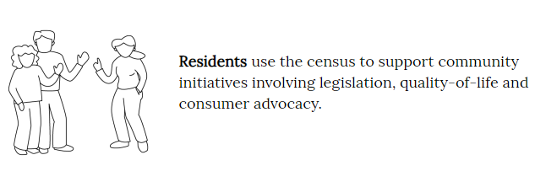
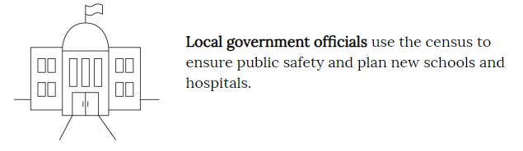
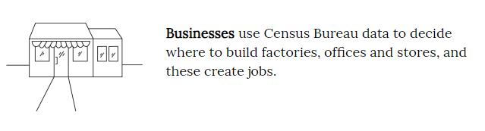
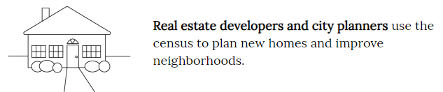
The Census in Your Community
Notes:
This slide is connected to the last slide, but demonstrates how some of the previously stated purposes of the census play out at the community level.

Slide 10
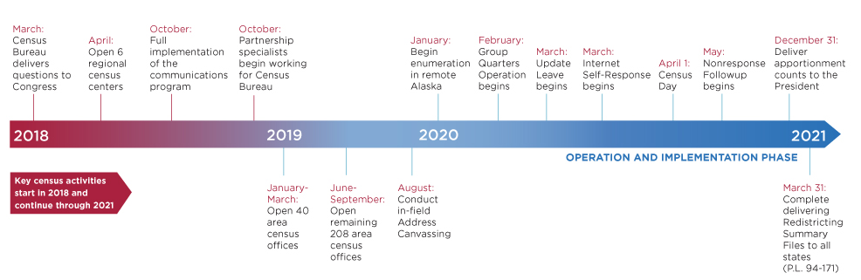
The 2020 Census
Operational Timeline
Notes:
Self-Response phase:
Census Bureau mails information about the decennial questionnaire to almost all households (before April 1, 2020).
For 2020, some households will be mailed the actual questionnaire, most households will be mailed an online link to fill out the form, & everyone will have the opportunity to mail in the form if they choose not to fill it out online.
The most accurate & complete population data is submitted during this phase.
Non-Response Follow Up phase: Begins May of 2020
The Census Bureau hires 100s of thousands of people to go door-to-door to count every household that didn’t self-respond (after April 1, 2020).
Much more expensive than the self-response phase ($2 BILLION in 2010).
During this phase, the risk is greatest that people will be missed and the count will be inaccurate.
Areas with large shares of households that don’t self-respond are therefore “hard to count”. Almost every community will have some households that don’t self-respond. But some communities have as many as half of their households that need to be counted in person. We’ve mapped these communities to help ensure a fair and accurate 2020 Census.

Slide 11
2020 Census
Counting The Population – Key Dates
March 12-20: Invitations sent to respond online
March 16-April 3: Reminder letters and postcards sent
April 1: Census Day
April 8-16: Reminder letters sent with paper questionnaire
April 20-27: Final postcard sent before in person follow up
May 4-July 24: Non-Response follow up visit

Slide 12
2020 Census
Counting The Population - Strategy
95% of households will receive their census invitation by mail
5% of households will receive their census invitation when a census taker drops it off
Less than 1% of households will be counted in person by a census taker, instead of being invited to respond on their own
An estimated 40% of households will require in person follow up
Notes:
All households will receive a letter asking to complete the census online, areas less likely to respond online will also receive a paper questionnaire. 6 attempts for in person follow up: 3 in person, 3 proxy
After 6 attempts, secondary sources will be used

Slide 13
2020 Census Economics
The Census hires 100,000s of people a cycle, and will spend over $15 BILLION* to complete the count
The average cost for counting a household:
  1970 : $16
  2010: $92
  2020: $107
Every person counted is equal to ~$2,000 in funding to your community a year – each year, for ten years!
*-census/https://www.gao.gov/highrisk/2020_decennial_census/why_did_study#t=1, https://www.census.gov/fieldjobs
Notes:
The Census if the biggest non-war governmental field operation. It requires a huge investment in both dollars and man power. It can be a generator of temporary local jobs in your community, and the results have a major impact on funding to your community for a decade.

Slide 14
2020 Census Economics
  Federal Funding varies by state, but on average every person counted is equal to ~$2,000 in funding to your community a year – each year, for ten years!
  Arkansas: $2,563.11
  Louisiana: $2,623.74
  New Mexico: $3,647.19
  Oklahoma: $1,816.59
  Texas: $1,653.86
*-census/https://www.gao.gov/highrisk/2020_decennial_census/why_did_study#t=1, https://www.census.gov/fieldjobs
Notes:
The Census if the biggest non-war governmental field operation. It requires a huge investment in both dollars and man power. It can be a generator of temporary local jobs in your community, and the results have a major impact on funding to your community for a decade.

Slide 15
Why Does the Census Matter to Community Action?
Notes:
Census is constitutionally mandated

Slide 16
Census Impacts Community Action
Census data:
  Determines funding for essential federal programs
  Informs CAA planning, strategy, and operations
  The populations we serve are often the most undercounted, which means our communities lose their fair share of
  dollars and representation
Notes:
The Census is important to Community Action for a number of reasons:
It determines federal funding that impacts all aspects of the work of Community Action Agencies at the agency, family, and community level
The information is crucial to the operations of Community Action.. With the data used to inform our community needs assessments, and other local decisions such as new business and real estate development that impacts the families we serve
If people are not counted it would negatively impact Community Action, yet there are groups that are consistently hard to count
4) These groups are the same people served by community action

Slide 17
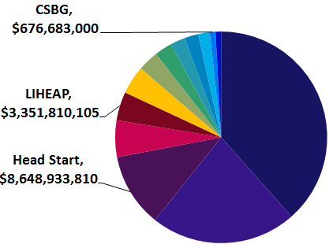
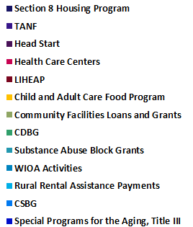
Census Data Drives Dollars
In 2016, 15 federal programs most used by CAAs relied on Census data to distribute $77 billion or 9% of $864 billion total federal program spending
Notes:
This slide is self explanatory, but important to note that the programs depicted here are not alll the programs that are impacted by the Census, just the ones that are most commonly utilized by Community Action. Worth noting out that the Weatherization program is one that is not included in this data

Slide 18
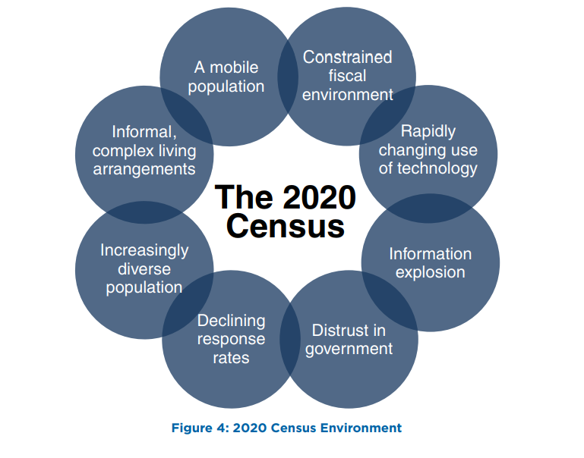
The 2020 Census- The Environment
Notes:
This slide is important. This slide’s purpose is to pivot from talking about how the Census Data is valuable to Community Action, to why making sure everyone is counted should be a concern for Community Action. The slide shows why this year in particular there are various factors that will make it difficult to ensure a complete count. And because we have already demonstrated why the Census is valuable to Community Action, this should be a big concern for Community Action, and is why we need agencies to do what they can to make sure people are counted. Below is an explanation of each circle:
• Constrained fiscal environment: Budget deficits place significant pressure on funding available for the research, testing, design, and development work required for successful innovation.
• Rapidly changing use of technology: Stakeholders expect the decennial census to use technology innovation, yet the rapid pace of change makes it challenging to plan for and adequately test the use of these technologies before they become obsolete.
• Information explosion: Rapid changes in information technology (IT) create stakeholder expectations for how the Census Bureau interacts with the public to collect data and disseminate data products.
• Distrust in government: The public’s concerns about information security and privacy, the confidentiality of information given to the government, and how government programs use the information they collect continue to grow. This impacts response rates and could make it more difficult for government agencies to collect important demographic survey information.
• Declining response rates: Response rates for Census Bureau surveys, and for surveys and censuses in general, have declined as citizens are overloaded with requests for information
and become increasingly concerned about sharing information.
• Increasingly diverse population: The demographic and cultural make-up of the United States continues to increase in complexity, including a growing number of households and individuals of Limited English Proficiency
• Informal, complex living arrangements: Households are becoming more diverse and dynamic, making it a challenge to associate an identified person with a single location. For example, blended families may include children
who have two primary residences.
• A mobile population: The United States continues to be a highly mobile nation as about 14.3 percent of the population moves in a given year

Slide 19
The Hard-To-Count Are:
New or forgotten housing
People trying to remain
hidden
Hard to Locate
Hard to Persuade
Suspicious of government
Not civically engaged
Undocumented
Misinformation
Hard to Contact
Hard to Interview
  Language barriers
  Low literacy
  No internet
  Unreliable mail
  Homeless
  Access barriers
  Transient communities
Notes:
Given this current environment, as well as what history of previous decennial census’ have shown us…we know that there will be certain groups of people that are hard to count. Which means they might not respond to the initial request to fill out the questionnaire and will likely require a non-response follow up. These groups are intersecting but broadly speaking these are the various categories that the hard to count fall into.

Slide 20
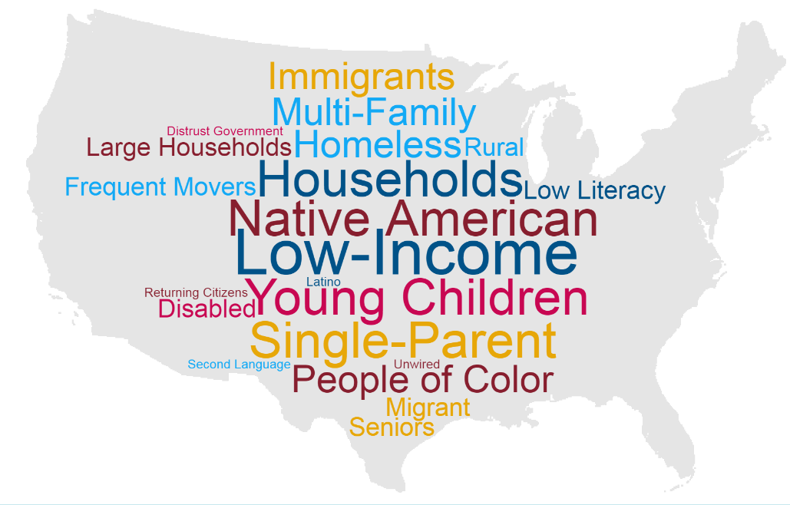
The Hard-To-Count Are:
Notes:
This means the hard to count population includes a variety of categories including:
Young children under the age of five.
Racial and ethnic minorities.
Non-English speakers.
Low income people.
People experiencing homelessness.
Undocumented immigrants.
People who distrust the government.
LGBTQ persons.
People with mental or physical disabilities.
People who do not live in traditional housing.
People who are members of disadvantaged or marginalized communities –with the most to lose – are at greatest risk of being uncounted. These are also the groups that are most likely to be served by Community Action

Slide 21
Get Out The Count –
What Is Being Done?
Notes:
Census is constitutionally mandated

Slide 22
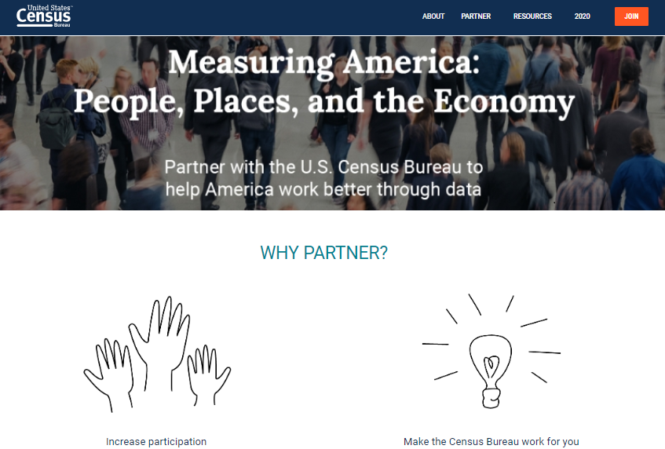
US Census Bureau: Partner Efforts
Notes:
The Census Bureau is investing a large amount of their own resources to ensure thaat everyone is counted. On their website you can join this effort and stay informed about all of the resources they offer by becoming a partner to the US Census.

Slide 23
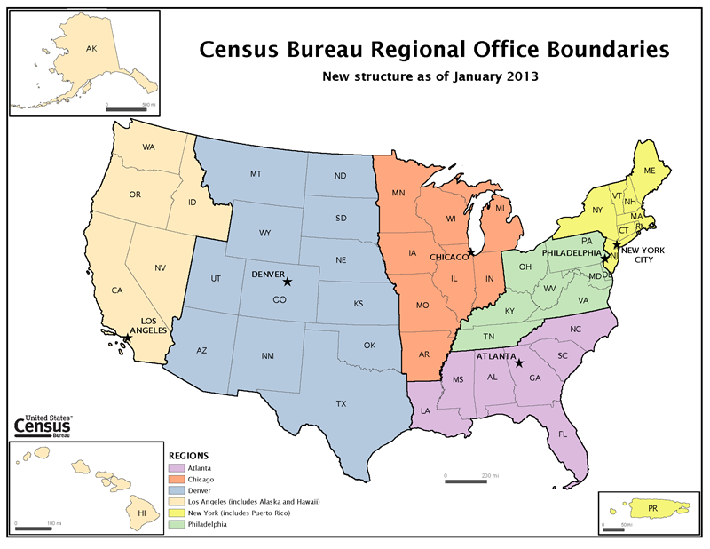
US Census Bureau: Partner Efforts
Your Regional Office
Notes:
The Census Bureau is investing a large amount of their own resources to ensure that everyone is counted. On their website you can join this effort and stay informed about all of the resources they offer by becoming a partner to the US Census.

Slide 24
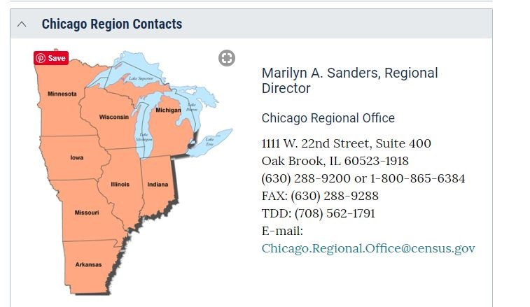
US Census Bureau: Partner Efforts
Your Regional Office
Notes:
The Census Bureau is investing a large amount of their own resources to ensure that everyone is counted. On their website you can join this effort and stay informed about all of the resources they offer by becoming a partner to the US Census.

Slide 25
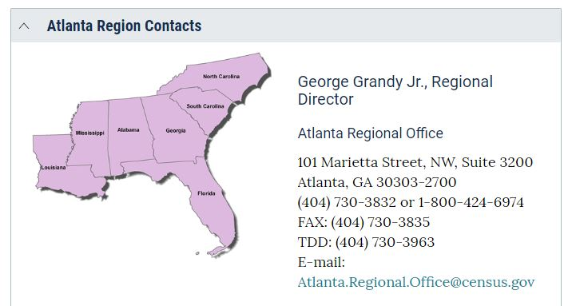
US Census Bureau: Partner Efforts
Your Regional Office
Notes:
The Census Bureau is investing a large amount of their own resources to ensure that everyone is counted. On their website you can join this effort and stay informed about all of the resources they offer by becoming a partner to the US Census.

Slide 26
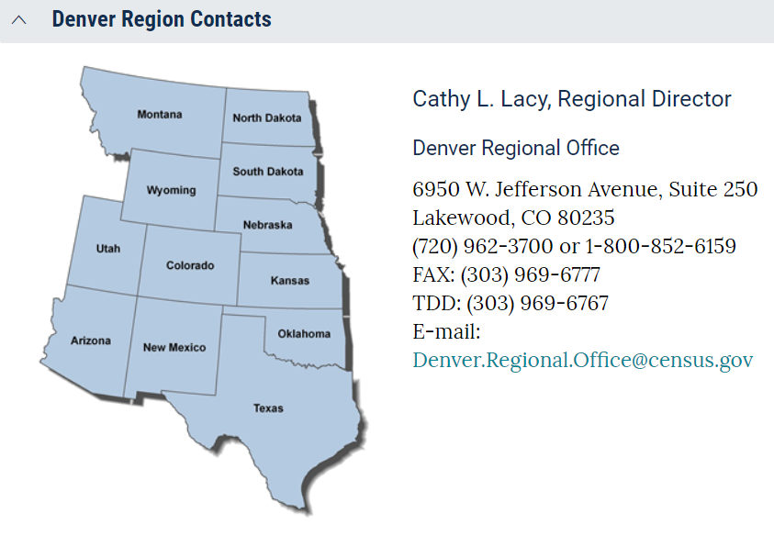
US Census Bureau: Partner Efforts
Your Regional Office
Notes:
The Census Bureau is investing a large amount of their own resources to ensure that everyone is counted. On their website you can join this effort and stay informed about all of the resources they offer by becoming a partner to the US Census.

Slide 27
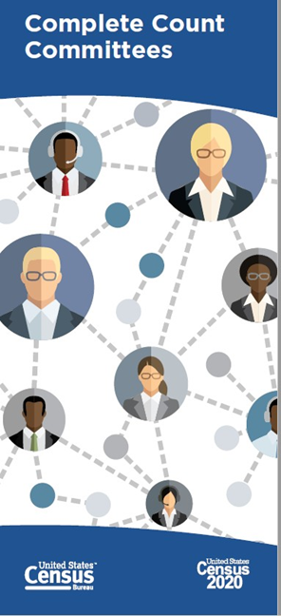
Complete Count Committees (CCCs):
Utilize local knowledge and resources to promote the Census through locally based outreach efforts
Provide a vehicle for coordinating efforts between tribal, state, and local governments; communities; and the Census Bureau
Help the Census Bureau get a complete count through partnerships with local governments and community organizations
Find existing Complete Count Committees on the Census website
Notes:
The Complete Count Committees (CCC) program is one of the main Get Out the Count efforts run by the Census Bureau. It is key to creating awareness in communities all across the country.
CCCs utilize local knowledge, influence, and resources to educate communities and promote the census through locally
based, targeted outreach efforts.
CCCs provide a vehicle for coordinating and nurturing cooperative efforts between tribal, state, and local governments; communities; and the Census Bureau.
CCCs help the Census Bureau get a complete count in 2020 through partnerships with local governments and community organizations.

Slide 28
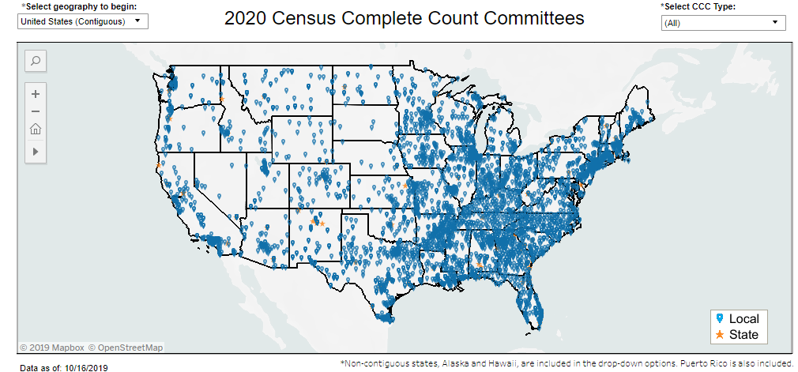
Complete Count Committees (CCCs):
Find existing Complete Count Committees on the census website:
https://2020census.gov/en/partners.html
Notes:
The Complete Count Committees (CCC) program is one of the main Get Out the Count efforts run by the Census Bureau. It is key to creating awareness in communities all across the country.
CCCs utilize local knowledge, influence, and resources to educate communities and promote the census through locally
based, targeted outreach efforts.
CCCs provide a vehicle for coordinating and nurturing cooperative efforts between tribal, state, and local governments; communities; and the Census Bureau.
CCCs help the Census Bureau get a complete count in 2020 through partnerships with local governments and community organizations.

Slide 29
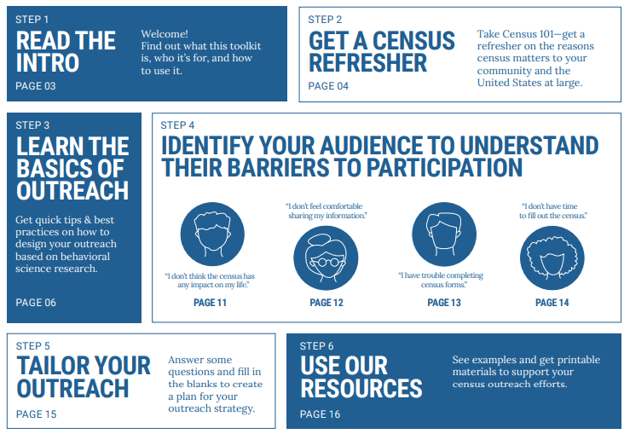
Census Bureau Outreach Toolkit
Notes:
One of the most helpful resources put together by the Census Bureau at this point is their partner outreach toolkit. This toolkit offers a basic overview of the census, discusses some of best practices for outreach, discusses some of the major barriers to participation with outreached tailored to meet those barriers, and then offers some promotional and informational resources to help support local outreach efforts.

Slide 30

















Census Counts 2020
Notes:
The Census Counts Campaign is a national collaborative effort funded by some of the nations largest foundations and funding organizations. These funders have come together to make a very large scale investment to help complement the census bureau’s outreach efforts to gauntness that the 2020 census is fair and accurate. The Census Counts campaign is lead by the Leadership Conference Education Fund alongside a growing number of national hub organizations that represent various hard to count groups (partnership for america’s young children, color of change, naleo) or networks of important stakeholders (state voices, ready nation, faith in public life)

Slide 31
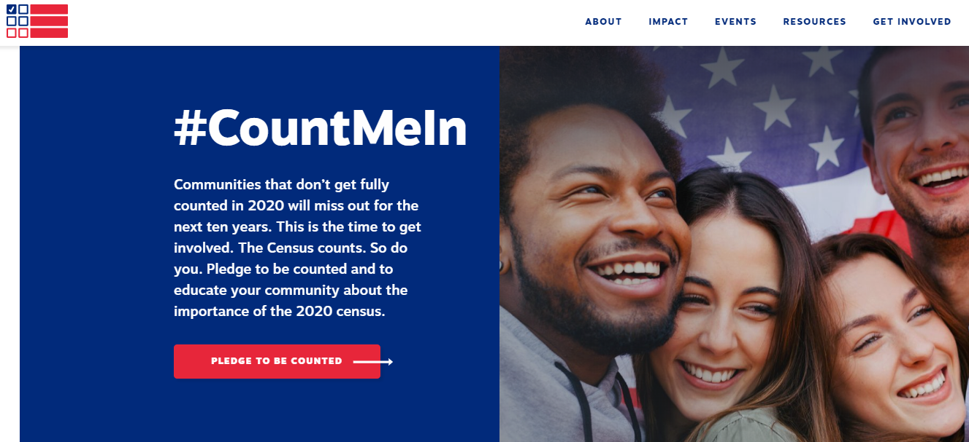

Census Counts 2020
visit www.CensusCounts.org - take the pledge to be counted and educate your community about the Census!
Notes:
April 1st of this year (one year out from Census Day) the Census Counts Campaign held a Census Day of Action. This was the largest effort of the campaign to date. Among the many activities of that day, the campaign officially launched their website: censuscounts.org, where thousands of people across the country had the ability to pledge to be counted and work towards a fair and accurate census. You can still visit and take the pledge and censuscounts.org, this will sign you up for important campaign updates and tie to a community of thousands already working on census outreach efforts. Additionally, the website is valuable resources to learn more about the various national partners involved in the Census Counts campaign as well as a continually updated list of resources to help with your outreach efforts.

Slide 32
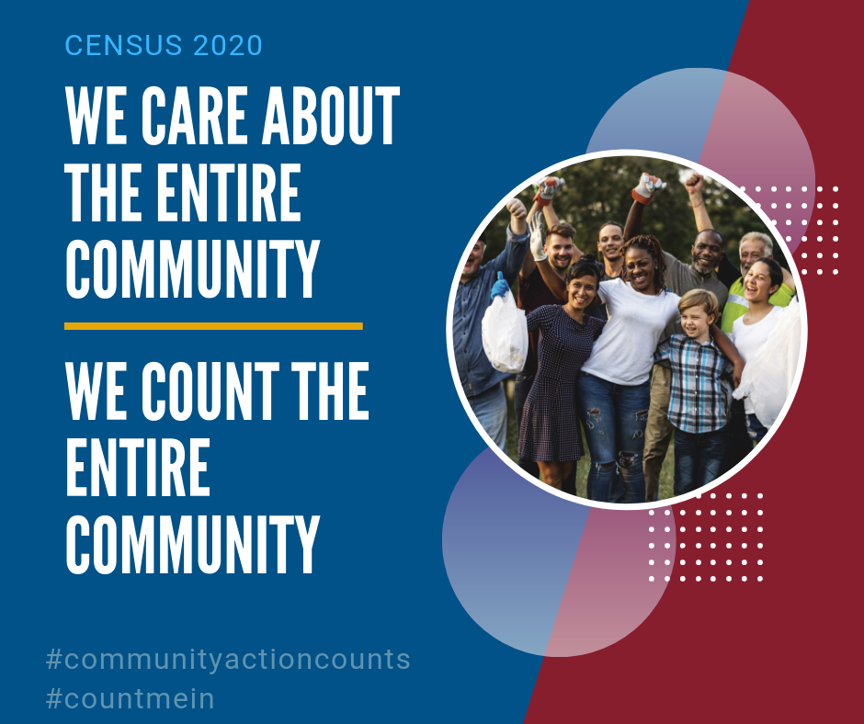
Community Action Counts -
What the Partnership is Doing:
Educate and increase awareness
Mobilize the network to take action
Curate and generate resources specific to Community Action
Equip agencies to conduct effective local outreach efforts
Notes:
Increasing Awareness and Capacity across the Community Action Network
Conducting in-person trainings on Census information, tools and curriculum at state, regional and national conferences
Holding regular national webinars about the value of a complete Census to Community Action, and showcasing tools to help CAA staff support our customers’ Census participation
Using the network of working group members and CAA field expertise to learn and promote Census best practices for Community Action

Slide 33
Community Action Census
Working Group
Includes 9 States with Largest HTC Populations
  Advisory Council, Network Resource
AZ – Cynthia Zwick
CA – Tony McAnelly
FL – Faith Pullen
GA – Lorraine Daniels
MA – Joe Diamond
NY – Jackie Orr
OH – Cheryl Grice
PA – Jen Wintermyer
TX – Laura Ponce
AL – Ron Gilbert
Notes:
Include if in one of these states, possibly delete if not

Slide 34
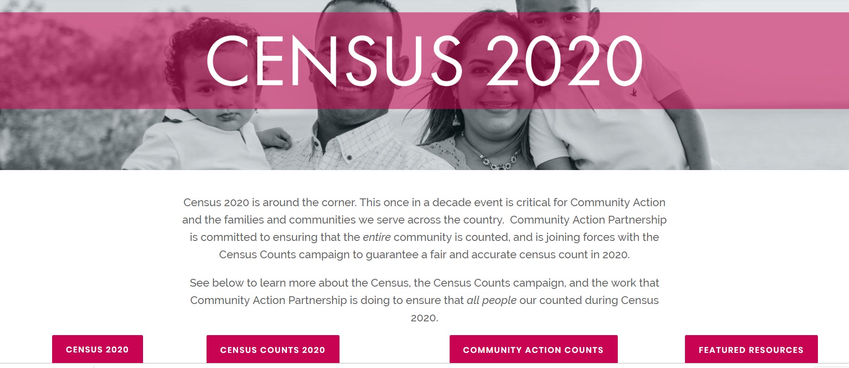
Community Action Counts
www.CommunityActionPartnership.com/Census-2020

Slide 35
Community Action
Complete Count Committee (CACCC)
Each Agency, Association, & State Office Should Nominate 1 Person To Be The Point Person For Their Office, And:
  Participate In Trainings And Webinars
  Help Organize Census Activities For Their Agency
  Be A Contact For Nationwide Partner Agencies
  Attend Census Academy And Be Certified On The Census
We Are Aiming For 100% Network Participation!
If we care about the entire Community, then we have to help count the entire Community!
Notes:
Rework language

Slide 36


Census Academy
On-demand courses, videos & resources
Peer Engagement & Virtual Networking
Virtual space for Learning Community Groups
Free & Accessible for the Network!
2 Census tracks
Approx. 2 hours per course
Get Census Certified!
Moodle is an online learning platform that provided trainers and learners with a single robust, secure, and integrated system to create personalized learning environments. https://moodle.communityactionpartnership.com

Slide 37
Get Out The Count
What Can You Do?
Notes:
Census is constitutionally mandated

Slide 38
Community Action Counts
Local Level Census Engagement
Learn about the Census in your Community
Network, Partner, Connect, Build
Social Media and Communications Campaign
Census Outreach at Agency Level
Notes:
Learn about your community
- Who is Hard to Count
- Connect Census to Important Local Issues: CNA
- Network, Partner, Connect, Build in The Community
-Tap into exisiting Census/GOTC Infrastructure: join or form Complete Count Committee, become Census Partner,Connect with local affiliates of groups involved with Census Counts, Recruit to fill Census Jobs
- Census Outreach at Agency Level:
-Equip Staff with knowledge (train the-trainer)to message about Census. Messaging is Key, overall most effective messages play up importance of the value of census to community, and trusted messangers. Front-line staff is a great vehicle for both.
- Information in Ageny: posters, resources,
- Computer Hubs for completion,
- Social Media and Communications Campaign

Slide 39
Community Action Counts
Local Level Census Engagement
Learn about the Census in your community
  Who makes up the hard to count in your community?
  What are the major concerns?
  Connect Census to important local issues
  Where is your regional Census office?
Notes:
Learn about your community
- Who is Hard to Count
- Connect Census to Important Local Issues:CNA
- Network, Partner, Connect, Build in The Community
-Tap into exisiting Census/GOTC Infrastructure: join or form Complete Count Committee, become Census Partner,Connect with local affiliates of groups involved with Census Counts, Recruit to fill Census Jobs
- Census Outreach at Agency Level:
-Equip Staff with knowledge (train the-trainer)to message about Census. Messaging is Key, overall most effective messages play up importance of the value of census to community, and trusted messangers. Front-line staff is a great vehicle for both.
- Information in Ageny: posters, resources,
- Computer Hubs for completion,
- Social Media and Communications Campaign

Slide 40
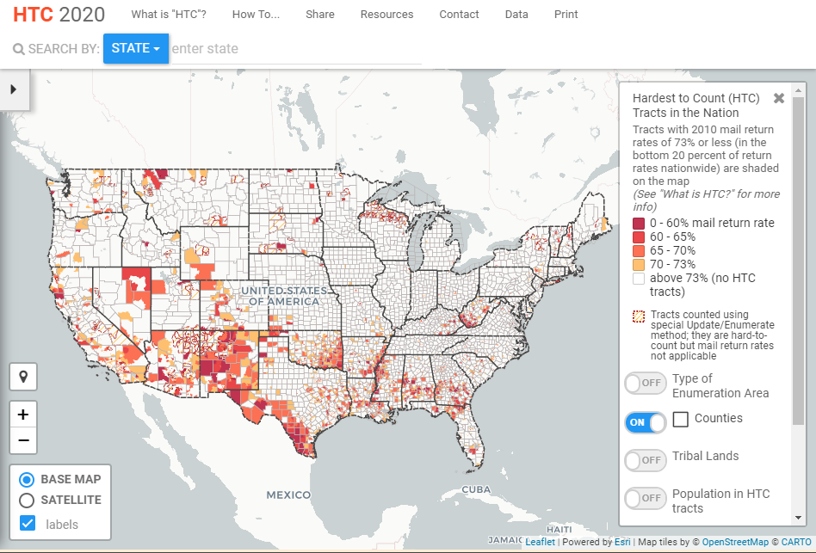
Finding The Hard To Count
www.CensusHardToCountMaps2020.us

Slide 41
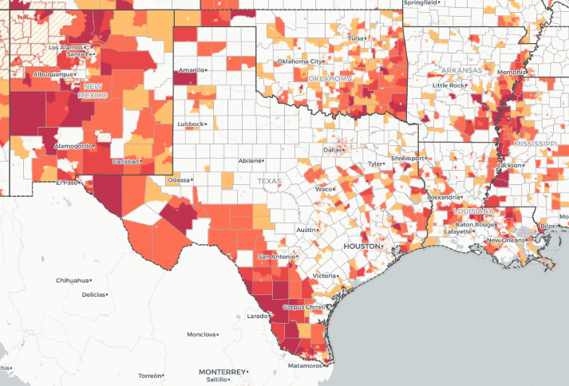
Finding The Hard To Count
www.CensusHardToCountMaps2020.us

Slide 42
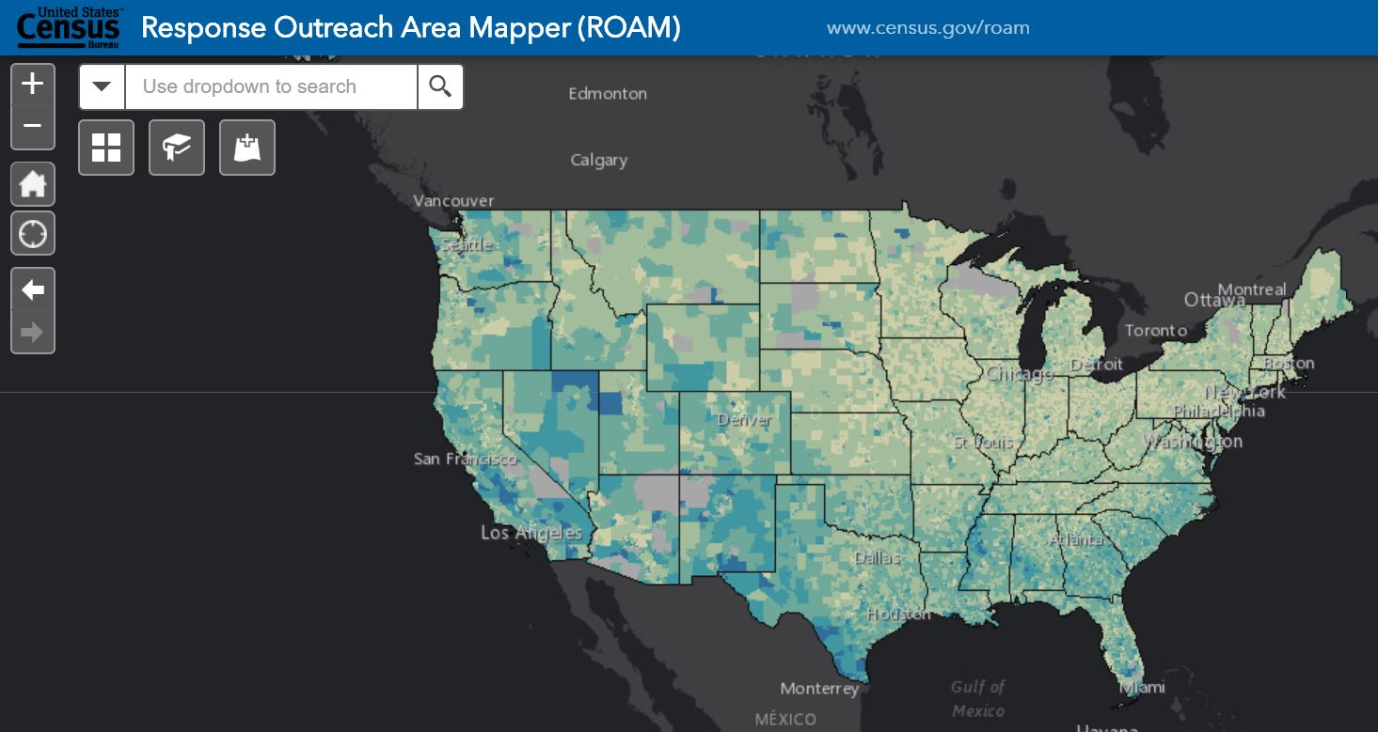
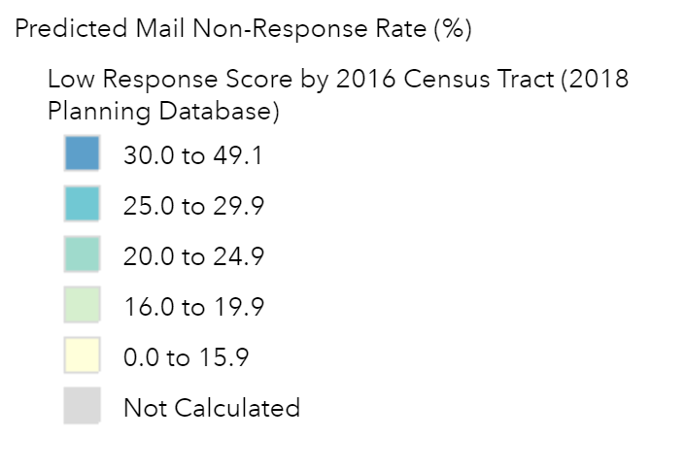
www.Census.gov/ROAM

Slide 43
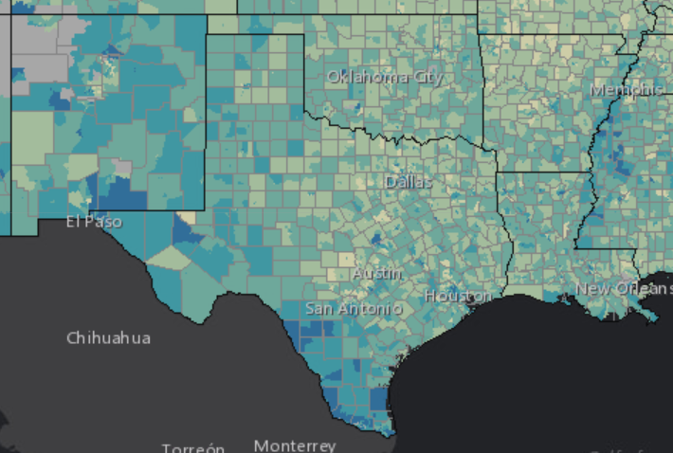
www.Census.gov/ROAM

Slide 44
Local Level Census Engagement
Network, Partner, Connect, Build in The Community
  Join or form Complete Count Committee
  Become a Census Partner
  Connect with local affiliates of groups involved with Census Counts
  Recruit to fill Census Jobs
Notes:
Learn about your community
- Who is Hard to Count
- Connect Census to Imporant Local Issues:CNA
- Network, Partner, Connect, Build in The Community
-Tap into exisiting Census/GOTC Infrastructure: join or form Complete Count Committee, become Census Partner,Connect with local affiliates of groups involved with Census Counts, Recruit to fill Census Jobs
- Census Outreach at Agency Level:
-Equip Staff with knowledge (train the-trainer)to message about Census. Messaging is Key, overall most effective messages play up importance of the value of census to community, and trusted messangers. Front-line staff is a great vehicle for both.
- Information in Ageny: posters, resources,
- Computer Hubs for completion,
- Social Media and Communications Campaign

Slide 45
Local Level Census Engagement
Census Outreach at Agency Level
  Train staff with knowledge about Census
    Messaging for HTC Populations
    Legalities and FAQs
  Information in Agency: posters, resources
  Technical Assistance
  Social Media and Communications Campaign
Notes:
Learn about your community
- Who is Hard to Count
- Connect Census to Important Local Issues: CNA
- Network, Partner, Connect, Build in The Community
-Tap into exisiting Census/GOTC Infrastructure: join or form Complete Count Committee, become Census Partner,Connect with local affiliates of groups involved with Census Counts, Recruit to fill Census Jobs
- Census Outreach at Agency Level:
-Equip Staff with knowledge (train the-trainer)to message about Census. Messaging is Key, overall most effective messages play up importance of the value of census to community, and trusted messangers. Front-line staff is a great vehicle for both.
- Information in Ageny: posters, resources,
- Computer Hubs for completion,
- Social Media and Communications Campaign

Slide 46
Train Your Staff –
Talking to the Hard To Count
The Right Messaging is Key
Incorporate Census into existing contact with customers
  7 touches
Empower staff – As service providers, we are trusted messengers

Slide 47
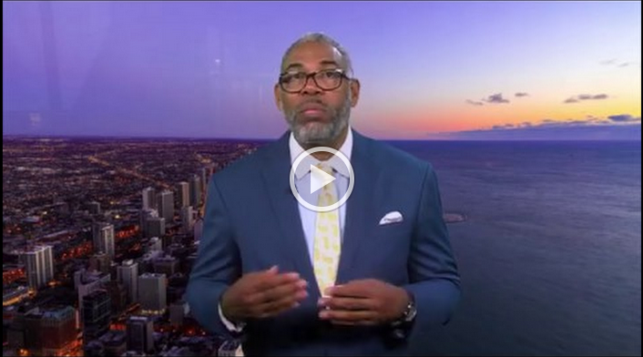
Training Tools: Introductory Video
We have a ~7 min video highlighting how to talk to our customers about Census concerns. Watch it on our website and share it with your agency!
Notes:
Insert video still and link when ready

Slide 48
Common Questions & Answers
Why is the Census important?
Notes:
Discuss additional videos/tools/resources “These are some examples”

Slide 49
Common Questions & Answers
Why is the Census important?
  The Census helps the community get its fair share of federal and state resources, especially for children.
    Specific programs such as LIHEAP, Head Start, WIC, etc.
    For every person not counted, it is estimated our communities could lose an average of $2,000 per person of funding for each of the next ten years.
Notes:
Discuss additional videos/tools/resources “These are some examples”

Slide 50
Common Questions & Answers
Do I participate if I am not a citizen?
Notes:
Discuss additional videos/tools/resources “These are some examples”
CONFIDENTIALITY! Title 13 provides the following protections to individuals and businesses:
Private information is never published. It is against the law to disclose or publish any private information that identifies an individual or business such, including names, addresses (including GPS coordinates), Social Security Numbers, and telephone numbers.
The Census Bureau collects information to produce statistics. Personal information cannot be used against respondents by any government agency or court.
Census Bureau employees are sworn to protect confidentiality. People sworn to uphold Title 13 are legally required to maintain the confidentiality of your data. Every person with access to your data is sworn for life to protect your information and understands that the penalties for violating this law are applicable for a lifetime.
Violating the law is a serious federal crime. Anyone who violates this law will face severe penalties, including a federal prison sentence of up to five years, a fine of up to $250,000, or both.

Slide 51
Common Questions & Answers
Do I participate if I am not a citizen?
  Yes, the US Constitution says that the Census should count every person, whether citizen or not.
    Federal money and creation of districts are both based on total size of population, not just citizens.
    There a number of safeguards in place to protect the privacy of data shared, including citizenship status.
Notes:
Discuss additional videos/tools/resources “These are some examples”
CONFIDENTIALITY! Title 13 provides the following protections to individuals and businesses:
Private information is never published. It is against the law to disclose or publish any private information that identifies an individual or business such, including names, addresses (including GPS coordinates), Social Security Numbers, and telephone numbers.
The Census Bureau collects information to produce statistics. Personal information cannot be used against respondents by any government agency or court.
Census Bureau employees are sworn to protect confidentiality. People sworn to uphold Title 13 are legally required to maintain the confidentiality of your data. Every person with access to your data is sworn for life to protect your information and understands that the penalties for violating this law are applicable for a lifetime.
Violating the law is a serious federal crime. Anyone who violates this law will face severe penalties, including a federal prison sentence of up to five years, a fine of up to $250,000, or both.

Slide 52
Common Questions & Answers
Do they come to my house?
Notes:
Discuss additional videos/tools/resources “These are some examples”

Slide 53
Common Questions & Answers
Do they come to my house?
  If you do not complete the Census form by the end of April, a Census staff member will visit your home to conduct the Census in person. They will not enter your home.
    You will get a letter in the mail, with instructions on how and when to complete the Census in March.
    Completing the Decennial Census before the end of April does not mean a Census employee won’t come to your home for verification or other Census surveys, although it does make it less likely.
Notes:
Discuss additional videos/tools/resources “These are some examples”

Slide 54
Common Concerns and Answers
Is it safe for me to provide my information?
Notes:
The Census is Private and Confidential
Federal Law Protects Your Information. The U.S. Census Bureau is bound by Title 13 of the United States Code. This law not only provides authority for the work of the Census Bureau, but also provides strong protection for the information it collects from individuals and businesses. As a result, the Census Bureau has one of the strongest confidentiality guarantees in the federal government.
It is against the law for any Census Bureau employee to disclose or publish any Census or survey information that identifies an individual or business. This is true even for inter-agency communication: the FBI and other government entities do not have the legal right to access this information. In fact, when these protections have been challenged, Title 13's confidentiality guarantee has been upheld.

Slide 55
Common Concerns and Answers
Is it safe for me to provide my information?
  Yes.
    Yes. Under the law, Census data can only be used for statistical purposes.
    Personal Census information cannot be disclosed for 72 years (including names, addresses, and telephone numbers, and citizenship status).
    Census Bureau staff who have access to personal information are sworn for life to protect confidentiality.
Notes:
The Census is Private and Confidential
Federal Law Protects Your Information. The U.S. Census Bureau is bound by Title 13 of the United States Code. This law not only provides authority for the work of the Census Bureau, but also provides strong protection for the information it collects from individuals and businesses. As a result, the Census Bureau has one of the strongest confidentiality guarantees in the federal government.
It is against the law for any Census Bureau employee to disclose or publish any Census or survey information that identifies an individual or business. This is true even for inter-agency communication: the FBI and other government entities do not have the legal right to access this information. In fact, when these protections have been challenged, Title 13's confidentiality guarantee has been upheld.

Slide 56
Common Concerns and Answers
Can I help someone fill out their Census form?
Notes:
Discuss additional videos/tools/resources “These are some examples”

Slide 57
Common Concerns and Answers
Can I help someone fill out their Census form?
  Yes.
    As a CAA staff member, you CAN help a customer get online and pull up the proper form.
    You can sit with a customer and read the form over with them prior to their completing it.
    You CANNOT fill out the form for them. There are privacy concerns that prohibit you from doing so.
      A family member can help them fill out the form online or on paper.
      You can help them call the Census hotline and fill out the form over the phone, or you can arrange for a Census Bureau staff member to help them in person.
Notes:
Discuss additional videos/tools/resources “These are some examples”

Slide 58
Common Concerns and Answers
What if a customer has accessibility issues?
Notes:
Discuss additional videos/tools/resources “These are some examples”

Slide 59
Common Concerns and Answers
What if a customer has accessibility issues?
  The Census has several ways forms can be returned
    The Census Bureau has dedicated staff members to assist people who have language or disability barriers.
    Census forms can be filled out online, on paper, or over the phone.
    Your Complete Count Committee will have more resources to help you guide customers.
Notes:
Discuss additional videos/tools/resources “These are some examples”

Slide 60

Engage With Social Media
Follow us on Twitter and Instagram: @CAPartnership
Sign-up for our Census newsletter for resources, trainings, and Census news
Join our Facebook group to engage with CAA staff across the network
Notes:
Need content – Jim has this as TBD. Could remove for earliest sessions.

Slide 61
Action Steps
Nominate your agency’s CACCC member!
Partner with the Census Bureau, contact local office
Join or Form a local Complete Count Committee
Recruit to fill Census Jobs in your Community
Find out who is Hard-To-Count in your Community
Train your agency to talk about the Census

Slide 62

Questions

Slide 63

Mini Workshop

Slide 64

SCENARIOS
What are some specific scenarios that describe barriers that your community is facing? Brainstorm on large Post-Its, then cluster the Post-Its into these categories:
Trouble with forms – Issues with language, literacy, or comprehension; disabilities; age.
Lack of Knowledge – Thinking the Census isn’t for them (or their kids); not knowing why it matters to them and their community.
Mistrust/Dislike of Government – Fear of getting in trouble (self or others); anti-government/anti-civic engagement sentiments.
Privacy - Concerns about data privacy or having their information used by the govt. Feeling the govt doesn’t need to know their info.
Access issues – Remote/Rural areas, no mail or internet.

Slide 65
Generate Solutions
Individually, brainstorm ideas to break down barriers – be creative!
You can be broad or narrow your focus to one specific person/group in your community.
Write down or draw your ideas on paper.
Notes:
This slide is straightforward but when touching on the bullets of Distribution of Funds, Informing Gov. Planning, and Informing Org. Decisions, this is a good opportunity to connect to functions of Community Action.

Slide 66

Wrap Up Discussion
Thoughts, Ideas and Actions!
Share your barriers and ideas with the group.
How can the Partnership make this easier to do?
What should we share from today with other CAAs?

Slide 67
Community Action Census Team
Partnership Staff
Lindsay Marsh, Project Director LMarsh@CommunityActionPartnership.com
Lil Dupree, Senior Associate – Research LDupree@CommunityActionPartnership.com
Center for Community Futures Subject Matter Experts
Jim Masters, JMasters@cencomfut.com
Allen Stansbury, Allen@Stansbury.net

Slide 68


Partnership Census Team
Jim Masters, Census Expert
JMasters@cencomfut.com
Lindsay Marsh, Project Director
Lmarsh@CommunityActionPartnership.com

