Slide 1

Implementing ROMA at the Local CAA Workshop
Using the Performance Management Framework

Slide 2
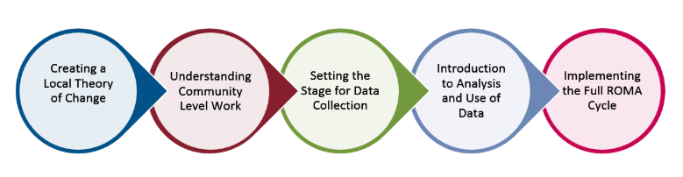
ROMA Modules
The ROMA Next Generation Training Series

Slide 3
Learning Objectives
Understand basic principles of a results orientation and performance management
Clarify how ROMA fits into the Performance Management Framework
Acknowledge that we start with assessment
Understand your Organizational Culture
Identify current ROMA implementation
Identify elements of an Impact Pathway Plan
Prepare to create a Local Theory of Change
Create action steps in your pathway toward impact
Prepare for monitoring progress and identifying success
Notes:
this is part of the work we are doing together to find ways for the network to move up to the new OCS Performance management Framework
the issue is that so many new ideas are being implemented at the same time that we have to make the most effective use of time and resources.
so this is about how to help move the agency’s thinking and culture and activities towards a Results (or Performance) Orientation so that all the pieces work together.

Slide 4
SETTING THE CONTEXT
Part I

Slide 5
CSBG Performance Management Framework
Involves an inclusive, multi-pronged approach to the purposes of the CSBG act
Provides accountability at 3 levels (local, state, federal) of the CSBG network
Ensures efficiency and effectiveness
Demonstrates stronger results for individuals, families and communities with low-income nationwide
Notes:
The CSBG PMF incorporates extensive input from the CSBG Network

Slide 6
CSBG Performance Management Framework (PMF): Implementation
Local Organizational Standards
State and Federal Accountability Measures
Results Oriented Management and Accountability (ROMA)
CSBG State Plan
CSBG Annual Report
ACSI Survey

Slide 7
What is ROMA?
Results Oriented Management and Accountability
Results Oriented – basic assumption that your agency services and strategies are provided to produce results (change).
Management– the system for producing and monitoring services and strategies
Accountability – the process for knowing, documenting and sharing the impact of your efforts
Notes:
You might think this is a simple question.
But many people have not clearly thought about what is behind the “four letter word” that is ROMA.
We are talking both about fundamental assumptions and about systems that support the assumptions.
ROMA has been a part of the CSBG network since the early 1990s and was included in the last reauthorization of the CSBG act in 1998.

Slide 8
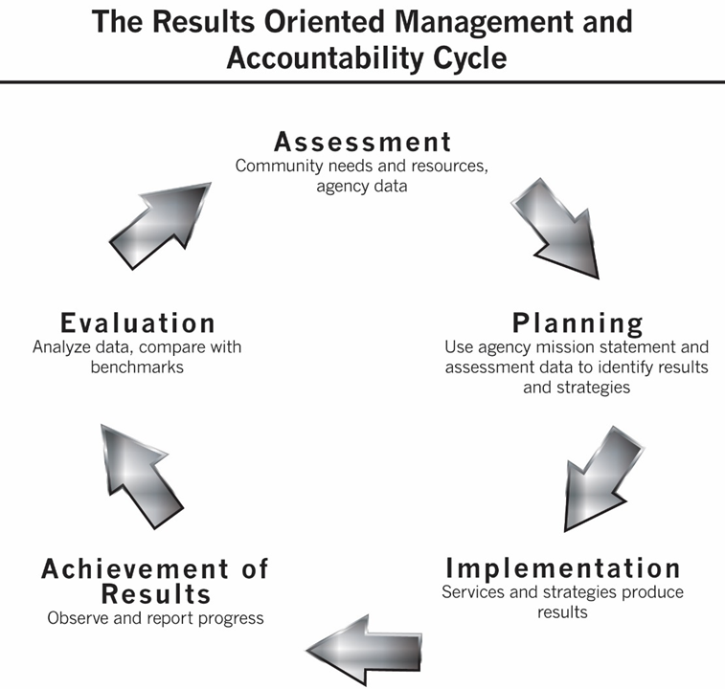
Elements of ROMA
Notes:
We are familiar with the ROMA Cycle which shows elements of the systems and process for management and accountability, but we need to step back to consider the “results orientation” part of the term more completely.
This graphic is based on IM 49 (2001)

Slide 9
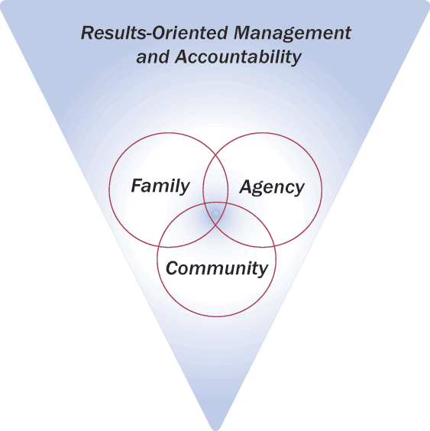
Organizational Standard 4.3
The organization’s Community Action plan and strategic plan document the continuous use of the full Results Oriented Management and Accountability (ROMA) cycle or comparable system (assessment, planning, implementation, achievement of results, and evaluation).

Slide 10
Organizational Standards
ROMA Cycle
Consumer Input and Involvement
Community Engagement
Board Governance
Human Resource Management
Financial Operations and Oversight
Community Assessment
Strategic Planning
Reporting
Data and Analysis
Organizational Leadership
Implementation
of Services and Strategies
Notes:
This shows the most obvious of the overlap between Org Standards and ROMA, but there are lots of ROMA principles and practices embedded in the elements on the left side that impact the agency’s ability to deliver high quality services and strategies (on the right side)

Slide 11
ROMA Next Generation Enhancements to ROMA
National Theory of Change (TOC)
Local Theories of Change
CSBG Annual Report
Increased focus on community level work
Increased focus on analysis and use of data
Emphasis on the integration of all phases of the ROMA cycle

Slide 12
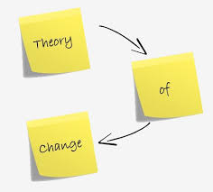
What is a Theory of Change?
A Theory of Change (TOC) is a conceptual road map for how an organization expects to achieve its intended impact.
While similar to a logic model (which has detailed information about needs, activities, inputs, outputs, outcomes, and indicators), a Theory of Change demonstrates the “big picture” about how all of these components work together.

Slide 13
A Theory of Change Is Like a Logic Model
It includes the core principles of the network, identification of strategies and services, and how the network will convert their organizational and financial resources into the desired results.
Often a graphic presentation of a mission statement
Notes:
How is it similar to a Logic Model?
The TOC is like the ROMA logic model in that it is a way of presenting a series of interrelated concepts so that they can be understood as a “big picture.”
Specifically, it focuses on making the connections among identified need, the agency response and the changes that are projected and actually accomplished. It ties all these to the agency's mission.
How is it different than a Logic Model?
It’s broader than a Logic Model. It adds a focus on the articulation of assumptions, and the processing of what has been learned.
It prompts analysis of the actual results identified at the end of a service period and provides the framework for data reflection related to review of how the services were provided and how the outcome data was collected . The Logic Model does not specifically identify "how" this type of reflection should be framed.
There’s a consideration of external factors and the preconditions related to the achievement of results. This context helps the agency identify what is in their control and what is not.

Slide 14

Why We Need It
*Make a complicated system easier to understand.
*Unify the network.
*Articulate core principles.
*Identify national goals.
Notes:
Q: How did the Community Action Theory of Change come about? A: In 2011, Community Action leaders began to gather feedback, through surveys, listening sessions and webinars, on the core principles of the Community Services Block Grant Program (CSBG). The network stated that it was critical for this theory of change to reflect elements of the current CSBG Act, incorporate CAA history, vision and values; as well as include fresh and innovative thinking about the future of our work. The resulting document articulates core principles for the Network, identifies CAA Network national goals, demonstrates the CAA Network’s unique approach to addressing poverty, and makes a complicated system easier to understand.
The National Community Action Theory of Change was developed from input collected from the field between 2013 and 2016. It evolved over that time as elements of the PM Framework were constructed and finalized. An early draft of the TOC graphic was included with the Annual Report submission for OMB approval, and the graphic you see here is the one that was finally approved by OCS and released August 18, 2017.
The introduction of the National TOC creates a snapshot of the complicated mission and vision that plays out through local CAAs, state associations, state offices, national partners and the federal office (OCS)
A theory of change is a brief expression of the assumptions that underpin the network’s actions, identification of the areas in which the network will provide strategies and services, and the expectation of excellence of the network that will convert organizational and financial resources into the desired results.
It provides a conceptual road map for how an organization expects to achieve its intended impact.
This is very similar to a logic model (which has detailed information about needs, activities, inputs, outputs, outcomes, indicators) but has the additional dimension of saying what the network believes and why it believes what it does will make a difference.
this TOC demonstrates commitment to accountability via Performance Management
Goal: Making a complicated system easier to understand.

Slide 15
The National Community Action Network Theory Of Change:
* Describes
* Portrays
* Identifies
* Demonstrates
* Connects
Notes:
*Describes the elements of a common framework Community Action Agencies (CAAs) use to produce change.
*Portrays the broad picture of Community Action: long term goals, core principles, and system capacity.
*Identifies the assumptions and core principles that guide the design of services and strategies to reach the long-term goals it hopes to achieve.
*Demonstrates commitment to accountability for the entire network through the Performance Management Framework and specifically to agency excellence through the Organizational Standards.
*Connects the foundation of a high performing national network to the services and strategies implemented by local CAAs in order to achieve the national Community Action goals.

Slide 16
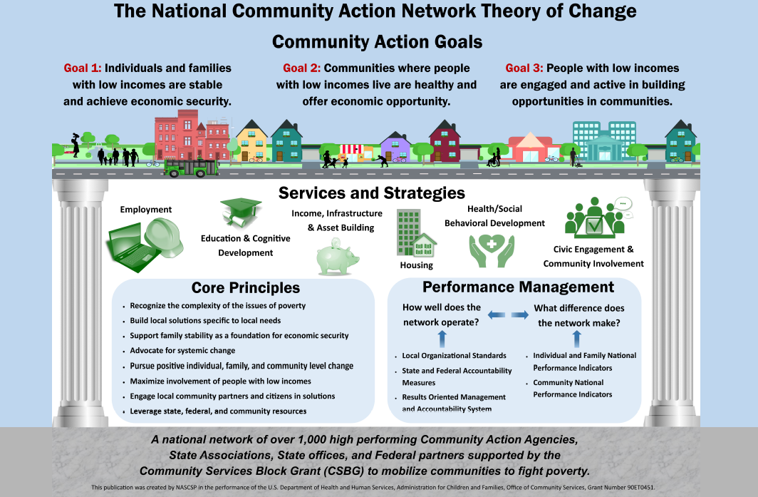
Notes:
The national TOC is the articulation of the underlying beliefs and assumptions that guide a service delivery strategy.
It identifies the “why” and the “how” of the activities undertaken and it identifies the “what” of change and improvement produced.
Incorporates CAA history, vision and values.
Articulates core principles for CAA Network.
Identifies CAA Network national goals.
TOC provides general guidance for the CSBG Network regarding the goals for individuals, families and communities – and sets out some expectations about “high performing agencies” and performance management (org standards, ROMA)

Slide 17
Community Action and CSBG
PERFORMANCE MANAGEMENT
How well does the
Network operate?
Local Organizational standards
State and Federal Accountability Measures
Results Oriented Management and Accountability System
What difference does the Network make?
Individual and Family National Performance Indicators
Community National Performance Indicators

Slide 18
Applying the National TOC to Your Agency
Not all local CAAs are the same
Each CAA will use the Performance Management Framework in ways that match their identification of local community needs and resources
At the local level you will want to demonstrate
How well does the AGENCY operate?
What difference does the AGENCY make?

Slide 19
Consider – What Results?
What stands in the way of a “results orientation?”
A historical focus on what we do, not what we accomplish
Confusion between services and results.
If we give out food boxes and people receive food boxes, the receipt of the service is sometimes considered to be an outcome.
It is not an outcome. It is receipt of a service.
Lack of follow up
lack of resources for follow up, lack of measurement plans
Notes:
Because it is important to know how much service we are able to provide with the CSBG funds and the additional funds they leverage, CAAs have always been asked to identify the number of people they serve and to quantify the services they provide.
More recently the focus has shifted to also knowing what has happened because of our activities.
Note: more recent is 20 years. We have had 2 decades to make the shift in perspective, so why hasn’t it happened universally across the country?
Next bullet is one reason.
The “food distribution” issue is a common one raised by agencies across the country.
The “results orientation” question is: What has changed for people who received the food? Do we know?
This brings us to the last bullet on this slide: follow up
Without follow up, the only thing you know for sure is that the service was delivered.
What are the problems with doing follow up?
One that we hear all the time is that there is not enough funding to support follow up
See what people in the audience thing about this idea.
Another is that a plan for follow up (for “measurement”) is not included in the other planning activities.
refer back to the flip chart with the list of outcomes you generated in the last activity and ask what kinds of measurement tools and processes people have in place to know if the outcome occurred or not, or if there has been progress towards the outcome.
make notes about the measurement tools.
In this part of the discussion, you might find that some of the things you previously wrote as outcomes are really outputs.
Discuss the differences at this time and circle the items that really are outcomes.

Slide 20
Two Different Approaches
Self
Sufficiency
Improved Quality
Of Life
More Basic Services
Improved Living Conditions
Asset Accumulation
OR
Jobs
Education
& Training
Health Care
Prevention/
Treatment
Basic Services
Advocacy
Basic Services
Notes:
Community Action Partnership of Kern County CA
They start with this question: HAVE WE ENDED POVERTY YET? WHY NOT?
They found that they were delivering basic services which were not moving people or changing their lives,
They moved to a theory of change based on building a “house” of different services and approaches that will lead to the outcomes at the top.
IF YOUR AGENCY IS ADOPTING A “RESULTS” ORIENTATION, YOU MUST CONSIDER THE AGENCY’S APPROACH TO GETTING THERE.

Slide 21
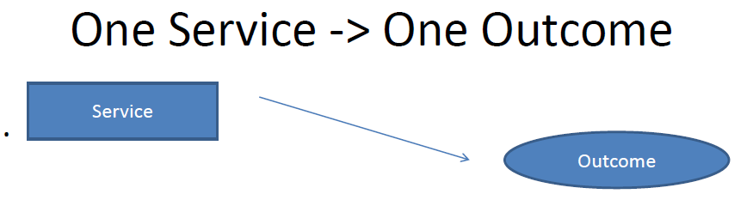
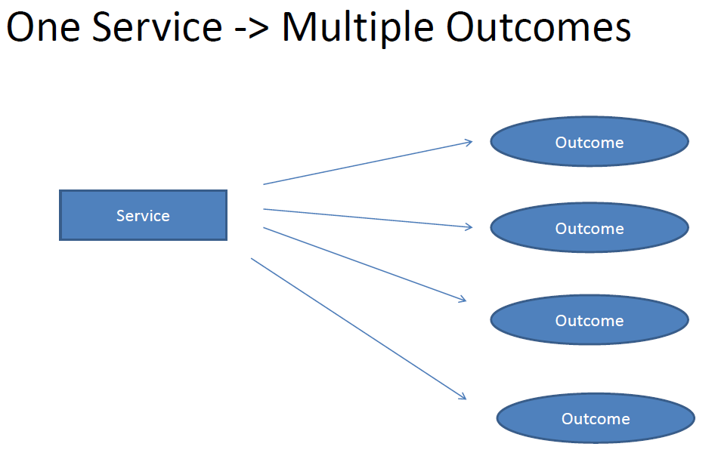
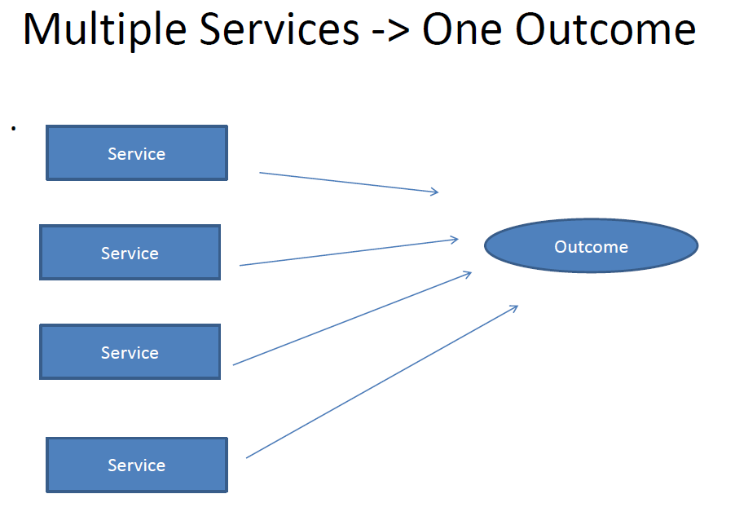
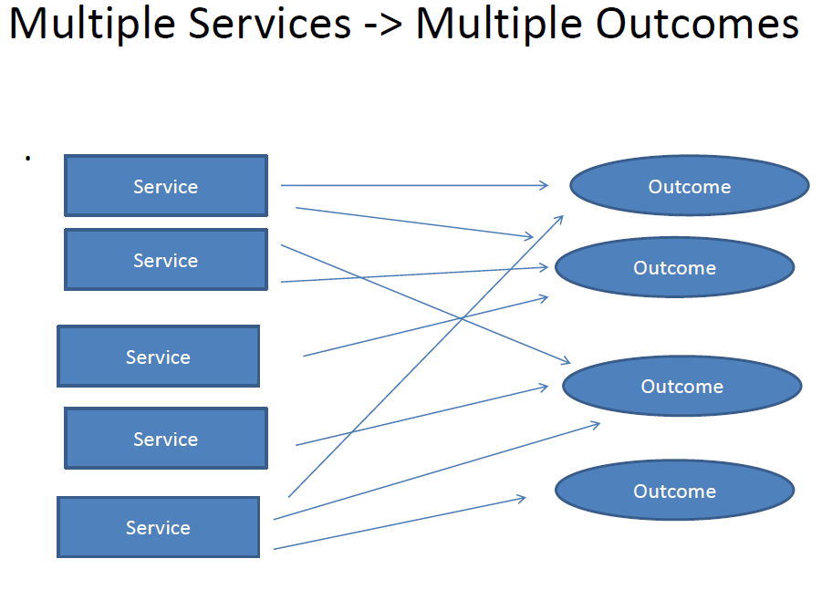
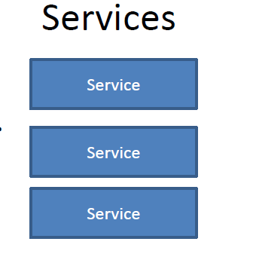
Supporting Results for Individuals and Families
Notes:
This series of slides shows how services can be considered.
Some services produce a single outcome (GED prep class > high school diploma), while others produce several outcomes (case management > secure housing, increase job skills, etc.). Some times multiple services are needed to produce a single outcome (food, transportation, child care, job search > secure employment). Multiple services can also produce multiple outcomes (someone receiving all the services mentioned above may achieve other outcomes besides just securing employment – such as outcomes associated with family stability )
Some times services are provided but no follow up is done to find out what the impact was. Some services are designed to meet an immediate crisis but there is no expectation to see a change in status for the recipient. Receipt of a food box may be important to tide the family over until other resources are developed, but the food box alone does not change (or contribute significantly to) the situation of the family.
These are areas considered to be services without direct outcomes:
Provision of food boxes
Providing a job fair or health fair or other community event that has no follow up and no specific objective for change.
Provision of child care
Provision of transportation
Remember they may contribute to an outcome but only if that is the intention of the provision of the service. If the provision of the service IS the end, that is an output and is not connected with an outcome.

Slide 22
ACTIVITY: What are the service -> outcome connections?
Think about the services your agency provides and the strategies you have been involved in.
Identify the outputs and the associated outcomes:
PROGRAM NAME:
Outputs | Outcomes
Notes:
Group participants for this activity. If you have people representing different programs, this is an activity where it would be useful to have participants grouped with their own programs.
Give each group a flip chart page and have them divide the page as the table on this slide – add program name at the top and then Outputs and Outcomes at the top of each half of the page.
Ask them to think about the primary activities (outputs) that they and their customers engage in and put them on the left side of the chart.
Then ask them to connect to the outcome that is produced (or is the target) of the service.
Bring the groups back and have them share –
Help them identify if the things in the outcome column really are about something that changed for the customer/community.
If you see a lot of outputs in the outcome column, make notes of these and say we will come back to discuss these further as we progress in this workshop.

Slide 23
Think About It!
Considering your own agency Mission and the services and strategies you provide can be a window into what you are communicating to the community.
Are these really the assumptions of your agency? Your staff? Your board?
Do your mission and services help to identify the big goals your agency has?
Notes:
Do you have a local Theory of Change? There is a lot of information in other places about creating local theory of change so it will not be repeated today.
There is a separate workshop devoted to helping your agency walk through the development of a Local TOC.

Slide 24
Local Theory of Change
What does your agency believe it should be doing to address issues related to poverty in your community?
The answer to this question will guide the selection of outcomes and actions that will accomplish those outcomes.
Notes:
Briefly state that if the agency has done the TOC work, then the agency KNOWS what it wants to accomplish and how it thinks it should do its work.
If the agency has not done this work, then this is something that will help the agency move to a “results orientation” by really understanding what they believe and what they expect to accomplish. Why are they in business? To perpetuate poverty in the community? NO. To make it easier for people to remain in poverty? NO.
What does the community THINK the agency is supposed to be doing?
Some agencies that do these activities are surprised to see what the community might be thinking about them.
If it isn’t what they want to project, they have to consider what they can do to fix their image.

Slide 25
Local Theory of Change
Starts with acknowledging specific assumptions about:
the causes and conditions of poverty in your local community
the agency’s role in addressing the issues related to poverty.
Notes:
It is important to be sure the Board Members and staff all understand what the agency believes about poverty and the agency’s role.
You could ask participants to think about prior reports of their success, about their most recent CN A and to think about what this tells them about poverty issues in their own community.
This also brings up the question about levels of need -- the agency needs to at least begin to actively think about how it is going to approach the identified and prioritized issues in their community. Will they work with individuals and families? With the larger community to tackle big problems? With their own agency staff and processes to improve things that are holding them back from producing results?

Slide 26
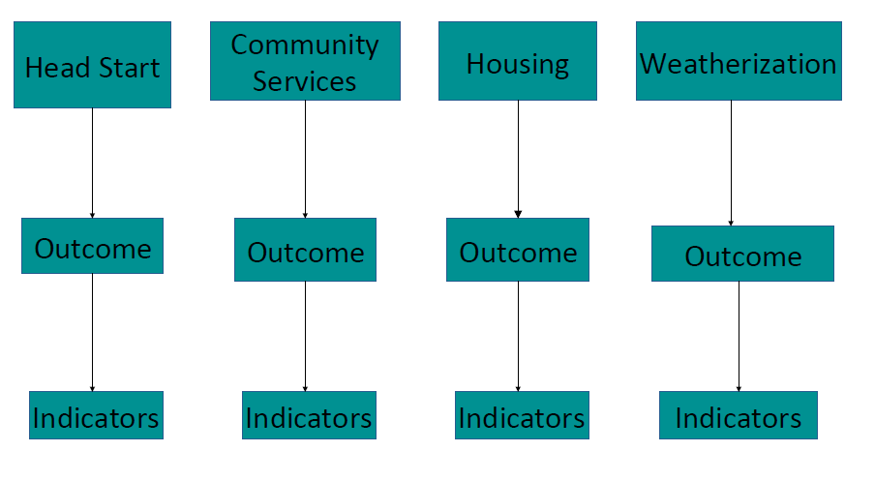
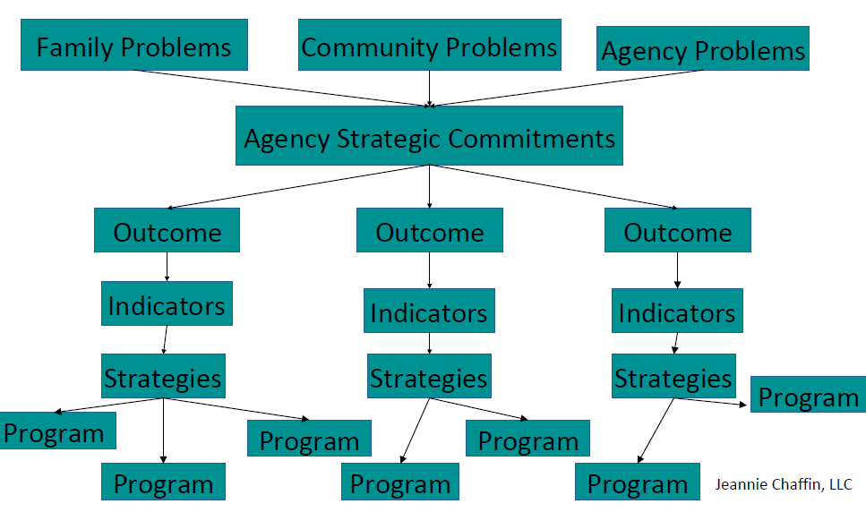
Program or Agency Outcomes?
Program Outcomes
Identified in Silos
Integrated View of Agency Outcomes
Notes:
Refer back to the activity. Connecting outputs and outcomes at the program level. Now have participants think about how those various program level outcomes come together to produce outcomes to meet the agency’s mission.
When you work on creating a Theory of Change, you have to consider how the programs in the agency operate (together or in silos).
Many agencies do a great job of identifying the outcomes for each of the specific programs they have.
And they are good grant managers.
The challenge we are faced with in the 2019 Performance Management Framework is to figure out how all of those separate program level outcomes work together for larger agency outcomes – and meet national goals.

Slide 27
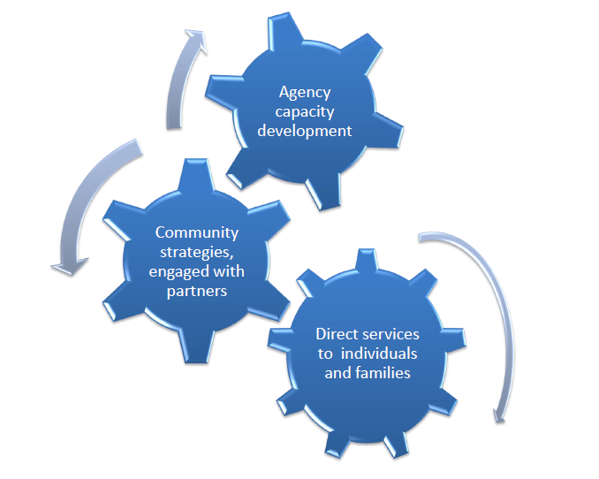
Integration of Levels of Work
Notes:
It is also part of the process to consider how family and community work must support each other – and how the agency’s health is an important cog in the works.

Slide 28
Trying Something New
Think about how “we have always done” the work of the agency
What is real, what is true, what is good, what has been done?
Think about the outcomes (changes) that you have achieved in the past.
Think about WHAT ELSE your agency could achieve if you were not focused on the provision of services (but rather on change).
The ideas that are generated by this kind of thinking will influence your creation of your local Theory of Change
Notes:
The agency will have to prioritizing the needs found in the CN A
What contributes to the priorities of the agency?
What is the criteria?
What we’ve always done
What we have funding to do
What is most important to our board
What is most important to our Executive Director
The big question we need answered - What is our approach to addressing the causes and conditions of poverty?

Slide 29
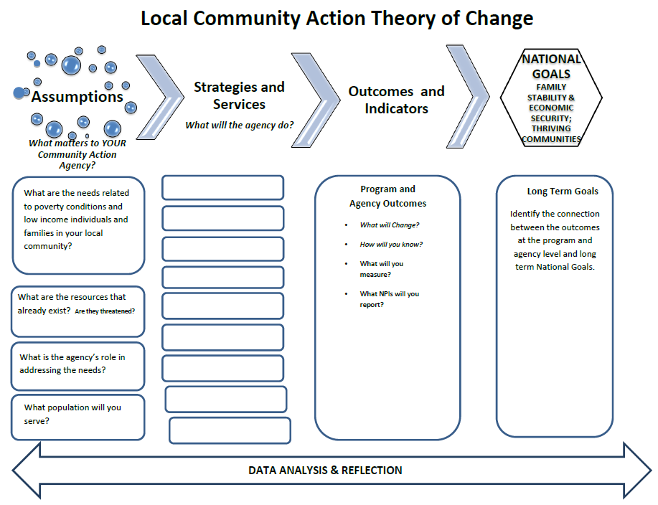
Notes:
Note: this is a template included in the posted material about creating a local TOC
WRAP UP PART I with a couple key points:
The elements of the Performance Management Framework supports/reinforces the core concept that we are Results Oriented.
The National and Local Theories of change can help us operationalize the Mission of the agency and guide selections of services and strategies to meet the needs of the community.
A strong agency will meet Organizational Standards and have the capacity to help individuals/families/communities reach their outcomes.

Slide 30
Assessment: Where are you now?
Part II
Implementing ROMA
Organizational Culture
Notes:
In this section we are going to look at the two PMF questions
How well does the agency operate? and What difference does the agency make?
from two different perspectives:
-- a deep dive into understanding the implementation of ROMA and
-- acknowledgement about the role of Organizational Culture in the way work gets done.

Slide 31
If we don’t know where we started, we cannot identify what has changed….. If we can’t identify the change, we can’t acknowledge success!

Slide 32

Using a Checklist for Implementation aka “ROMA Audit”
Helps you identify:
What are you doing now that would demonstrate each phase of the ROMA Cycle
What could be done differently to include the ROMA element
Notes:
It is important for us to find out what is current status -- this is how we actually determine what our needs are, then we can identify what we want to see change, and from there make a plan.
NOTE: IF YOU ARE AN NCRI WHO IS GUIDING THIS PROCESS OR IF THERE ARE NCRIs INCLUDED IN THE WORKSHOP:
The NCRI Portfolio asks for this kind of information at the end of each section. What does the agency do well at this phase? What could be done differently? Before you engage in this workshop, pull the portfolio out and review what you identified in the ROMA Cycle phases. This will be a start for your Audit.

Slide 33
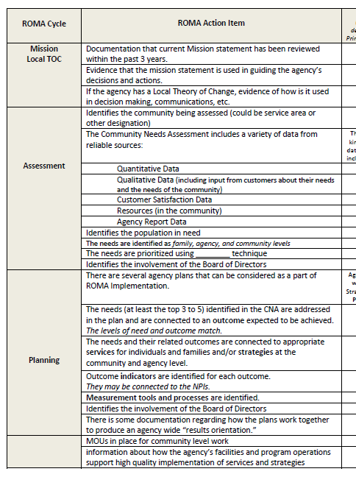
Notes:
Pass out copies of the ROMA checklist
You are going to give them some ideas about the checklist before approaching each of the segments individually.

Slide 34
When completing the checklist, consider:
--What can you identify right now for each phase of the cycle?
--What do you need to find out more about?
--Who do you need to talk to (to find out what is happening in other departments)?

Slide 35
In each phase of the ROMA Cycle, consider:
Who is involved and what do they do? Is their work done at program or agency level?
What is expected to be achieved in each phase for the agency? For the specific program? What (if anything) is required by other funding sources?
How does the agency collect, aggregate and analyze the data in each phase? Is it different in different departments? How does it come together for the agency?
How will you know if the activities and processes are being done well? Are they successful? What makes the process useful?
How is the data/information from each phase used at the program or agency level? What would happen if this part of the cycle was left out? What if it was improved?
Notes:
These questions can be used as an “interview format” to guide your discussions with other departments and other people at the agency.
Seem like a lot?
Let’s see what one agency has done to begin to understand their agency!

Slide 36
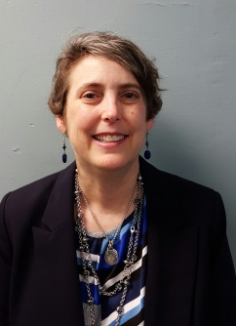

Case Study
Debbie Markman
Resource Development Director
Economic Security Corporation of Southwest Area, Joplin, MO
Notes:
Note to facilitator: For a deeper dive of the case study, you may show the case study video in place of or in addition to slides 36-41.
https://youtu.be/sQCe1Q5abf0
An accompanying Case Study publication is available on ESC as well.

Slide 37

How do you know?
To find out who is “doing ROMA” it is important to talk to peers and colleagues in the agency.
Notes:
Debbie says: I found it useful to talk to clerks, janitors and everyone else in the agency.
As I was talking, I shared key elements of ROMA with others in the agency. My goal was to find out what they were doing that was part of the ROMA cycle. In other words, I worked at catching them doing ROMA”

Slide 38
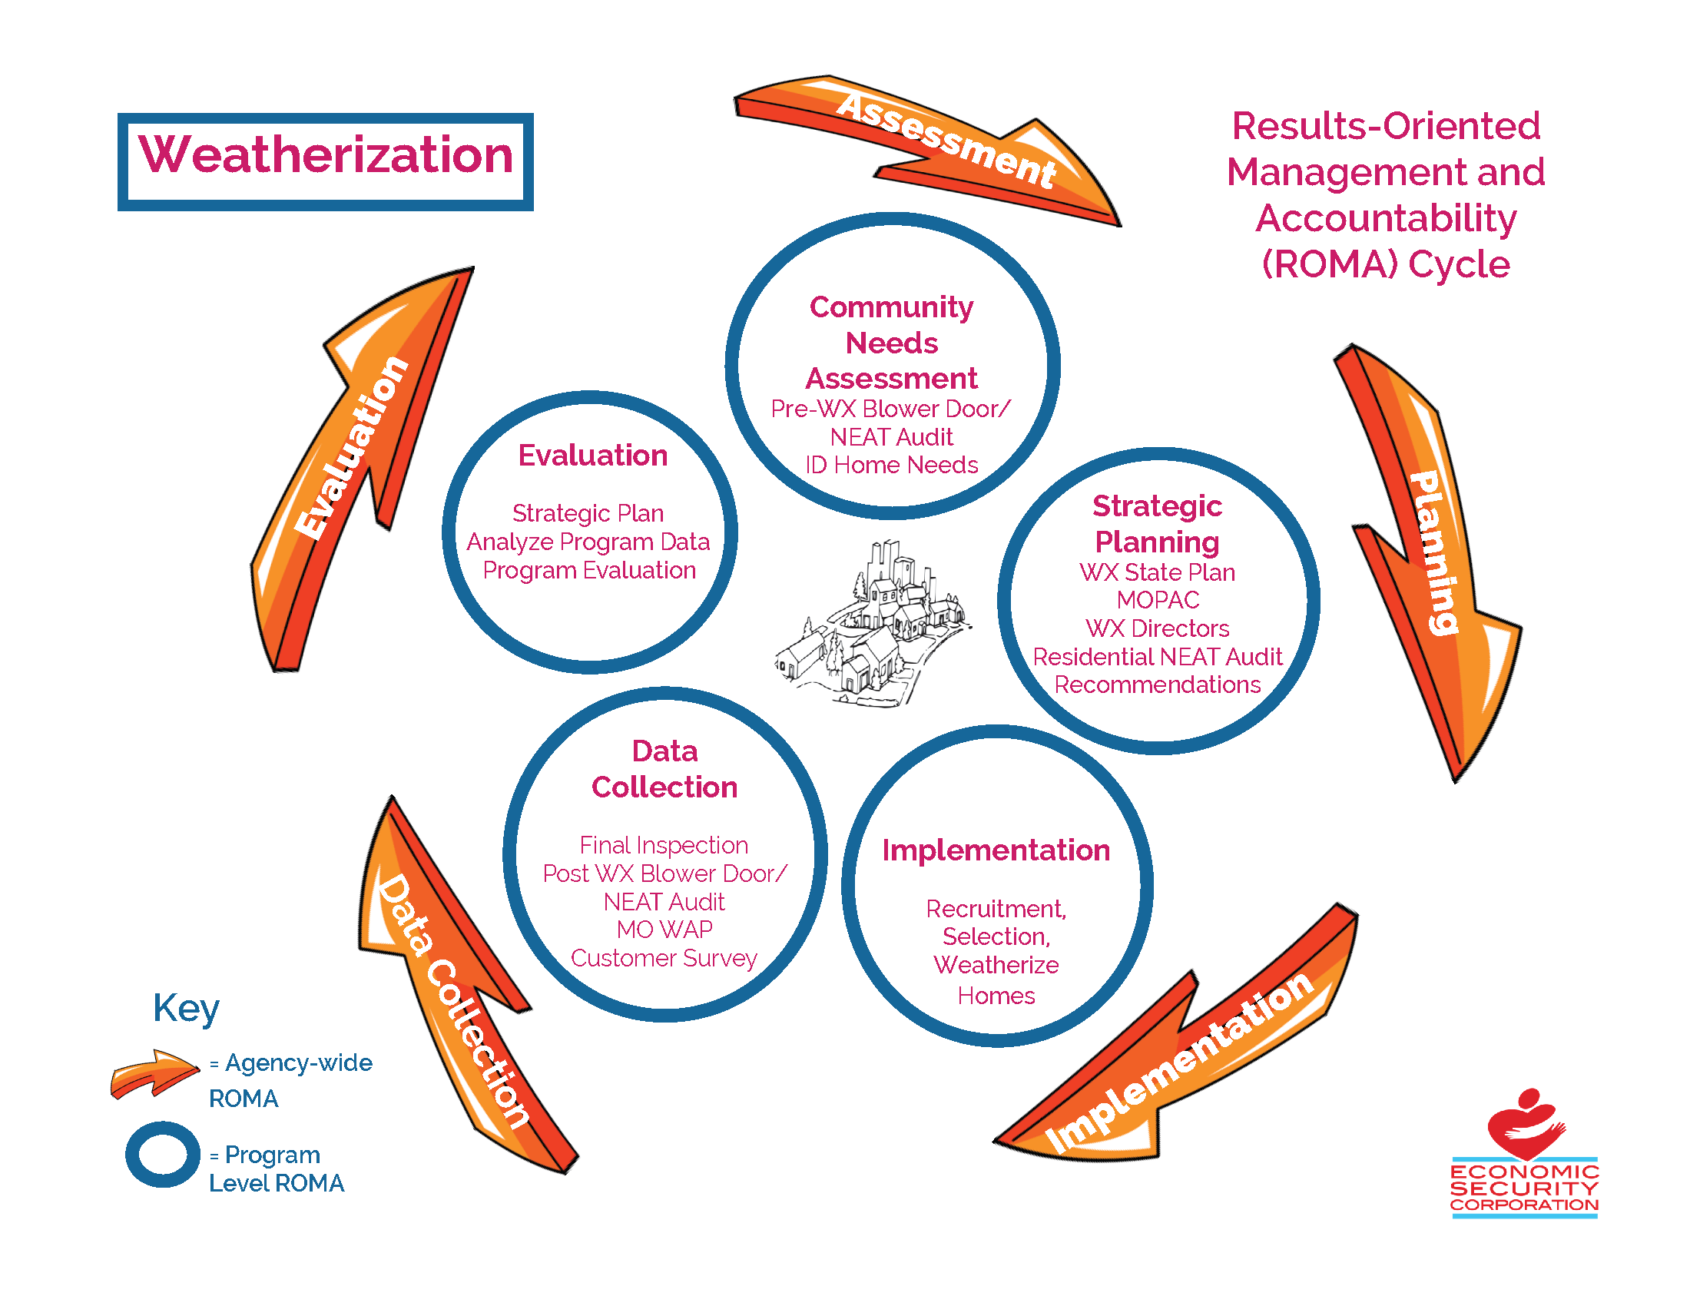
Notes:
Debbie says: “3 years ago, Weatherization Director asked me (after a ROMA training), how could this be relevant for his Weatherization crew. So I literally stared at this graphic on my wall, building and refining it with notes I gathered for 2 years.
Note to facilitator: at the Partnership web site there are examples of other departments in Debbie’s agency

Slide 39
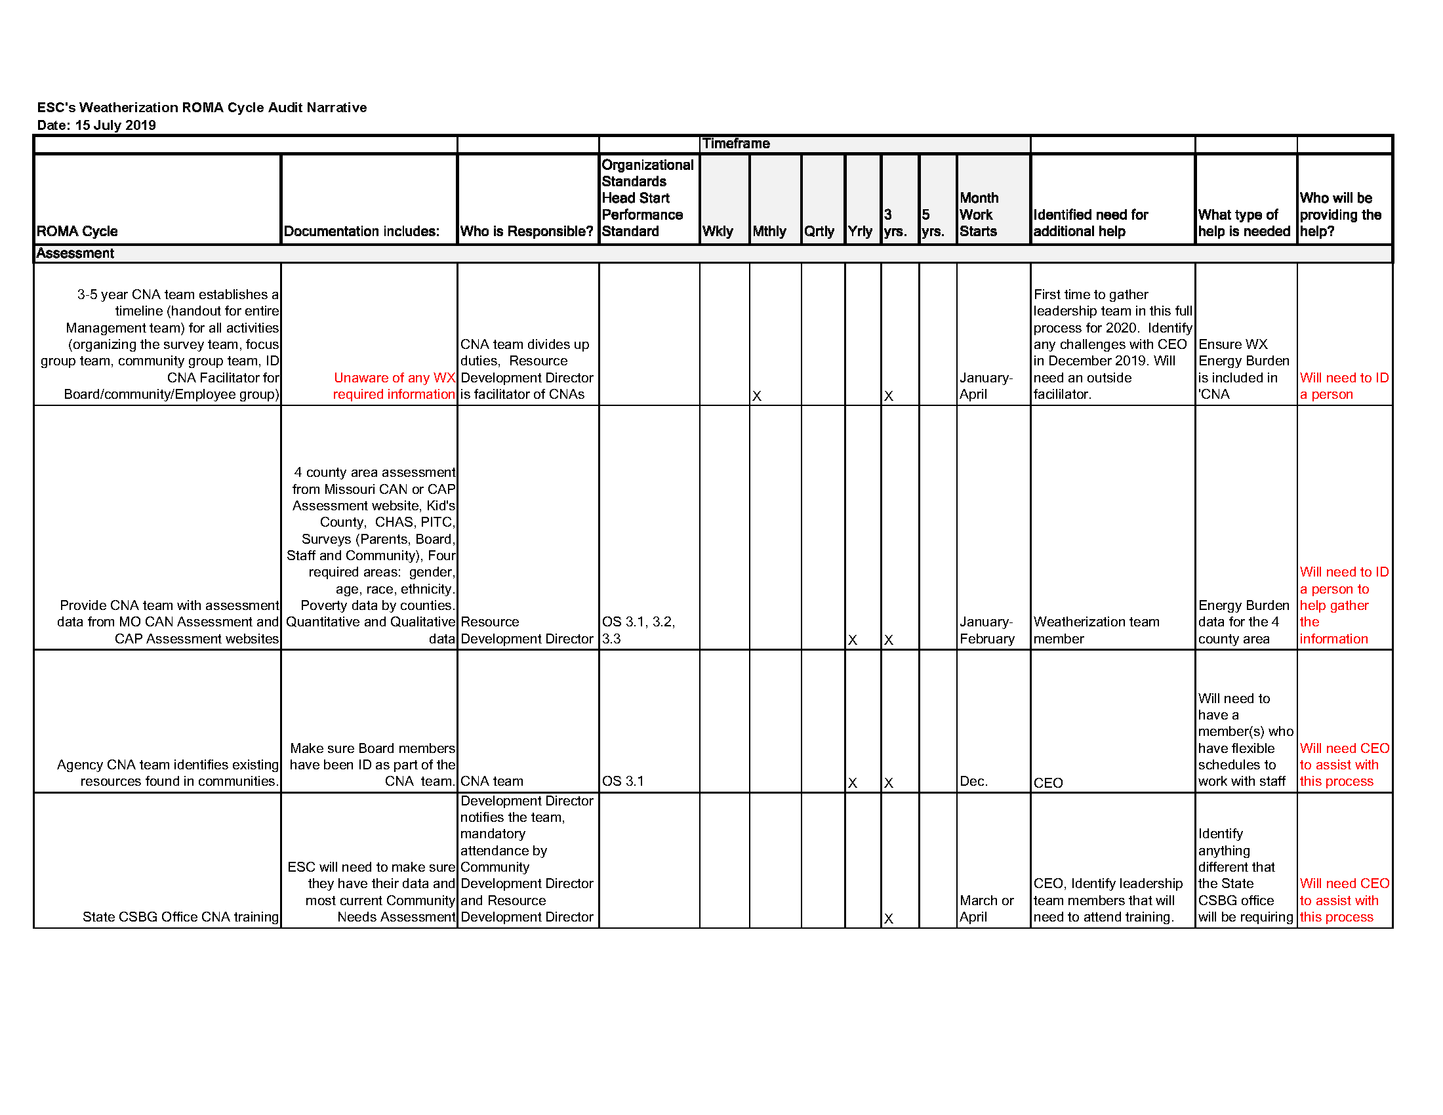

ESC’s Weatherization ROMA Audit- Assessment
Notes:
Debbie: While producing this graphics was helpful as a way to demonstrate “buy in”, what I found completing these graphics is that we were missing steps and missing data in the evaluation process.
For instance we have tons of weatherization reports, but nothing about internal process or customer outreach. So the next step for me was completing the ROMA cycle audit.
We added columns to the basic ROMA Checklist to give me places to make notes about the processes in each phase.

Slide 40
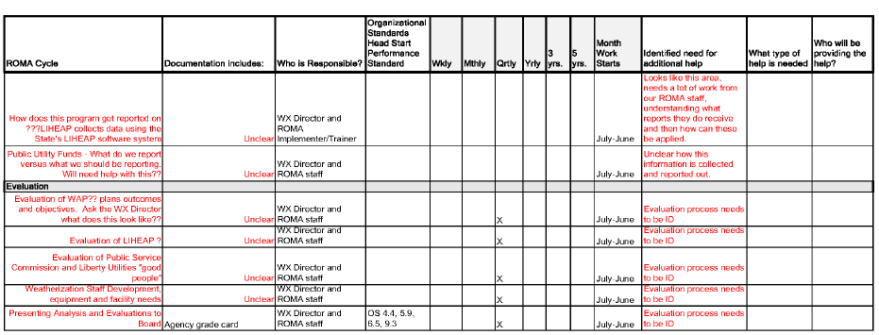
ESC’s Weatherization ROMA Audit - Evaluation
Notes:
You will see that as they got to the Reporting and Analysis (evaluation) of data, that more items were flagged as needing more information for clarification or improvement.
Note to facilitator: be sure YOU are able to read this page, because it does not project well and you will have to talk about the items that are identified.

Slide 41
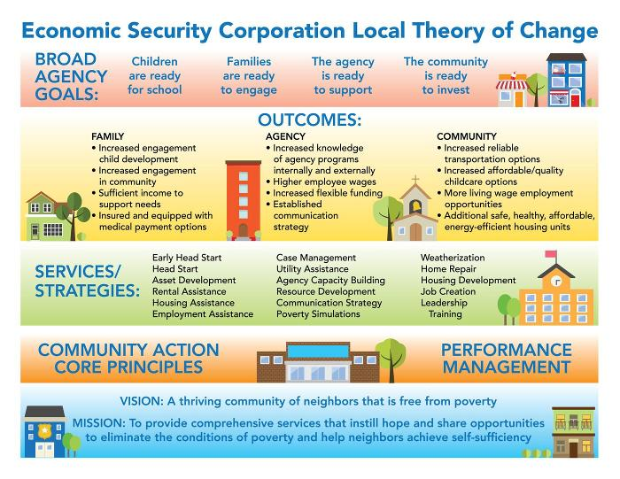

Notes:
All this work produced this Local TOC (example from Debbie agency Economic Security Corporation)
This is how the ideas from their work at assessing the agency functioning were presented after a graphic artist was engaged.
Debbie says: Now this is in every office in every location of the agency. It is the guiding force behind activities and will be the basis of future planning

Slide 42
Considering Each Phase
Mission and Local TOC
Assessment
Planning
Implementing
Reporting
Analysis
Reassessment
Notes:
This will help the agency see the specifics of each phase of the ROMA cycle so they can begin a process similar to the one Debbie's agency used
Note to facilitator: this is just a list of the elements in the check list . With each of the slides that follow, have participants look at the checklist you have handed out and talk to their neighbors about what they think they will find at their agency. Have them make notes on the checklist regarding things they want to follow up on.
At each section, ask for report from the group about what they talked about.

Slide 43
Mission and Local TOC
What do you know about your Mission statement?
has been reviewed within the past 3 years
Is used to guide agency decisions and actions.
Meets Organizational Standard 4.1
If the agency has a Local Theory of Change, it is used in decision making, communications, etc.
Notes:
This will begin a series of table activities, where the participants can talk about each phase of the Cycle and make notes
If agency has no local TOC, how might a process to consider the agency’s assumptions and overall goals be useful?
Ask for report out.

Slide 44
Assessment of Needs and Resources
The Community Needs Assessment includes a variety of data from reliable sources
Qualitative, Quantitative, Customer Satisfaction, Resources, Agency Report
CNA identifies population in need
Is there a clear process for making meaning out of all the assessment data
Identifies family, community, agency levels of need
Who is involved in the analysis of data?
How are priorities identified?
Agency meets Org Standards 3.1- 3.5
CATEGORY THREE: Community Assessment
Board involvement is documented
Notes:
The NCRI portfolio asks for examples of each of the kinds of data that is expected to be included in the CN A.
This group can take a similar look at the actual document to see what is included, how useful it is to creating a profile of the community, and what processes are included to analyze the raw data (turn it into information).
Stimulate the Discussion – how are priorities established? Is it JUST the item that got the highest number of comments? If 90% of the individuals interviewed or surveyed said they could not afford their housing, does this become a priority for the agency?
What else must be considered?
--Agency mission. (does your agency have capacity to address this issue? Is the agency dedicated to this issue – or is it focused on employment or other domain?)
--Resources the agency has or can develop (does the need align with the services you already provide? Consider what role the agency will play if the top need does/does not align)
--Partnerships the agency has or can develop
Etc….
Ask for report out.

Slide 45
Planning
There is an agency-wide Strategic Plan
The Community Action Plan is a part of the Strategic Plan
Focused on issues related to families and communities of low income
Identifies how agency funds are used to meet broad agency goals
(not just program activities in silos)
Plans connect directly to Community Needs Assessment
Identifies both outputs and outcomes
Identifies how success will be measured
Tools, indicators, etc.
Agency meets Org Standards 6.1- 6.5
CATEGORY SIX: Strategic Planning
Board involvement is documented
Notes:
Consider the difference between Strategic Plan (agency wide) and the Community Action Plan used for CSBG funding requests.
Also consider other program plans (proposals) that provide identification of services/strategies, outcomes and how success will be identified.
Ask for report out

Slide 46
Implementing Services and Strategies
Understand the Human Resource policies and procedures related to staff qualifications, training, supervision, monitoring, etc.
Staff have access to resources for improvement of knowledge and skills
CATEGORY SEVEN: Human Resource Management
Fiscal policies and procedures are in place to assure funds are spent appropriately to support achievement of outcomes
CATEGORY EIGHT: Financial Operations and Oversight
There is process in place to secure Customer Satisfaction feedback
All level of staff understand the target population to be served and the expectations related to service:
How many people will be served?
Who are they?
What service do they get?
What changes?
Community strategies are understood, discussed and monitored throughout the agency staff and board.
Notes:
How is quality of service/strategies assessed? Remember that the performance management framework is about improving efficiency and effectiveness.
Ask for report out.

Slide 47
Observation of Results and Reporting
Do all staff in the agency understand the system for data collection and aggregation into reports?
Are reports shared with program staff? Shared across programs (agency wide reporting practices)?
What is included in the reports?
Demographics of the population served
Service provided
Outcomes achieved
What info is provided to the Board?
Do they review reports?
Is CSBG Annual Report data submitted to the State Office, assuring accuracy and timeliness of submission.
Agency meets Org Standards 9.1, 9.2, 9.4
Notes:
Participants can talk about these points in general, ask for report out, and then you will facilitate two other activities related to observation and reporting.

Slide 48
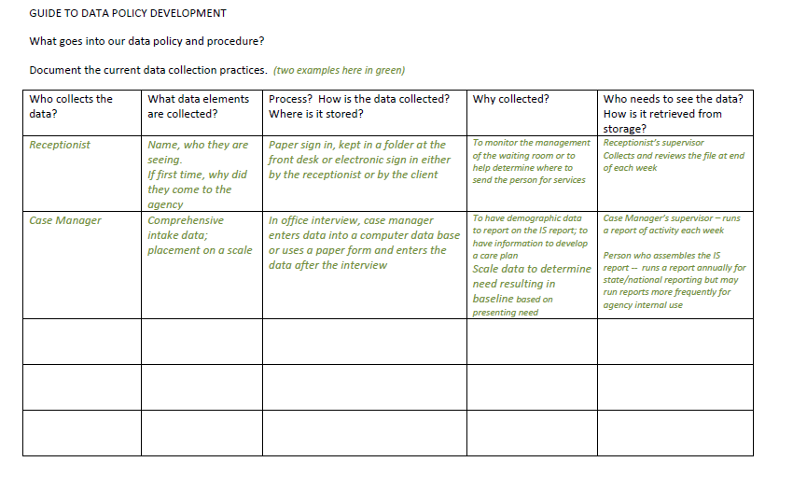
Notes:
This is a hand out for the first of the additional activities related to observation and reporting of data. This one focuses on where/how data is collected and who does the collection.
Take time to get participants to talk about data collection in their own agency using this tool as a guide.
Challenge them to go back to their agency and consider the data that is collected by each staff person in the agency!

Slide 49
Considering Your Reports
Quality of the data provided
Presentation of the data in the report
Usefulness of the data to your specific job duties; usefulness to the decision makers
Performance Focus
Notes:
This is the second activity – focused on considering the agency’s reports.
This can stimulate general discussion about what reports there are in the agency.
Post the names/descriptions of the reports on a flip chart pad.
Ask “who gets these reports?” add that info to the flip chart.
Provide handout of the Assessing Your Reports tool.
Ask participants to pick one report they are really familiar with, and respond to say if the report data is Then
Quality of the data -- Accuracy, completeness and timeliness of the data included in the report (4 items)
Presentation of the data in the report – it is easy for the reader to find data that is important to him/her? (6 items)
Usefulness of the data – is it relevant to the task of managing the program/service? Do I have access to the data when I want/need it? (7 items)
Performance Focus – includes data on outcomes and performance (3 items)
Do you know how the outcomes are measured?

Slide 50
Analysis of the Data/Evaluation
How is data/reports used?
Compare actual results with performance targets/projected success rates
Compare the demographics of the population served with the population identified to be in need in the CNA.
Consider the connections among people, services, and outcomes.
Identify those who have received single services, multiple services, or bundled services and determine the difference (if any) in their outcomes.
Are questions asked that will need additional assessment data?
Does the Board receive recommendations based on analysis of data.
Are recommendations and decisions based on data?
Organizational Standard 9.3
Does the agency take action based on analysis of data?
Adjust performance goals as needed as evidenced by actual performance.
Continue strategies that achieve desired performance goals.
Revise or discontinue strategies that do not achieve desired performance.
Notes:
This is the last of the cycle phases.
After time for discussion, ask for report out.
Ask how improved value from the analysis of data in the agency could be achieved.
There are a couple ideas on the next slide.

Slide 51
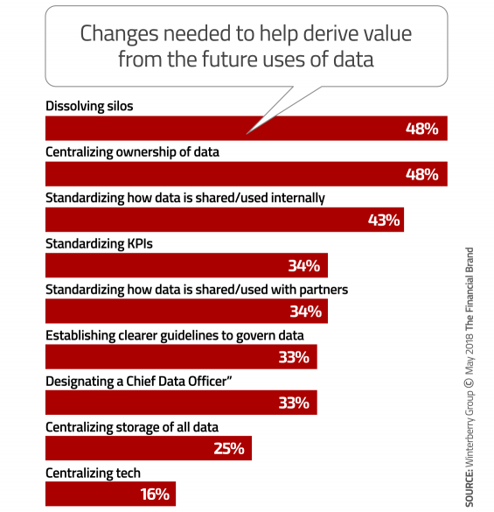
Notes:
This is just one agency’s idea of changes that are needed to improve use of data.

Slide 52
Reassessment, Planning Updates
Based on analysis and recommendations, what additional assessment data would be useful for agency decision making?
Collect appropriate data elements to refine assessment profile.
Update plans based on new data.
Consider if the data collection and analysis processes are working or if they need to be modified.
Notes:
As ROMA is a cycle, we are back to reassessment and updating the plans.
Ask for any ideas about the importance of continuing to reassessment following analysis of data.

Slide 53
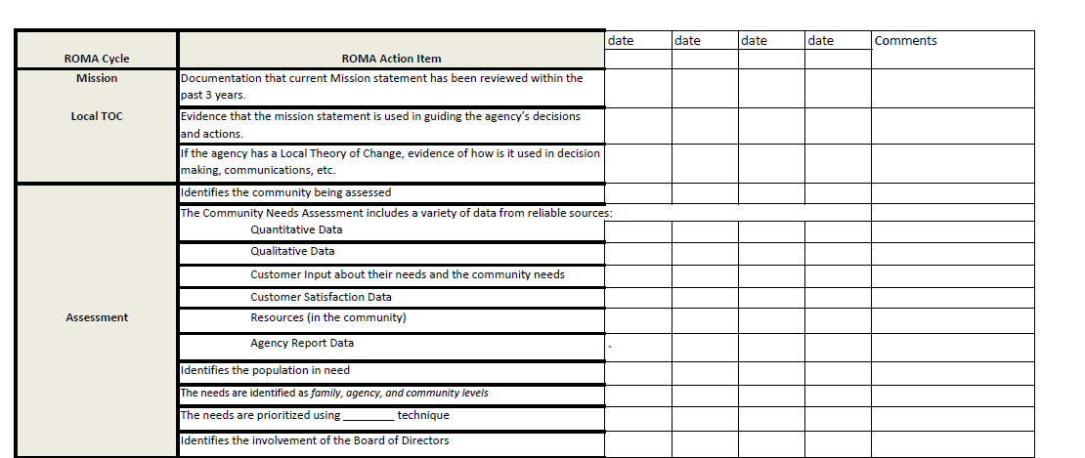
Establishing a Profile
Notes:
Similar to what we saw from Debbie’s agency, it will be important to SEE where the agency is doing well and where there are changes needed.
Using the checklist as shown here can allow you to note the agency current status in each phase
Ideas: using a check if the area is functioning well, or a color code (red, yellow, green) or making reference to a scale” maybe using numbers (identifying benchmarks as 1 = “in crisis” to 5 = “thriving”)
You will see later how this profile can be used to create a scorecard to monitor progress.

Slide 54
How does work get done?
Considering your Organization’s Culture
Notes:
This slide starts the second part of Part II
We are turning to consider organizational culture now.

Slide 55
Work gets done
Drucker cautions us:
“Work doesn’t get done by a magnificent statement of policy. Work is only done when it is done. Done by people.
By people who are properly informed, assigned and equipped.”
Afterword, Five Most Important Questions
Notes:
Yes, this is an important point to consider… and we would like to add that, when thinking about ROMA implementation, the work needs to be done by people who have a “results orientation.”
The orientation of the people assigned the work is a reflection of the organization’s culture. So we have to take some time now to consider what we mean by “organizational culture” and why it is important to understand the culture that impacts the behavior of the people involved.
Later we will talk about improving a ROMA Culture.

Slide 56
Organizational Culture
learned beliefs, traditions, principles and guides for individuals
collective behaviors that members of a group commonly share with each other.
Notes:
Specific organization may have its own practices, norms and understandings that the people within it have developed over time, creating an organizational culture that is apparent to both those on the inside and out. Not surprisingly persons from outside an organizational culture when forced to interact with it may find its policies and procedures puzzling or problematic.

Slide 57
Why is organizational culture so important?
Culture shapes behaviors and help individuals understand the organization.
Culture is often so strong and so powerful that when there is a discrepancy or inconsistency between the current culture and the objectives of change, the culture will win.

Slide 58
The “Culture” In An Organization
Includes beliefs about
What the world is like (what is reality?)
How to respond to social and material environments
The appropriate way for people to interact with each other
Such things as chain of command and other management structures
Notes:
One way to understand culture is to consider that people are programmed by their cultural group to interpret and evaluate behaviors, ideas, relationships and other people in ways that are unique to their group.
“Culture” is a set of social traditions passed on through an organized group.
This set of traditions help groups and individuals within a group decide what is considered the correct way of living, thinking, feeling and viewing the world.
The traditions form a set of beliefs and ways to respond.
It includes attitudes, norms, and values that the group accepts as valid and important
These beliefs can determine the limits that members will live by and be accepted by the group.

Slide 59
Culture Is Reflected in
Way work is organized
How technologies are used
How staff responds to customers
The understanding of conditions related to poverty
Health/wellness (including mental health), disabilities
education, motivation, etc…..
…….
Notes:
Aspects of culture all form over time and have a direct effect on how members of the community handle their problems and interactions with each other and the outside world.
The dots in the fourth bullet indicate that this list is just the start of identifying how you can recognize the impact of culture.
For instance: Does your agency have a service focus or a results focus?

Slide 60
Organizational culture
“is a pattern of shared basic assumptions that the group learned as it solved its problems of external adaptation and internal integration. These patterns have worked well enough to be considered valid…and therefore, taught to new members as the correct way to perceive, think, and feel in relation to those problems.”
- Edward Schein
Notes:
A pattern of shared basic assumptions – (we all agree to these certain rules, norms, expectations)
That the group learned as it solved its problems – (come from facing challenges together)
Of external adaptation and internal integration –(how do we fit into the world and how do we work together)
That it has worked well enough to be considered valid –(we did this and had some success so it must be the way to go)
And, therefore, taught to new members as the correct way to perceive, think and feel in relation to those problems –(we better share with these newbies what we learned and how we deal with things around here. May be verbal or through nonverbal means. For example if someone reacts a way that is outside of our “norm” we may respond with an uncomfortable look or show a negative reaction. Newcomers quickly learn what is expected).
Consider that this is similar to our understanding of culture in general.

Slide 61

Organization Culture
https://www.youtube.com/watch?v=y-PvBo75PDo
Notes:
Show the video and discuss:
How does this relate to our definition of organizational culture?
Can you think of examples in organizations that are similar to the banana example? Behavior that is seemingly unexplainable but it is related to past constrictions and situations?
What habits are continuing in your agency without being questioned?
We do lots of things that we don’t know why we do them. Some of them are things that used to have a purpose but no longer do. Some of them are actually barriers to doing the work better!!

Slide 62
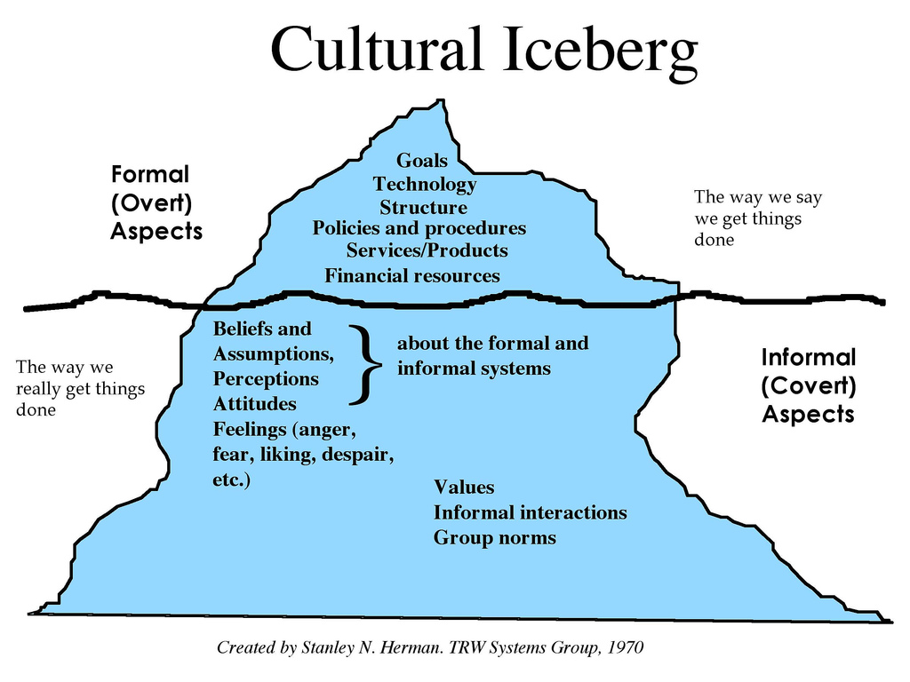
Organizational
Notes:
This is a commonly accepted idea about culture (the iceberg image) that has been adapted to reflect organizational culture.
The iceberg is divided into two parts and helps us understand workplace dynamics or organizational culture. The top part shows the visible, formal or overt aspects of an organization such as systems, structures, policies, technologies of an organization. This represents “the way we say we get things done.”
The lower part, below the water line, shows the hidden, informal or covert aspects of an organization such as attitudes, beliefs, values, and perceptions etc.

Slide 63
Consider…
The formal/overt messages your agency uses in describing your services and goals
The informal or hidden aspects, attitudes, feelings under the surface
Notes:
formal messages could be found on brochures, on the “talking points” used to describe your agency’s role in the community, on how your agency is profiled in listings or referral indexes. What images are displayed representing your agency? How do you think it is seen by your wider community?
It may be uncomfortable sharing informal organizational culture aspects. After all, they are “below the surface” for a reason. (maybe you are unaware, or maybe things in some ways function better without this information being shared).
What aspects would you feel comfortable sharing? how information is shared between supervisors and workers, how clients are discussed within a staff meeting, what kinds of inter-departmental communication exists, etc. Are employees valued for their skills and abilities? What evidence is there that this is or is not true in your workplace?

Slide 64
One tool: Assessing the Organizational Culture
Look Around
What do you see? What does that tell you?
Internal Communications
Communications with Others
Chain of Command
Decision Making
Values of the Organization
Staff Qualifications and New Staff Orientation
Notes:
Provide handout of the Organizational Assessment
As we said at the beginning of this presentation, we hear that organizational culture is blocking change – and so this brief section on org culture is an important reminder that NCRPs need to understand some basic underlying influences that would not be picked up in the “process and practice” ROMA audit. This would get at some deeper understanding of assumptions, and is a foreshadowing for the Local TOC development discussion that we will have at the end of the day.
This is a list of the items in the Org Culture assessment that is posted on the web
Detailed information about this will be in the posted material to accompany this presentation.
This is an activity that participants will take back to office and actually do.
For today they will just start to consider what all goes into Organizational Culture.

Slide 65
Look around
What do you see at the entrance? In work spaces?
How are people dressed?
Does this differ in the various areas of the building?
How much interaction is there?
Who is talking to whom?
Where do people congregate?
How is the furniture arranged?
What is the noise level?
Is everything quiet? Or loud? Are people talking? Can you hear conversations? Or just general voices?
Notes:
This is an example of some of the items you will be assessing -- this is the detail of the first item in the assessment (as identified on prior slide).
– what does the entrance say about the agency? Ask “is it inviting?” if there are not any responses you could “seed” the discussion with some questions like: Is the posted material in more than English? Are there “employee only” signs on some of the doors? Is the “receptionist” behind a wall? Or is there even a live person that can be accessed upon entry?
-- What does your individual work space look like? Is the work space in your department different from other sections of the agency? Do staff have personal photos? Motivational posters? ROMA Posters?
-- What are people wearing? Casual attire? Is this the same for all of the agency?
-- what is the noise level? Is everything quiet? Or loud? Are people talking? Can you hear conversations? Or just general voices?
-- What are people wearing? Casual attire? Is this the same for all of the agency?
-- what is the noise level? Are different parts of the agency “louder” than others?
This will give them an idea of what we are looking for…
But there are more sections that deal with what written documents look like, how communication happens, what policies are enforced, what kinds of “celebrations” happen and so on..
--

Slide 66
Another Set of Tools: Are You Results Oriented?
Two surveys:
one that staff responds to about their own activities and
one in which they consider the agency’s perspective
Notes:
This is also posted on the web. It is a tool from 2016.
It is just a possible way for NCRPs to think about the agency’s orientation.
Does your agency have a service focus or a results focus?
Provide these two documents as handout to participants.
the next two slides are just screen shots of the two tools.

Slide 67
 | Are you results oriented? -- AGENCY SURVEY
 | Read the statements below. They are "paired" to represent either a service orientation or a results orientation. | Select the one that is MOST like your agency
 | Pick either statement a or b in each pair. | a. | b.
1 | a. Our agency publicity highlights what we do (the services we provide).
 | b. Our agency publicity highlights what was accomplished by the families and communities we serve and does not separate these accomplishments by "department" or "division" of the agency.
2 | a. Our agency policies and procedures are compliance driven.
 | b. Our agency policies and procedures are results driven.
3 | a. Our agency's strategic plan identifies what each department (or each funding source) will do.
 | b. Our agency's strategic plan includes clearly defined outcomes that will be achieved through the work of the entire agency, not just by a department.
Notes:
If you have time, you can have participants respond and get a sense if everyone in the room has the same opinion of the agency’s orientation.
This is a good place to see if everyone understands the elements in the same way.

Slide 68
 | Are you results oriented? -- STAFF SURVEY
 | Read the statements below. They are "paired" to represent either a service orientation or a results orientation. | Select the one that is MOST like your agency
 | Pick either statement a or b in each pair. | a. | b.
1 | a. When asked about my job, I primarily talk about what services I do.
 | b. When asked about my job, I primarily talk about what changed and what was accomplished by the families and communities I serve.
2 | a. I I think about my work in terms of applying the rules of funding sources or of the program.
 | b. I think about my work in term of helping families and communities change for the better.
3 | a. I think of myself as a staff member of a particular department or program of our agency.
 | b. I think of myself as a staff member of the agency, who is working to improve the lives of people with low income.
Notes:
Even if the agency demonstrates a specific perspective, it might be in conflict with individual staff perspectives.
This tool can help identified these differences.

Slide 69
CSBG Performance Management Framework (PMF): Implementation
Local Organizational Standards
State and Federal Accountability Measures
Results Oriented Management and Accountability (ROMA)
CSBG State Plan
CSBG Annual Report
ACSI Survey
Notes:
Note to facilitator: Use this as a kind of “bringing together” all of the discussions your group has had to date.
Remember the elements of the Performance Management Framework we introduced at the beginning of the training.
State and Federal Accountability Measures, the CSBG State Plan and the ACSI Survey are the primary responsibility of the State CSBG office and OCS – but they base those activities on data from local CAAs.
We have included reference to the Organizational Standards, ROMA and the Annual Report in the prior discussions, but before you select a topic area to Impact at your agency, take a look at these elements and see if there is anything in the PMF that needs attention. Are there any Organizational Standards areas (as: having to do with human resources or fiscal areas) that should be included in your Plan? Any thing from the Annual Report that is of specific concern so it should be included?

Slide 70
Once you have baseline data you will have a better understanding of:
what is happening right now
what is not happening
The next step is to consider exactly what you think could change.
Notes:
WRAP UP THIS SECTION with key points:
The tools we provided can lead to more discussion about assessing the organizational culture, as the culture of the organization can impact how change is viewed, implemented, etc.
Remember the PMF questions: how well does the agency operate? What difference does the agency make?
It is important to establish a base line so you can identify progress (change) and success.

Slide 71
From ROMA Audit to Impact Pathways Plan
Part III
What action will you take?
Notes:
After assessment we move to planning!!

Slide 72
Identifying a Path
Help agencies (using their NCRPs) make explicit their personal and agency-identified expectations related to improving implementation of the full ROMA cycle in the Community Action Network.
Help agencies use ROMA to improve performance and visibility.
Some barriers:
Have fear and anxiety about approaching agency change.
Don’t have a “map” (need the steps showing how we could complete something).
Need to understand both quantitative and qualitative sides of the work
Notes:
We know there is resistance to change. Resistance takes many forms and they are a natural part of any change process. Get some ideas from participants about why this is true.
Here are a couple ideas:
Fear of the unknown
Fear of loss of job, security, status
Depression
Anxiety
Anger
Poor communication
Lack of clarity, inability to make decisions.

Slide 73
We are introducing two terms to this process: Scale UP and Scale OUT
Scaling Up involves building a ROMA Culture in agencies and in the network that produce a supportive environment to embrace a “results orientation” and a performance management framework.
Scaling Out is a “horizontal” spread of knowledge and principles from peer to peer throughout the entire national community action network.

Slide 74

Scale Up: Recognizing a ROMA Culture
Support Organizational Culture that is Results Oriented
Embrace a unifying Local Theory of Change
Connect with the National Theory of Change

Slide 75
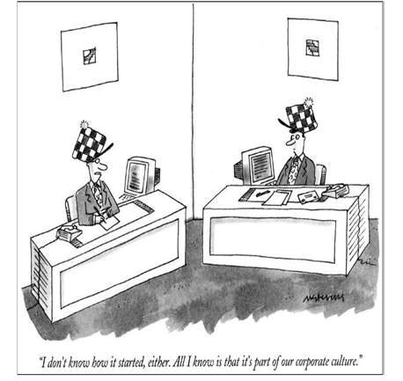

Slide 76
Why do efforts to initiate organizational change fail?
No matter the change, no matter the organization, there is one constant that largely determines success or failure – it is the role and importance of organizational culture.
Culture shapes behaviors and help individuals understand the organization.
Culture is often so strong and so powerful that when there is a discrepancy or inconsistency between the current culture and the objectives of change, the culture will win.

Slide 77
Moving to a Results Oriented Culture
Implementing the concepts of Performance management
Notes:
We have discussed movement from a service centric culture to a performance centric culture in out network for at least two decades.
And yet we still hear that ROMA is a burden or too much trouble or at the bottom line is not useful. We hear that the agency only has time to deliver the services to people in need and the rest of the “stuff” that goes into that ROMA thing would take away from the “real work” of the agency.
Recently, newly certified ROMA Implementers have told us that they are not able to put their skills to work at their agency because of two major barriers: 1) They report that the Executive Director does not “buy-in” to the “whole concept.”
2) They tell us that “no one wants to change.” Well, this isn’t a surprise! Who does want to change – especially if it is something that appears to be working for them just the way it is.
It seems that the idea here is that if the ED would buy-in then the others would have to change. That the person with the ultimate decision making power (the top leader) would just make everyone “use ROMA”.
There are a couple things here that we should consider.
What do we mean by “buy in” and do we really believe that a directive from the ED will be all that it takes to make a culture change?
We are not the first network to face the need for Culture Change – so there is a lot of research that we can use to help us move forward.
Everyone recognizes that cultural change within an organization is not easy and certainly not instant.
For this presentation, we have taken some of the ideas “from the field” and worked them into a series of “building blocks” that may help you move your agency forward!

Slide 78
What we hear…
Change to:
“ROMA isn’t a part of the broad agency culture. “
It may be something CSBG programs talk about, but it’s not recognized across the agency.
“There is limited buy in from executive leadership”
Is it often noted that leadership sees that things are working just fine now – so why change?
“ROMA is just for CSBG so it doesn’t impact the rest of the agency”
"there's an opportunity to shift our org culture to one of results-orientation“
"we have yet to prove the value of ROMA to the leadership"
“we are able to use ROMA resources to improve the whole agency, not just CSBG funded projects"
Notes:
Does your agency have a service focus or a results focus? Think about the activity (first thing on day 1) where you had to think about one thing you’d want to share about your agency. Was it the results your agency helps to accomplish? Or the services you provide?
Consider the language on this slide.
Think about the importance of how people talk about ROMA and how subtle shifts in language can cause a big change down the road.
Change "Roma isn't part of the org culture" to "there's an opportunity to shift our org culture to one of results-orientation"
Change "the leadership doesn't buy in" to "we have yet to prove the value of ROMA to the leadership"
Change the idea of ‘having to do ROMA for the whole agency", we could reframe as "being able to use ROMA resources to improve the whole agency, not just CSBG funded projects"
So, rather to focus on the burden that is placed on the NCRP, see it as an opportunity and a process.

Slide 79
Buy-in or No Buy-in at the Top ?
“I am very familiar with Leadership that won’t buy in to ROMA. Because, for years, that was me.”
Notes:
Here is a testimonial from a CAA ED
“I am very familiar with Leadership that won’t buy in to ROMA. Because, for years, that was me.
When I was part of Executive leadership at an agency in Indiana, I just refused to embrace ROMA.
Oh, I would make sure that the agency met the minimal requirements for the state and feds. I sat, glassy-eyed, through more than one ROMA training in the early years of the millennium. Oh, I made sure our IS report was submitted, on-time and accurate. But beyond that, “no thankyou”!
It is only recently…since taking my current post, becoming a Certified ROMA Trainer, and working with a network of passionate professionals… that I have been converted. (And you know they say there is no one as zealous as a convert!)
I know how I used to be. The one thing that made me turn the corner was the was the ORGANIZATIONAL STANDARDS
Perhaps the strongest argument for Executives to support ROMA culture is the impact it will have on meeting The Organizational Standards for Community Action Agencies. For me, these mandatory standards convinced me it was time to take ROMA implementation seriously.
We got a first glimpse in 2014. In January 2015, Information Memorandum 138 from the Office of Community Services nailed it down. State and agencies were required to measure and report their achievement of the standards starting in 2016. In 2017 the state began monitoring all agencies on whether we are meeting the Organization Standards.”
So the REQUIREMENT of Organizational Standards was the key in this example that made the shift in “buy in” at this agency.
But is that enough to really make the change? It was for this Leader.
But for a REQUIREMENT, sometimes all that is needed is a check in the box (in most cases) and that won’t move the agency to a “results orientation” culture. What will move the agency to appreciated the value of a ROMA culture?
Well, for sure, the ED/CEO/person at the top must at least acknowledge the requirement to meet Organizational Standards (which have ROMA embedded throughout) - so that can be a foundational buy-in to the whole concept.
But really what is needed is a CHAMPION.

Slide 80
Who is the Champion?
The person at the top of the agency (ED/CEO)
Someone from agency leadership (upper management) who has authority
Anyone else who feels passionate about the anti-poverty work the agency is doing
to move individuals and families to economic stability and
to support the creation of healthy communities
Notes:
Consider what is meant by “buy-in.”
-- Literally it means “to make an investment”
If the Leader has agreed to have staff trained as either Nationally Certified ROMA Trainer or Nationally Certified ROMA Implementer that is one kind of I
investment. How that person then is supported can be part of building the culture and we will discuss later.
--It also means “to believe in and support an idea, concept, or system.” – which is more to the point here.
If the Leader does not believe in ROMA, that is what is commonly identified as a barrier to culture change.
-- And finally it can mean “to accept an idea as worthwhile.” We think this is a critical part of buy-in, because it is about the value of ROMA as worth while to the agency.
It is clear that there is not just one way to influence organizational cultural change
In all of the ways that organizational culture change is studied, it is clear that there needs to be a champion for the change. Someone who believes the change is not only beneficial, but necessary – and urgently needed.
Often it is believed that the champion must be someone in a leadership position from the top levels of the organization.
If not the Executive Director or CEO, the ROMA champion needs to be part of the Executive Leadership, because the champion will need to have authority to make decagons and to direct (or at least support) new behaviors.
But it is also true that the champion can come from within the organization at other levels and the champion can influence those in authority and the decisions that are made. (there will be more trainings in 2019 to help individuals who are not “the boss” learn to use their influence to lead from where they are in the agency)
Keep this idea in mind as we talk about the building blocks of a ROMA culture. Be thinking about who the champion is/could be in your agency. Is it you?
So what does it look like when the agency has embraced the move to a results orientation and embraced the concept of performance management?

Slide 81

Building Blocks of a ROMA Culture
Recognition of a Results Orientation
Broad exposure to Introduction to ROMA
Executive Staff and Board acceptance and participation in ROMA and Performance Management
Trained staff in trusted position
Employing a shared language
Includes the whole agency (not just CSBG)
Incorporated into existing regular activities
Notes:
Before you can think about changing a culture, it is important for you to have a clear picture of what the culture should look like when the change has happened.
Start with thinking about the result. ☺
These building blocks were created from ideas provided by Jane Hopkins, NCRT in IL, and from the feedback from NCRIs in Region 3.

Slide 82
#1. Recognition of Results Orientation and Performance Management
The agency demonstrates …
Having a focus on results not services
Acceptance that agency performance must be identified and improved
Understanding of ROMA principles
Value of Performance Management systems (ROMA) as a tool
Notes:
Provision of services vs strategic thinking?
Here are a couple of the key concepts (on the slide).
In this building block, we have joined the idea of a results orientation with the broader performance management because they go together.
If you are about producing results, you have to know how the results are produced. Who are the participants? What do they need? What actions are needed? What resources are needed? Who are the service providers?
… and then How well did we do? What went well and what needs to be reviewed to find out how to improve it?
These (and many other) questions are answered in the course of the ROMA Cycle.
It is important to believe that the implementation of ROMA is going to improve the agency’s performance.
You can probably think of others.
(get some ideas from participants and put on flip chart)

Slide 83
Being Results Oriented Means Being Data Centric
Both long term strategic and day-to-day operational decisions should be based on facts that can be sourced back to reliable and accessible data.
Is the agency oriented to apply data as a source of actionable insight in support of advocacy, marketing, engagement of stakeholders and the broader focus of the organization?
Does the organization value decisions that are supported by verifiable data that is accurate, reliable, timely and complete?
Notes:
This requires a management system that monitors data entry and provides follow up.
The agency has a system and process to store, retrieve and aggregate data so it can be analyzed.
Fostering and maintaining a culture that embraces data, and has a data focus (data collection, storage, aggregation, analysis and use) that is integrated into standard operations…not something ‘extra’ that is done later.
Data must be turned into information to support on-going decision making.
Organizations need to invest not just in data analytics, but across four operational pillars: People, Platforms, Partners, and Processes.

Slide 84
#2. Broad Exposure to Basic ROMA and Performance Management Principles
Assure shared understanding across the whole organization
Schedule and conduct Introduction to ROMA training for all departments
Directors, Managers, Supervisors
Board Members
Direct service staff
Repeat or expand training as needed to reinforce and refresh knowledge
New staff and new board members
Staff who have a change in work duties; Board members with new responsibilities.
Notes:
Start with the WHY!! (like we did with the elevator speech activity at end of yesterday’s session)
How does it fit? What is the point?
Remember it takes “shared attitudes, values, goals, and practices” to make an organizational culture.
The best way to start a ROMA culture is with the Introduction to Results Oriented Management and Accountability curriculum for all departments.
Providing this training is also a financial investment. It involves staff time, materials, possibly lunch, possibly travel.
There are some staff who attended Intro to ROMA training many years ago and so maybe they just need a refresher (could use the Board Training power points available at the partnership web site for these)
But for all new staff and board members, the full one day training provides all of the key concepts of ROMA – on which the entire Performance Management framework is built.
Of course this is important for program directors, managers and supervisors – but also for those providing direct services to customers. They need to understand how their work fits into the whole agency mission and goals.
Don’t forget to train the BOARD
If you don’t have a Nationally Certified ROMA trainer within your organization, there should be someone near you who can come and provide at least annual training. Contact the Association to help you schedule this.
As indicated above there are 7 short power points (about 15 min each) that cover the ROMA basics and are designed for Board members. If your Board meets monthly, you could do one of these each month – if quarterly, take 45 mins to an hour to cover 3 or four sections at each meeting.
Don’t consider this a one-and-done.
There are additional training materials available – on topics specifically related to the ROMA Next Generation items (Local Theory of Change, Community Level work, Data Collection and Analysis) and some deeper dives into Community Needs Assessment and Strategic Planning -- that can be used with staff who are engaged in those activities.

Slide 85
#3. Executive Staff and Board Acceptance and Participation
ED and Board demonstrates Results Orientation and Performance Management principles
Organization activities are linked to National Goals
Focus is on outcomes not just outputs
Actual performance is compared to projections
ROMA language is part of every Board agenda
Frequent reference to the ROMA cycle in reports and discussions
Assure Executive and Board have training on ROMA
Notes:
OK – back to “buy in at the top”.
What do you think this looks like??
Yes, the culture will not be sustained if the agency leadership does not understand the value of ROMA principles and practices. And they need to not only give lip service to acceptance of ROMA, but also must actively participate!
Keep in mind the importance of the Leaders – but don’t just stop here if you do not currently have buy-in.
Don’t wait for this building block to be in place before moving to the others!!
Your CHAMPION (you?) will be working on the other building blocks at the same time with the end goal of having all the critical buy-in in place at some time!!!
It is important that everyone is clear about what ROMA is and what it is not.
This applies to both Executive Staff AND to the Board of Directors.
Remember that the Board is like the “company” and they are responsible for setting policy and direction of the agency.
They cannot be left out if a ROMA culture is to be created. And they cannot be expected to buy-in without understanding.
So they need both basic introduction to the principles and then on-going reinforcement of how the application of the principles is benefiting the agency.

Slide 86
#4. Trained staff in a trusted position
Organization has invested in staff member(s) becoming Certified ROMA Professional (NCRP)
NCRP is valued and trusted Organization trusts in the expertise that training imparts to that staff person
NCRP has assigned duties that include review and input on all aspects of agency planning and implementation of ROMA.
The agency has staff with expertise, experience, and skills to get the most value out of their data with an emphasis on data analytics.
Notes:
It implies that organizations have the right expertise, experience, and skills to get the most value out of their data with an emphasis on data analytics.
Are you valued as NCRP? Trusted? Building relationships and trust is YOUR job. You have to earn it. What can you do? Who can you influence? Can that person influence others?
The agency should have a least one member of the staff who has been through formal training as either a ROMA Trainer or ROMA Implementer (or both). So in order to do this, the organization will have to invest in that training. This is another demonstration of agency/Executive buy-in.
It is important that there be some thought as to how that investment will be put to use once someone has become certified. Whether the person comes from the leadership, management, or front-line staff within the agency, once they earn that ROMA certification, they return with unique knowledge and skills. It is important for the organization to recognize and use that. The organization needs to trust in the expertise that the ROMA training imparts to staff persons who get certified. While they will not be the only person in the agency who understands ROMA (at least not in the long run once the culture is ROMA-tized), they will have some particular focus on the principles. It will be up to them to share their knowledge with other staff – but they should be recognized as having (or having access to) specific knowledge.
It is clear that the NCRP should have a clear direction from administration that will allow them to consult on all aspects of agency planning and implementation. If they are not the ones leading the Community Needs Assessment and Community Action Planning, they could be checking and advising all steps while they pass along their training and understanding to others. The ROMA-trained staff could also review how the plan is being implemented, and if results are being measured in a way that will let the agency for a good evaluation of its results.
Steps needed to make this happen:
Investment for training of NCRP (Trainer or Implementer) at the agency
Access and voice granted to designated/trained staff
See the NCRI and NCRT Considerations Documents for ideas about who is the best choice!

Slide 87
#5. Employing a Shared Language
Become familiar with the terminology of Performance Management, Results Oriented Management and Accountability, Continuous Quality Improvement
Use terminology consistently (we suggest adapting ROMA terminology)
Use acronyms carefully
Notes:
Speaking the Same language
Whether you are talking about a nation, a peoples, or an organization: Without a shared language there can be no shared culture. For building a ROMA Culture, we need to consistently use the common ROMA language.
While ROMA is really not much different from other performance management systems, some terms are used in specific ways that are somewhat different to how they are typically used.
For example
We talk about “services” as the actions the agency does for individuals and families, and “strategies” that are agency and community level activities.
We talk about Goals (as the National Goals in the Community Action Theory of Change), Outcomes (what is accomplished to meet the goals) and Indicators (how the outcomes are measured). Other systems will include “objectives” but ROMA lets the objectives fall within the local agency action plans.
We make a distinction between Outcome Indicator (both Projected and Actual) and Performance Indicator because the Performance Indicator can describe measuring both/either the Outcomes (results) and Outputs (the process).
The important take-away here is become fluent in the vocabulary of Results Oriented Management and Accountability so the whole organization can understand the language. There is a list of terminology and definitions available from the National Association of State Community Service Programs (NASCSP) website
By example (and gentle correction if needed), you can move the needle to get everyone understanding and speaking in ROMA terms. (In this, the broad exposure to the Introduction to ROMA curriculum across the agency will be very helpful).
One final warning about your ROMA vocabulary – Beware of Acronyms! They can really hinder communication. NPI doesn’t mean anything to most people whereas National Performance Indicator might. The same is true for CAP instead of Community Action Plan. Even beware of the acronym “ROMA” and use “Results Oriented Management and Accountability” as often as possible.

Slide 88
#6. Include the Whole Agency
All program areas are Results-oriented
ROMA thinking is not limited to CSBG
ROMA Cycle is foundational to organization strategic planning.
ROMA cycle is applicable to all activities in the agency
Identify results and report performance throughout all programs.
Create a Local Theory of Change
Notes:
We often hear that ROMA is just for the CSBG funded activities.
This is a myth that must be overcome if the results oriented culture is to flourish. Your AGENCY needs to be results oriented
“CSBG is only a small portion of our budget” but gives the agency access – not a burden but rather resource.
We need to understand that ROMA is an Organizational Practice and must be foundational for all of the agency activities. The development of an agency Local Theory of Change can help with this building block. As the agency considers what it wants to accomplish as a whole agency (not just what the individual programs will accomplish) everyone can see how the different parts of the agency work together to achieve agency wide results.
Your ROMA Champion may have the challenge of making friends with key staff in every department to share ideas about results orientation and performance management.
Some ideas about how would you reinforce ROMA principles; integrate the values into all aspects of the agency functioning, include:
Posting values of a “results orientation” in the workplace (via a local theory of change perhaps)
Recognize people who integrate these values into their everyday work
Seek out new staff who will support these values
Include values in recruiting and performance appraisal process

Slide 89
#7. Incorporate ROMA in regular Activities
Use the Checklist to map out current practices for all areas of the ROMA Cycle in all program (department) areas.
Adapt Monthly Program Reports
Assure all program reports include outcome language
Reference National Goals and activities reported by National Performance Indicators (NPI’s)
Notes:
This is probably the most important step, because if the agency (staff) think of ROMA as an additional task, they are likely to avoid it.
But if it can be pointed out that the agency is already doing activities that are part of ROMA, the chance of acceptance improves dramatically.
The use of the checklist to map out what is happening, who is doing what, etc. will be very helpful.
including ROMA principles and concepts in their monthly program reports, using the vocabulary of Results Oriented Management and Accountability.
For instance, they aren’t saying that “WIC served x number active clients”. They are saying that “X number infants and children had health and physical development improved as a result of adequate nutrition”
Program directors also report identify which of the National Goals their program strive for. So the same WIC monthly report told us that their efforts are so Individuals and families with low incomes are stable and achieve economic security.
Putting ROMA language and concepts in the monthly report may seem like a small thing, but it has had a huge impact for organizations that have done this.
It provides ongoing focus on our results.
It keeps us clearly targeting the National Goals
It also brings results-orientation consistently in front of the management and the board who receive the reports.

Slide 90
How to Change the Organizational Culture
First, assess the current culture.
Then, understand what the changed culture would look like.
Make a plan for change
Implement, reassess, analyze, plan for next steps
Notes:
In other words, use the ROMA Cycle!!
Identify resources for assessing org culture that are available on the web site.
Include actions you want to take to address barriers identified in your assessment when you create your Impact Pathways Plan.
Remember “how well does the agency operate?” can depend on the organizational culture.

Slide 91
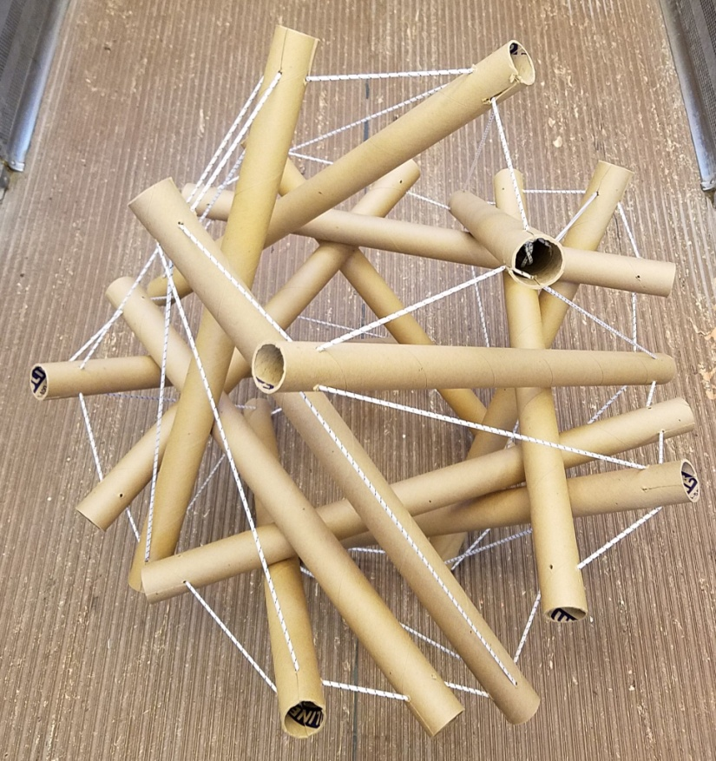
Scale Out: Everyone Has a Role in ROMA Implementation
Support Effective Action
Notes:
To improve agency performance through the implementation of the full ROMA Cycle and the Performance Management Framework
“Improving” is another word for “change” and we all know how difficult change can be.
We want to consider how we can create a pathway to the change that will improve the agency
Some ideas to consider as we get started:
The starting point for transition is not the end you have in mind, but what will need to end to leave the old situation behind…
Nothing so undermines organizational change as the failure to think through who will have to let go of what when change occurs.
Managing Transitions – Making The Most of Change by William Bridges

Slide 92

Scale Out
Spread knowledge and principles from peer to peer to create a cohesive body of support – tied together by common understanding and the desire to act.

Slide 93

Some Things That Have Worked
Talk to your peers
Engage a “planning partner”
Organize a group of interested people who can discuss and consider actions related to improving agency efficiency and effectiveness.
Create stories and speculation about the expected impact
Promote “Knowledge Transfer”

Slide 94

Sharing ROMA
Consider how you can share key elements of ROMA with peers and colleagues in the agency.
New employees
Management Teams
Board Members
Connect with people who are champions in the agency.
Notes:
Various kinds of sharing sessions and training are cited by NCRPs.
One recurring example is “on boarding” of new employees, providing a ROMA orientation as part of the first days on the job.
This “sharing” is also known as “Knowledge Transfer”

Slide 95
Positional and Personal Power
There are two kinds of power – one that comes from your position in the agency (because of your job, you have authority to make decisions) and the other that comes from your interest and passion about a subject (your personal power)
Recognize the importance of influence (instead of leadership or authority)
Improve your communication skills:
conflict management, relationship and trust building
reflection, powerful questions, empathy, curiosity
Act from humility
Join your knowledge with the knowledge of others
Notes:
ROMA implementation is not just for staff who are in positions of power.
Recognize that different views, priorities, realities need to be considered and valued

Slide 96
Where are you in the agency?
Sphere of interest
Sphere of influence
Sphere of control
Notes:
Consider your role in the agency. What is in your control? What can you influence? And what is interesting to you?

Slide 97
Thinking about your role
Is ROMA valued in the organization?
Do you have tasks and responsibilities related to ROMA implementation?
How do other professionals/staff in your setting view work related to ROMA?
Are you valued for your work with ROMA?
How do you view your ROMA work?
What do you think your contribution is to your agency? What could it be?
Notes:
Ask NCRPs in the audience: What does being a Certified ROMA professional mean to you? Are you in a position to be a champion?
Ask workers who are NCRPs to think about their position in the agency using these statements.
Ask those who are not NCRPs to think about the statements in relationship to the ROMA implementation tasks they are assigned.
Ask those who not engaged in ROMA work, what IS your role?
Ask EDs if they value the people who are charged with any of the ROMA implementation tasks – and how they show this value
Indicate that this is just to get participants thinking about values, responsibilities and actions.

Slide 98
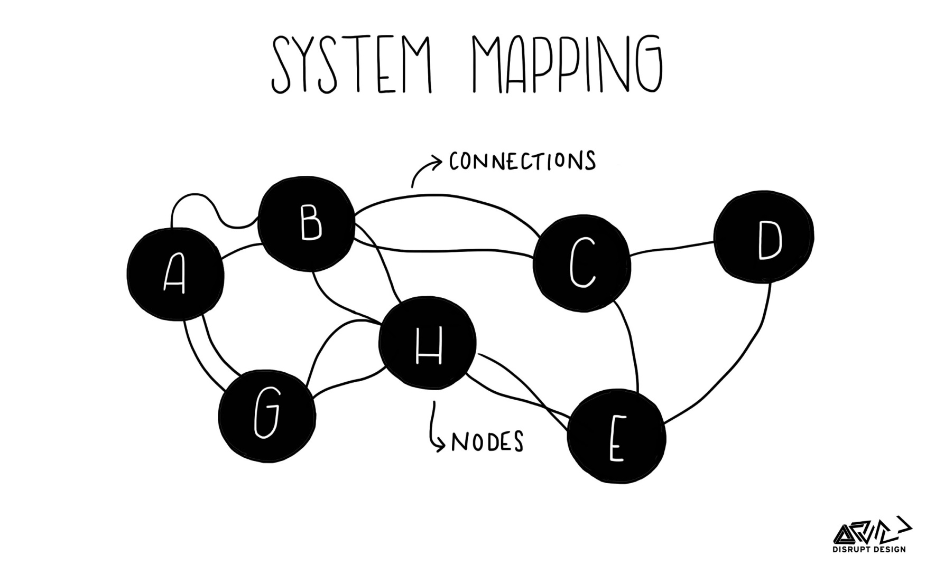
Find The Influencers
Notes:
The behavior of a system is driven by its underlying structure and the relationship between the elements. By constructing an Influence Diagram, those
relationships can be identified and documented such that they can be explored with a view to understanding or modifying a system’s behavior.
If you are not the ED or have the ED’s ear, you will have to find the Influencers in your agency.
Who influences the decision makers? Who influences them?
How can you get to talk to the people who have influence?
The process for constructing an Influence Diagram comprises four steps:
Step 1: Brainstorm all potential elements of the system of interest. An element can be a person and groups of people, a process, equipment or hardware, building and places. Basically anything.
Step 2: Identify natural groups of elements that have similar/common views/features/aspects. These groups should be given a collective name. The combination of steps 1 and 2 is a Systems Map.
Step 3: Using the groups construct the Influence Diagram by identifying and documenting the influences between the various groups. The approach here is to consider each system element on the map and determine the presence and nature of any relationship with any other group. The relationships can be physical entities, information and controls flows or less tangible influences. Finally, record any relationships on the map to create the influence diagram:
•Show only definite influences or relationships, but do not ignore influences, because they are not tangible.
•Try to avoid influence lines crossing.
•Make sure that the diagram is easy to follow.
•Show the direction of the influence.
•Name the influence.
Step 4: Review your completed Influence Diagram to explore and understand observed system behavior or potential behavior. At this point it may be necessary to consider the “components” inside the groups on the Influence Diagram and determine whether or not to redefine the groups or consider the interrelationships inside a group.

Slide 99
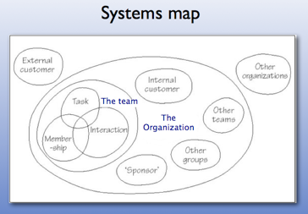
Sub Groups Can Be Important
Notes:
This just is a way to get you to recognize that your systems map may identify sub groups that are working together – and may have different patterns of behavior than the other sub groups and the agency as a whole.
Some sub groups may have mini-cultures within the organizational culture.
Note to facilitator: don’t get lost in the diagram.. It is just a graphic to show that some parts of the agency may work together.
It might be different departments that are grouped together.
It is important to know where the support for ROMA lives in these different groups, so you know how to begin to influence them.

Slide 100

Create a plan
-Identify the IMPACT
-Understand the PATHWAY needed to get to the impact
-Create action steps in your PLAN
Notes:
Our goal for NCRPs: Help make explicit their personal and agency-identified expectations related to improving implementation of the full ROMA cycle in the Community Action Network.
Our goal for the network: increased capacity to achieve results.
So we believe the use of a Plan will help to identify the impact that is going to be seen because of the implementation of this plan.
Once you have identified the baseline, you can then pick something to work on that will have an impact.
Identifying the impact you want to work on will help you move to knowing what the pathway is toward that impact!!
But the plan must have clear action steps to make it a reality.

Slide 101
What would be easy?
What is one thing you identified as a barrier that might be easy to change?
Are there some people/departments that are interested in change, but just don’t know how to move forward?
If they are already moving, it could be easy to help them along!
Notes:
What impact do you expect to see?
When you identified the baseline, you found things that were “in crisis” or “vulnerable” and you probably identified some things that are “stable” but could be moved into “safe” with just a little bit of attention.
What do you pick to work on first?
One idea is to pick something easy to start with because once you have a “win” it is easier to continue to be successful.

Slide 102
What is critical?
Is there something that is not happening, or something that is not happening well?
Something that is an Organizational Standard that is “unmet”?
Something that you feel you can influence?
Notes:
You may not make a big change in something that is complex, but you might be able to identify one step forward.
Example: the agency has not done a Community Needs Assessment in more than 5 years and doesn’t have a plan to do one now… that will take considerable activity to get moving and to get all of the pieces in place (see separate training about putting together a CNA team and collecting data).
So you can consider one thing you feel you can do to start the movement. Maybe offer to do a training about the CN A.

Slide 103
Recognizing what you can and can’t do (right now)
Start with something you CAN change
Build a win and then you will have success stories to build on
Is there something happening that is an excellent example of ROMA principles? Something that is already working? How can you promote and celebrate it?
Notes:
Celebrating something that is working can be a good strategy for creating interest in the full ROMA Cycle.

Slide 104
Establish a Pathway forward….
First: identify ONE issue to address
Identify the potential impact of this work on the agency’s performance
Clearly define the current process. Identify the current steps.
Ask the people who are engaged in the process now. What do they do? When do they do it?
Consider what needs to change
Gather statistical data if it is available. How many? How often? How much? What agency report data do you have regarding this issue?
Check with your peers in other agencies to see how they are addressing the same issue.
Identify the point where the system breaks down.

Slide 105
What do you need for change?
Quality Improvement
ROMA
impact
Knowledge base
people
resources
What do you need?
skills
Ability to interact
Software Hardware
time
Notes:
Don’t forget that you need resources to put your plan into action.
These are just some ideas… each of you will have to identify what you need to make an impact!

Slide 106
Example: We do a good job of reporting on outputs but not with reporting on outcomes.
How is the reporting on outputs structured?
Who does it? How often? Measurement tools? How is it collected?
What is the related outcome? (or outcomes)
How would you know if that was achieved?
Who would do data collection? How would they measure? How often?
Identify the point where the system breaks down or could break down
What is the barrier (time, customer is not available for follow up, tool doesn’t provide measure, etc.)?
What has to happen first to make an impact?
What will that open the door for? (and so on…..)
Establish a pathway to support the establishment of the new action steps.
Identify resources you will need (time, people, material, training, etc.)
Time frame for you to be engaged in the pathway.

Slide 107
Pathway for collecting output data
Intake worker collects demographic data and enters into data base
Housing counselor meets with family and identifies immediate needs and services available
Family is referred for a rent payment and data regarding the service (including amount of payment) is entered into the data base
Service data is reported to supervisor monthly
Supervisor meets with Housing Counselor to discuss number of people served and amount of rent payments distributed
No plan for follow-up to find out results
Appears no discussion about overall family goals is happening
Only service data is reported – no outcome data is expected to be reported
Supervisor and counselor do not talk about what might have happened to the families served
Notes:
Consider where a focus on results could be included. (click to bring in pink arrows)

Slide 108
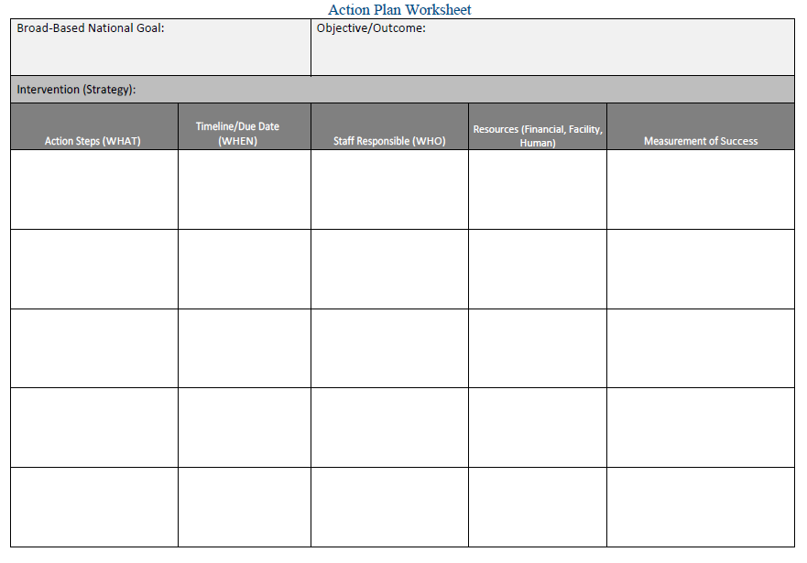
Notes:
Hand out blank worksheet and get participants to consider the example and identify some action steps that would address the issues in the example provided.
Have them just work on the first four columns. (We will come back to measures of success later.)
After about 5 minutes, ask for some feedback from the participants to see how they are approaching the task.
Then show the next slide, which is how we started to consider what was needed.

Slide 109
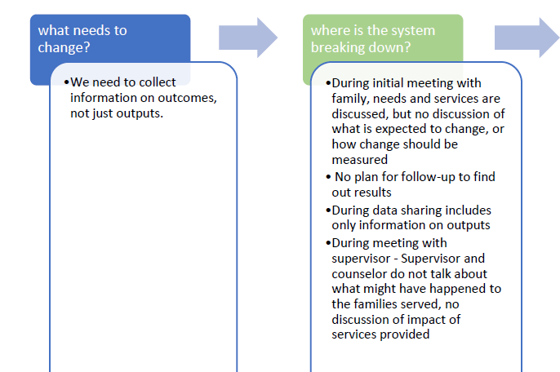
Notes:
We identified the areas that showed us where the process was breaking down.
It starts with the initial meeting with the customer, when we are currently just identifying eligibility and referring to a service that is available.
Using this flow chart idea will help to identify what actions need to be taken.
Have the group go back to their work on creating action plan. Give another 5 minutes.

Slide 110
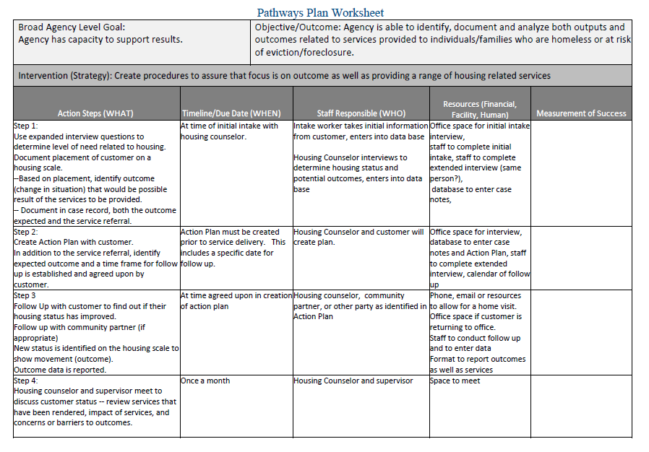
Notes:
After sharing some ideas from the participants, you can show this example of first four columns – this takes the things identified on the flow chart and makes the action steps more specific.

Slide 111
Some Ideas of Areas to Pick for the Plan
.
.
.
.
.
.
Notes:
Ask participants to identify some areas that they have already identified.
Here are some ideas for consideration:
Once realizing that you are not integrating the phases of the ROMA cycle, you want to identify how you can improve consideration of performance, improvement and results of new efforts as all part of the same process.
The plan is not based on what is identified in the community needs assessment.. How can this be addressed?
Identifying measurement tools and practices to track impact (at both family and community levels)
Strengthen data collection processes – what supports are needed at the level of direct service workers who are entering the data
Who is doing the analysis (in addition to reporting) of the data? How can this be shared/improved?
How can data be better used to inform decision making?

Slide 112
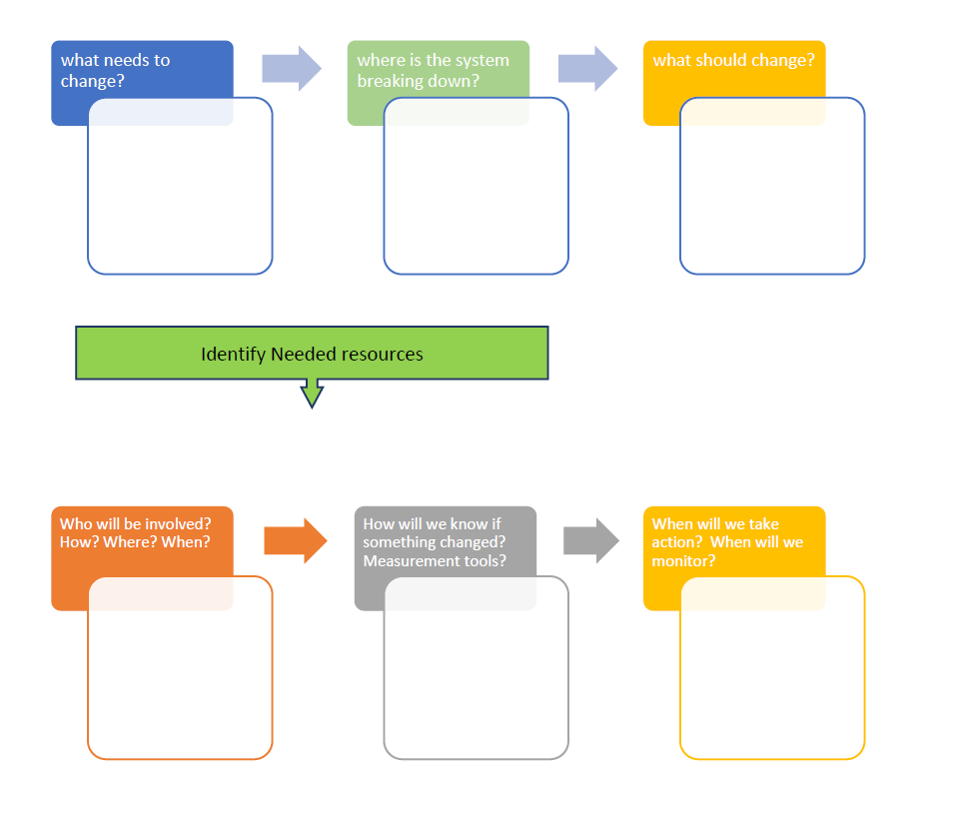
Blank Flow Chart
Notes:
This is an example of a flow chart that can be used to identify action points.
You can make copies of this and hand out to participants.

Slide 113
Observe and measure results
After you have taken action, you need to know what happened

Slide 114
Include Indicators in your Plan
Your Impact Pathways Plan will not only include steps and time frame, but will also include “indicators” of success.
How will you know you are making progress?
What do you expect to see change that you can measure?
Notes:
There is a column in the action plan handout about measures of success.

Slide 115
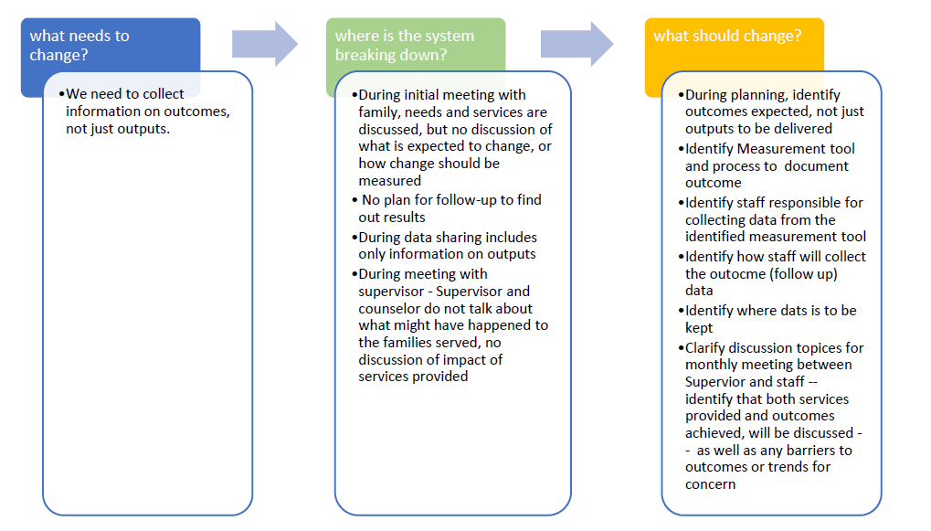
Notes:
Example with measurement processes identified – this isn’t just about the measurement tools, but also about who will do it and what happens to the data from the tool.

Slide 116
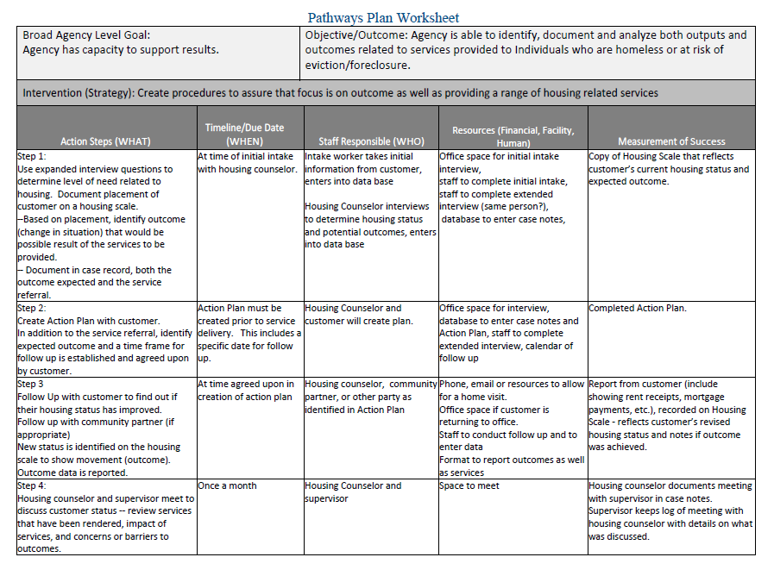
Notes:
Example with measurement tools identified

Slide 117
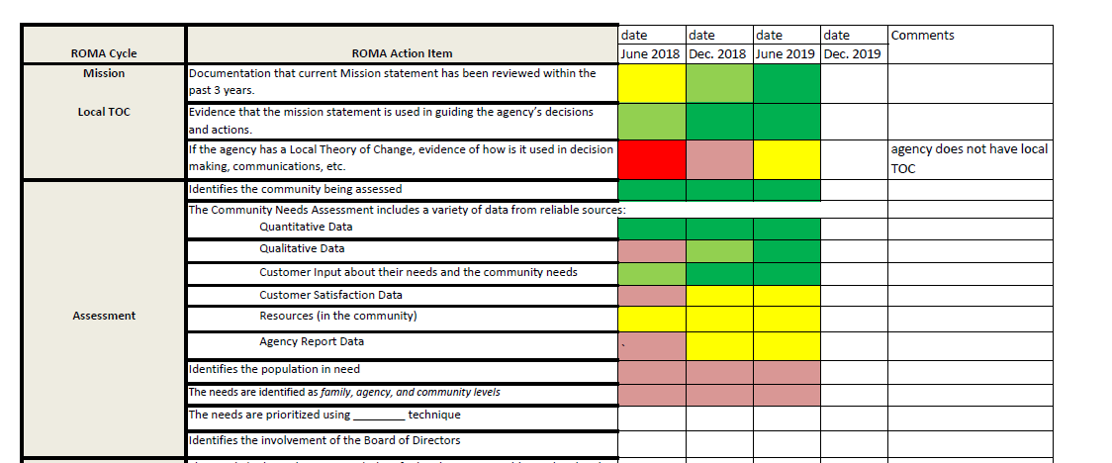
Use a Scorecard to Follow Progress
Notes:
This is a simple way to track progress……
You will need to identify what measurement processes you will use to identify movement from yellow to green to red.
Or from “in crisis” to “thriving”

Slide 118
Some General Trends to Monitor
These are things the network is talking about:
Using ROMA cycle to consider performance, improvement and results of new efforts
Identifying measurement tools to track impact at both family and community levels
Strengthen data collection and analysis (in addition to just using data for reporting)
Using data to inform decision making
Notes:
Are any of these happening in your agency? How could these ideas be put into your Impact Pathways Plan?
What else is important?
Quality of staff?
Access to unrestricted funds to meet needs
???

Slide 119

Closing Thoughts

Slide 120
What else do you need to know?
Will my organization do all of this?
Considering how much we are already doing, what needs to happen to improve?
Who will take the lead? Who is responsible?
Notes:
Who is your champion?

Slide 121
So what can YOU do?
What is the first thing you will do?
Will you use the ROMA checklist to determine your agency’s current practices?
Other steps?
Notes:
We have provided the ROMA Audit Checklist as a way to help you assess what is currently being done to implement ROMA.
Given you some examples of how to create a plan for a pathway to impacting change in your agency
identified some “building blocks” that could be useful as you consider a strategy to improve a ROMA culture,
and suggested using a scorecard to follow your progress toward change.
What will you do ?

Slide 122
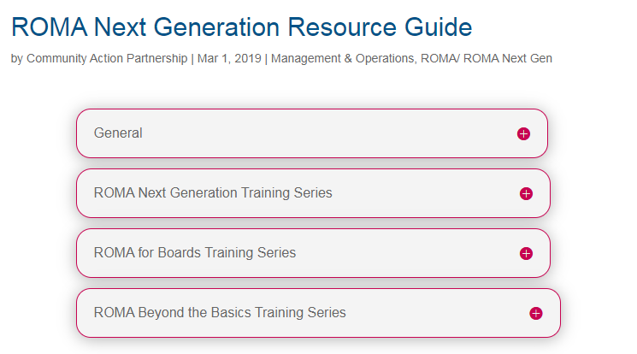
Implementing ROMA ROMA Next Generation Training Series
https://communityactionpartnership.com/publication_toolkit/roma-next-generation-resource-guide/

Slide 123
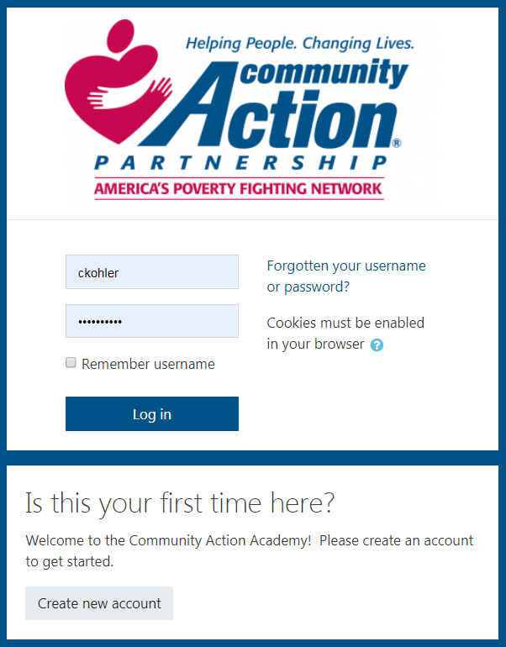
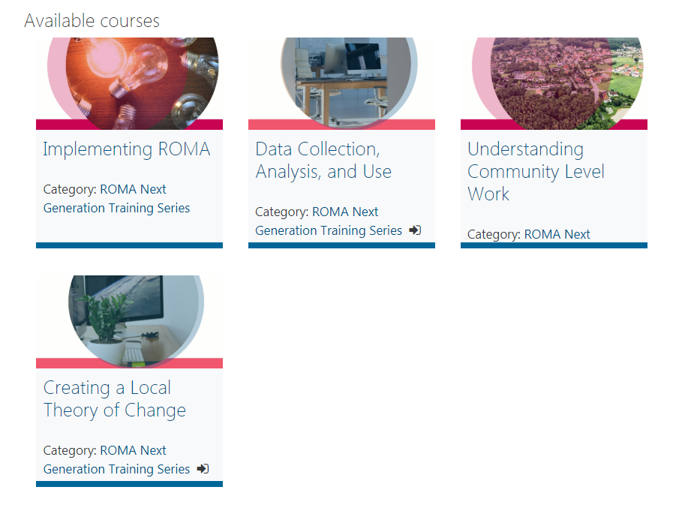
On-Demand eCourses Community Action Academy
NEW!
Implementing ROMA
Access Community Action Academy (FREE!)
Create Account/Login → ROMA Training → ROMA Next Generation Training Series
https://moodle.communityactionpartnership.com

Slide 124
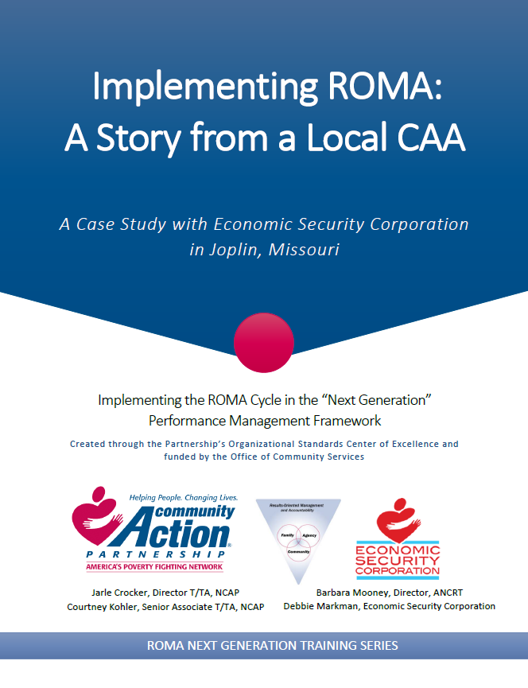
Associated Resources
Partnership Website:
https://communityactionpartnership.com/publication_toolkit/roma-next-generation-resource-guide/
Community Action Academy:
https://moodle.communityactionpartnership.com/course/index.php?categoryid=23

Slide 125
Contacts
Courtney Kohler, MPA, CCAP, NCRT
Senior Associate, T/TA
Community Action Partnership National Office
ckohler@communityactionpartnership.com
Barbara Mooney, Ed. D., NCRP
Director
Association of Nationally Certified ROMA Professionals
barbaramooney@windstream.net
Carey Gibson, MSW, NCRP
Project Manager
National Peer to Peer NCRI Project
careylgibson@gmail.com
This presentation was created by the National Association of Community Action Agencies – Community Action Partnership, in the performance of the U.S. Department of Health and Human Services, Administration for Children and Families, Office of Community Services Grant Number 90ET0465. Any opinion, findings, and conclusions, or recommendations expressed in this material are those of the author(s) and do not necessarily reflect the views of the U.S. Department of Health and Human Services, Administration for Children and Families.

