Slide 1

National Webinar:
Solar Initiatives in Rural Communities
July 24, 2019
Hosted by:
Weatherization Leveraged Partnerships Project
Notes:
National Hub for the 1,000 Community Action Agencies
Out network has a long history in fighting poverty, connecting families to opportunity, and promoting equity in our communities
We offer a variety of services and implement different strategies to respond to the local need
From Head Start, to workforce development, to LIHEAP, and WAP, and Senior Services – we know the needs of the community, and the community knows us
The Community Action Network documented over 200,000 partnerships in 2016
Our Weatherization Leveraging Report showed the $358 Million leveraged by the WAP Network as a result of partnerships and advocacy
The Community Action and Weatherization Network are key players on issues of energy equity in our communities – today’s webinar will offer one way to utilize that expertise

Slide 2

Weatherization Leveraged Partnerships Project
Funded by the Department of Energy to offer training and assistance to WAP subgrantees and their associations in designing private partnerships and programs that leverage the WAP.
Notes:
The Weatherization Leveraged Partnerships Project that I manage at CAP is funded by DOE to promote these kinds of partnerships
To offer training and assistance to
WAP Subgrantees
Their Associations
Designing Private PARTNERSHIPS and PROGRAMS
That Leverage the WAP
Thrilled to have Madiana Mustapha to talk about ways for you all to get involved in the Energy Efficiency For All work, and with two local organizations – Southwest Georgia Community Action Council and Georgia Watch to share their insights on working on these issues.

Slide 3

THE PROMISE OF
COMMUNITY ACTION
Community Action changes people’s lives, embodies the spirit of hope, improves communities, and makes America a better place to live. We care about the entire community and we are dedicated to helping people help themselves and each other.

Slide 4

https://communityactionpartnership.com/events/category/webinars/

Slide 5

Training & Technical Assistance
The Community Action Partnership offers a variety of Training & Technical Assistance (T/TA) to meet the needs of the national network. Topics include, but are not limited to:
Management & Operations Organizational Standards
Community Needs Assessment Strategic Planning Data Analysis Board Governance Succession Planning Customer Satisfaction Systems Strategic Financing
Risk Assessment
Innovative Practices
Two-Generation Approaches Bundling Services
Financial Empowerment
Racial Equity
Trauma Informed Approaches Health Intersections Homelessness Poverty Trends Developing a Learning Community
We design and deliver trainings tailored to the needs of our Network:
Webinars l Workshops l 1-2 day In-Person Trainings

Slide 6
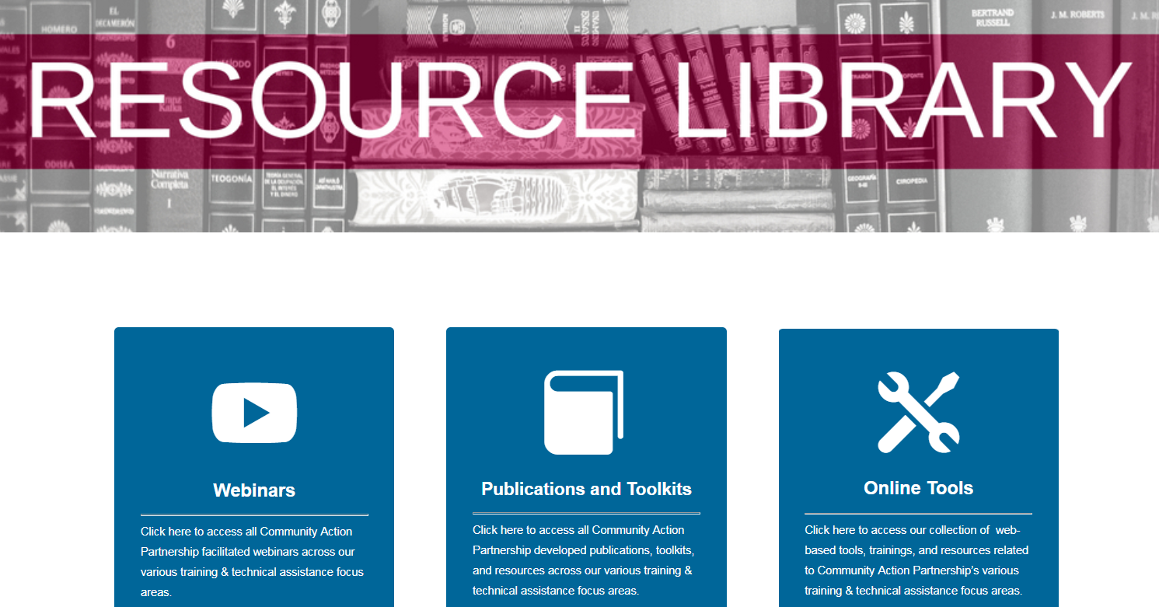
NEW! Partnership Resource Library
www.communityactionpartnership.com > Tools & Resources > Resource Library

Slide 7

2019 National Community Action Partnership Annual Convention
Community Action: A Voice for Change

Slide 8
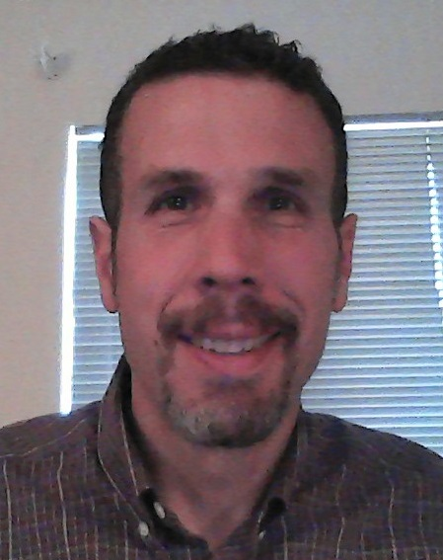
Mark Moormans, Manager - Strategic Projects, People Incorporated
Mr. Moormans holds a degree in Architecture from the Massachusetts Institute of Technology and brings a wealth of business, project management, design, construction and community development experience to People, Incorporated. He has worked for over twenty years in both for-profit and non-profit leadership roles successfully managing multi-million dollar budgets and supervising cross-functional teams of over 100 people, often spread over diverse geographic areas, including internationally. During his tenure in Eastern Europe, he worked to establish and staff a network of benevolent organizations whose impact and development projects spanned eight countries. He is responsible for managing People Incorporated’s portfolio of new and ongoing strategic projects, including most recently the first $1MM phase of a multi-phase CDBG project for a recovering historic mining community in the Appalachian region of southwest Virginia.

Slide 9

People Incorporated of VA
Solar Initiatives
in Southwest Virginia
Solar Workgroup of SW Virginia

Slide 10
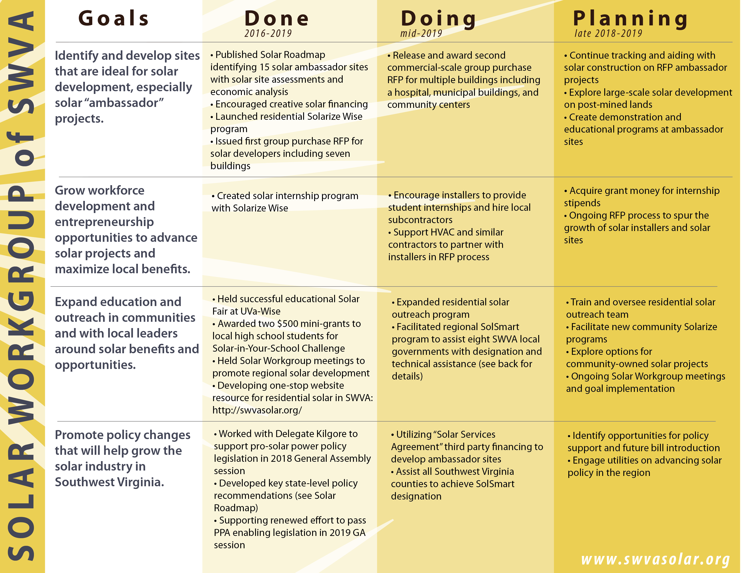
Notes:
Brief history of the Solar Workgroup of SWVA, People Inc. as a co-convener
Goals in simple English - 1) Install high-visibility, cost effective solar, 2) by Southwest Virginia residents, 3) understood and appreciated by residents and leaders, 4) in a solar friendly policy environment.
Our goal as a CAA – lower, more predictable utility expenses, potential job creation

Slide 11

Progress
Existing Installations
  Abingdon (very limited, low maintenance)
  Dante (more comprehensive, service issues)
In Process Implementations
  Norton Elderly Housing (40 units)
  Abingdon LMI Housing (20 units)
Supply Chain opportunities?
Notes:
Our participation in larger scale group commercial RFPs as pilots to determine larger scale rollout and feasibility
Also discuss regional cultural change regarding sustainable job creation vs. rich fossil fuel history

Slide 12
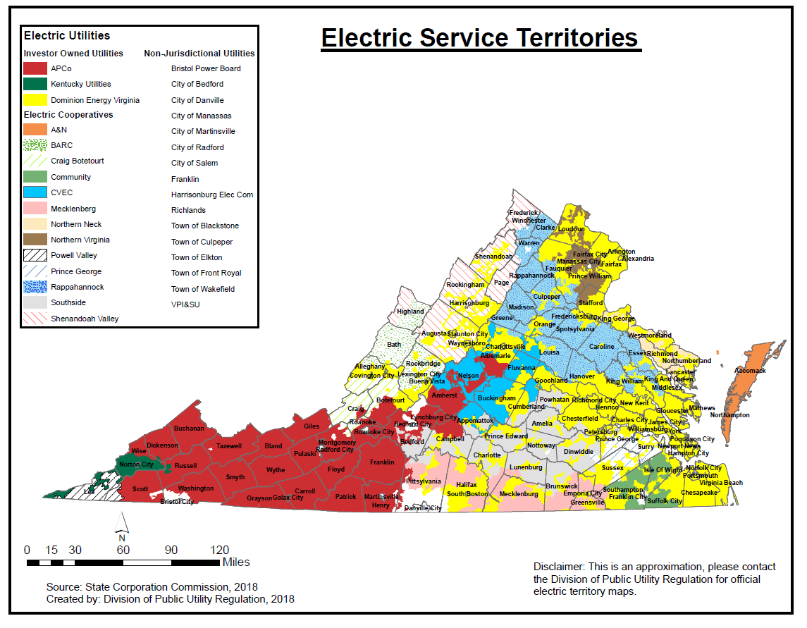
Diverse Provider Landscape
Notes:
Map of the electric service territories in Virginia. Dominion is yellow – major population centers; APCo is red; ODP/Kentucky Utilities is green and PVEC is green striped.
Unfortunately, solar policy and energy regulation is NOT uniform across the state; but instead, it sometimes applies differently to the different electric utilities.
Working with SCC to help make policy application uniformly fair across the state.

Slide 13
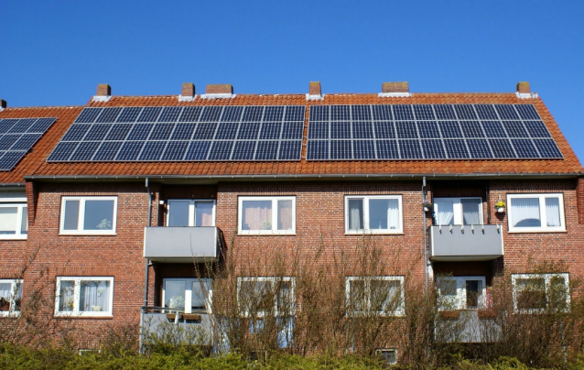
Challenges / Legislative Priorities
Third Party Ownership/PPAs
Net Metering
Meter Aggregation
Community Solar
Notes:
Define terminology and discuss disparities in how policy is applied in our region, particularly as it affects non-profits and/or commercial multi-housing installations
PPAs are about tackling the barrier of upfront cost
Net metering is about gaining the benefit from solar by selling back power (in the form of credits) to utilities
Meter aggregation is about allowing multi-housing units the benefit of shared solar arrays (brings down upfront installation costs and longer term management costs)
Community solar is about bringing solar to LMI home-owners who otherwise couldn’t afford individual installations.

Slide 14
Bryan Phipps, VP/Chief Development Officer
bphipps@peopleinc.net
276-619-2286
Mark Moormans, Manager - Strategic Projects
mmoormans@peopleinc.net
276-619-2247
Notes:
Our participation in larger scale group commercial RFPs as pilots to determine larger scale rollout and feasibility
Also discuss regional cultural change regarding sustainable job creation vs. rich fossil fuel history

Slide 15
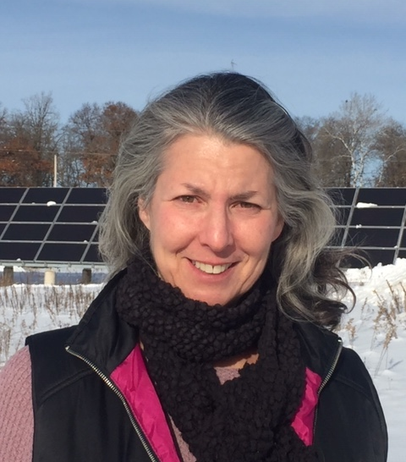
Vicki O’Day – Development Director RREAL
Vicki’s early career spanned twenty years in the financial services industry where she helped people invest for their futures then later focused on development of new products and services. She’s an active advocate for advancing the clean energy economy and transforming money consciousness.
At RREAL, Vicki manages the CS4CA program and works with community development leaders in creating strategies and social impact finance mechanisms to build resilient futures that mitigate energy poverty and combat climate change.

Slide 16
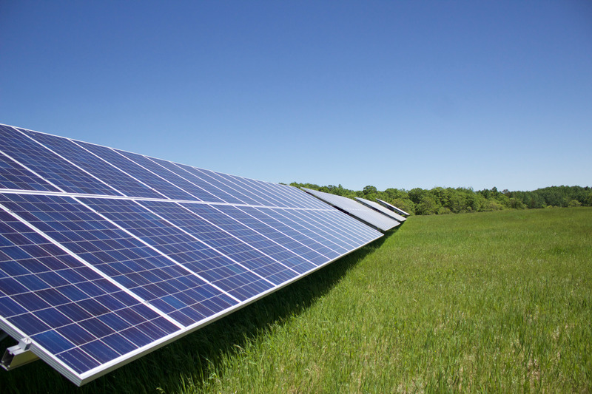
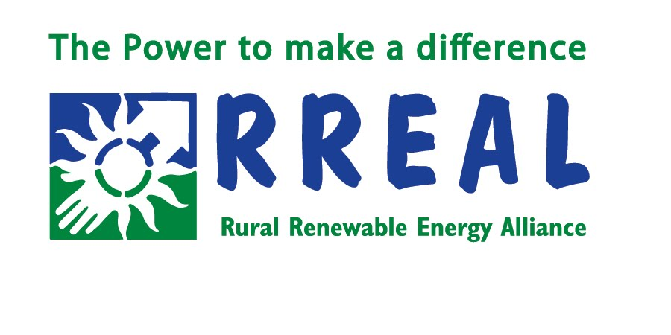
Changing the Face of Energy Assistance with Solar Assistance
2019 Community Action Partnership
Community Solar for Community Action

Slide 17
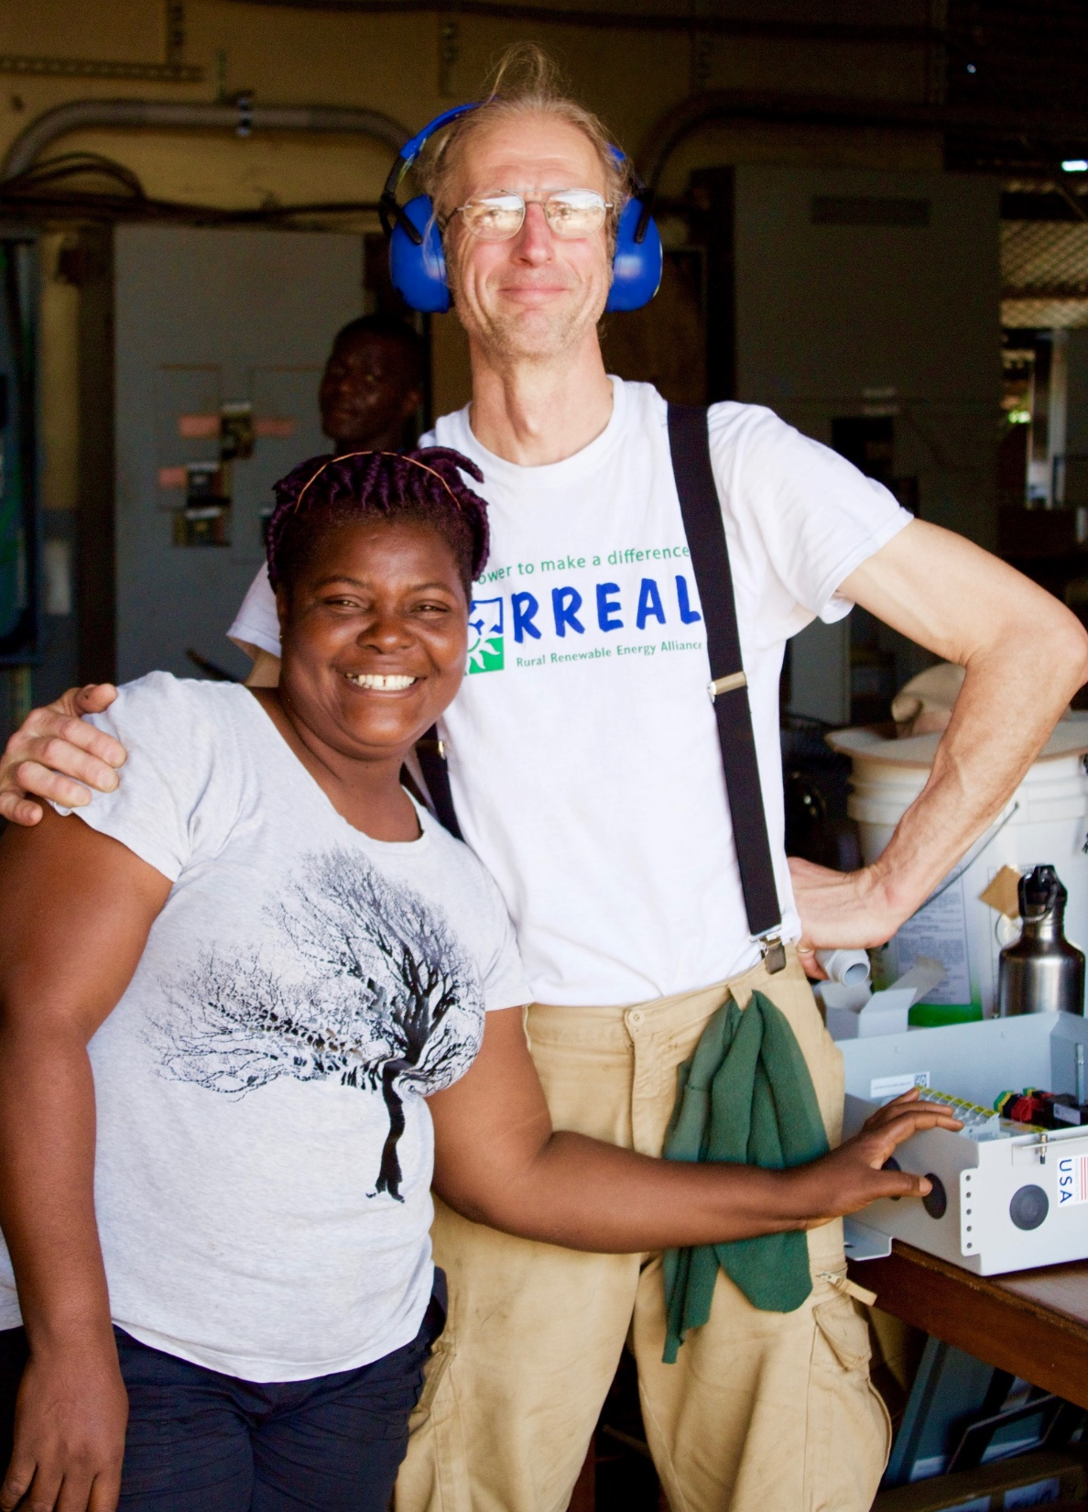
MISSION
RREAL is a Minnesota-based 501c3 nonprofit with a mission is to make solar energy accessible to everyone and empower rural and low-income communities across the globe with a clean, reliable source of energy.
MISSION

Slide 18
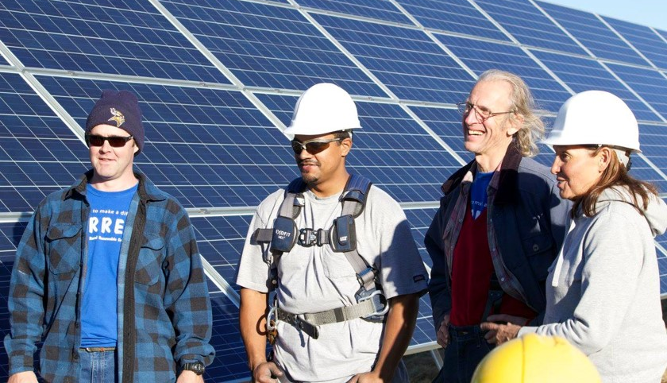
First Community Solar Integration into LIHEAP
Leech Lake Nation
RREAL developed
RREAL funded
RREAL served as EPC
200 kW Ground Mount
Partnership with First Nation
Solar Energy is a Fiscally Responsible Solution to Energy Poverty!

Slide 19
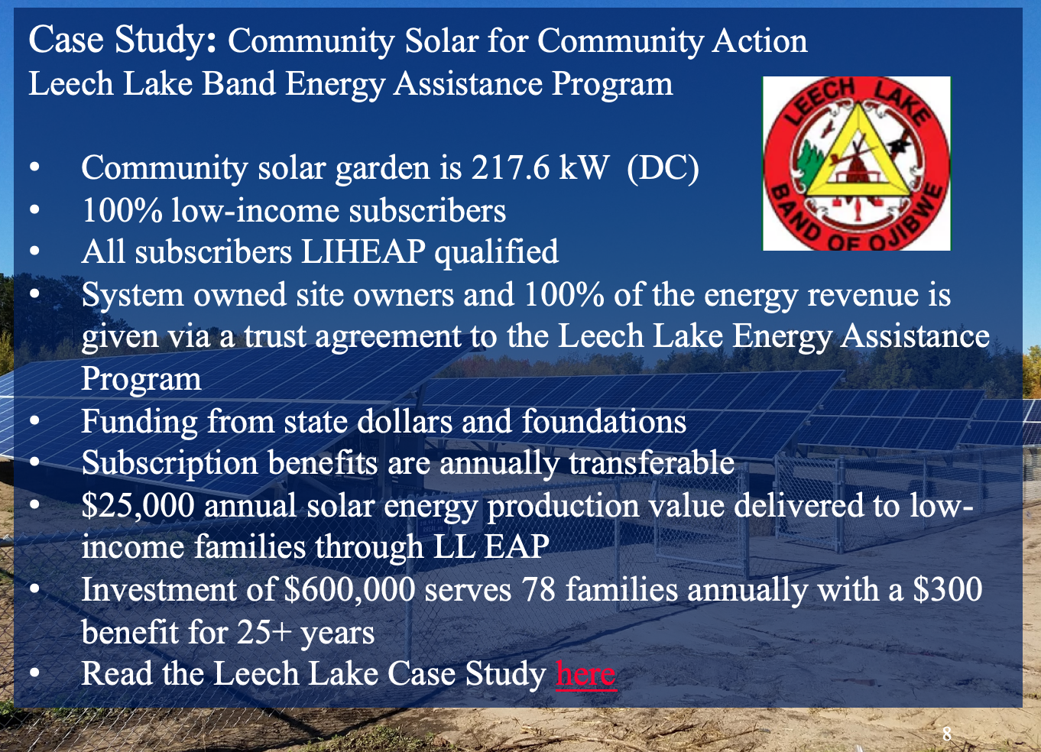
www.rreal.org/cs4ca

Slide 20
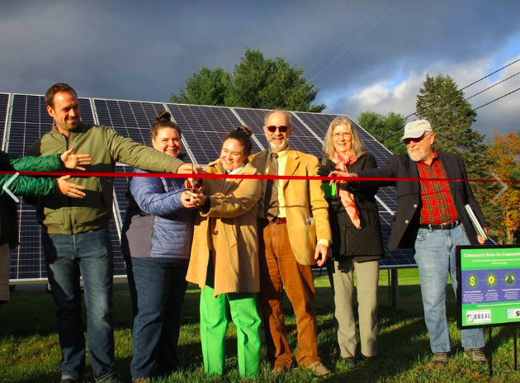
Westminster, Vermont
RREAL’s capacity to work with diverse stakeholders is unmatched and a testament to our collaborative spirit and technical acumen.
In partnership with Southeastern Vermont Community Action, RREAL developed and acted as technical advisor and financier for a ground-breaking CS4CA project where virtual net metering credits are serving as bill assistance for low-income Vermonters. We work across the nation and world!
RREAL’s efforts foster success and esprit de corps.
Nation Scaling of our Community Solar for Community Action Program
Notes:
110 kW DC array
50 families w on-bill credit

Slide 21

Community Solar for Community Action: A Nationally Scalable Model
White Earth Nation (2019)
American Indian Housing Organization (2017)
Leech Lake Band of Ojibwe (2017-2018)
Southeastern Vermont Community Action Agency (2018)
Tri-County Community Action Agency (2019)
Franklin County, Ohio (2020)
Kansas City Community Action Agency (2020)
= Upcoming Projects
Mississippi Delta LMI CSG (2020)
= Past Projects

Slide 22
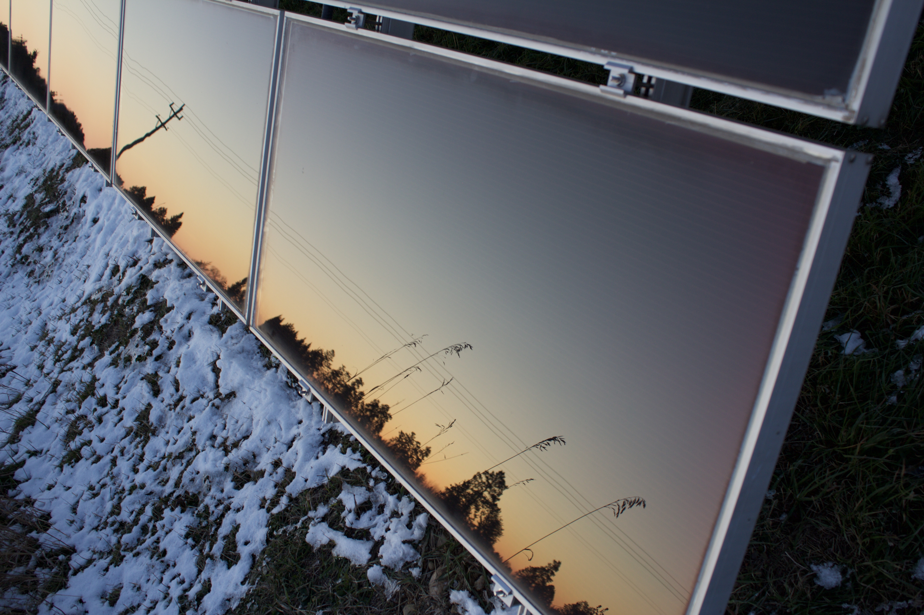
\
Key Benefits of Delivering Community Solar Assistance through CAPS
Low-income customer acquisition
Income Verification
LIHEAP Eligible
Public-private partnership
Utility relationships already exist
Mission and service alignment
National delivery infrastructure
Scalable, replicable, sustainable
Locally owned and operated
You Name One
Another?

Slide 23
WHY is this IMPORTANT?

Slide 24
HOW does it WORK?

Slide 25

WHAT about FUNDING?

Slide 26
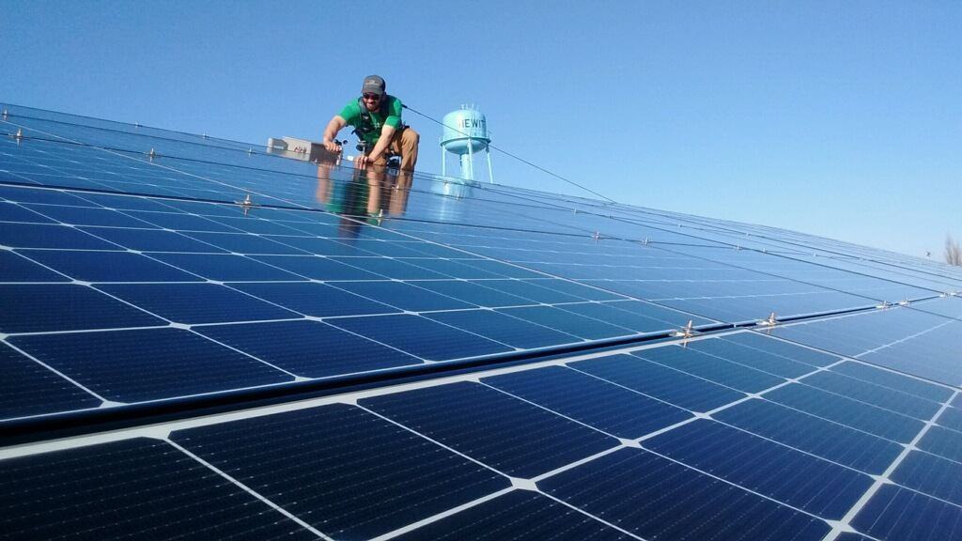
THANK YOU!
Thank you for your consideration and interest.
RREAL invites Community Action Partners across the United States to join us in delivering this innovative Solar Assistance model in your community.
For additional information, please contact me,
Vicki O’Day * vicki@rreal.org * 952-239-6198
Rural Renewable Energy Alliance
P.O. Box 89, Pine River, MN 56474
www.rreal.org/cs4ca

Slide 27
Thank You For Joining Today’s Webinar!
For More on Energy Partnerships:
Attend the Energy Partnerships Track at the CAP Annual Convention
August 28-30, 2019 in Chicago
    Update from the Department of Energy
    Percentage of Income Payment Plans
    Solar as a Social Enterprise
    General Session – Leading the
    Campaign for Affordable, Accessible Energy for All
Visit http://bit.ly/EnergyPartnerships
Contact Kathryn Maddux, kmaddux@communityactionpartnership.com
This presentation was created by the National Association of Community Action Agencies – Community Action Partnership, in the performance of the U.S. Department of Energy, Energy Efficiency and Renewable Energy Grant Number, EE0008051. Any opinion, findings, and conclusions, or recommendations expressed in this material are those of the author(s) and do not necessarily reflect the views of the U.S. Department of Energy, Energy Efficiency and Renewable Energy.

