Slide 1

Community Action and the Census:
What State Associations Need to Know
April 23, 2019

Slide 2
Agenda
Welcome and Introductions
Quick Census Overview
Why does the Census matter to us?
Get out the Count - what is being done?
Get out the Count - what state associations can do?
Next Steps and Questions

Slide 3
Welcome!
What do you already know about the Census?
What are you already doing for Census engagement?
What do you worry about?
Notes:
Please type your thoughts on these in the chat window

Slide 4
What is the Census?
Notes:
Census is constitutionally mandated

Slide 5
“Representatives and direct Taxes shall be apportioned among the several States which may be included within this Union, according to their respective Numbers…
The actual enumeration shall be made…within every subsequent term of ten years, in such manner as they shall by law direct”
- Article 1, Section 2 of the US Constitution
Notes:
Census is constitutionally mandated

Slide 6
Census Data is Used To…
Apportion representation among states
Draw congressional and state legislative districts, school districts, and voting precincts
Distribute federal dollars to states
Inform government planning decisions at the federal, tribal, state and local level
Inform organizational decisions (e.g., where to locate, size of market, etc.) of businesses and non-profits
Enforce voting rights and civil rights legislation

Slide 7
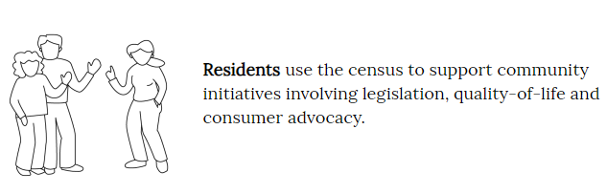
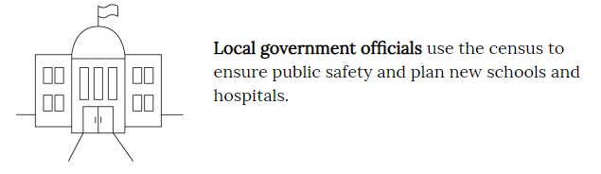
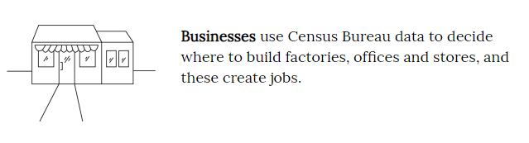
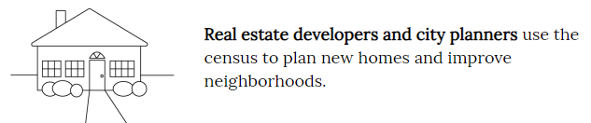
The Census in Your Community

Slide 8
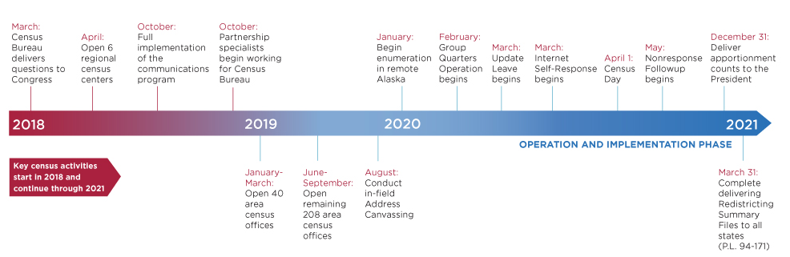
The 2020 Census
Operational Timeline
Notes:
Self-Response phase:
Census Bureau mails information about the decennial questionnaire to almost all households (before April 1, 2020).
For 2020, some households will be mailed the actual questionnaire, most households will be mailed an online link to fill out the form, & everyone will have the opportunity to mail in the form if they choose not to fill it out online.
The most accurate & complete population data is submitted during this phase.
Non-Response Follow Up phase:
The Census Bureau hires 100s of thousands of people to go door-to-door to count every household that didn’t self-respond (after April 1, 2020).
Much more expensive than the self-response phase ($2 BILLION in 2010).
During this phase, the risk is greatest that people will be missed and the count will be inaccurate.
Areas with large shares of households that don’t self-respond are therefore “hard to count”. Almost every community will have some households that don’t self-respond. But some communities have as many as half of their households that need to be counted in person. We’ve mapped these communities to help ensure a fair and accurate 2020 Census.

Slide 9
2020 Census Economics
Census Data will be used to distribute $800 BILLION in government funding for services
The Census hires 100,000s of people a cycle, and spends $15+* BILLION to complete the Census
The average cost for counting a household in 2020 dollars:
  1970 : ~$16
  2010: ~$92**
*https://civilrights.org/value/2020-census/, https://www.census.gov/fieldjobs
**in 2020 constant dollars

Slide 10
Why does the Census matter to Community Action?
Notes:
Census is constitutionally mandated

Slide 11
Census data determines federal funding (CSBG)
Census data informs all aspects of CAAs work
An inaccurate count means communities lose their fair share of resources and representation
Some groups are historically hard to count
They are the same people served by CAAs
Notes:
The Census determines federal funding that impacts all aspects of the work of Community Action Agencies at the agency, family, and community level (link to ROMA)
- Yet: Ensuring a fair, inclusive, and accurate count requires planning, testing, updating, training, and oversight. (Like a CAA!)
Some groups of people have historically proven to be challenging to count accurately, these groups are the same people surved by community action

Slide 12
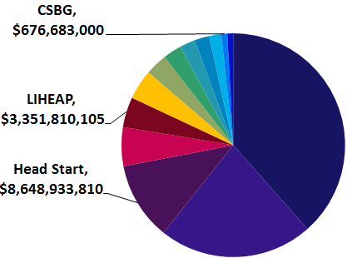
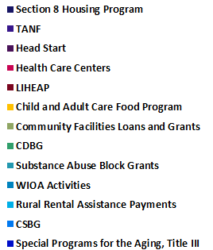
Census Data Drives Dollars
In 2016, 15 federal programs most used by CAA’s relied on Census data to distribute $77 billion or, 9% of $864 billion total federal program spending

Slide 13
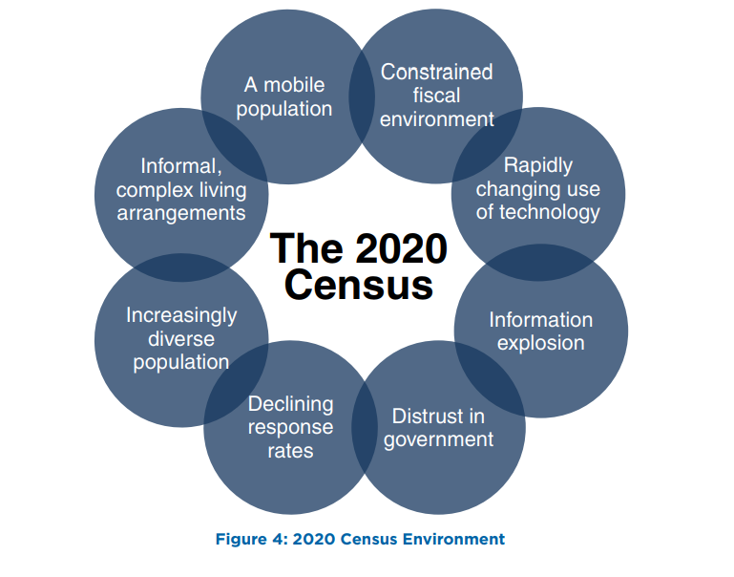
The 2020 Census- The Environment
Notes:
The Changing Environment and Escalating Costs
The 2020 Census challenge is exacerbated by multiple environmental factors that have the potential to impact its success.
• Constrained fiscal environment: Budget deficits place significant pressure on funding available for the research, testing, design, and development work required for successful innovation.
• Rapidly changing use of technology: Stakeholders expect the decennial census to use technology innovation, yet the rapid pace of change makes it challenging to plan for and adequately test the use of these technologies before they become obsolete.
• Information explosion: Rapid changes in information technology (IT) create stakeholder expectations for how the Census Bureau interacts with the public to collect data and disseminate data products.
• Distrust in government: The public’s concerns about information security and privacy, the confidentiality of information given to the government, and how government programs use the information they collect continue to grow. This impacts response rates and could make it more difficult for government agencies to collect important demographic survey information.
• Declining response rates: Response rates for Census Bureau surveys, and for surveys and censuses in general, have declined as citizens are overloaded with requests for information
and become increasingly concerned about sharing information.
• Increasingly diverse population: The demographic and cultural make-up of the United States continues to increase in complexity, including a growing number of households and individuals of Limited English Proficiency
• Informal, complex living arrangements: Households are becoming more diverse and dynamic, making it a challenge to associate an identified person with a single location. For example, blended families may include children
who have two primary residences.
• A mobile population: The United States continues to be a highly mobile nation as about 14.3 percent of the population moves in a given year

Slide 14
The Hard-To-Count Are:
New or forgotten housing
People trying to remain
hidden
Hard to Locate
Hard to Persuade
Suspicious of government
Not civically engaged
Undocumented
Misinformation
Hard to Contact
Hard to Interview
  Language barriers
  Low literacy
  No internet
  Unreliable mail
  Homeless
  Access barriers
  Transient communities
Notes:
This means the hard to count population includes a variety of categories including:
Young children under the age of five.
Racial and ethnic minorities.
Non-English speakers.
Low income people.
People experiencing homelessness.
Undocumented immigrants.
People who distrust the government.
LGBTQ persons.
People with mental or physical disabilities.
People who do not live in traditional housing.
People who are members of disadvantaged or marginalized communities –with the most to lose – are at greatest risk of being uncounted.

Slide 15
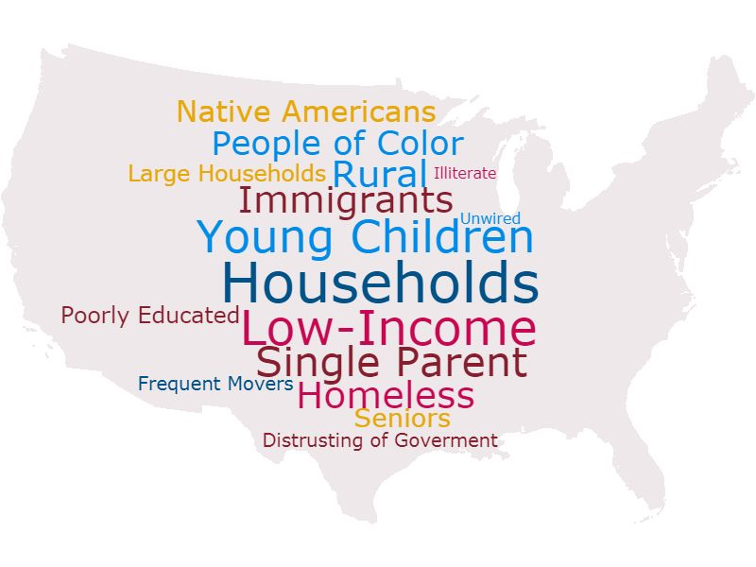
The Hard-To-Count Are:
Notes:
This means the hard to count population includes a variety of categories including:
Young children under the age of five.
Racial and ethnic minorities.
Non-English speakers.
Low income people.
People experiencing homelessness.
Undocumented immigrants.
People who distrust the government.
LGBTQ persons.
People with mental or physical disabilities.
People who do not live in traditional housing.
People who are members of disadvantaged or marginalized communities –with the most to lose – are at greatest risk of being uncounted.

Slide 16
Get Out The Count –
What Is Being Done?
Notes:
Census is constitutionally mandated

Slide 17
The Players
The Census Bureau
Census Counts
The Partnership and Community Action Network
Notes:
Census is constitutionally mandated

Slide 18
The Census Bureau
$15 billion being spent, nationwide, to count all people living in the US
Will support 250 Census Area Offices across the country
Census Day: April 1, 2020
Census can be completed online, by phone, or by mail.
www.2020census.gov
Notes:
Census is constitutionally mandated

Slide 19
The Census Bureau Engagement
Sign up as a Census Partner
Invite the Census to speak at your next Association meeting
Form or join a Statewide Complete Count Committee (CCC) and encourage local level CCCs
Advertise jobs with the Census to the Network: www.2020census.gov/jobs
Notes:
Census is constitutionally mandated

Slide 20
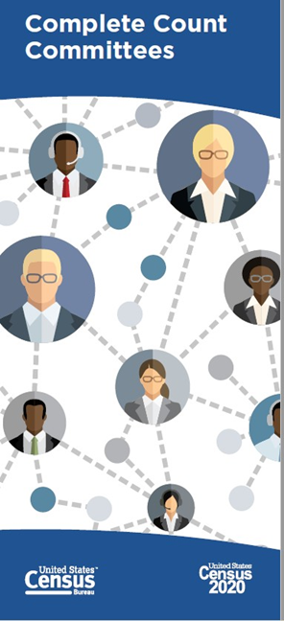
Complete Count Committees
CCCs utilize local knowledge and resources to promote the census through locally based outreach efforts.
CCCs provide a vehicle for coordinating efforts between tribal, state, and local governments; communities; and the Census Bureau.
CCCs help the Census Bureau get a complete count through partnerships with local governments and community organizations.
Notes:
The Complete Count Committees (CCC) program is key to creating awareness in communities all across the country.
CCCs utilize local knowledge, influence, and resources to educate communities and promote the census through locally
based, targeted outreach efforts.
CCCs provide a vehicle for coordinating and nurturing cooperative efforts between tribal, state, and local governments; communities; and the Census Bureau.
CCCs help the Census Bureau get a complete count in 2020 through partnerships with local governments and community organizations.

Slide 21
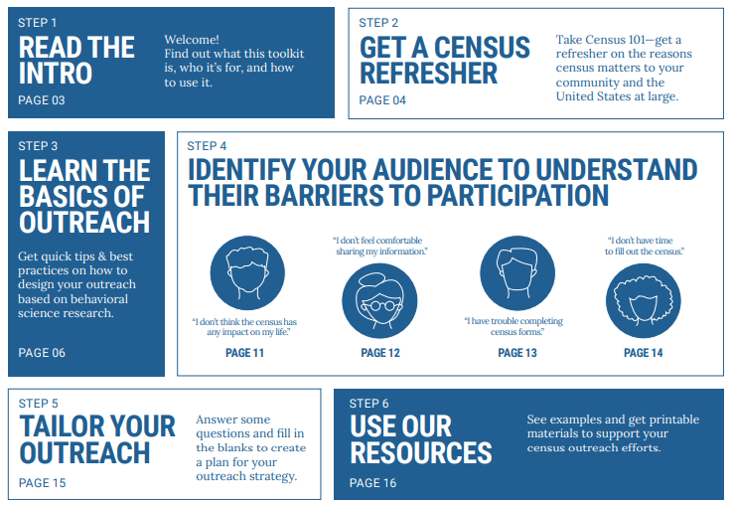
Census Bureau Outreach Toolkit
Notes:
The Complete Count Committees (CCC) program is key to creating awareness in communities all across the country.
CCCs utilize local knowledge, influence, and resources to educate communities and promote the census through locally
based, targeted outreach efforts.
CCCs provide a vehicle for coordinating and nurturing cooperative efforts between tribal, state, and local governments; communities; and the Census Bureau.
CCCs help the Census Bureau get a complete count in 2020 through partnerships with local governments and community organizations.

Slide 22
Census Bureau - Action Steps!
Contact your Census Bureau Regional Office and meet your Community Engagement staff
Invite them to your conferences and events
Sign up to be a partner on the Census website
Join/Form a Complete Count Committee at the state and local levels
Refer people to jobs with the Census

Slide 23

A collaborative campaign of 15+ national hub organizations, dozens of community partners in 30+ states working towards a fair & accurate 2020 Census.
Our communities can’t miss out on the political power they deserve & the resources their communities have earned.
Notes:
Census is constitutionally mandated

Slide 24
















Census Counts 2020

Slide 25
Census Counts 2020: Partner Efforts
Hub of Hubs
National Hubs
State Hubs
Local Action!

Slide 26
Census Counts – Action Steps
Contact State Hub (Count Action Network (CAN)) lead in your state
Connect with other hub network entities
Take the pledge to be counted, and receive campaign updates: www.censuscounts2020.org
Notes:
Census is constitutionally mandated

Slide 27
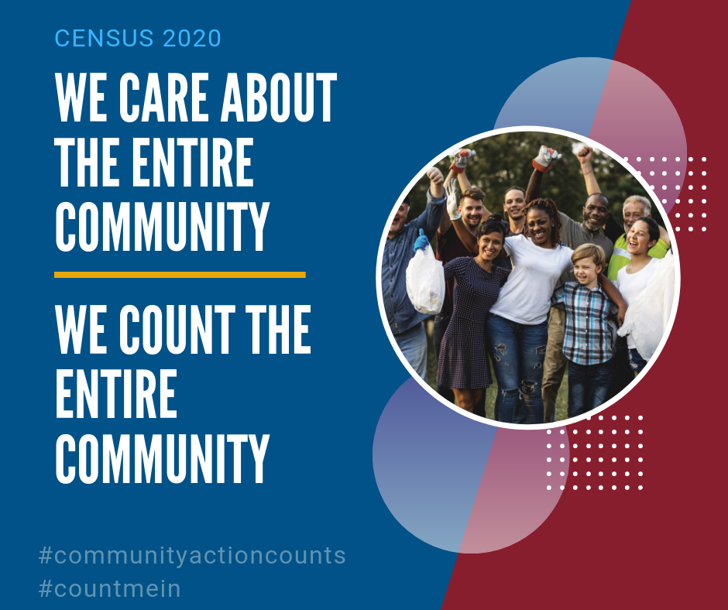
Community Action Counts-
What the Partnership is doing:
Educate and increase awareness of Census across network
Activate and mobilize the network to take action
Curate and generate census resources specific to Community Action
Equip agencies to conduct effective local outreach efforts
Notes:
Increasing Awareness and Capacity across the Community Action Network
Conducting in-person trainings on Census information, tools and curriculum at state, regional and national conferences
Holding regular national webinars about the value of a complete Census to Community Action, and showcasing tools to help CAA staff support our customers’ Census participation
Using the network of working group members and CAA field expertise to learn and promote Census best practices for Community Action

Slide 28
Community Action Counts-
What the Partnership is doing:
Training Materials
  Population Specific Webinars
Presentations at State Association meetings
Census Specific eNews
Social Media Campaign
Resources for frontline staff FAQs
Notes:
Census is constitutionally mandated

Slide 29
Community Action Census
Working Group
Includes 9 States with Largest HTC Populations
  Advisory council, network resource
AZ – Norma Gallegos
CA – Tony McAnelly
FL – Faith Pullen
GA – Lorraine Daniels
MA – Joe Diamond
NY – Jackie Orr
OH – Cheryl Grice
PA – Jen Wintermyer
TX – Laura Ponce
(Invited AL and NJ)
Notes:
Include if in one of these states, possibly delete if not

Slide 30

Training Tools
The Partnership has developed a series of videos to show how to talk to our customers and answer questions about their Census concerns
Notes:
Insert video still and link when ready

Slide 31

Engage With Social Media
Follow us on Twitter and Instagram, @capartnership
Sign-up for our Census newsletter for resources, trainings, and Census news
Join our Facebook group to engage with CAA staff across the network
Notes:
Need content – Jim has this as TBD. Could remove for earliest sessions.

Slide 32
Community Action Counts-
Action Steps!
Utilize Partnership resources to educate and increase awareness of Census in your state
Find out what parts of your state are Hard-To-Count and why
Look up how the census data will drive the distribution of Federal dollars to your state
Invite the Partnership to conduct a Census training at Conference
Train your agencies on how to encourage Census participation

Slide 33
Get Out The Count –
What State Associations Can Do?
Notes:
Census is constitutionally mandated

Slide 34
State Legislative Efforts
State legislators can support the 2020 Census by proposing bills and resolutions that:
  Appropriate funds for census outreach
  Establish a state “Complete Count” program
  Affirm access to residential buildings
  Raise Constituent Awareness of the Census
Notes:
Census is constitutionally mandated

Slide 35
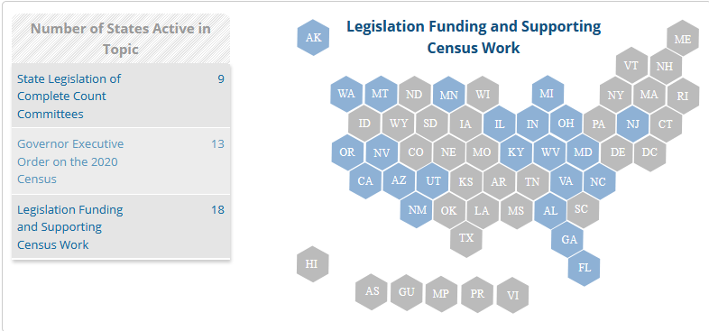
State Legislative Efforts
http://www.ncsl.org/research/redistricting/2020-census-resources-and-legislation
Notes:
Census is constitutionally mandated

Slide 36
State Legislative Efforts – Action Steps
Determine Legislative Session Dates
Contact State Elected Officials to appropriate funds for Census outreach
Connect with other local advocates to coordinate with and support existing advocacy efforts
Notes:
Census is constitutionally mandated

Slide 37
Resources for State Associations
List of SCCC/CCC’s
List of State CAN Network Contacts
CUNY Hard-To-Count Map
CBPP Report: Federal Aid to State and Local Gov.
Preparing for the 2020 Census: How State Legislators Can Ensure That Every Person Counts
National Conference on State Legislatures: 2020 Census Resources and Legislation
Notes:
Census is constitutionally mandated

Slide 38
Contact Us
Lindsay Marsh, Project Director
  lmarsh@communityactionpartnership.com
Liza Poris, Program Associate
  eporis@communityactionpartnership.com
Lil Dupree, Senior Associate, Research
  ldupree@communityactionpartnership.com

