Slide 1
Achievement of Results for Boards
Observing and Reporting
Progress and Results
A Video Series for CAA Board Members
Notes:
Objectives of this video will be to help the board identify:
agency performance -- what is working and what is not
the “why” behind the performance
how do they find out,
what does it all mean,

Slide 2
Implementing ROMA – A Video Series for CAA Boards
Introduction to Implementing ROMA for Boards
Creating a Local Theory of Change
Strategic
Planning
Implementation of Services and Strategies
Observing and Reporting Results
Community Needs Assessments
Analysis and Evaluation
Notes:
This presentation is a part of a series that is intended for Community Action Agency Board Members interested in deeper understanding of
How to help your Community Action Agency increase its capacity and its results.
How to meet and exceed Organizational Standards
The Roma Next Generation Video Series consists of these modules.
With me today to present this particular concept is Dr. Barbara Mooney, the Director of the Association for Nationally Certified Trainers. She is co-author of Introduction to ROMA, Research Fellow for the National Association for State Community Service Programs, consultant to the national Community Action Partnership, regional coordinator for Region Three Performance and Innovation Consortium and contributing author to Temple University's Strengths-Based Family Worker Training curriculum. Over the past five years, she has worked on the development of the OCS Performance Management Framework.
In addition we have …..

Slide 3
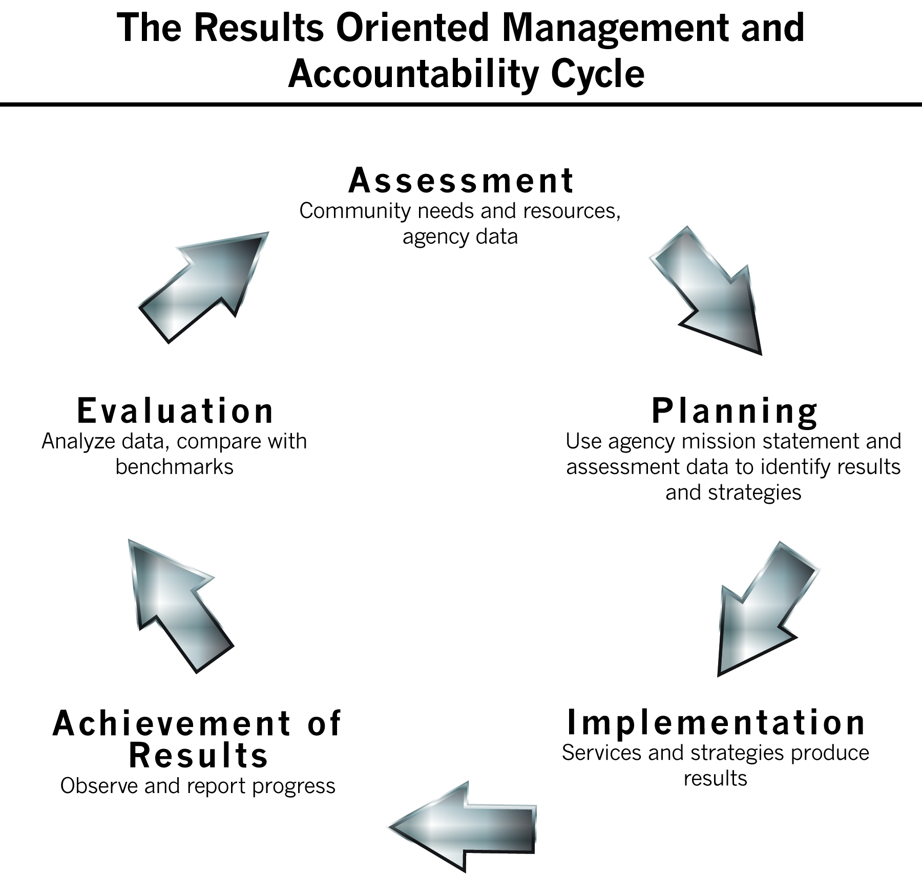
Notes:
The next phase of the ROMA Cycle we will explore is that of Reporting – observing, reporting your progress and results.
There are a number of Organizational Standards related to the Board’s role in the Reporting process.
The organizational standards related to this:
Standard 5.9
The organization’s governing board (department’s advisory board) receives programmatic reports at each regular board meeting.
Standard 9.1
The organization/department has a system or systems in place to track and report client demographics and services customers receive.
Standard 9.2
The organization/department has a system or systems in place to track family, agency, and/or community outcomes.
Standard 9.4
The organization/department submits its annual CSBG Information Survey data report and it reflects client demographics and CSBG-funded outcomes.

Slide 4
Board Roles
Duty to review programmatic reports
Duty to assure the organization has a system in place to track:
Client demographics
Services customers receive
Family, agency and community outcomes
Duty to approve and submit designated reports to funding sources
Notes:
These two standards are in the Data and Analysis section, as they are about more than just completing reports.
We will come back to talk about this more in the last video segment.

Slide 5

Purpose of Reporting
Meet a requirement of funding source
Share programmatic information with
Board
Agency staff
Volunteers
Partners
Communicate with the public and with policy makers
Notes:
Reporting should NOT just be viewed as a way to continue to fulfill a requirement of a funding source.
Of course that is a necessary part of “doing business” and is very important that it be done.
But reports are also an integral part of helping you know if your agency is doing any good.
As a board member you are not going to be engaged in the actual data collection or measurement processes which we will discuss in this segment.
But you should understand what they are and why they are important.
If your agency is to be “data centric” - as expected of Next Generation agencies - the culture that fosters this approach has to start with the Board.
You have to demonstrate an interest in and a value of measurement and accountability – and understand that these are a function of reporting.

Slide 6


Something to Remember:
"Not everything that can be counted counts and not everything that counts can be counted."
- Albert Einstein
Notes:
Just because you count it, does not make it important or useful.
In the Reporting phase of the ROMA Cycle, the agency will be aggregating the data that was collected in the Implementation phase.
We will talk about the kinds of measurements that are useful to include in the agency’s reports.
Note: for the purposes of this series, we have artificially talked about a key practice or concept in one of the segments – when in fact that practice or concept must be applied throughout the “full Implementation of ROMA”.
Remember that we talked about “how will you know?” in several other video segments. That is because you must establish measurement tools and data collection processes well before you get to the Reporting phase. If you do not have these in place, you will have no data for your reports.
Some of what we are covering here must be a part of the Planning discussions and the Implementation activities.
We are talking about it here as a matter of convenience. Remember that we said all the phases of the ROMA cycle must be integrated. This is one of the places where a key concept (that of identifying measurement tools and processes) crosses over many of the phases.

Slide 7
Measurement Needed For:
Process Indicators
How many?
Who are they? What are the demographics?
What services do they get?
How many units of service?
Outcome Indicators
What happened?
Was there a change in status?
Was there progress toward a change in status?
Notes:
As staff begins to put services and strategies into operation they will identify how they will be measuring and documenting both what they do (process of service delivery) which is about outputs AND they will be measuring what happened (the outcomes)
The process indicators are typically measured by intake documents, assessments, attendance/participation logs and other agency documents (which could be paper or electronic form).
It is also important to identify measurement tools and processes details that make the emphasis on documenting program and agency results.
If staff stop with identifying the indicator without identifying how they will measure (the tool that is proof, the process for collecting data, the frequency of collection), then the focus on the outcome could be just lip service and not carry actual meaning. That means that proving the outcome happened might get no attention.
Outcome indicators require follow up to secure proof (evidence) that something has changed.

Slide 8
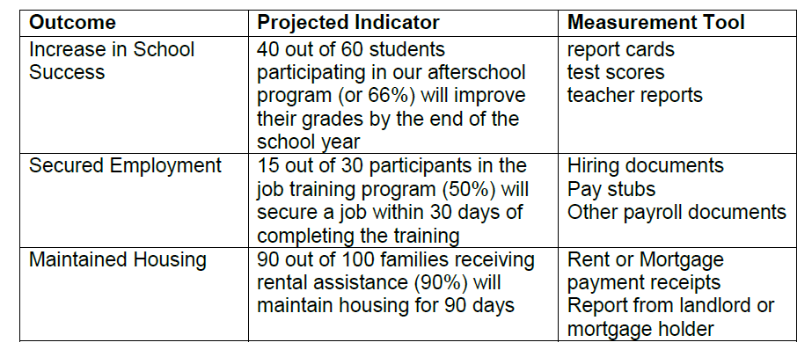
How Will You Know?
Notes:
Some tools that could measure the outcomes and indicators are identified here.

Slide 9
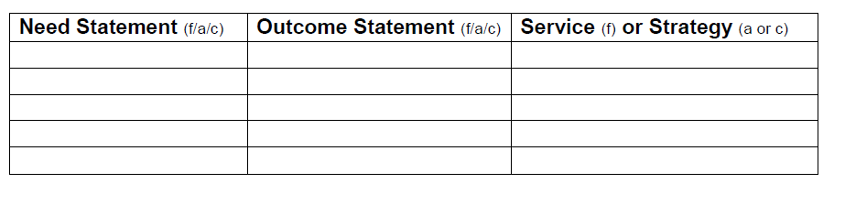
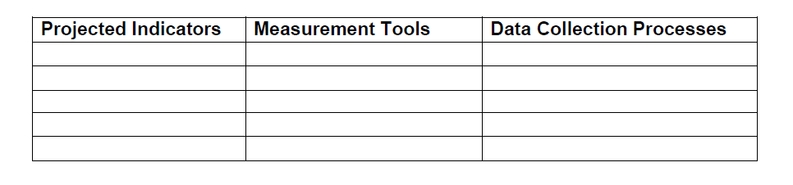
Adding to the Logic Model
Notes:
Reminder that Logic Models are useful tools to provide quick snapshots of the various programs
The next step in the development of a Logic Model is to identify the measurement tools and processes to be used to demonstrate the outcome has been achieved (or progress has been made). On the last slide you saw examples of measurement tools.
The data collection process leads into creating reports for your various funding sources – and also leads to reporting internally (staff and board) so communication about the various programs can be maintained.
It will become the basis of the analysis we will do in the next phase.

Slide 10
Data Collection Process
Data is collected at many different places and times in your agency
Here are just a few things you may want to know about your agency’s data:
Who gathers data?
Receptionists, case managers, etc…
When is the data collected?
At first visit? After enrollment is approved? Many times during the provision of services?
How is it stored?
Notes:
Questions for Board Members to consider:
Who would collect the data for measurement? case managers, teachers, Weatherization Inspectors, and other staff. Sometimes data is collected by partner agencies and provided to our agency staff.
What is the data collection process? How does the staff collect the data? phone follow up, home visits, clients bring information into the office, etc.
How often is the data collected? How often is it reported?
Do you know how the data is stored? case records, agency data bases.
Who gets to see (and use) the data?

Slide 11
What Happened?
After the delivery of the service(s), follow up will be done to update the indicators that were developed for implementation
How many did we actually serve?
How many actually achieved the service?

Slide 12
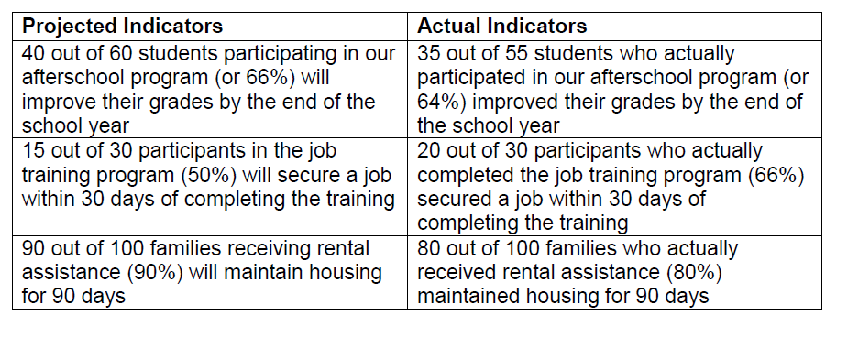
Actual Performance
Notes:
In the actual indicators you see the actual performance stated with the number actually served, number actually achieving and the percent of success.
You see that sometimes the number projected to be served is different – and almost always the number achieving is different.
We will come back and analyze this information in the next video segment.

Slide 13
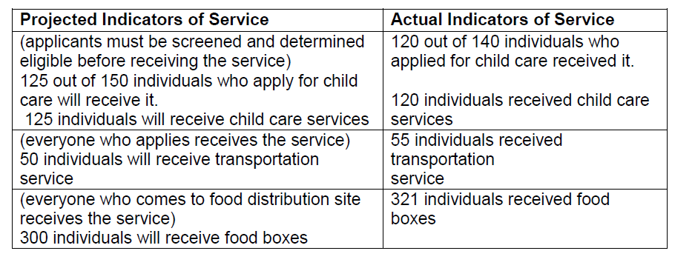
Service Only - Not Change
Notes:
Some services your agency delivers are what are being called “support services”
For instance, customers need child care and transportation as a means to some other outcome. Just receiving the service is not considered to be an outcome.
Food distributions are to decrease food insecurity. Or to be a gateway to other services. But there isn’t research to prove that people who receive food at these kinds of distributions are better off.
UNLESS: If you have some ways to measure the change in their lives, you can express it as an outcome, but you will need measurement tools and follow up procedures.
For instance: Do children in the child care program demonstrate improved school readiness because of their participation? How do you know?
Programs that are only about service delivery will be challenged in the new Performance Management Framework environment. It is up to the Board to be thinking about how the services are a part of the agency’s overall mission.
We are not saying that your agency should not do these kind of services, but rather that you consider how these services fit into the overall agency purpose.
How do they fit into your Local Theory of Change?

Slide 14
Consider the Quality of the Reports
If the report is confusing to read, it can cause you to have more questions than answers
If there is too much data, you could miss essential elements
If the data isn’t sorted, you may be flipping through pages to find what you want to know
Notes:
The way data is reported can impact the usefulness of the data.

Slide 15
Things to Consider
Quality of the data
Accuracy, completeness and timeliness of the data included in the report
Presentation of the data in the report
Is it easy for the reader to find data that is important to him/her?
Usefulness of the data
Is it relevant to the task of managing the program/service? Do I have access to the data when I want/need it?
Performance Focus
Does it include data on outcomes and performance as well as services?
Notes:
Many agencies are creating “dashboards” to help visualize data reporting.
Not everything is appropriate for this kind of treatment but if done correctly it can provide a quick way to share information and analysis as well as raw data.

Slide 16
Who gets the reports?
Besides reports that come to the Board, who else gets reports?
What agency staff have access to the reports?
Are they posted on the web site?
Are there other ways they are communicated to the public and the media?
Notes:
Some people think about “reports” as just the documents that have data generated by the programs.
But they are also the means by which this kind of performance can be communicated – both within the agency and outside the agency.
The Board and staff should consider how reports can be used effectively to meet multiple purposes.

Slide 17
Taking Action
Understand what data is collected for management and accountability related to agency programs
Assure that the data is reliable
Get reports from the programs on a regular basis
Work with staff to assure reports to you are easy to read and formatted in a way that is useful
Assure all reports that are submitted are:
Accurate, timely, and complete
Notes:
While this standards are about goals, it does speak to “progress” toward meeting the goals.
We take that to mean that the Board should have reports on how the agency’s services and strategies have been Implemented and Reported to others.
Standard 6.5
The governing board (or advisory body) has received an update(s) on progress meeting the goals of the strategic plan (or comparable planning document) within the past 12 months.

