Slide 1
Implementation of Services and Strategies for Boards
Putting the Plan into Action
A Video Series for CAA Board Members
Notes:
Objectives of this video:
How will the agency’s strategic plan be implemented?
Is there an Action Pan showing who will do each essential activity?
Do the program managers need to work on resources, budgets, personnel issues?
How are customers recruited for the services?
How are partners engaged for the strategies?
What will happen? Who will identify the Indicators?
How will you know? Identify measurement tools and processes.

Slide 2
Implementing ROMA – A Video Series for CAA Boards
Introduction to Implementing ROMA for Boards
Creating a Local Theory of Change
Strategic Planning
Implementation of Services and Strategies
Observing and Reporting Results
Community Needs Assessments
Analysis and Evaluation
Notes:
This presentation is a part of a series that is intended for Community Action Agency Board Members interested in deeper understanding of
How to help your Community Action Agency increase its capacity and its results.
How to meet and exceed Organizational Standards
In this series of presentations, we will be identifying the key principles and practices that are a part of the performance management system that is unique to the CSBG/CAA network. This system is known as Results Oriented Management and Accountability or ROMA.
We will show how the ROMA Cycle as seen here is embedded into the Organizational Standards and will make reference to the video series that is specifically for the Organizational Standards, while not repeating the information found there.

Slide 3
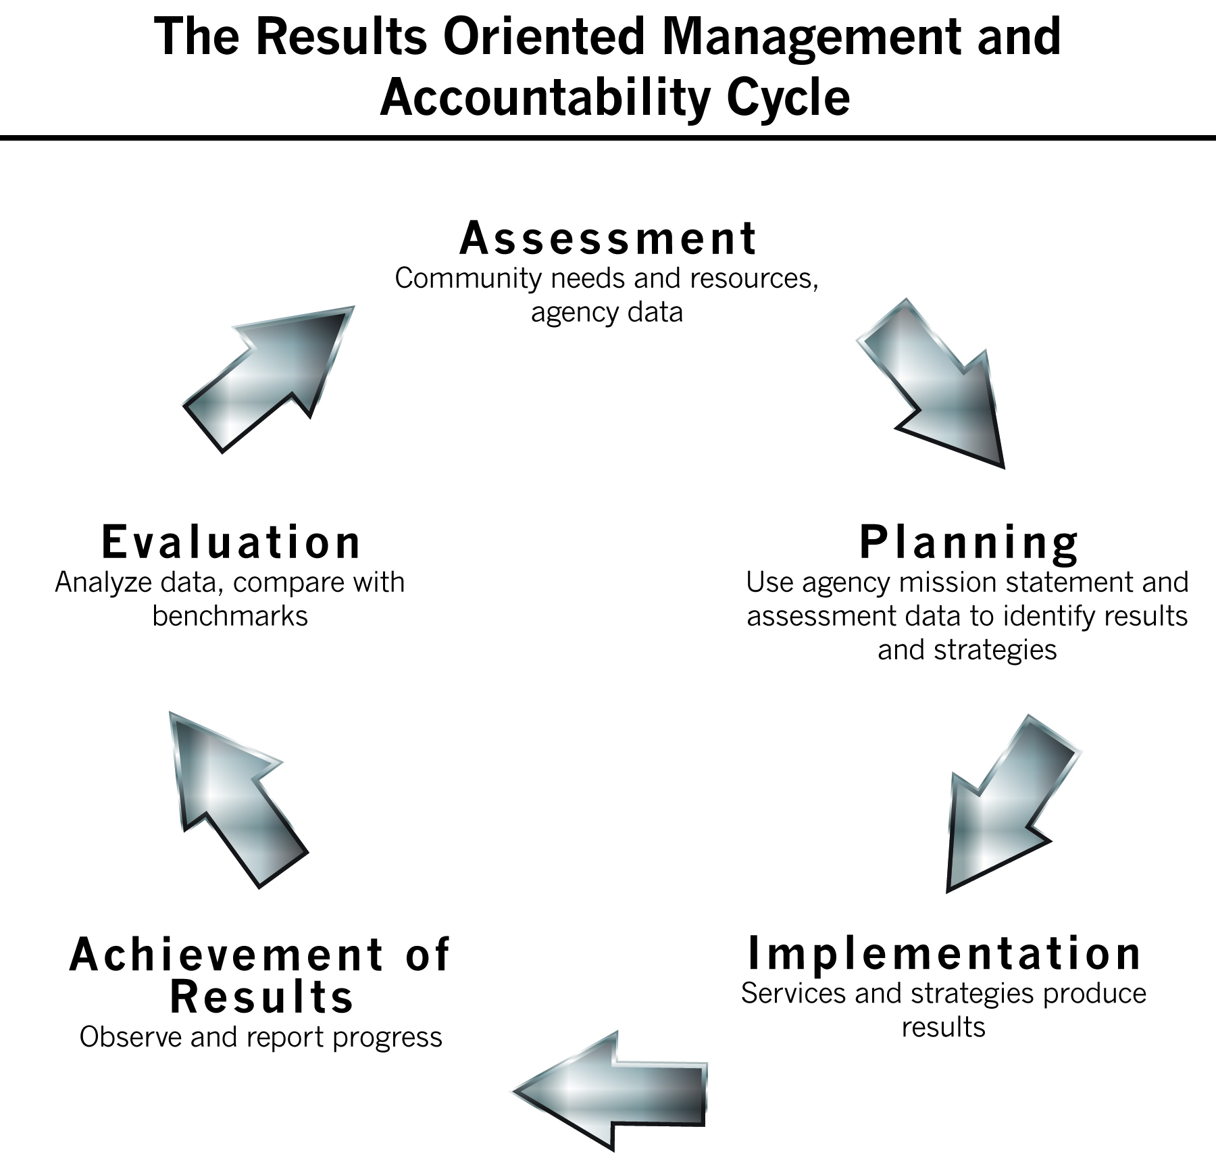
Notes:
The first phase of the ROMA Cycle we will explore is that of Implementation of Services and Strategies.
There are no Organizational Standards related to the agency’s provision of services (at the individual and family level) and strategies (at the community and agency level). But it is clear that the delivery of high quality services is expected in the National TOC and in the expectation of the achievement of results.

Slide 4

Board Role in Implementation
The board is responsible for assuring that personnel and fiscal policies and procedures are in place
The board is not involved in the day-to-day operations of the agency as it delivers services and engages in strategies
Notes:
For example, the board is not engaged in personnel issues and should not encourage employee conflicts to be brought to them – until after the standard conflict resolution process is completed.
Even as this is true, there are some essential elements of program implementation that should be understood by the Board members.

Slide 5
Putting the Plan to Action
How will the agency-wide Strategic Plan be used to implement services for individuals & families and strategies for communities and for the agency itself?
Is there an Action Plan showing who is responsible for doing each essential activity?
How will the quantity and quality of the services and strategies be evaluated?
Notes:
Implementation of services and strategies includes a number of factors related to agency capacity (staff who will be involved, locations of activities, timing of activities, costs, partners, etc.)
It also has to do with the quantity (frequency, intensity and duration) and quality of the services and strategies in which the agency is engaged.

Slide 6
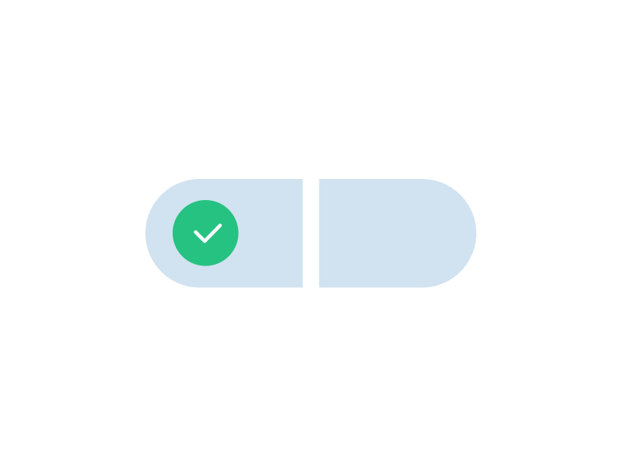
Quality
When we consider evaluating how well we are delivering services, we will need to understand not just how many services we have delivered, but what is the quality of the service delivery?
Are we efficient in our delivery?
Are we effective? What change will we produce?
Notes:
A lot of things go into the evaluation of service quality. Some program funding has designated quality measures.
Agency job descriptions can help to assure you have considered what skills and knowledge are needed to do the essential work of the agency. They can guide you to hire the people who meet the criteria – and then that they are properly trained and equipped. Finally they must know what they are expected to do.
The process for supervision and evaluation of employees would be identified in the personal policies.

Slide 7
Getting Ready
What is needed for the staff to put the Action Plan into service?
Are there budget issues that must be settled?
New facilities secured? Existing facilities repurposed?
Supplies to be ordered?
New staff hired? Training for both existing and new staff required?
Notes:
Do the program managers need to work on resources, budgets, personnel issues?

Slide 8
Open the Doors
When creating the Strategic Plan, you may have considered how many customers you can serve with the resources you have – but NOW your staff must plan to get sufficient response to the services you are offering
Some questions to consider:
What is the target population you expect to serve?
How are customers identified for the services?
How will you let them know the service is going to be available?
Are there any special barriers you will need to overcome (language, access to the service site, hours of operation, etc.) during your outreach?
At the community level, how are partners engaged for the strategies?
Notes:
Once staff is “ready” to start your service, how do they get customers?
Who are they?
What eligibility do you need to assure?
How many do you expect to serve? (remember in the Planning phase, you – or the staff – considered this question. Now is the time to take a closer look (taking into account the resources for the program and the expected costs of providing the service). Now that you have the services “ready to go” make sure you have a target for the number of people who can be served.
This is a good place for us to talk about “when does an applicant become a customer”?
Some steps to becoming a customer:
Application, screening, enrollment, intake/assessment, provision of services (is there a minimum number of hours of service that will “count” toward the population that will be measured for progress/success)
Not all of the people who apply will move forward to enrollment. Not all of those who start the service may finish it.

Slide 9
What Will You Track?
An indicator is a specific, observable and measurable characteristic that can be used to show changes or progress a program (service, strategy) is making toward achieving a specific outcome
It should be based on data that is complete, accurate, timely and reliable
• It should be appropriate to the outcome and useful for program management.
Notes:
An outcome represents a specific result/change a program intends to achieve
But an indicator helps you know that something has changed.
Characteristics of an Indicator:
It can be measured – and data collectors understand what data is needed and how to collect it
If the measure isn’t useful, it isn’t the right measure.
Appropriate to the outcome (don’t measure height with a thermometer)
And make sure it is relevant -- important -- to the outcome (and larger mission and agency wide goals)
Here is an example of indicators: In order to measure an increase in global warming, (an example of a change we expect to see –not a good change but an important one to track), we monitor the change in weather patterns, the number of hurricanes in a specific area where there are usually not hurricanes (like in Maryland), or decreasing rainfall in California. These things are indicators of the negative outcome.

Slide 10
GOALS
OUTCOMES
INDICATORS

Slide 11
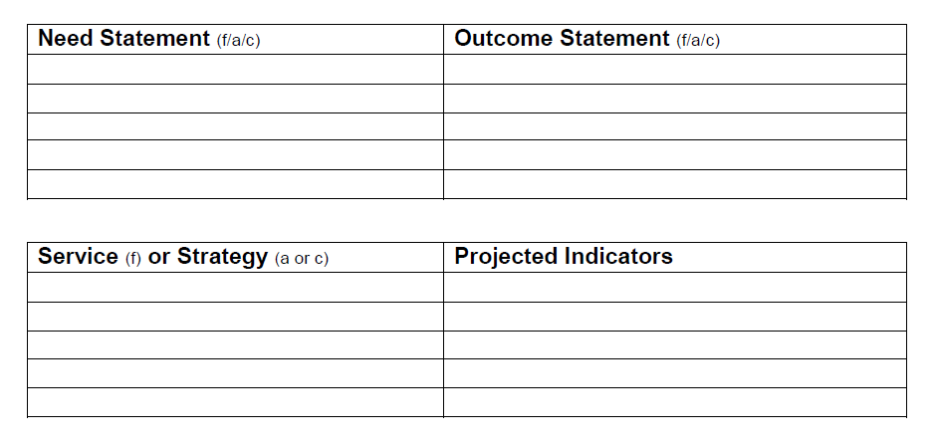
Program Connections
Notes:
We started to build a Logic Model in the prior segment.
These are useful tools – both to provide quick snapshots of the various programs, AND they can be viewed collectively to understand how each fits into the overall agency goals.
This chart shows the addition of the next column of a logic model, where the Implementation can be tracked.
The Board is not involved in the development of indicators but should be aware of what they are and what they mean to the implementation of services and strategies.

Slide 12
How many indicators for each outcome?
There should be at least one indicator for each outcome, but in fact there may be several different indicators that all work together to demonstrate the outcome
An indicator helps you follow change over time
It’s a way to detect progress or lack of progress toward an outcome
Notes:
More appropriate to our work, an indicator identifies the evidence that indicates the result of participation in the activity or service.
To identify an indicator, ask yourself: What would it look like if the participant was to achieve success? How would we know it that the participant was successful? What would I see, hear, read that would tell me this change has happened?
Some indicators may be straightforward and easy to measure.
Sometimes one indicator may be all that is necessary for clear explanation. For example, increased school graduation rate is an agreed upon indicator for the outcome school success.
Other times, several indicators may be required. For example, improved parental involvement in school may require numerous indicators such as: parents helping with homework, parents communicating with the teacher, parents participate in school functions and meetings.
To help you follow progress over time, setting intermediate benchmarks helps you measure movement towards your final outcome.

Slide 13
Program Connections Using a Logic Model Framework Indicators and Outcomes
Need Statement (family level) | Outcome Statement (family level)
Parents are not involved in their children’s school activities | Parents increase their involvement with children’s school activities
Service | Projected Indicators
50 parents will participate in monthly parent support group meetings during the school year | 50 parents will report helping with homework
 | 30 parents will report that they communicated with the teacher
 | 45 parents will report that they participated in school functions and meetings.
Notes:
In this slide you see that we have added a new column to the logic model we started in the Planning section.
Here we identify the need and outcome, and the service we will provide.
In the service section, we include the number we project to serve.
Then we identify those things we are going to measure to prove the outcome happened. We also project how many of the people served will achieve each of the indicators identified.

Slide 14
National Performance Indicators
Community National Performance Indicators (CNPIs) and Family National Performance Indicators (NPIs) are found in the CSBG Annual Report
These NPIs are a standardized set of indicators that are connected to common outcomes reported by local CAAs
These relate to all of the outcomes expected to be achieved by the CAA, not just to those funded by CSBG
Notes:
In addition to establishing their own program and agency indicators, CAA staff will be comparing the results of their services and strategies to the standardized list of Community National Performance Indicators (CNPIs) and Family National Performance Indicators (FNPIs) found in Modules 3 and 4 of the Annual Report.

Slide 15
Establish Targets
Data elements to include in the Indicator statements related to the results of our activities:
How many will we be able to serve?
How many of those receiving service are expected to achieve the outcome?
What is the projected percent of success?
This is also called: “setting targets” for your performance
Notes:
What will happen?
Who will identify the Indicators? (program staff? Planning staff? ??)
Consider: The Indicators define the data that will be collected to document the change. (the first two “–” bullets on this page)
The relationship between these numbers produces a percent that shows the expectation of success for those receiving service.
This is the foundation of data that will be used to identify what works and for whom.

Slide 16

Why Use Targets?
A target is the number established before services are provided that say what the agency expects to happen
To establish a quantifiable target number for your services and your indicators, your agency will rely on your past experience with this (or similar) programs and the details of your well constructed plan
Notes:
Some questions to consider:
What are our identified outcomes and the indicators that will prove our success?
How much change do we expect to see?
How large of an effect will these outcomes have on our community?
What resources do we have to provide the services and strategies that will produce the outcomes?

Slide 17
A Few More Examples: Targets or Projected Indicators
40 out of 60 students participating in our afterschool program (or 66%) will improve their grades by the end of the school year
15 out of 30 participants in the job training program (50%) will secure a job within 30 days of completing the training
90 out of 100 families receiving rental assistance (90%) will maintain housing for 90 days
Notes:
Selecting indicators takes time and thought. Agency staff (in a data centric agency) will want to continue to refine the indicators until they clearly explain the aspect of success in which they have interest.
Additional example of Targets (also known as “projected indicators” on this slide add the percent of expected success and a time frame
We will come back to these examples in the next section to see how well we did at setting our targets.

Slide 18
Taking Action
Understand what data is collected for management of agency programs
Get reports from the programs on a regular basis
Compare the Action Steps with the progress toward providing services and engaging in strategies
Notes:
While these standards are about goals, it does speak to “progress” toward meeting the goals. We take that to mean that the Board should have reports on how the agency’s services and strategies are being Implemented.
Standard 6.5 |Private
The governing board has received an update(s) on progress meeting the goals of the strategic plan within the past 12 months.
Standard 6.5 |Public
The tripartite board/advisory body has received an update(s) on progress meeting the goals of the strategic plan/comparable planning document within the past 12 months.

