Slide 1
Creating a Local Theory of Change for Boards
What is your mission?
What do you expect will change?
A Video Series for CAA Board Members

Slide 2
Implementing ROMA – A Video Series for CAA Boards
Introduction to Implementing ROMA for Boards
Creating a Local Theory of Change
Strategic Planning
Implementation of Services and Strategies
Observing and Reporting Results
Community Needs Assessments
Analysis and Evaluation
Notes:
This presentation is a part of a series that is intended for Community Action Agency Board Members interested in deeper understanding of
How to help your Community Action Agency increase its capacity and its results.
How to meet and exceed Organizational Standards
The Roma Next Generation Video Series consists of these modules.
With me today to present this particular concept is Dr. Barbara Mooney, the Director of the Association for Nationally Certified Trainers. She is co-author of Introduction to ROMA, Research Fellow for the National Association for State Community Service Programs, consultant to the national Community Action Partnership, regional coordinator for Region Three Performance and Innovation Consortium and contributing author to Temple University's Strengths-Based Family Worker Training curriculum. Over the past five years, she has worked on the development of the OCS Performance Management Framework.
In addition we have …..

Slide 3
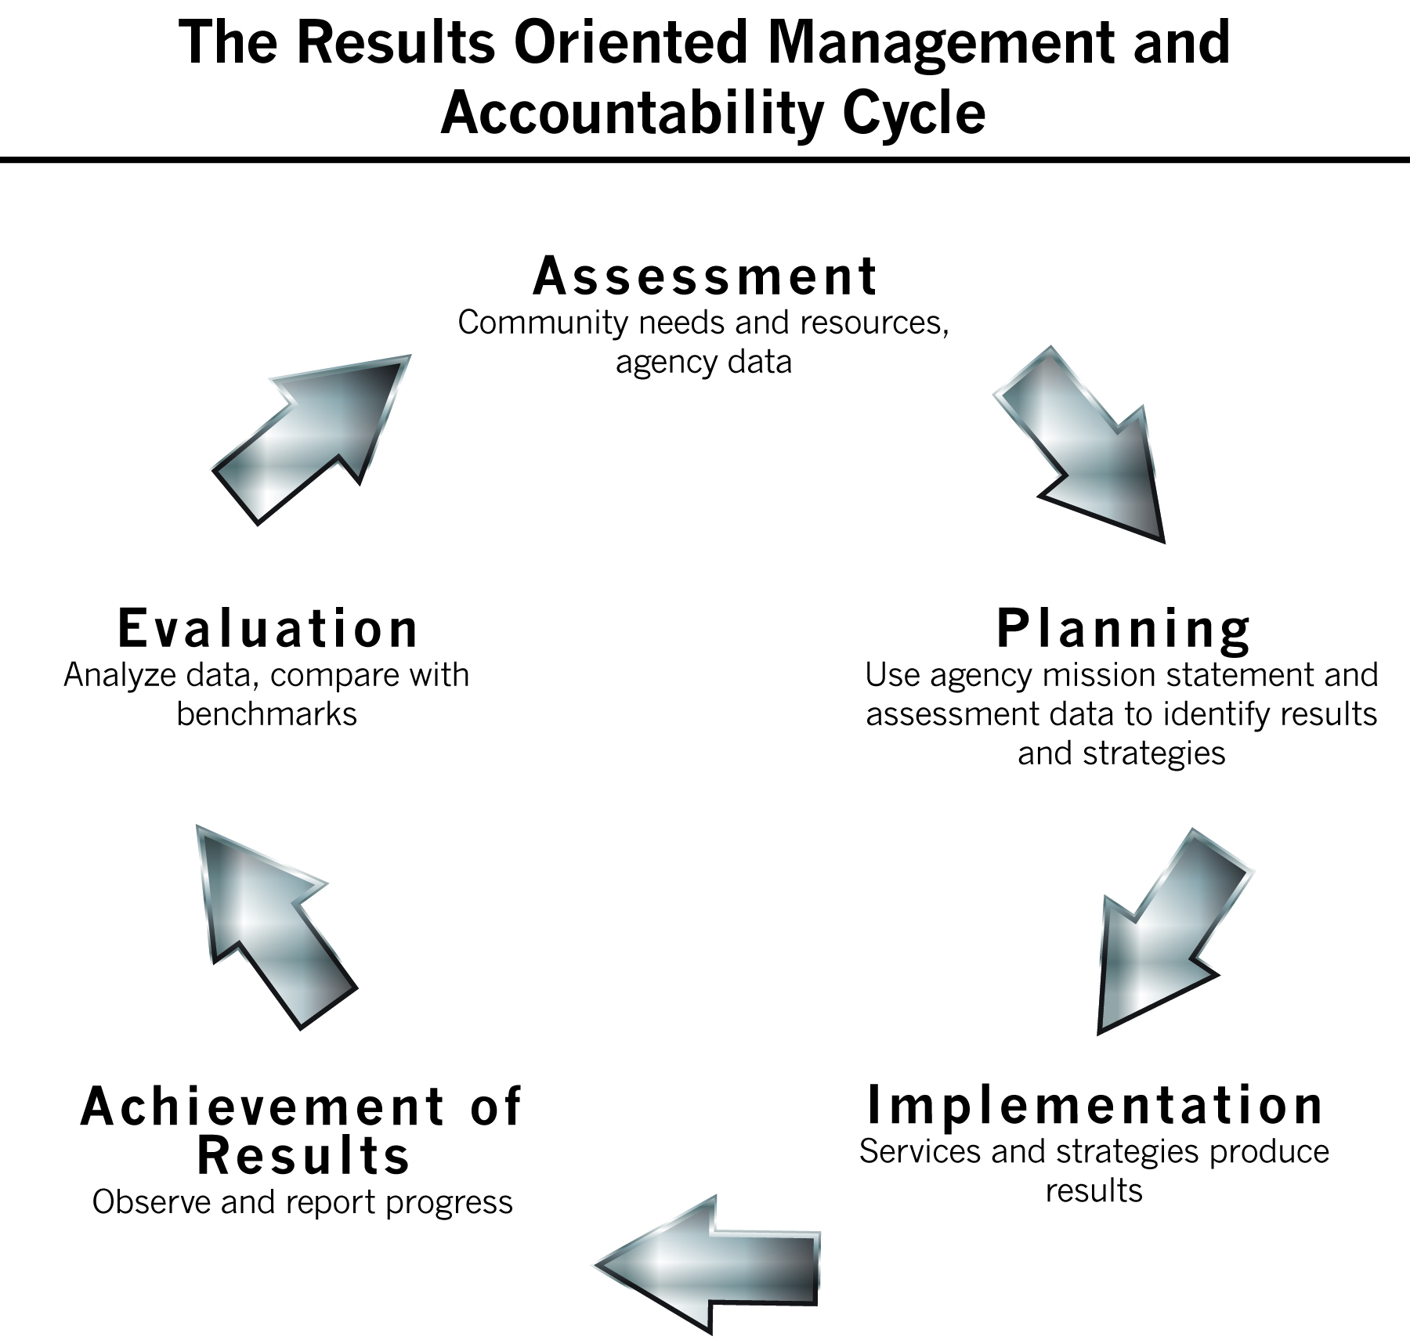
Creating a Local Theory of Change
Notes:
The next topic we will explore is that of creating a local Theory of Change.
We suggest that you engage in this activity once you have completed the assessment of needs and resources, and have “made meaning” (analyzed the data) out of what you found in that process. Then you can consider your Theory of Change before you start your planning process.

Slide 4
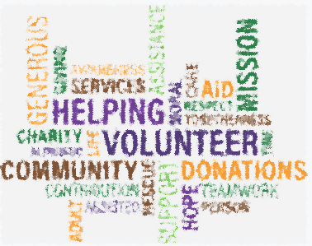
What is your mission?
The mission statement of your organization is the first consideration when identifying your agency’s theory of change.
Notes:
Agencies must make decisions about what they can do to fulfill the CSBG Act goals and purposes – as that funding is an essential part of the agency’s identity.
If you are a private non-profit agency, you were approved by the IRS for this status because your mission meets the requirements for “charitable work.”
So it is important that you understand the mission statement – and what the assumptions are behind the statement.
We do not always think about “what we assume” but our beliefs are always behind our knowledge and are instrumental in the decisions we make.
If we think we can “reduce poverty” or “eliminate the causes of poverty” (which many CAA mission statements say) then that means that we understand why people are in poverty, and what is needed to get them out of poverty.
If you are a public agency, you will still have a mission statement that guides your work.
Standard 4.1 for public agencies indicates that the “board” or “advisory body” has reviewed the department’s mission statement within the past 5 years and assured that:
1. The mission addresses poverty; and
2. The CSBG programs and services are in alignment with the mission.
in the case of a public CAA, the mission statement may be influenced by official policy. For instance if the CSBG program is housed in the Department of Housing and Community Affairs, you would expect to see a greater focus on housing related issues. Or with Department of Commerce, a greater focus on employment and business development. Of course this isn’t always the case, but understanding the influences ot official policies is important in public CAAs.

Slide 5
The Essence of Who You Are
A Mission Statement contains the essence of who you are, as an agency
After reading your Mission Statement, someone should know what your agency believes about poverty and what the long term goals (changes) your agency will achieve
Anyone should also know who you serve and if you have connections with others in the community
Notes:
The mission statement has four key elements – target population to receive services, the services to be provided by the agency, the outcome expected because of the services and any relationships the agency has with others.
Decisions are based on background assumptions held by board and staff – and these assumptions can sometimes be seen in the agency mission statement.
Assumptions (or beliefs) include what each person knows about the people we serve and the challenges they face, the conditions of the community, and how our work might create change. There may be some significant differences in the assumptions that board members and staff hold – These need to be on the table because these assumptions impact what each person thinks is needed to create change and achieve results.
It is important to clearly articulate and discuss these underlying assumptions about poverty and why people remain in poverty before you discuss the role that your organization might play.
Let’s look at a couple examples.

Slide 6
Assumptions Behind Mission Statements
Examples to consider:
To eliminate the causes of poverty in partnership with the county human service offices by strengthening low income individuals, families, and communities through self-sufficiency initiatives in XX County.
To work with other agencies, jurisdictions, and the people of YY County to plan and manage social services and to achieve a safe and healthy community.
Notes:
The agency needs partnership with other human service agencies.
Strengthening low income individuals will lead to the elimination of the causes of poverty.
Self sufficiency initiatives will strengthen families.
The agency can provide self sufficiency initiatives. (Has trained staff, resources; And knows what these would be)
We will serve low income individuals, families and communities
We will be successful if we “strengthen” individuals, families, communities.
We will be successful if we eliminate the causes of poverty.
We will work together with many different people
Example 2:
(none of these are policy makers or power groups so there is an assumption they are not needed to be successful -- unless “jurisdictions” = policy makers).
We will plan and manage social services
This will lead to safe and healthy communities
We will be successful if we plan and manage services.
We will be successful if we achieve a safe and healthy community.

Slide 7
Anti-Poverty Mission
What needs that have been identified do you think you are able to address?
How will addressing specific needs align with the overall anti-poverty mission of the CSBG funding?
Notes:
Part of the problem is that we don’t have a standard definition of “poverty”
There is the federal poverty guideline – that is based on the cost of food (which many people feel is inadequate)
For a long time, there have been are many researchers who are trying to define the essential elements of “poverty”
One researcher said that It takes courage to work in a field where the concepts and methodologies of such a complex issue are not precise enough to be useful working tools.
In other words, if we can’t define the situation, how do we work on a solution?
What is essential to change to help individuals, families and communities be “better off”?

Slide 8
Definitions – Beyond FPL
Poverty Defined:
"the state of one who lacks a usual or socially acceptable amount of money or material possessions” – Webster's Dictionary
“[when someone's] resources are so seriously below those commanded by the average individual or family that they are, in effect, excluded from ordinary living patterns, customs and activities“ - Professor Peter Townsend, the leading authority of the last 50 years on UK poverty
Notes:
FPL = Federal Poverty Level
Federal poverty levels are used to determine eligibility for certain programs and benefits, including savings on Marketplace health insurance, and Medicaid and CHIP coverage. Eligibility could be based on 125% of poverty (CSBG) or “up to 185% of poverty” (WIC) or other limits based on the FPL
For 2018 – for a family of 4 – the FPL is $25,100.
To put that into context, a person working a 40 hour a week job for a full year would have to earn about $12 per hour to make that gross income.
Beyond just those numbers:
The key words in these two definitions are "socially acceptable" (Webster's) and "ordinary" (Townsend).
The first implies that income poverty thresholds depend on the social norms of the society in which someone lives and the second implies that they depend on the incomes of the ordinary people in society.
So, what is considered 'socially acceptable' or 'ordinary' depends on the society in which the person lives.

Slide 9
Social Exclusion
“Individuals, families, and groups in the population can be said to be in poverty when they lack the resources to obtain the type of diet, participate in the activities and have the living conditions and amenities which are customary or at least widely encouraged or approved in the societies in which they belong”
Notes:
The rest of the quote from Townsend 1979
It further defines poverty as being a form of social exclusion.

Slide 10
Your Neighborhood Matters
Research has shown a correlation between where you live as a child and your opportunities to achieve economic success as an adult
One response: Policy makers intend to reduce concentrations of poverty by enhancing the social mix of neighborhoods
Another response: assure that low income communities have access to resources
Notes:
EXPLORING THE RELATIONSHIPS BETWEEN INDIVIDUALS' SOCIAL POSITION, NEIGHBOURHOOD CONTEXT AND THE SCALE OF NEIGHBOURHOOD
Authors Roger Andersson, Sako Musterd March 2010
Avoiding high immigrant concentrations in particular neighbourhoods is another issue that fuels political debate and policy intervention in many Western European countries, Scandinavian countries included. However, there are clear gaps in the understanding of the relationship between neighbourhood composition and social outcomes. One of these gaps regards the scale of the neighbourhood; if there would be neighbourhood effects, what scale is it relevant to consider? Is mix good or bad for the social prospects of individuals at a level that is very local, for example a few neighbouring streets, or could mix be helpful at a somewhat higher scale?

Slide 11
The Economic Costs of Poverty
We need to think about the economic impact of poverty on society. Here are a couple areas to consider:
Delayed health care results in higher treatment costs that are passed onto everyone through increased health care premiums
Maintaining shelters for persons who are homeless is an approach that is expensive and hardly addresses the immediate problem, let alone the long-term problems these individuals and families face
Notes:
There are numerous factors at play that clearly shows how poverty negatively affects the overall economy.
The cost of child poverty: $500 billion a year. The United States has the second-highest child poverty rate among the world's richest 35 nations, and the cost in economic and educational outcomes is half a trillion dollars a year, according to a new report by the Educational Testing Service. July 25, 2013.
Expenditures on poverty reduction can be viewed as public or social investments, which generate returns to society over time in the form of higher real gross domestic product (GDP), reduced expenditures on crime or health care problems, reduced costs borne by crime victims or those in poor health, and improvements in everyone’s quality of life in a wide variety of other ways as well. http://www.npc.umich.edu/publications/u/working_paper07-04.pdf

Slide 12
The Economic Costs of Poverty (continued)
Poverty in one neighborhood affects the overall economic prosperity of the larger community around it
Increased crime in unsafe neighborhoods leads to lack of productivity of the residents of that community
This includes such things as lower graduation rates, reduced participation in the workforce and decreased economic output
Underdeveloped human capital creates needs which put a strain on government resources

Slide 13
Different Kinds of Poverty
Some things to think about:
Lack of resources in different life domains, may produce different poverty experiences
Is there a single domain that is outside the norm or is there an accumulation of problematic situations in multiple domains?
How does severity of the poverty experience impact on opportunities for mobility?
Does the length of time matter?
Was there a “Poverty producing event” (death of wage earner, divorce, disaster)
Consider the trend of increased “in-work poverty”
Notes:
The correlation between low income and life-style deprivation is stronger the longer people are confronted with financial poverty.
Poverty can include severe deprivation on one life domain or a multitude of not so severely deprived situations on multiple life domains
The “in-work” poverty situation in Many wage earners are getting less than $12 per hour (note that minimum wage jobs pay 40% less), or working less than 40 hours a week, or not having benefit leave so not getting a full 2000 hours in a work year – if they have a spouse and 2 children or are single spouse with 3 children, they will fall below 100% of FPL. And even if they do get the 100% FPL, we know that they are still at risk of not meeting their family needs at that level. A family of four really needs two full time wage earners at 12/hour or higher hourly wages.
We’re talking about millions of people—8.9 million working adults, in fact—who work full time but are unable to keep their families out of poverty. More and more, the face of the poor is that of mothers and fathers struggling to feed, house, clothe, and educate their children—parents who are doing their best but still aren’t getting by.
Most minimum-wage jobs don’t provide paid sick leave or health insurance. Imagine this: The school nurse calls to say that your child is sick and needs to go to the doctor. If your job doesn’t provide paid sick leave, your pay will be docked for the hours of work that you miss. If you don’t have a car, you need to take public transportation to pick up your child and take him or her to the doctor—that is, if you have a doctor. Otherwise, you’ll likely have to wait in an emergency room. And when you finally take your sick child home, you will need to figure out who can take care of them so that you can go back to work. All in all, you’ve probably missed half a day’s work and wages—if not more—just to get your child to and from the doctor.

Slide 14
What Can You Change or Maintain?
Change is considered to be POSITIVE if it is an improvement in the lives of families and individuals or in the circumstances in the community
As you are considering your assumptions and identifying the problems that the needs assessment had brought to your attention, you have to think about what is in your power to change
We also identify a NEUTRAL change when we have prevented something from getting worse
Much of what Community Action Agencies do in our anti-poverty mission framework is to help families avoid a crisis so they can maintain a measure of stability
Notes:
Can you provide better employment for everyone in your community? Of course not. Or at least not alone and not for everyone.
Can you help adult family members increase skills so they are eligible for better employment? Probably
Can you provide sufficient tangible benefits to make a difference? Maybe – or at least in the short term to prevent a crisis.
Note: if things get worse, that is a NEGATIVE change.

Slide 15
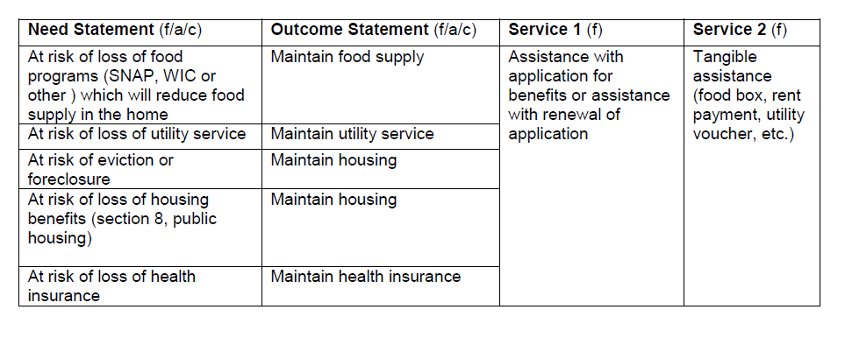
Maintaining Stability
Notes:
This slide has some examples of things that CAAs routinely do for families who come to them in an “at risk” situation.
Helping our customers apply for and receive benefits can be what helps them maintain stability in their family.
Some agencies have the resources to provide (or refer customers to someone else to provide) direct tangible services.
Without this kind of assistance from the CAA, the families could:
have their utilities shutoff and experience the resulting negative consequences,
not have sufficient food for adults and children,
lose health insurance resulting in delayed treatment, increase in illnesses and utilization of expensive and limited emergency room services
Preventing these scenarios from happening is better for the health and well being of families and economically beneficial for society since it is accepted that preventing a situation such as the above is less expensive than treating it after the fact.
It is up to the Board to decide what approach the agency will take in these situations.

Slide 16
How Will You Know?
What indicators will measure progress towards the goals?
What evidence will identify that the outcomes have occurred?
Indicators
Evidence
Notes:
While you are examining your assumptions, consider how you will know that any change has happened or that you have maintained the family in a stable situation.
Regardless of the kinds of problems you say you will address, you will have to have a way to prove that you have had an impact on the problem.
What do you believe about follow up?
We cannot follow up with our customers because they move from the location we first served them.
We cannot follow up because they don’t want to answer our questions – they got a service and they are satisfied, so why would they want to talk to us any more?
Follow up is essential to demonstrate that we have accomplished some outcomes.

Slide 17
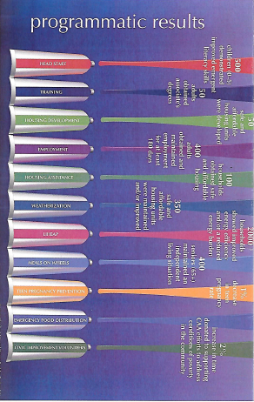
Notes:
This is the time that the agency needs to consider how the programs they have been delivering are working together to achieve larger outcomes.
Here is a graphic of one agency’s different programs. They have Head Start and Training and Housing Development and Employment and Housing Asistance and Weatherization and LIHEAP and Meals on Wheels, and Teen Pregnancy Prevention and Emergency Food Distributions and Civic Improvement/volunteers
Each of these programs has its own results: children with emergent literacy skills, adults obtained associate degree, housing units developed, and so on.
This is the way many agencies think about their programs. Each has a separate funding source, with specific goals and outcomes they are to achieve.
But what happens, overall, to the customers of this agency?

Slide 18

Notes:
The top of the graphic shows that all of the programatic results come together to create an overall outcome, that of families moving out of poverty.
This graphic was produced by Jeannie Chaffin and Brown, Buckley and Tucker.

Slide 19
Two Different Approaches
Self
Sufficiency
Improved Quality
Of Life
More Basic Services
Improved Living Conditions
Asset Accumulation
OR
Jobs
Education
& Training
Health Care
Prevention/
Treatment
Basic Services
Advocacy
Basic Services
Notes:
Community Action Partnership of Kern County CA
They start with this question: HAVE WE ENDED POVERTY YET? WHY NOT?
They found that they were delivering basic services which were not moving people or changing their lives,
They moved to a theory of change based on building a “house” of different services and approaches that will lead to the outcomes at the top.

Slide 20
Notes:
This is based on a specific identified need:
children who are not reading at grade level by the end of third grade are four times more likely to drop out of high school
over the last decade, only 37 percent of third-graders in Chemung and Steuben counties were reading at grade level
The local CAA, Pro Action of Steuben and Yates, Inc. partnered with the United Way and two school districts to create a community level theory of change.
The goal of our Kids on Track initiative is to ensure all children are reading at grade level by age 8, so they are set up for success in school, work and life.
This graphic shows a lot of different services, strategies, approaches, partners – all working together to achieve an overarching goal: 3rd grade students proficient in Math and Reading.

Slide 21
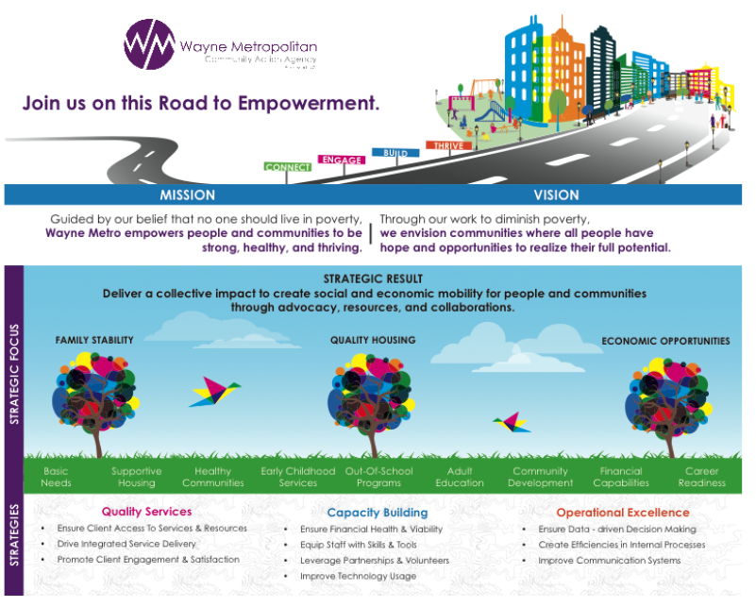
Notes:
This is a simple graphic from Wayne Metro, MI. It includes mission vision, results and strategic focus.
Quality services are identified as one foundation of their TOC.
Note that this TOC also includes agency level goals in the “Capacity Building” and “operational excellence” sections as part of the foundation.

Slide 22
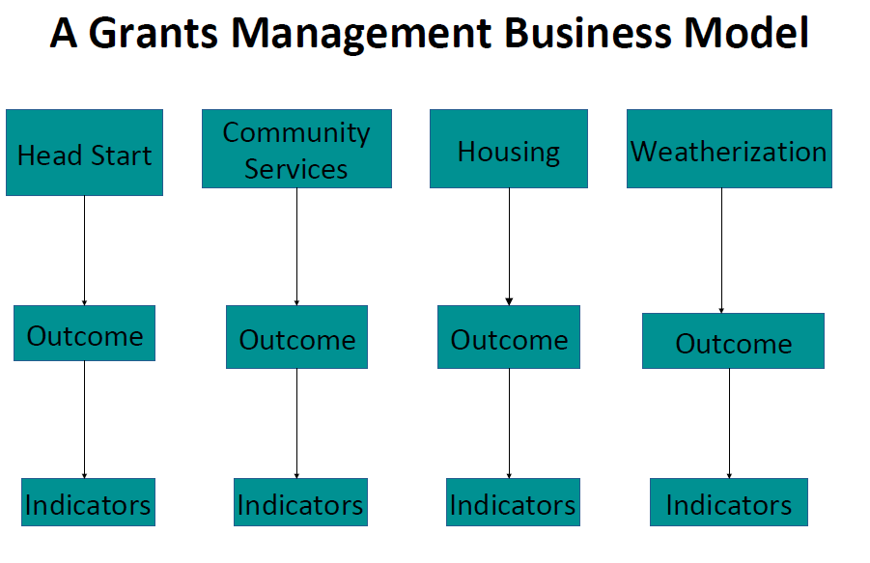
Notes:
Another visual to make the point that individual programs may have well written Logic Models that identify the outcomes and indicators FOR THEIR OWN PROGRAM
(see next slide)

Slide 23
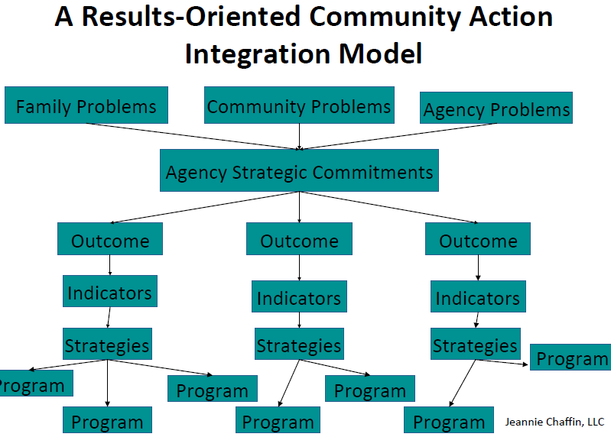
Notes:
But the local agency Theory of Change shows how these are all integrated.

Slide 24
Taking Action
Consider the “big picture” relating to your agency’s goals and how you plan to achieve them
- How does it all fit together to achieve outcomes?
Get ready for Strategic Planning process:
- The Community Needs Assessment, your agency Mission Statement and your local Theory of Change are the documents you will need as you begin Strategic Planning
- You also need agency fiscal reports so you know what funds you have available to support your planned actions
Notes:
The agency’s theory of change is a way to look at the whole agency.
As you move to the Strategic Planning phase of the ROMA Cycle, you will be considering program logic models – which have some similar elements.
Program logic models will identify connections among the needs, services, outcomes and measurement – but it will be up to the Board to see how the individual programs fit together into the agency wide vision.
The Organizational Standards say that an agency wide budget is important for fiscal management.
Standard 8.9 The governing board annually approves an organization-wide budget.
We will talk more about the role the budget plays in Strategic Planning in the next video.

