Slide 1
Community Needs Assessment for Boards
Identifying Needs and Resources
A Video Series for CAA Board Members
Notes:
Objectives of this video will be to help the board identify:
what they need to know,
how do they find out,
what does it all mean,

Slide 2
Implementing ROMA –
A Video Series for CAA Boards
Introduction to Implementing ROMA for Boards
Creating a Local Theory of Change
Strategic Planning
Implementation of Services and Strategies
Observing and Reporting Results
Community Needs Assessments
Analysis and Evaluation
Notes:
This presentation is a part of a series that is intended for Community Action Agency Board Members interested in deeper understanding of
How to help your Community Action Agency increase its capacity and its results.
How to meet and exceed Organizational Standards
In this series of presentations, we will be identifying the key principles and practices that are a part of the performance management system that is unique to the CSBG/CAA network. This system is known as Results Oriented Management and Accountability or ROMA.
We will show how the ROMA Cycle as seen here is embedded into the Organizational Standards and will make reference to the video series that is specifically for the Organizational Standards, while not repeating the information found there.

Slide 3
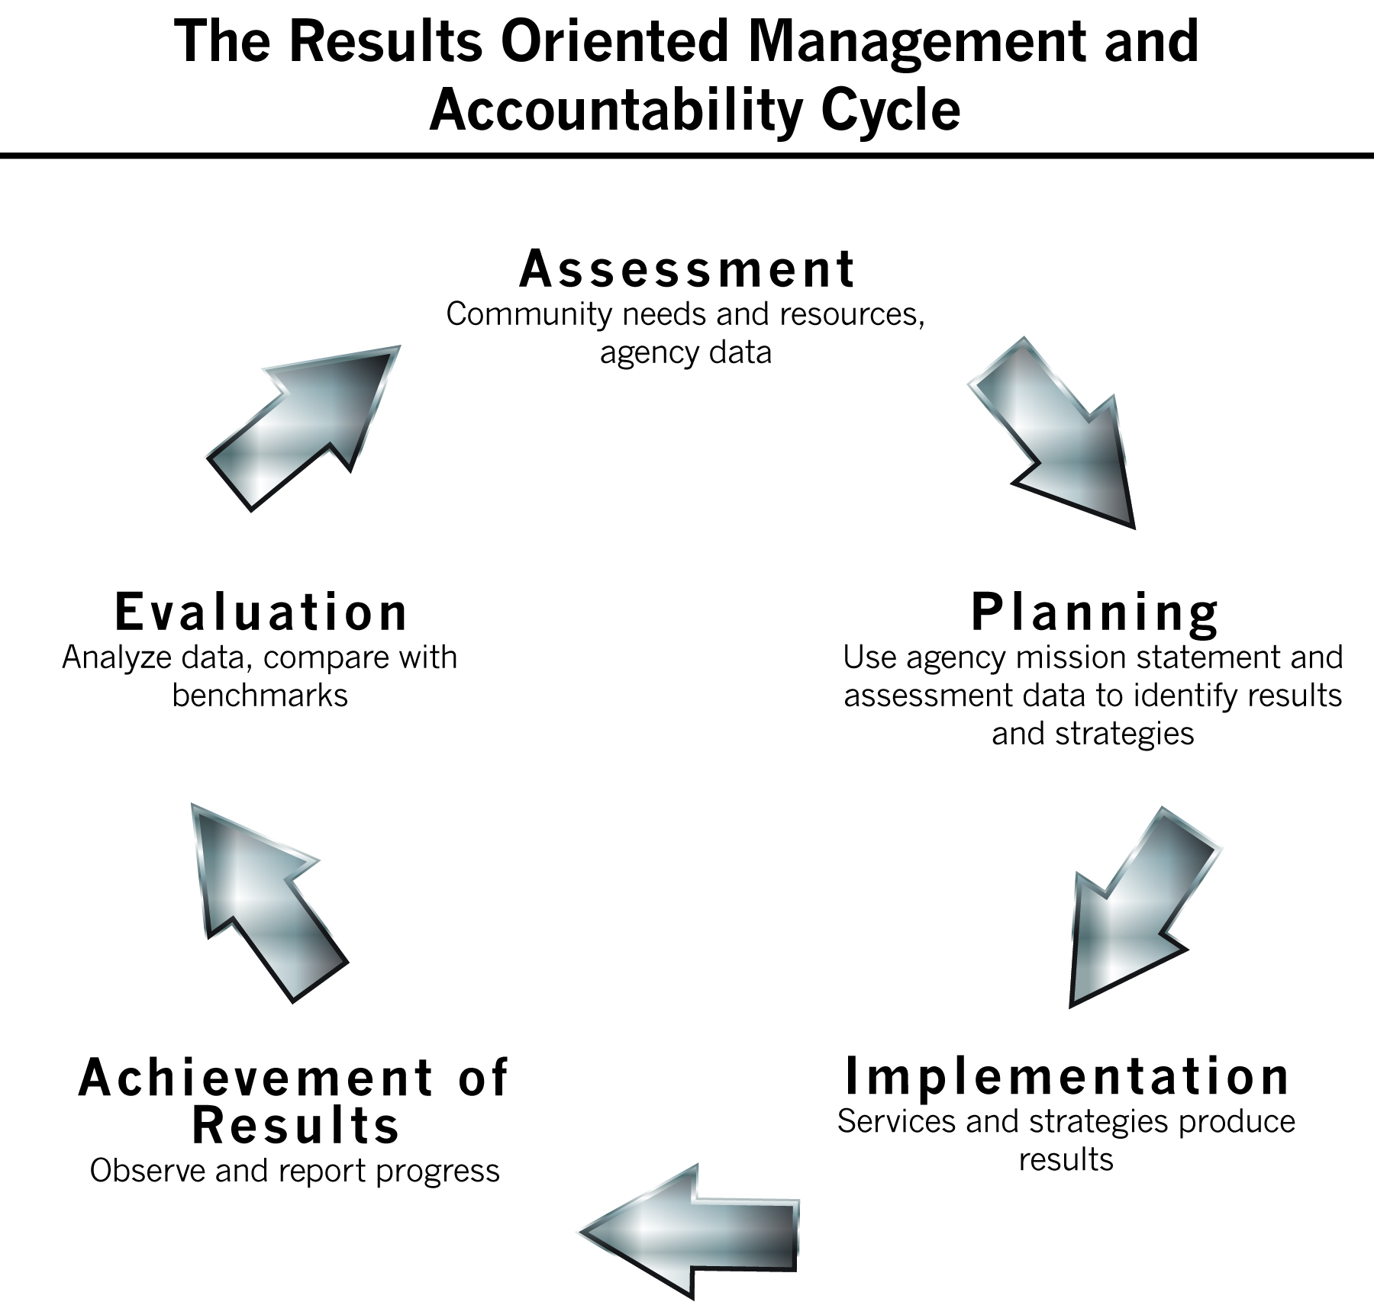
Notes:
The first phase of the ROMA Cycle we will explore is that of Assessment.
From Organizational Standards (Category Three): Local control of Federal CSBG resources is predicated on regular comprehensive community assessments that take into account the breadth of community needs as well as the partners and resources available in a community to meet these needs. Regular assessment of needs and resources at the community level is the foundation of Community Action and a vital management and leadership tool that is used across the organization and utilized by the community to set the course for both CSBG and all agency resources.

Slide 4
What is a Community Needs Assessment?
A systematic process for creating a profile of the needs & resources of a given community or target population
A process that produces a clear description of the specific causes & conditions of poverty that are facing individuals and families in a given community
The community needs assessment process takes into consideration the existing resources available in the community to meet the needs of its residents with low income, and the gaps in existing resources that are preventing economic mobility
Notes:
Because the process includes “collecting and analyzing a broad array of data and information to develop a comprehensive picture of a particular community” (Claire Higgins) it is important that you go into a discussion about Assessment with some questions that the agency has identified.
Basically the assessment should answer: What do you want to know? Why do you want to know?
For example, you will want to know some specifics about the poverty issues facing your community. Do you have a higher percent of families in poverty than the rest of the state or the nation? Is poverty concentrated in specific areas of your service area?
You may want to know what the people you serve think about their community – do they have the resources they need to have stability in their family? Do they feel safe? Think there are opportunities for them to improve their circumstances?

Slide 5
What is the Purpose of a
Community Needs Assessment?
Using the information from a local community needs assessment will assure that each Community Action Association is focusing its resources on the unique circumstances in their own community
Assessing existing resources in the community helps avoid duplication of services, and thus allows the most effective use of the agency’s own resources
Notes:
If you say the purpose of a community assessment is “it is required” or “it is something to check off on the Org Standards list” then you won’t have the understanding of how useful the community assessment can be for your agency. There is a very basic premise at play here; Community Action is “needs based” and programs and services in each agency/community should be “adjusted” to meet the needs of the community.
The assessment process helps identify what those adjustments should be for maximum impact and effect.
o Offers a picture of the community at a point in time relative to its needs – both real and perceived
o Creates opportunities for community members to more closely examine their geographic area and consider how it fits into the local region
o Provides a look at the “Why?” behind the obvious circumstances
Let’s start looking at some elements of an assessment process

Slide 6

The Community
Each agency identifies the community and the population they are assessing
  The focus of the assessment will be on the low-income population in the community, but it will be important to know what the norms are in the identified community as a comparison
Notes:
The community is defined by the agency doing the assessment.
Most often the assessments are done for the service area that the agency covers. Sometimes these include many counties, or represent both urban and rural areas – each with very different needs and resources.
Figuring out how to handle these differences should be included in the plan. And after data is collected it must be arranged in a way to make it easy to look at the data from the different communities. Some assessment reports have different sections for each county in a multi-county area.
When you are gathering data about the community, you will be seeing the whole community.
Then you will want to sort out the data that is specifically about individuals and families with low income.
Is there a clear picture of who is poor in your community?
Does poverty impact a particular age group?
Is your older population poorer? Are there more senior citizens living on low fixed incomes?
What trends do you see?
Nationally a new kind of poverty (known as “in-work” poverty) is growing. These are families where one or both of the adults are working, but still not earning enough to meet the family’s needs.

Slide 7
Who Will Be Involved in
Conducting the Assessment?
Identify and assemble a diverse Assessment Team -- including board members or a committee of the board
Identify what role each team member will play in the assessment process
Notes:
It is important for the Board members to participate in the assessment process, but what role should they take?
Some Boards create a committee that works with staff to put together a plan for the assessment process.
It really is a good idea to have a plan. We suggest you establish an Assessment Team of some kind that will develop a plan before you get started with this project. There is additional information about actually conducting a needs assessment, but this video is just an overview of the process.
Board members represent different sectors of a community and as such they bring a range of experience, perspective, knowledge
Their own opinions, in the form of survey responses, can help to enrich the data that is collected. They may be able to gather surveys from partners, businesses, policy makers or others – more easily than staff can do.

Slide 8
Different Parts to the Assessment
Identifying Appropriate Quantitative (Statistical) Data
Gathering Qualitative Data
Considering Agency Data
Understanding the Resources and Assets in the Community
Using Customer Satisfaction Data to Identify Agency Needs

Slide 9

QUANTITATIVE DATA
What statistics are important?
How can they be presented?

Slide 10
The Statistics:
Using Community Commons
Provides summaries of census data (the raw numbers related to many different factors)
AND also provides customizable visualizations of the data in different forms (such as maps)
  Maps of the entire service area
    Where are the areas of high poverty concentration?
    Are there any food deserts?
  Zip code maps
    Identify specific data by zip code
Notes:
There are lots of ways to get statistics. The US Census Department publishes all its data so it can be used to create a profile of your community.
You can find out how many people own their homes versus those who rent, how many families have one (or two) parents in a household with children … and many more statistics.
But sometimes that is hard to navigate these numbers.
A program called Community Commons was created to help make access to the data more user friendly. It is possible to download charts, graphs and maps (and other visualization tools) that will help you share the data with your Assessment Team.
If you find that the majority of people with low income are found in the north west section of your service area, you would want to work on getting your services out there – so they can be easily accessible to the people in need. If there is limited transportation, you would not want to locate your main office or your primary service sites in places where access is difficult.
If you find areas where there are no low cost grocery stores or stores where fresh produce is available, that may prompt a community level strategy to be established.

Slide 11
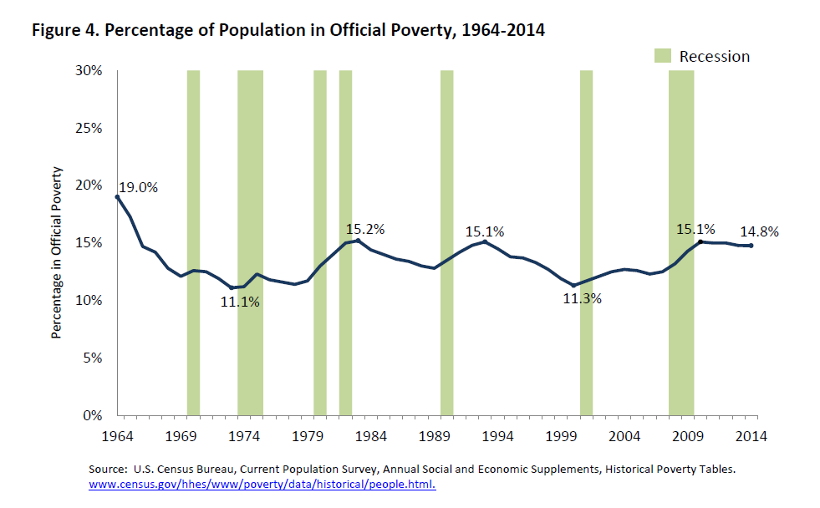
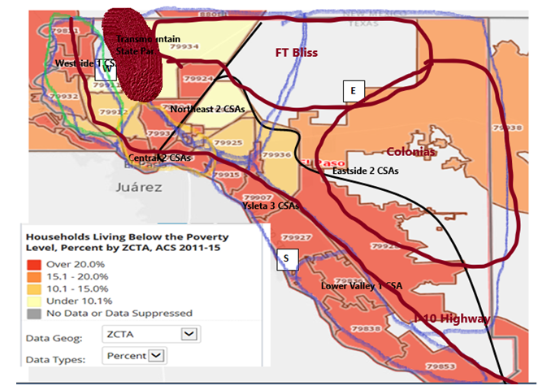
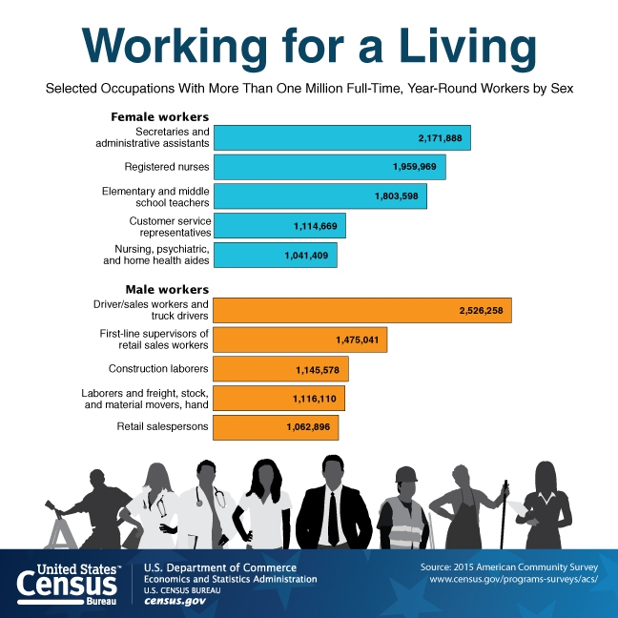
Maps, Charts and Graphs
Notes:
On the left is an example of a Community Commons zip code map for one service area in Texas.
This prompted a discussion between the local agency and the state CSBG office about geographical barriers (a 7,192 ft high mountain in the middle of the city; an army base that has few highways that allow people to cut through; and a major Interstate 10 that cuts through the county) and how these helped identify the best placement of service sites. In one case, it was identified that one of the areas did not have accurate census data because of the remoteness of the area.
This kind of discussion shows how statistical data can be useful to an agency.
Charts can also help to present the data – here is a trend line (showing poverty over a 50 year period) and a graph of different occupations in the area.

Slide 12
Sorting the Quantitative Data
How do various data points interconnect?
Reports from Community Commons can sort data bringing different areas together
  High poverty and low education
  Health indicators and poverty
  Housing patterns in low income communities
Notes:
We have been talking about Quantitative data – this is data that is expressed in numbers. It can be shown as pictures, maps, charts, etc
To make the data useful, it must be analyzed in some fashion -- turning it into information.
You will want to know how different data points interconnect – for example, as you may suspect, the data may show that areas where the adults have limited education are those of high poverty.
Some health indicators -- like low birth weight, instances of asthma, use of the emergency room for health care -- can also be mapped to coincide with particular neighborhoods or areas. For instance there is a special table creator using American Housing Survey (AHS) data to create custom tables to find out how many families with children ages 5 – 17 have asthma in a low income community – as compared with in a higher income community.
How do housing patterns differ in low income and middle income communities? Home ownership? Absentee landlords?
Your Assessment Plan will help you identify what data you want to collect to answer your questions about the needs in your community. What needs are reflected for each domain (from the service list in the National TOC)?
To help you “make meaning” from the data, you will need some additional types of data.

Slide 13

QUALITATIVE DATA
What will this help you to know?

Slide 14
Getting Qualitative Data
It isn’t enough to just have numbers to show the scope of the issue, you also need to add a human component to your assessment to find out the depth of the issue
  To find out what matters to people, you have to ask them what they think
  Some ways to collect qualitative data include: open ended survey questions, interviews, forums, focus groups
Who would you ask?
Notes:
Just having the quantitative data isn’t enough.
You have to understand what that data MEANS to the people who are living and working in the community.
So you have to ask them what they think. This is about asking open ended questions (not just giving people a list of items to select from, but acually giving them a chance to talk about what they know.
Who do you ask?
Some agencies ask their own customers about the issues they face in the community, and that is very valuable data.
But they aren’t the only people to ask.
You’d want to know what your partners (other human service providers) think and want to do about the issues.
You’d want to know what policy makers think about the issues and what they think you should be doing.
Business owners can weigh in on many important topic areas – need for education and training, reasons why they have experienced employee turn over, how they feel about living wage and benefit packages for their employees.

Slide 15
Customer Input about Community Needs
It is helpful to ask your customers to identify their own needs and the resources they think would help them address them
And to ask them what the community at large needs – from the perspective of someone who lives in the community
Notes:
As we said before, getting input from your customers is one way to collect qualitative data.
Customers can identify community crime and safety issues, increasing impact of substance abuse, environmental concerns, or problems of limited access to resources that they have experienced.
This slide refers to “customer input” and we will talk about “customer satisfaction” in a couple minutes.
Standard 6.4
Customer satisfaction data and customer input, collected as part of the community assessment, is included in the strategic planning process.
But is not enough just to ask your customers what they need or what they see is needed.

Slide 16
Get Input From:
General Public and Policy Makers
Businesses/People Who Work in the Community
Customers and Other Residents with Low-Income
Members of Other Organizations
Human Service Providers
Notes:
You will get different information from each of the different sectors you ask.
The information will allow you to identify both community level needs and family level needs.
For example: You may find there isn’t much affordable housing in a low income neighborhood and that the cost of formerly affordable housing has risen dramatically over the past 5 years. You can tell that this is a community level needs which will affect everyone in the community. This will have to be addressed by creating more affordable housing units! It cannot be solved by helping individual families.
But what are people with low-income saying about this situation? What are other service providers (who work with low income population) saying? Does the business community have to say?
If you want to find out what it means to the individuals and families living and working in that community – you have to ask them!
How do they manage to pay for high housing costs (those that are more than 1/3 of their income)? Would they be willing to move if they could find a less expensive apartment? One that was safer? Or more energy efficient? What resources would they need to make such a move? Are these resources available?
These issues can all be identified as individual or family level needs – as they will be addressed on a “one at a time” basis.

Slide 17

Agency data
Your agency has a wealth of data that can inform the creation of a profile of the community.

Slide 18
Agency Capacity
The statistical data the agency gathers for reporting should be included in the assessment process
  numbers of customers served, demographic data about them, identification of services provided and outcomes achieved
Agency data can show which of your facilities are being used by the largest number of customers, which of your services are used most often, and …
Notes:
The same data you turn in for reporting purposes can be come information to use during your assessment process.
Customer satisfaction data can tell you more. We will come back to that in a minute.

Slide 19
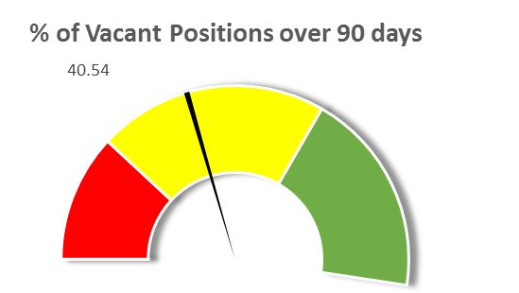
An Engaged Tripartite Board
Some quantitative data can help identify agency issues, like:
Does the board have full membership?
This kind of graphic can provide data in an easily understandable way
CSBG Tripartite Board Dashboard
Vacant Board Positions | Vacancies |  | Vacancies under 30 days | Vacancies Between 31 and 90 days | Vacancies Over 90 days Assign Program Monitor
Consumer | 10 |  | 1 | 4 | 5
Public | 13 |  | 1 | 7 | 2
Private | 14 |  | 4 | 5 | 8
Total: | 37 |  | 6 | 16 | 15
Network Board Positions | Total Number
Consumer | 185
Public | 200
Private | 190
Total: | 575
Notes:
this is from the state of MI – a way to validate something important about the agency capacity

Slide 20
Fiscal Data
Prior year
  Financial reports by program (include income and expenses)
  Agency wide financial reports
  Audit reports and responses
Identification of any unencumbered amounts available for next year’s programming
Notes:
One important area of agency level assessment is the fiscal data.
Refer to Organizational Standards
Standard 8.1
The Organization’s annual audit (or audited financial statements) is completed by a Certified Public Accountant on time in accordance with Title 2 of the Code of Federal Regulations, Uniform Administration Requirements, Cost Principles, and Audit Requirement (if applicable) and/or State audit threshold requirements.
Standard 8.2
All findings from the prior year’s annual audit have been assessed by the organization and addressed where the governing board has deemed it appropriate.
Standard 8.7
The governing board receives financial reports at each regular meeting that include the following:
1. Organization-wide report on revenue and expenditures that compares budget to actual, categorized by program; and
2. Balance sheet/statement of financial position.
(for publics this standard includes: as allowed by local government procedure.)

Slide 21

Customer satisfaction
How is the Agency doing? What does the Agency Need?

Slide 22
Customer Satisfaction
You will also want to ask your customers if they were satisfied with the services they received from your agency
  Did they value the service?
  Did it help them? How did it help them?
Customer responses to questions about how satisfied they were with the service they received is an excellent source for the identification of agency level needs
Notes:
Customer Satisfaction data is an excellent source for the identification of agency level needs.
If customers have an issue with the amount of time it took for them to get a service or the trouble they had in getting to the service site, that will let you know that you must identify either new resources or new ways of using your existing resources. If customers praise your staff, the way they were respected during service, the ease of accessing the service – that will let you know you must maintain your resources to continue to provide the level of service that has satisfied them.

Slide 23

Resources and assets
What is already available? Where are the gaps?

Slide 24
Identifying Resources
Identify the resources in the community
  What resources are available already to meet the needs you are finding?
    Who is providing these resources?
  Where are they?
    Are the resources located in the same areas where needs are identified?
  Are they accessible to your customers?
    Are your customers eligible for the resources?
    Are they easy to access?
Notes:
You can use the mapping tools to find out where the resources are located.
Other community agencies.
Specific program resources such as food, housing, education, etc.
Financial resources.
Are there other resources already available to meet the needs you have identified?
Are any of the resources you currently use as referral sources for your customers at risk (threatened)?
Are any new resources being developed (emerging)?

Slide 25

Identifying needs and setting priorities
You must make “information” out of the CNA data!

Slide 26
So what do you know?
Remember we started this discussion asking:
What do you want to know and why do you want to know it?
  Does the data you collected provide you with answers?
  It is up to you to help make meaning out of all this data
Your next steps are to establish priorities and develop need statements that will guide the Strategic Planning process
Notes:
As a Board member, you will want to understand the assessment data.
Many times staff collects and aggregates the data – or a consultant is hired to produce the Community Needs Assessment report – and a giant document is delivered to the Board for consideration and approval.
The document would require considerable time to read and analyze what is being presented.
What do you do?
How can the Assessment report be tailored so it is easy to understand?

Slide 27
Prioritizing the Needs
Not every identified need will become a top priority for your agency even though it may be important
  Your agency does not have unlimited resources
  Some times the issue that raises to the top is something that the agency has not been addressing
  A top priority may be something outside the current mission of the agency
Notes:
Often we hear that customers are given a survey asking what service they need the most.
And the service that raises to the top of the list (has the most people who select it) becomes the agency’s top priority.
Some times the issue that raises to the top is something that the agency has not been addressing. We mentioned employment opportunities earlier. People need better paying jobs. If that is an issue related to providing skill development for individuals so they can qualify for better jobs, your agency may be able to provide assistance (either directly or through referral to a partner). But if there are not better jobs in the community, then the task becomes one of creating or stimulating the creation of higher paying jobs with benefits. This is a much more difficult problem. It cannot be done by the agency alone. It (probably) cannot be done within the next program year. While the agency has been involved in job training and employment counseling, it has never been involved in creating job opportunities before. So what does the agency do with this “top priority” need?
Other times the top priority may be something outside the current mission of the agency. The agency’s Theory of Change focuses on how they will prepare children for school. But the top priority is that the community lacks affordable housing. The agency has never had any programs related to housing issues. What does the agency do?

Slide 28
Who sets the Priorities?
“The role of leadership is to transform the complex situation into small pieces and prioritize them”
- Carlos Ghosn
How does your board make the leadership decisions?
What happens when there are different opinions about what is most important?
Notes:
There are many techniques to use to prioritize the issues – force field analysis, the five whys, setting up a matrix, cost-benefit analysis,
Once you have decided on the priority issues that the agency will address, before the Assessment Committee hands its work off to the Planning Committee, a list of need statements should be developed.
Regardless of your process, there may be situations in which judgment calls are required. One segment who provided input thinks x is the biggest need and another segments thinks is it Y. When you move to planning phase, you will consider many different factors and the “top” needs may change.
it is important to be clear with all participants in the Assessment Committee whether their ‘votes’ are binding, or simply ‘recommendations’. It is also important to be clear about whether certain individuals have the power to make judgment calls and/or eliminate “priority” areas based on other factors.
This takes considerable time and effort to determine
NOTE -- This process includes identifying criteria to use in the prioritization process.

Slide 29
Identifying Need Statements
Don’t just say “housing is a top need”
  You must be very specific about how the “housing” need is defined as that will set the path to solution
  Your community may need more affordable housing units, or families may be at risk of eviction, or agency doesn’t have sufficient staff to provide needed services
Provide enough information so anyone can tell what level of need is being represented
Don’t characterize the need as “a need is for service.” Rather say what the need is
Notes:
Using the information created by analysis of the variety of assessment data elements, the Assessment Committee should come up with a list of need statements.
When we talk about the “levels” we mean family, agency and community.
First bullet: Housing is a need that can manifest itself on all three levels. But it is up to you (as you are creating the need statements) to be clear about what aspect of the need you want to focus on. You may only look at family level needs and that is ok, but don’t state the need as a community level need and then say you are going to address it (when you do your Strategic Planning) by providing family level services. (unless they are a part of a comprehensive community strategy)
Here is what I mean: the need is “there is not enough affordable housing in our community” and the service you have always provided in the past is “one month rent assistance payment” – giving the rent assistance will not increase affordable housing in the community.
Second bullet – when you identify the need, make sure to say enough so anyone can understand what your focus will be. Some examples:
Individuals do not have skills to enable them to obtain jobs that pay better than minimum wage. (family level need)
There are very few employers in our community who pay better than minimum wage. (community level)
Our agency does not have the resources to provide training for skilled jobs. (agency level). Sometimes we get confused when we say the agency needs to provide employment services. Yes, that is exactly what the agency is in business to do, but that is the strategy in which the agency will engage to meet an individual need of its customers. What does the agency need to enable it to provide this service.
Third bullet -- These are examples of identifying a need for a service:
Families need weatherization. Individuals need mental health counseling. Families need rental assistance.
When you phrase the need in this way, the outcome becomes the receipt of the service. And that is not “results oriented” thinking. We want to know the need that makes you think the service is appropriate, so we can identify the change that will happen.
Restated needs:
Families have high utility bills. Individuals demonstrate behaviors that are destructive to family functioning. Families are at risk of eviction.
With the restatement, your outcomes will not just be that the individual or family received the service:
Families have lower utility bills. Individuals have changed behaviors and family functioning. Families maintain their housing.
It is at this time that you set the path for the rest of the ROMA phases. NOTE – you can change your focus in the Planning phase because that is when you are

Slide 30
Taking Action
Strive to have an agency wide comprehensive CNA
  Combining the data from Assessments that might be done for a specific focus, or by a partner
Approve the CNA and record the Board action
Identify a Planning Committee who will take the assessment data to consider in developing an agency wide strategic plan
Use the data to inform your local Theory of Change
Notes:
It is useful if the board can help reinforce the importance of an agency wide focus – if you are seeing multiple assessments come through for different programs, you should ask that the data be organized so you can see an overview of the identified community (not just pieces of it).
We will talk about your local Theory of Change in the next video.

