Slide 1
Introduction to
ROMA Implementation for Boards
A Video Series for CAA Board Members
Notes:
Standard 4.3
The organization’s Community Action plan and strategic plan document the continuous use of the full Results Oriented Management and Accountability (ROMA) cycle or comparable system (assessment, planning, implementation, achievement of results, and evaluation).
In addition, the organization documents having used the services of a ROMA-certified trainer (or equivalent) to assist in implementation.

Slide 2
Implementing ROMA –
A Video Series for CAA Boards
Introduction to Implementing ROMA for Boards
Creating a Local Theory of Change
Strategic Planning
Implementation of Services and Strategies
Observing and Reporting Results
Community Needs Assessments
Analysis and Evaluation
Notes:
This presentation is a part of a series that is intended for Community Action Agency Board Members interested in deeper understanding of
How to help your Community Action Agency increase its capacity and its results.
How to meet and exceed Organizational Standards
The Roma Next Generation Video Series consists of these modules.
With me today to present this particular concept is Dr. Barbara Mooney, the Director of the Association for Nationally Certified Trainers. She is co-author of Introduction to ROMA, Research Fellow for the National Association for State Community Service Programs, consultant to the national Community Action Partnership, regional coordinator for Region Three Performance and Innovation Consortium and contributing author to Temple University's Strengths-Based Family Worker Training curriculum. Over the past five years, she has worked on the development of the OCS Performance Management Framework.
In addition we have …..

Slide 3
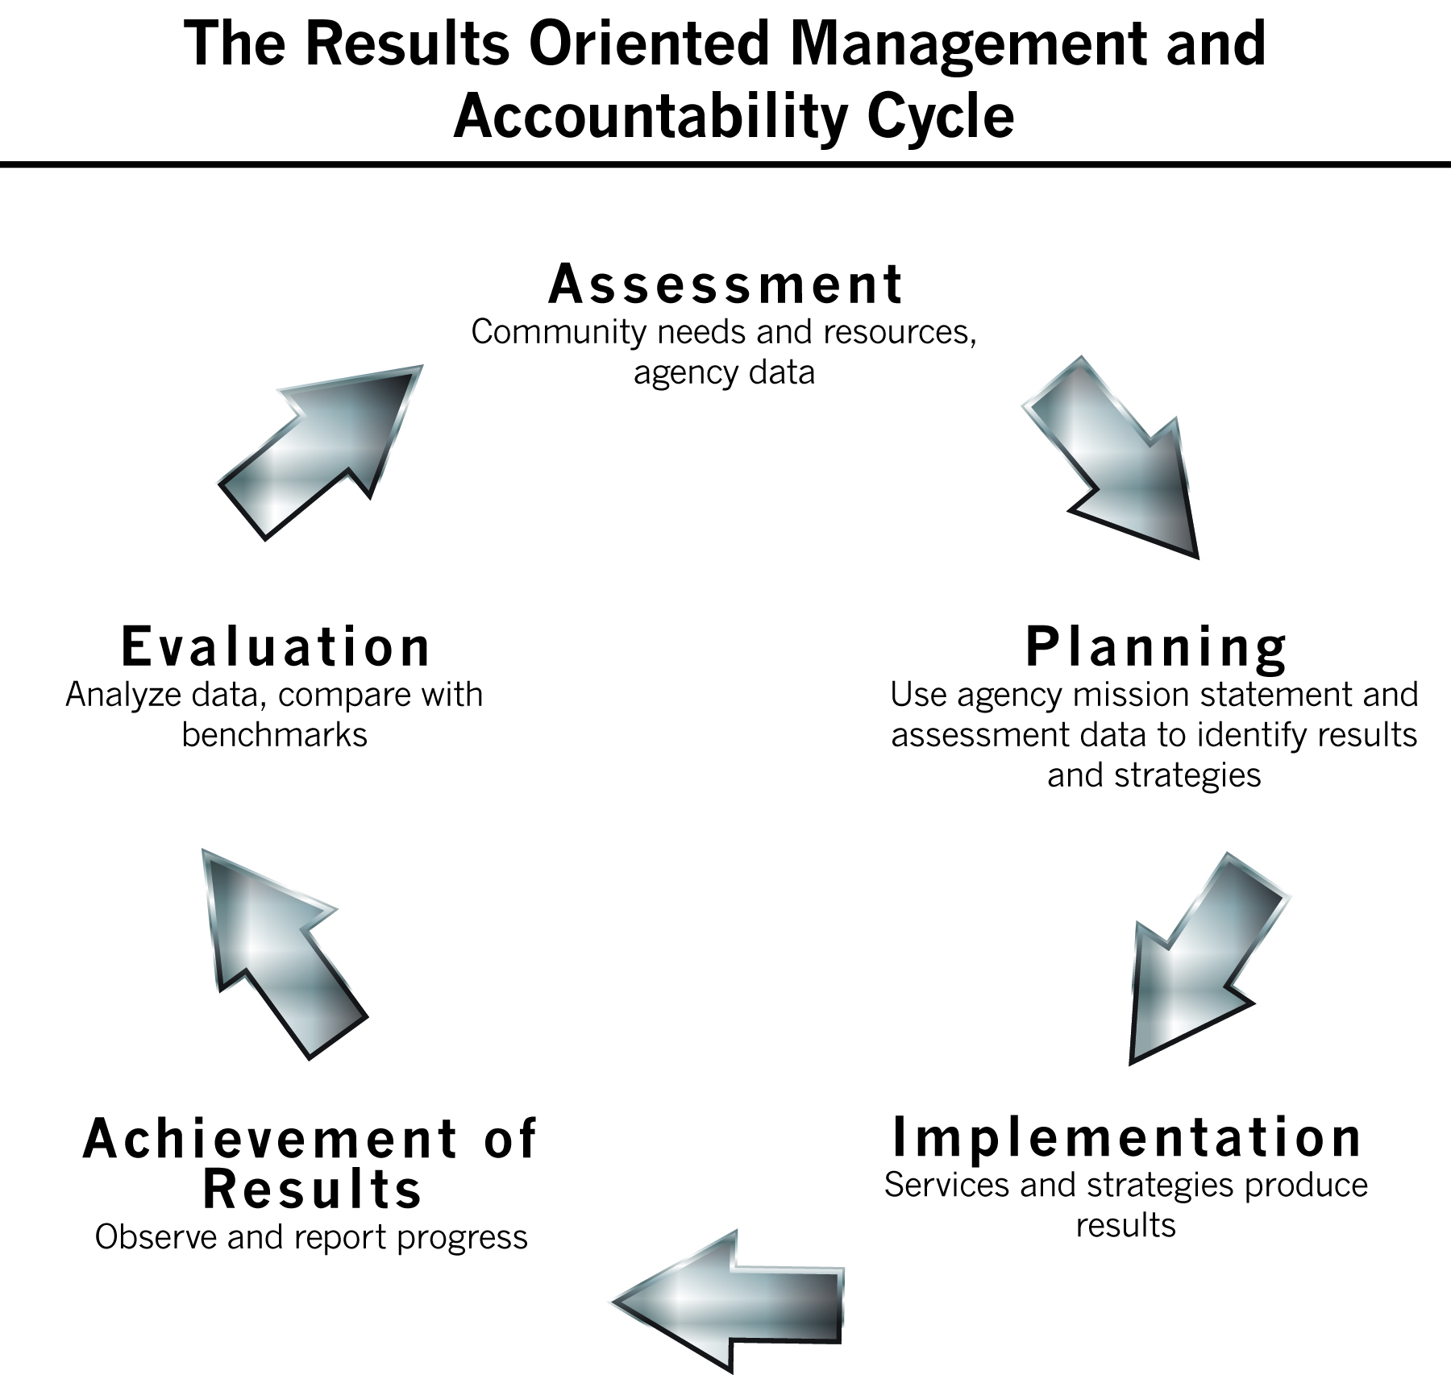
Notes:
In this series of presentations, we will be identifying the key principles and practices that are a part of the performance management system that is unique to the CSBG/CAA network. This system is known as Results Oriented Management and Accountability or ROMA.
We will show how the ROMA Cycle as seen here is embedded into the Organizational Standards and will make reference to the video series that is specifically for the Organizational Standards, while not repeating the information found there.
We know that there are some differences in how public and private Community Action Agencies are governed, but in both cases the Board has a role in assuring the agency is being operated with a “results oriented” perspective.
As you look at the ROMA cycle, you can think of many other business models that have a similar approach to this.
To begin, the organization has to find out (or verify) what the community needs and what resources are already in place. This is the foundation on which the organization plans and carry’s out its mission or work.
Then, of course, the organization does its work, (Implementation of Services and Strategies is the 5 o’clock spot on the cycle).
Processes for observation and documentation of the work of staff are identified in the Planning section, but carried out as the work is done and staff sees what “happened” as a result of the work.
Finally you consider and evaluate what was accomplished – and that leads to finding new questions to ask about needs and resources, and back to doing assessment work.

Slide 4

Notes:
However, these basic steps are not always done in that sequence. Sometimes movement is clockwise (as shown originally) and sometimes it is counter-clockwise. Other times steps are started because of a question raised in another section:
What we learn while we are implementing services and strategies will affect what we know about the community’s needs and resources.
The results we observe and report will impact our planning and the analysis of our data will change how we implement services and strategies.
These are just a few connections – but you can see that these elements must be interacting in an on-going way to produce good management and accountability.
Strong agencies recognize they cannot simply complete a community needs assessment every three years and on the off years, ignore assessment of community needs. They recognize while a strategic plan might be in place for three to five years, they need to review and update it regularly based on new information and results.

Slide 5


WHY a Results Orientation?
It’s important for the Board to understand why a results orientation is the focus of the new Performance Management climate

Slide 6
Results – Not Just Services
Why is reporting on services provided by your agency not enough?
Notes:
CAAs have historically measured things like:
the number of food baskets distributed
the number of Meals-on-Wheels delivered
the number of children attending Head Start centers
the number of families receiving WIC services
the number of adults attending GED classes
the number of clients served per day

Slide 7
Take Me Out to the Ballgame
Baseball Case Study
Here’s the situation:
The local team finished last in the prior season. To boost dwindling attendance, the team promotes the following statistics…

Slide 8
Take Me Out to the Ballgame
Outfielders ran 3X more laps during spring training
Pitchers threw 2x many pitches during spring training
Batters took 4X as much hitting practice during spring training
The team hired 2 new coaches
The team also invested $100,000 in a state-of-the-art communications system to enable the Manager to talk with them & give real-time perspectives on each play from strategic vantage points in the stands during the games
By the All-Star break, the team is taking an average of 17 more swings at pitches per game . . .

Slide 9
Take Me Out to the Ballgame
And the fans say,
“So what?”
because they’re still in last place,
without a single player
who deserves to be on
the All-Star Team
Notes:
The fans don’t care about the process if they don’t get the results.
What they care about is winning!

Slide 10

Playing Ball with Community Action
The Board of Directors are like the Owners of a ball team
The Executive Director is like the Manager
The funders, community, & clients are like the fans who want to see results
Notes:
For Community Action Agencies, changing lives and improving communities is how we score runs and win games.
If all we tell the community is how much service we provided, is it no wonder that our “fans” may also say: “so what?”
If we just say we hand out food boxes, what does that matter to the funders?
We have to make it clear that what we do has a profound impact on the lives of the people we serve.

Slide 11
Remember:
While it is important to be able to talk about the services that your agency provides, you must also be able to identify how these interventions produce results
What has changed because of
your agency’s work?
Notes:
Just like the baseball team that must hit the ball to score runs and win, Community Action won’t change lives without delivering services efficiently, compassionately, and intelligently.
But you have to know why you are doing these services and what impact they have on individuals, families and communities.

Slide 12

Where We Are today
Results Oriented Management & Accountability (ROMA)

Slide 13
ROMA and the Organizational Standards
As of January 2016, the Community Action Organizational Standards became a part of the new Performance Management Framework presented to the CSBG network by the US Office of Community Services
  All of the ROMA principles and practices are embedded in the Organizational Standards
  Many of the Org Standards are directed at the actions of the CAA Board of Directors
  Through the Org Standards, the ROMA principles are reinforced and they are expected to be supported and promoted by the Board
Notes:
CSBG = community service block grant
More than half of the Org Standards have Board involvement included in the standard.
Information about how you can demonstrate application of ROMA through the Organizational Standards is available.

Slide 14
ROMA Next Generation
What’s been called ROMA Next Generation is a way of talking about an increased focus on the elements of ROMA
  It is also about using some new tools to assure the network is implementing the full ROMA Cycle to constantly achieve results for individuals, families and communities

Slide 15
New and Renewed
The adoption of a National Community Action Theory of Change (TOC)
  Support for creation of local TOCs
Renewal of the CSBG network understanding of the necessity of working toward community change
  as well as individual and family outcomes
Focus on improved collection and analysis of data
  Connection of identified needs, populations served, services and strategies implemented, and indicators of performance
  Increased understanding of the importance of data collection, analysis and use at every point of the full ROMA Cycle
Notes:
We will discuss the Theory of Change next and also in a separate video segment. This is an added way to help our network talk about who we are and what we accomplish. It will also help us figure out what the needs assessment data is telling us about our community, and will help us identify what our agency’s focus will be.
ROMA Next Generation is about a renewed focus on community change, because it is more evident that ever before that family and community successes are related – you can’t have family success in communities with no resources or opportunities.
It is also about a renewed focus on analysis of data from all phases of the ROMA Cycle. Not just about collecting data for reporting, but about considering how the data can be connected and used.

Slide 16
New and Renewed
Continuous improvement utilizing the Community Needs Assessment (CNA), the Community Action Strategic Plan, the State Plan, the Annual Report, & the Congressional Report
Integration of all of the phases of the ROMA Cycle
Integration of all aspects of the Performance Management Framework
Notes:
ROMA Next Generation is about using your data for continuous improvement
As we showed you, the ROMA Cycle is not to be taken as just a clockwise series of actions, but those actions are to be on-going and integrated.
and it is important to keep in mind the intention to integrate of all aspects of the Performance Management Framework (that includes Organizational Standards too). The next slide identifies all the parts of the PMF

Slide 17
Elements of the
Performance Management Framework
Organizational Standards
Automated State Plans
State and Federal Accountability Measures
American Customer Satisfaction Index (ASCI)
New CSBG Annual Report Approved by Office of Management and Budget (OMB)
  Includes new National Performance Indicators at family and community levels

Slide 18
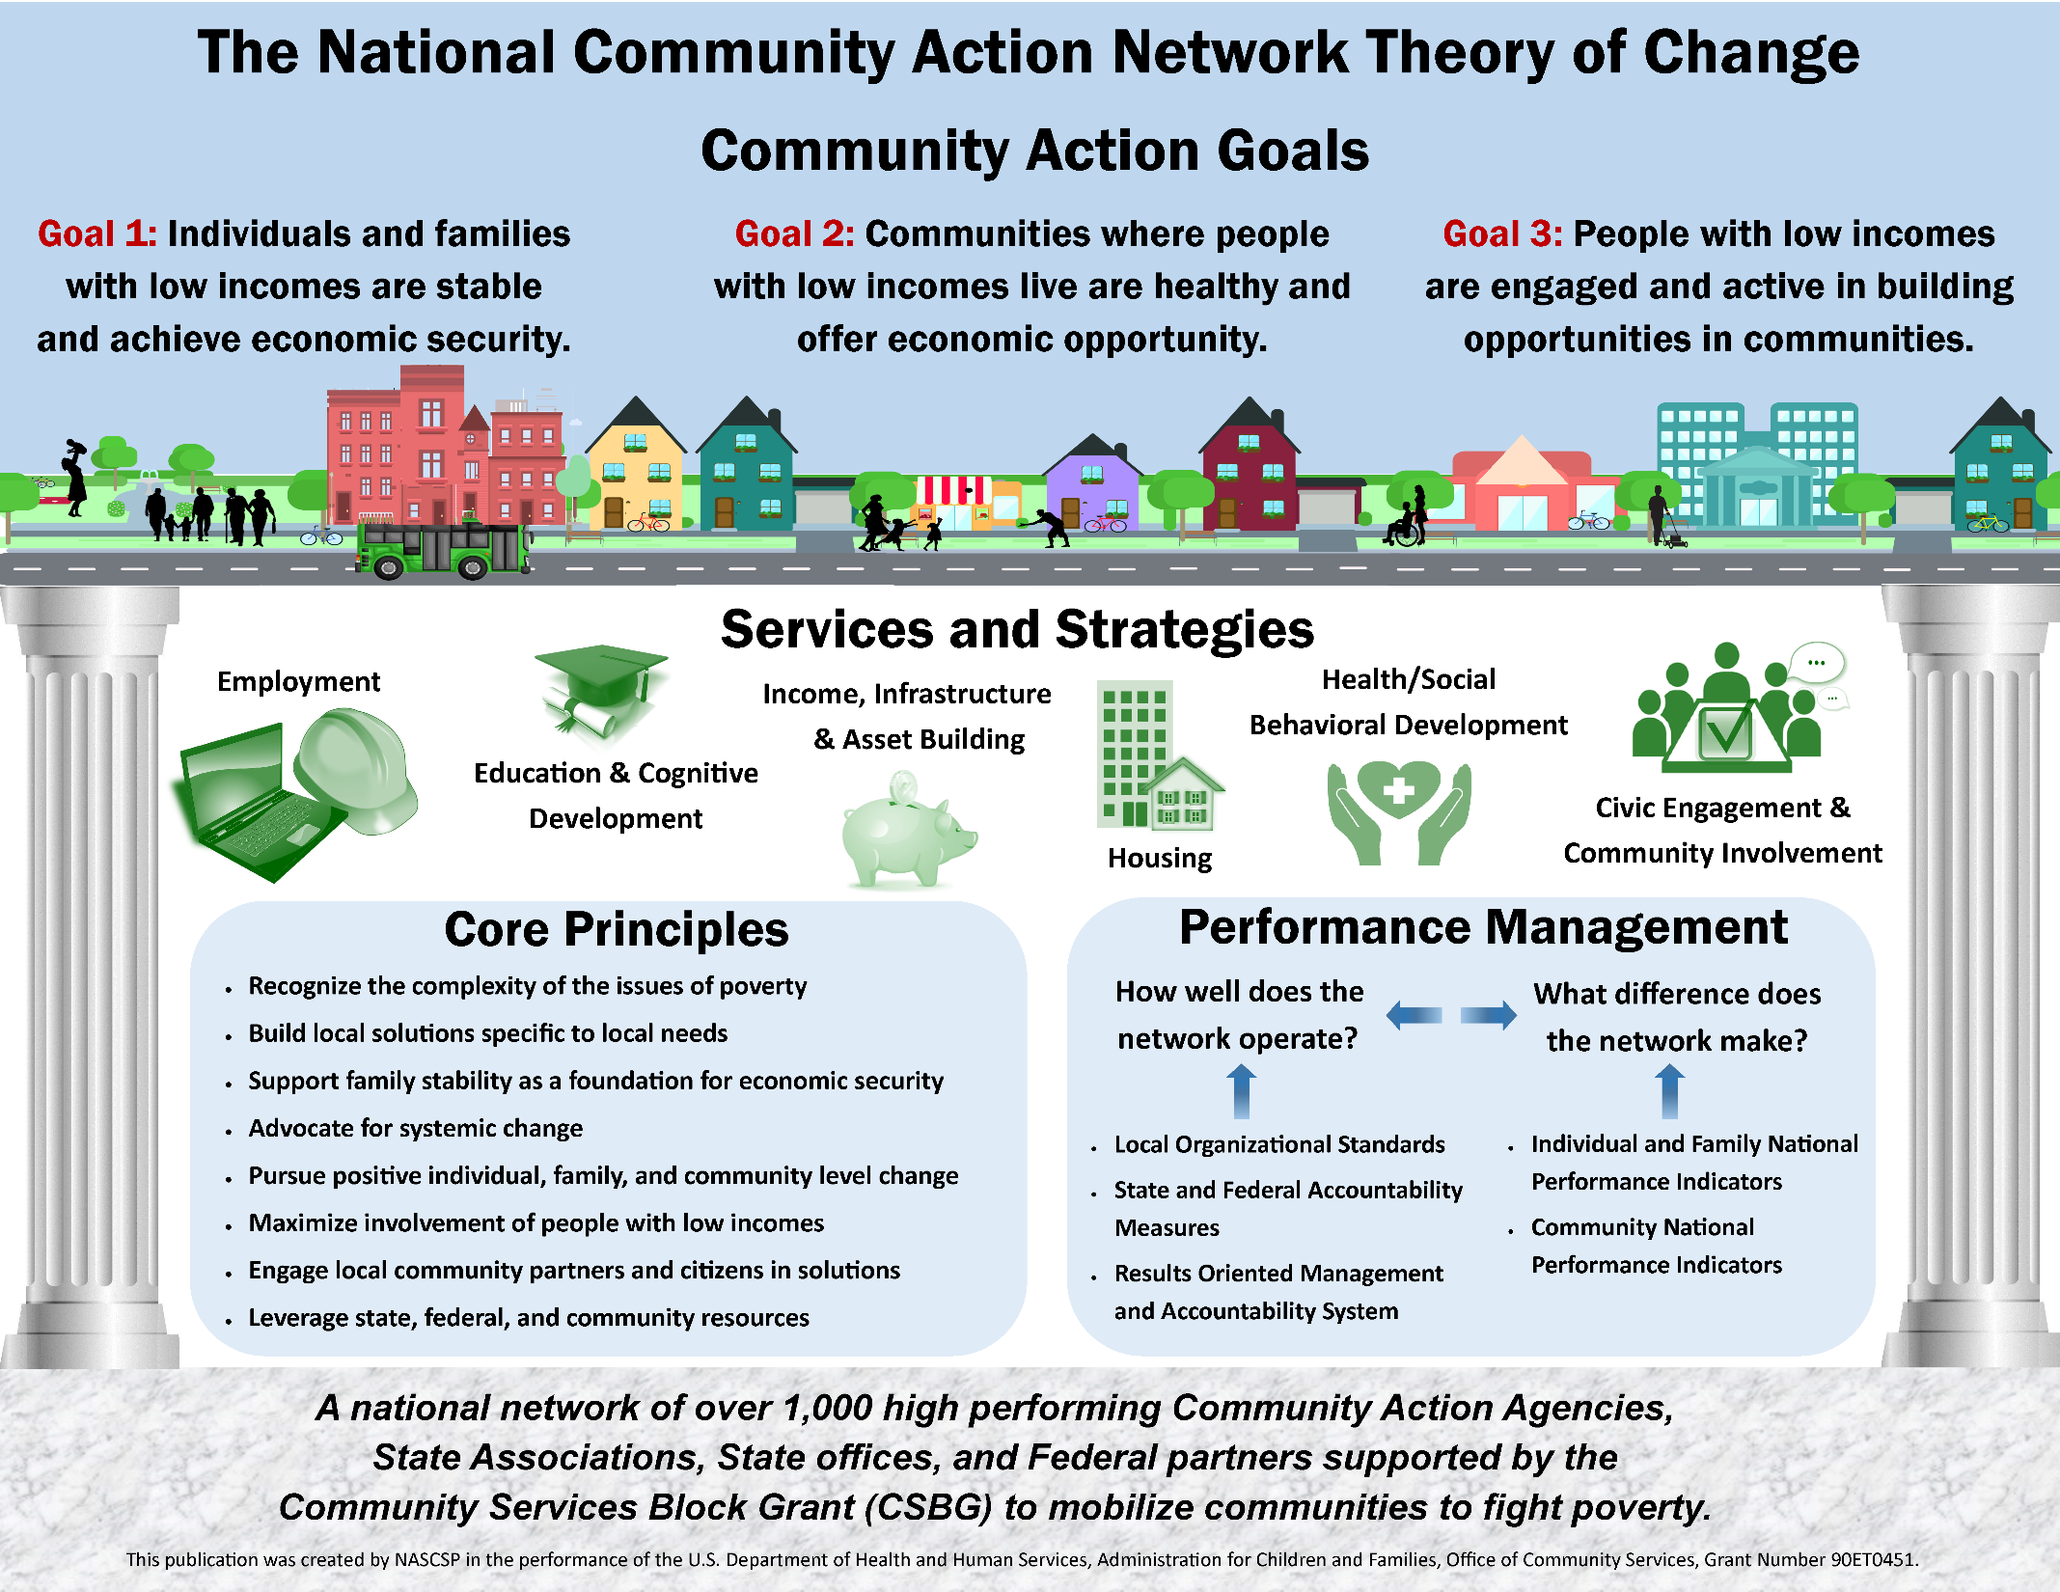
Notes:
A recent addition to the concept of implementing the ROMA Cycle is the National Community Action Theory of Change. A theory of change is a way to demonstrate the very complicated nature of this network that is tied together by the common receipt of Community Services Block Grant (CSBG) funds.
At the top are the three Community Action Goals we have for the individuals, families and communities of low income.
In the middle we see the Services and Strategies where we work in many different areas of life, not just in one.
At the bottom we see the Core Principles and Performance Management framework the defines our network and the importance and ability to manage our performance and achieve results.

Slide 19

Foundation
A national network of over 1,000 high performing Community Action Agencies, State Associations, State offices, and Federal partners supported by the Community Services Block Grant (CSBG) to mobilize communities to fight poverty.
Notes:
At the bottom of the TOC, the “foundation” stresses the importance of the local CAAs having the ability to achieve results.
It acknowledges that this network is tied together by the common receipt of Community Services Block Grant (CSBG) funds.
We know there is a lot that goes into maintaining a “high performing Community Action Agency” – having places for staff to work that meet their needs (clean, safe, with places for meetings and dialogue and access to current technology) – having direct service and management staff that is properly trained (providing staff development as needed to assure they are prepared to do their work) – having quality personnel and fiscal staff – and so on. These are not all identified here, but they may find their way into local Theories of Change as each agency assesses their own needs.
Without spending time, energy and resources on maintaining the local agencies, the network would fail. Understanding what your own agency needs to do its work is essential in the implementation of a results orientation.
Of common interest to all of the CAAs in the network is being connected to the state associations, state office and federal partners for the support they can provide and being connected to the local community so they can work together to fight poverty.
It is these connections where the individual efforts and results of the 1,000 CAAs are aggregated (added together) into a single message and “One Voice” to advocate on behalf of low-income persons and their communities and demonstrating the positive impact of our programs and services.
Without spending time, energy and resources on maintaining the local agencies, the network would fail.
Understanding what your own agency needs to do its work is essential in the implementation of a “results orientation.” We will talk more about this when we introduce the local TOC process.

Slide 20
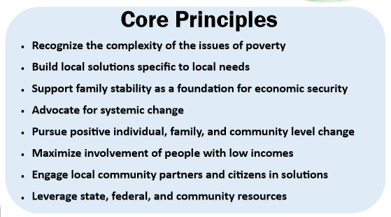
Notes:
Since the beginning of the CAA network, which started with federal funding in 1964, there have been come common principles that have identified our unique approach to the problems associated with poverty.
These were identified as the most common among the whole network. Your local agency will probably have some principles that are specific to your community.
Overall, we know that poverty is not just about a lack of money. Of course that is the basic truth – but it is also about lack of resources. There are resources in communities that have limited access – think about children in school and how some children cannot take advantage of sports or clubs because they do not have funds or transportation or other necessities. And lack of skills. And…. But we will get you thinking about this in a later video.
In fact we will come back to talk more about all of these principles.

Slide 21
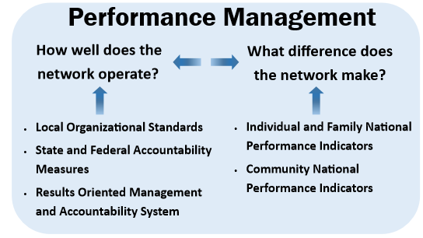
Notes:
In this section of the TOC, we see that our network values accountability at the local level, the state level and the federal level.
There is a series of videos for Boards that is designed to explore the Organizational Standards, and we will reference them throughout our exploration of the ROMA cycle. The Organizational Standards have ROMA principles embedded in them, and your agency will not be meeting the standards without implementing ROMA. Understanding ROMA will help you consider how the agency can meet and exceed the basic standards.
In addition to knowing how well the agency operates – the examination of “what do we do?” – the network is funded to make a difference in issues related to poverty. The TOC references National Performance Indicators – statements that can be used to guide the measurement of specific changes that happen on the way to one or more of the National Goals. These NPIs identify progress for individuals and families and also for communities, because we know that individual success cannot be sustained in communities with serious problems. Individuals cannot work at good paying jobs if there are none in the community.

Slide 22

Services and Strategies
Notes:
Some human service providers are focused on only one aspect of an individual’s development. We call these “domains”.
The WIOA programs focus on employment issues.
Schools and training programs focus on education.
HUD has a focus on housing related issues.
But Community Action Agencies typically weave funding streams together to provide a range of services that are designed to address multiple issues.
Not every local agency addresses the same domain areas. Remember, each agency bases its work on the assessment of the needs and resources in the community -- so each agency has a different set of services and strategies designed to match their own assessment.
The are numerous connections, combinations and relationships and these a just a few of the possibilities. What we do know is that all domains must be working together in both a person’s life and in their community to move out of poverty or achieve economic security.
Local TOCs may only identify a few of these services, or may identify sub sets of these (such as child care, transportation, nutrition services)
But these represent the full range across the country.

Slide 23
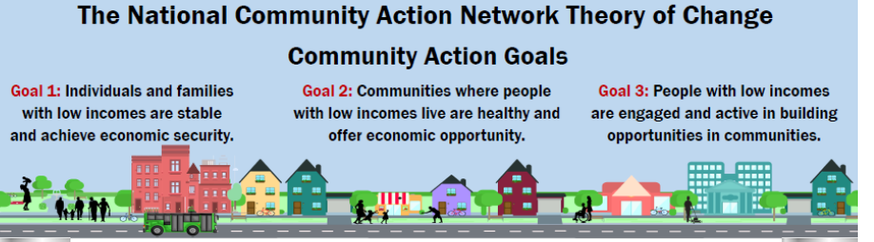
Three National Goals
Notes:
In these three national goals, the TOC says exactly what the network aspires to achieve.
Individuals and families move out of poverty – or as the goal says “achieve economic security”
But not only that, but also that they are engaged in their communities and that their communities are healthy and offer opportunities.

Slide 24
We Will Discuss
Assessment
  What you need to know, how do you find out, what does it all mean, how will you use it
Planning
  What do you want to change, what needs to be done, do you have the resources to do it, who can help, what actions will you take, how will you measure your performance
Implementing Services & Strategies
  Family: Who are you serving, how many, what services do you give them
  Community: what community partners are engaged
Notes:
In the video series we will discuss key elements of each phase of the ROMA Cycle with a focus on Board roles and responsibilities.
It is clear that implementing the full ROMA Cycle requires an organizational culture that understands the purpose and value of performance management and uses data for decision making.
Fostering and supporting this kind of culture takes leadership from the Board as well as from executives and management staff.
This series should provide you with some foundational knowledge on which to build your skills to accomplish this.

Slide 25
We Will Discuss
Observing, Reporting
  What happened, was there progress, what changed?
Analysis and Evaluation
  Did you do what you thought you would do, why or why not?
Assessment
  What new questions do you have about your community?
Notes:
Remember that once you consider what happened and what it means to your agency and the families/communities you serve, then you may have new questions that the next round of assessment will help you to answer.
Those questions and answers will be important in the next round of Planning and so on…..

Slide 26
Take Action
Make sure you understand the basic principles and practices that define ROMA
Consider how your agency will use the services of a ROMA certified Trainer or Implementer to help you assure you are using the full ROMA Cycle
Just a few ideas:
  Create a calendar for the board related to appropriate review of Organizational Standards and ROMA
  Create board committees for various aspects that may need additional attention but not full board involvement
Notes:
This board series should provide you with the foundation you need to understand the basics of ROMA
You will have to develop some processes that will enable you to get feedback from certified ROMA Trainers or Implementers – and consider how you will incorporate that feedback into your on-going activities related to assessment, planning, delivering services, reporting and analysis.
Consider some ideas about how to assure full ROMA implementation (Org Standard 4.3) and meeting (and exceeding) all of the Org Standards.

