Slide 1
Strategic Planning and Performance Management: UPO’s Approach
United Planning Organization
Presented By
Dana M. Jones, President & CEO
Daniel Ofori-Addo, Director, Office of Performance Management
(Webinar: Presented as part of the Community Action Partnership’s Organizational Standards Peer-to-Peer Series)
(July 17, 2018 - Washington, DC)

Slide 2
Overview
About the United Planning Organization (UPO)
Strategic Planning: From Process to Goals
Development of Tactical Plans
Shifting Focus to Performance Measurement and Management
Operationalizing Continuous Improvement
Quarterly Reviews / Accountability Process
Peer to Peer
Management to Board
Implementing Changes: Management and Staff
Evolution of a Complex Agency-Wide Scorecard
Operational Effectiveness
Strategic Plan Implementation Success
Continuous Improvement
Organizational Capacity Development
Exploring the Next Level of Performance Management

Slide 3
About UPO
Located in Washington, DC.
Mission: Uniting People with Opportunities
Uniting Clients with the Opportunity to Become Self-Sufficient.
Uniting Staff and Volunteers with the Opportunity to Fully Utilize Their Skills in Making a Difference.
Uniting Funders with the Opportunity to Invest in Transforming the Lives of Clients.
Uniting Partners with the Opportunity to Extend the Efficiency and Effectiveness of Services Delivered.
Uniting Residents with the Opportunity to help their Fellow Residents in Need. [Maximum Feasible Participation]
Private nonprofit human service corporation.
Established on December 10, 1962.
Become a community action agency DC in 1964.
The only designated CAA in the District of Columbia.

Slide 4


The inspiration that keeps us moving forward.
3

Slide 5
Strategic Planning: From Process to Goals

Slide 6
Leadership
Getting Started
Top - Down
Bottom - Up
Kick Off by Board of Directors
Kick Off by Executive Director
Kick Off by Two Self-Study Work Groups
BOSS & POP
Powerful Questions
SWOT Analysis Commissioned
Review of Needs Assessment
Cross functional teams working together:
POP: The Product Opportunity and Performance Working Group
BOSS: The Business Opportunities Support Systems Working Group

Slide 7
POP Work Group
Research Questions Included:
To reduce poverty and move customers from dependency to self-sufficiency, what are the service areas that increase the likelihood of customer self-sufficiency.
What are the trends in service delivery?
Given our agency’s size and level of resources, what agency goals should we aim to achieve from FY 2013-FY 2018?
What performance management systems should be implemented to assure greater accountability?
What have our clients expressed as their most urgent unfulfilled needs?

Slide 8
POP Work Group
Are we providing the right configuration of services to successfully meet those needs?
What should the organizational structure look like for UPO to be more agile and better able to respond to internal and external threats?
What would a de-centralized UPO look like and would that be more effective in moving the agency forward?
Who is our competition (including other community action agencies) and what are they doing differently to brand and market their services?
Who should our target customers be and how are they identified?
What should our strategy be to attract customers in need?
What “Best Practices” have other private and public organizations implemented to attract their target customers?

Slide 9
POP Work Group
What program elements constitute a center of excellence and which agencies are modeling centers of excellence?
How can UPO deliver superior customer service that exceeds expectations?
What are the housing conditions in the District and what are our viable options for developing housing alternatives?
What community economic development activities should UPO undertake given the recent recession and on-going gentrification?
Who should be our strategic partners, (public, private, in/out-of-state) and how should we partner with them to better serve DC residents?

Slide 10
BOSS Work Group
Research Questions Included:
What systems or policies hinder high performance at UPO?
What areas lack clarity of direction and process?
What areas consume too much time and money?
What software upgrades, additions or changes are needed to enhance organizational performance?
What other technology is needed to enhance efficiency and productivity?
What will give us a competitive edge?
What policies require updating to assure realistic and relevant management practices?
What SOPs are missing but needed for effective and efficient service delivery?

Slide 11
BOSS Work Group
What changes are needed at UPO’s service locations to assure quality service delivery?
What equipment and software needs should be planned for between 2012 and 2017?
How will shifts in demographics and economic development impact UPO?
What is the “low hanging fruit” that can be secured with minimum capital investment that will give us an edge?
What are the strategic locations in the city for service delivery?

Slide 12
Research, Analysis and Synthesis of Findings
Multiple Surveys
Multiple Input Sessions:
Customers
Partners
Volunteers
Board of Directors
SWOT Analysis
Work Group Reviews and Deliberation
Separate Synthesis of Findings:
POP Group
BOSS Group
Subsequent Strategy Brainstorming Sessions.

Slide 13
Goal Development
Two Parallel Teams Commissioned to Analyze Content and Identify Goals.
Independent Content Analysis by Each Team:
Involved Detailed Reviews of the Findings of both Work Groups, their Suggestions and Proposed Strategies.
Each Team Identified Six Goals.
Five of the Six Goals Were Common to Both Lists.
The sixth was developed by fusing the remaining two.
Review and Adoption of Goals by Executive Team and by Board of Directors.
Commissioning of the Development of Tactical Plans by the Board of Directors.
Assignment of the Development of Tactical Plans by the Executive Team to all offices and divisions.

Slide 14
Strategic Goals 2013 - 2018
GOAL # 1. Continue to develop and implement a marketing and branding campaign
 | a. Updated Material and Web Presence b. Social Marketing Approaches | c. Host Voices Forums d. Friend Raising Sessions
GOAL # 2. Increase Non Government resources by $5,000,000 by September 30, 2018
 | a. Foundation Appeal b. Fee Based Services | Private Sector Contracting Related Business Income Approaches
GOAL # 3. Restructure Service Delivery System to focus on Economic Security with programming directed at family development through asset enhancement opportunities
 | Strategy A. Employment Programming Strategy B. Expanded Adult Education and Training Division Strategy C. Early Learning Network | Strategy D. Youth Division Continuum – ages 6 to 24 Strategy E. Create a Community Re-Investment Division Strategy F. Expanded Green Technology Division Strategy G. Community Health and Wellness Division
GOAL # 4. Create and Grow Social Enterprise Opportunities
 | a. Green Capital b. Facilities Management c. Child Care | d. Substance Abuse Treatment e. Transportation
GOAL # 5. Expand to become a Washington Metropolitan Regional Provider
GOAL # 6. Modify business policies and practices to increase efficiencies and productivity

Slide 15
Development OF TACTICAL PLANS

Slide 16
Development of Tactical Plans
Division of Labor
Programmatic Divisions
Administrative Offices
Task
Review
Division Mission
Division Goal
Division Objectives
Develop Tactical Steps to be undertaken to achieve applicable agency-level strategic goal
Identify
Staff person(s) responsible for each tactical activity
Timeframe
Outcome Indicators /Measurement Tool
Task
Review
Office Mission
Office Goal
Office Objectives
Develop Tactical Steps to be undertaken to achieve applicable agency-level strategic goal
Identify
Staff person(s) responsible for each tactical activity
Timeframe
Outcome Indicators /Measurement Tool

Slide 17
Leadership
Input Solicitation by the Leaders of Programmatic Divisions and Administrative Offices from Staff and Customers
One-on-One Reviews with Executive Team
By Division and Office Directors
Of Draft Tactical Plans Developed
Feedback and Improvement Suggestions
Recommendations for Improvements by Executive Team
Taking the Long-term perspective
Thinking outside the box encouraged
Planning for Resource development and assessment
Ensuring Tactical Plans Span all 5 Years of Strategic Plan Period
Presentation of Refined Tactical Plans to the Board
By Division Director and Executive Team
Board Input for revisions provided and incorporated.
Adoption of Tactical Plans

Slide 18
Shifting Focus to Performance: Measurement and Management

Slide 19
Leadership
Application for COMPASS DC Grant/Project
By UPO’s Executive Team
Winning of COMPASS DC Consulting Project
UPO’s Assigned COMPASS DC Consulting Team Comprised 7 Members with MBAs from the top 20 Business Schools in the Country
Consulting Project Involved:
Analysis of Strategic Goals Developed
Analysis of Tactical Plans Developed
Development of Analytical Framework for Aggregating Performance on Tactical Steps
Delivery of Strategic Planning Performance Measurement Tool to UPO

Slide 20
Operationalizing Performance Management
Modification of Existing Performance Measurement Reporting
Reports Originally Called Chief Operating Office (COO) Reports
Enhancements Included:
Tracking Human Resource Allocation, Availability and Use
Tracking Budget to Actual Spending Relative to Program Performance
Tracking Resource Leveraging
Tracking of Performance on Tactical Plans
Reports Renamed: Performance Measurement Reports
Fomenting of a Discussion About A Robust Agency-Wide Scorecard
Need to Aggregate Programmatic, Administrative and Operational Performance
Need to Aggregate Performance on Tactical Plans and Strategic Plan
Results of Pathways Self-Study Pointed to the Need for a Scorecard.
Creation of an Office of Performance Management by UPO’s Executive Team by re-organizing existing reporting, evaluation and monitoring functions.

Slide 21
OPERATIONALIZING Continuous Improvement

Slide 22
Leadership
Quarterly Presentations of Performance Measurement Reports (PMRs)
Monthly Managers’ Meeting Focused Wholly on PMRs Once Each Quarter
Outcomes Outside of Performance Targets Required Explanation
Peer-to-Peer Input provided by fellow Managers
Executive Team Input Provided
Quarterly Presentations by Program Managers to Program Operations Committee
Board Member Input on Programs Provided
Influence on Board Actions
Program Operations Committee of BOD Presents Major Themes and Findings to Full Board
Subsequent Board Agendas Shaped by PMR Content

Slide 23
Continuous Improvement
Redeployment of an already functioning Program Outcome Earnings System
For the Development of Program Plans and the Tracking of Outcomes.
Key program outcomes priced in such a way that full performance would earn full program budget.
Formalization of Quarterly Monitoring Reviews of All UPO Programs
Quarterly On-Site of Desk Audit Monitoring
By Monitoring and Evaluation Analysts
Sampling of data entered by front-line staff
Reviews of actual performance relative to planned performance
Review of operations relative to funder agreements, laws and regulations
Findings Documented in Formal Reports Shared with Program Staff and Executive Team
Critical Findings Trigger a requirement for a corrective action plan from the program reviewed
Corrective Action Plan Implementation Monitored by Monitoring and Evaluation Analysts

Slide 24
Continuous Improvement
Formalization of Monthly Issue Log Review
For the purpose of tracking unresolved findings
Monthly meetings focused on review of issue log
By Executive Team and Office of Performance Management
Unresolved findings become the focus of actions and interventions by Executive team
Programmatic team meetings involve discussions of team member roles in implementing corrective actions.
Semi-Annual Monitoring of Administrative Offices
Office Systems and Performance Relative to Best Practices
Surveys of Internal Customers and Level of Satisfaction with Services Delivered
Annual Customer Surveying and Analysis
Quarterly Customer Input Box Content Analysis
Quarterly Staff Input Box Content Analysis

Slide 25
Continuous Improvement
Monthly Monitoring Reviews of Funded Partner Program Performance by UPO’s Office of Performance Management
Program Outcome Earnings Reporting by Partners
Validation of Outcomes Reported
Payment Processing Contingent on Performance Level
Development of Standard Operating Procedures for Service Delivery
Development of Tools for Quality Assurance

Slide 26
Continuous Improvement
Expanding Staff Capacity to Achieve Results Through Targeted Training.
Periodic Special Emphasis Training for Staff Offered by Personnel of the Office of Performance Management
Intake
Economic Security Assessment
Basic Data Entry
Case Management Training
Review and Analysis of Programmatic Reports
ROMA Training
Offered at All New Hire Orientation Sessions
Full Day ROMA Training Facilitated Quarterly
Up to 25 Staff Trained Quarterly
Staff encouraged to receive full-day training at least once every three years
Strengths-Based Family Worker Training Offered Semi-Annually.
Strengths-Based Leadership Training Offered Annually.
Semi-Annual Special Emphasis Training Offered by Bowie State University to Selected Cohorts of UPO’s Staff and Management.

Slide 27
Evolution of a Complex Agency-Wide Scorecard

Slide 28
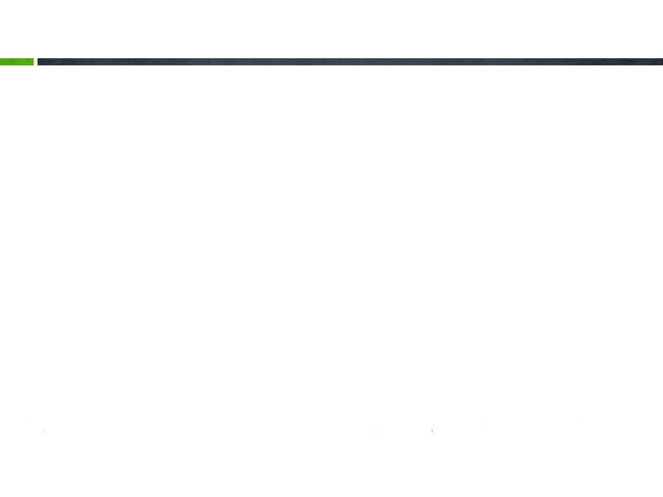
Dimensions and Weighting
Dimension | Weight
Organizational Standards | 5%
Agency Strategic Plan Progress | 5%
Financial Strength | 5%
Customer / Staff Input | 5%
Capacity Building / Maintenance | 5%
Program and Administrative Monitoring | 5%
ROMA / Programmatic Outcomes / Customer Self-Sufficiency | 70%

Slide 29
Dimensions of Agency-Wide Scorecard
Organizational Standards
Percentage Organizational Standards Met or Not Met
Agency Strategic Plan Progress
Percentage of Tactical Steps Completed
Financial Strength
Percentage of Financial Oversight Review by Board of Directors and Managers Completed
Completion of Audit
Filing of 990
Customer / Staff Input
Percentage of Scheduled Surveys Completed and Analyzed
Customers
Staff
Funders
Board Members
Volunteers

Slide 30
Dimensions of Agency-Wide Scorecard
Capacity Building / Maintenance
Percentage of Scheduled Quarterly Full-Day ROMA Training Facilitated
Percentage of Scheduled Board Meetings and Board Committee Meetings Conducted
Percentage of Scheduled Performance Review Meetings Conducted at Management Level
Percentage of Scheduled Performance Review Meetings Conducted at Board Level
Percentage of Scheduled Central Client Data Tracking and Case Management Training Facilitated
6. Program and Administrative Monitoring
Percentage of Scheduled Quarterly Programmatic Monitoring Reviews Conducted
Percentage of Scheduled Semi-Annual Administrative Office Reviews Conducted
7. ROMA / Programmatic Outcomes / Customer Self-Sufficiency
Aggregated Performance Level of All Programmatic Divisions that Deliver Service Leading to Self-Sufficiency
Actual Performance as a Percentage of Projected Performance Levels
Emphasis is on the impact that services have on customer progress to self-sufficiency.

Slide 31
Exploring the Next Level of Performance Management at UPO

Slide 32
Next Steps
Strategic Planning for FY2019 to FY2022
Tactical Plan Development in Progress
Enhancing the Scorecard
Replacing Process Metrics with Result Metrics
Revisiting Role and Impact of Customer Satisfaction Survey Results on Agency-Wide Performance Score
Staff, Clients, Volunteers, Partners, BOD & Funders
Trending satisfaction levels based on results of surveys
Going beyond our Programmatic and Administrative Quarterly Performance Management Report presentations/reviews
Adding mid-year group examinations and discussions of agency-level performance in the collective deliberation sessions within the management team and with the BOD.

Slide 33
Questions?

